Slide 1
Quantization: Is It Possible to Improve Classification?
在
Weizhi LU, Mingrui CHEN, Kai GUO and Weiyu LI
Shandong University, China

Slide 2
Introduction
Quantization of sparse features
Quantization of sparse random projections
Conclusion

Slide 3
Introduction
在

Slide 4
Introduction
Quantization
1
1
0
$$τ$$
$$−τ$$
0
$$τ$$
-1
{0,1} binary quantization
{0,$±$1} ternary quantization
Application
Data compression: large scale retrieval
Model compression: deep binary/ ternary networks

Slide 5
Introduction
With significate quantization errors, will the quantization surely degrade the accuracy of classification?
Currently, most existing works report degradation
But, there are a few exceptions:
Deep binary/ternary networks on small datasets
Quantization of wavelet features on object detection
Is there a general setting which ensures that the quantization could improve the classification accuracy?

Slide 6
Introduction
Model
Model 1: Quantization of sparse features $x$
Quantization
for classification
$$x$$
$$z$$
Model 2: Quantization of sparse random projections $y=Rx$
Random Projection
Quantization
$$x$$
$$y$$
$$z$$
for classification

Slide 7
Model 1:
Quantization of sparse features
在

Slide 8
Quantization of sparse features
Model 1: Quantization of sparse features $x$
Sparse feature generation
Ternary and Binary quantization
Classification

Slide 9
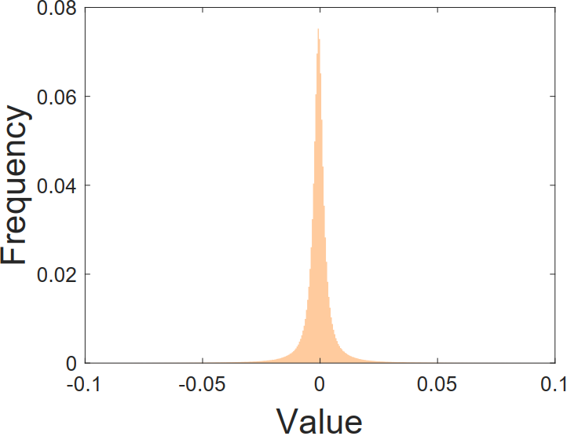
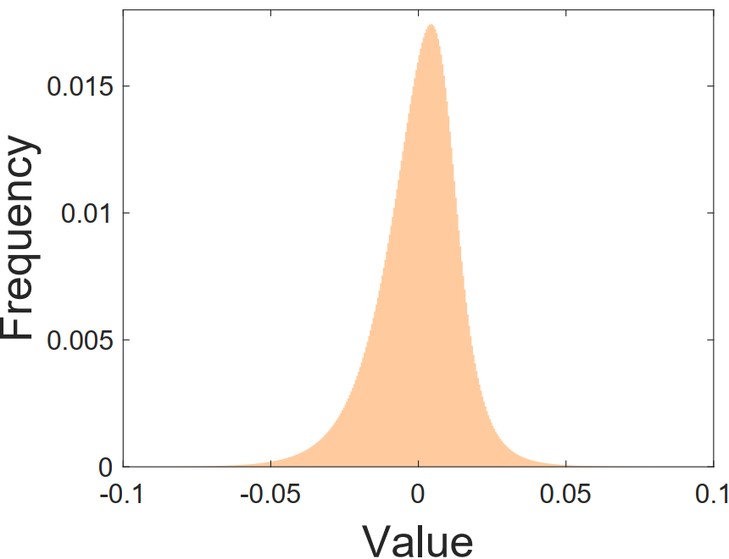
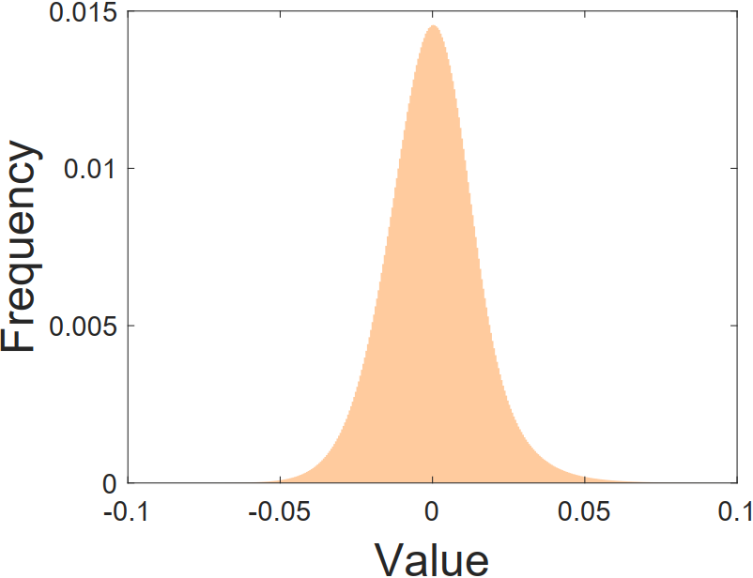
Quantization of sparse features
Generation of sparse features $x={\left(x_{1}, x_{2},⋯,x_{n}\right)}^{⊤}∈ℝ^{n}$
DWT/DCT features: on simple datasets, such as YaleB
Convolutional network features: such as the AlexNet and VGG16 features on the complex datasets Cifar10 and ImageNet
YaleB
ImageNet
Cifar10

Slide 10
Quantization of sparse features
Quantization
Ternary codes (TC)
Binary codes (BC)
Real-valued codes (RC)
$1$, $x_{i}>τ$
$1$, $x_{i}>τ$
$x_{i}$, $x_{i}>τ$
$$z_{i}=$$
$0$, $−τ≤x_{i}≤τ$
$$z_{i}=$$
$$z_{i}=$$
$0$, $−τ≤x_{i}≤τ$
$−1$, $x_{i}<−τ$
$0$, $x_{i}≤τ$
$x_{i}$, $x_{i}<−τ$
Sparsity ratio: $k/n$ (RC, TC), $k/2n$ (BC)

Slide 11
Quantization of sparse features
Classification
Popular classifiers
Exemplar-based method: kNN, kNNC, LSC, SRC
Learning-based method: SVM
kNNC (k nearest neighbor per class): A variant of LSC we propose, which calculates the similarity to each class by summing the distance of the query object to each of the k nearest neighbors in the class.

Slide 12
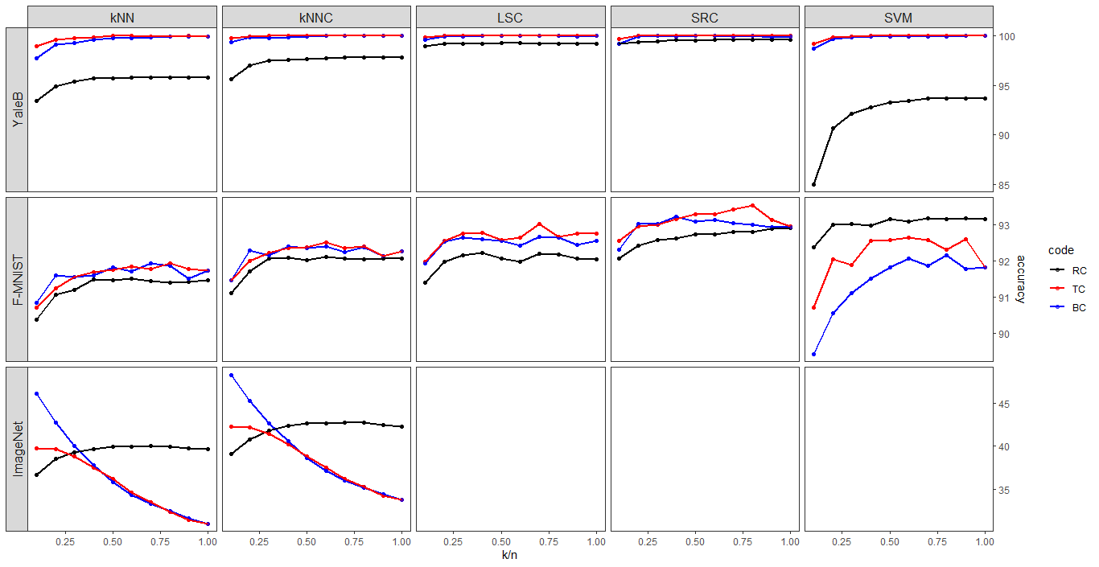
Introduction

Slide 13
Quantization of sparse features
Overall, the classification gain indeed could be obtained with the two operations involved in our ternary/binary quantization, including:
The removal of small elements in magnitude
The magnitude unification of the remaining large elements
The gain should be attributed to:
The former helps to reduce noise and compact intra-class distance
The latter helps to suppress the underlying outliers

Slide 14
Model 2:
Quantization of sparse random projections

Slide 15
Quantization of sparse random projections
Model 2: Quantization of sparse random projections $y=Rx$
Sparse feature generation
Sparse matrices-based random projection $y=Rx$
Ternary and Binary quantization of $y$
Classification of quantized $y$

Slide 16
Quantization of sparse random projections
Random Projection
$$y=Rx$$
where $x∈ℝ^{n}$, $R∈ℝ^{m∗n}$, $m≪n$.
The popularly used random matrices mainly include:
Gaussian matrices: tend to generate dense projections $y$
Sparse $\{0, ±1\}$ ternary matrices: tend to generate sparse projections $y$

Slide 17
Quantization of sparse random projections
How to obtain classification gains on the quantization of random projections $y=Rx$?
Sufficiently sparse $R$: the sparse $\{0, ±1\}$ matrices with only one nonzero element per column
Sufficiently sparse $x$: the sparse features studied before

Slide 18
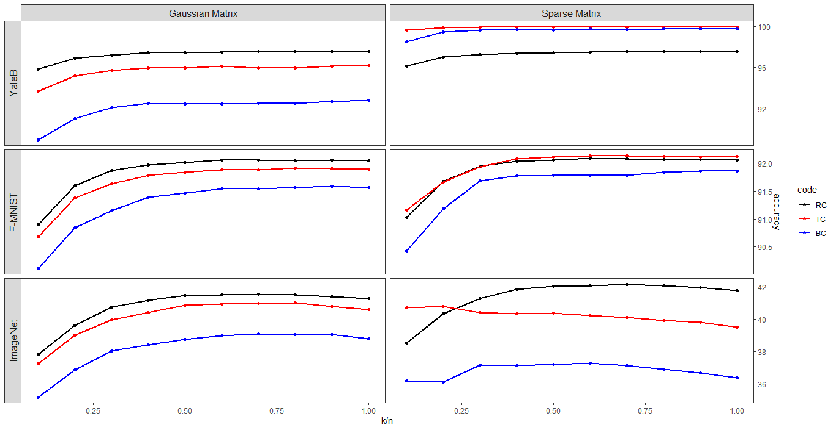
Introduction
Overall, the extremely sparse $\{0,±1\}$ matrices indeed could provide classification gains, while Gaussian matrices failed.

Slide 19
Conclusion
在

Slide 20
Conclusion
Theoretical questions on quantization
Ternary and Binary quantization tends to improve classification as the features $x$:
Sufficiently sparse
How sparse?
Sufficiently good for classification
How good?
See our upcoming paper “Quantization can improve classification”.

Slide 21
Conclusion (Cont.)
Theoretical questions on random projection
The quantization of $y=Rx$ tends to improve classification as the features $x$
Random matrices $R∈{\left\{0,±1\right\}}^{m∗n}$ : with only one nonzero element per column
High-dimensional features $x$: sufficiently sparse
See our upcoming paper “Sparse random projections for coding”.

Slide 22
Conclusion (Cont.)
Connection with deep quantization networks
Our quantization gain can help understand the good performance of deep networks after binary/ternary quantization.
Random Projection based on sparse $\left\{0,±1\right\}$ matrices
Linear exemplar-based classification (kNN, kNNC) with quantized features
The above two linear operations form a one-hidden-layer network with quantized parameters/activations.

Slide 23
THANKS FOR YOUR ATTENTION

