Slide 1
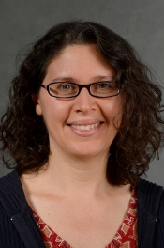
AV2Wav: Diffusion-Based Re-synthesis from Continuous Self-supervised Features for Audio-Visual Speech Enhancement
AV2Wav: Diffusion-based re-synthesis
from continuous self-supervised features
for audio-visual speech enhancement
Ju-Chieh Chou, Chung-Ming Chien, Karen Livescu
TTI-Chicago

Slide 2
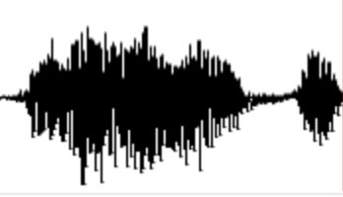
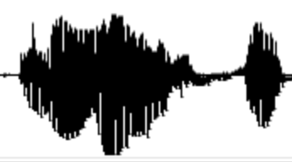
Audio-Visual Speech Enhancement (AVSE)
SE: remove noise from noisy speech.
AVSE: utilizing additional visual cues, such as lip motions, to improve speech enhancement (SE) performance.
Visual cues can be quite helpful!
In AVSE, because we have visual cues as references, we can also consider AV source separation (another speaker as interferers) and lower SNR than SE.
?
AVSE
Model
Noisy speech with video
Clean speech
SE
Model
AVSE
Model
Noisy speech
Clean speech
Mixed speech with video
Clean speech

Slide 3
SE formulation
Conventional: predicting mask in time-frequency domain, i.e. $P\left(m | \text{noisy} \text{speech}\right),\text{s}\text{.}\text{t}\text{.} m⊙\text{noisy} \text{speech}=\text{clean} \text{speech}$
Issues with conventional: some signals are difficult to recover from mask operation, and mask operation tends to allow noise to bleed through.
Generative SE: $P(\text{clean} \text{speech} |\text{noisy} \text{speech})$
Generative AVSE: $P(\text{clean} \text{speech} |\text{noisy} \text{speech},\text{lip} \text{motions})$

Slide 4
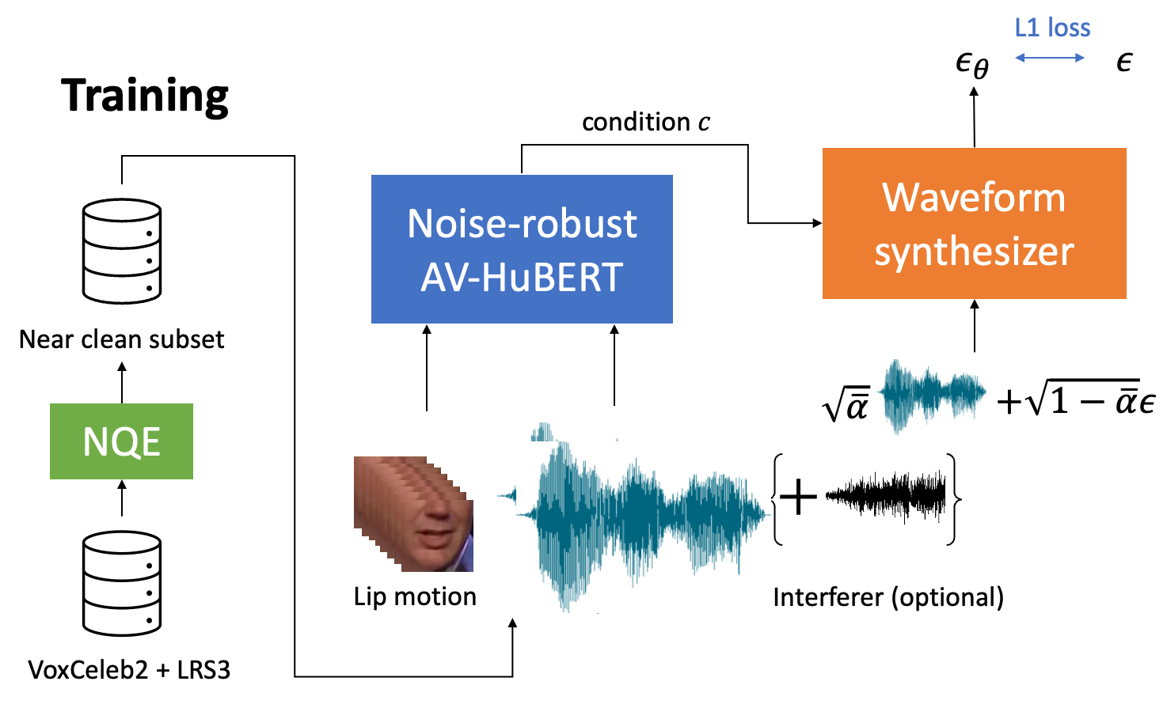
AV2Wav framework
Challenge: most AV speech are collected in the wild (e.g. TED talks, interviews). The “clean speech” are usually not clean enough.
This work: data selection using neural quality estimator (NQE) + noise-robust AV-HuBERT (denoiser) + diffusion waveform synthsizer (speaker)
[3] Ho et al., Denoising Diffusion Probabilistic Models
, NeurIPS, 2020.
Notes:
Try to focus on high-level, focus more on challenge

Slide 5
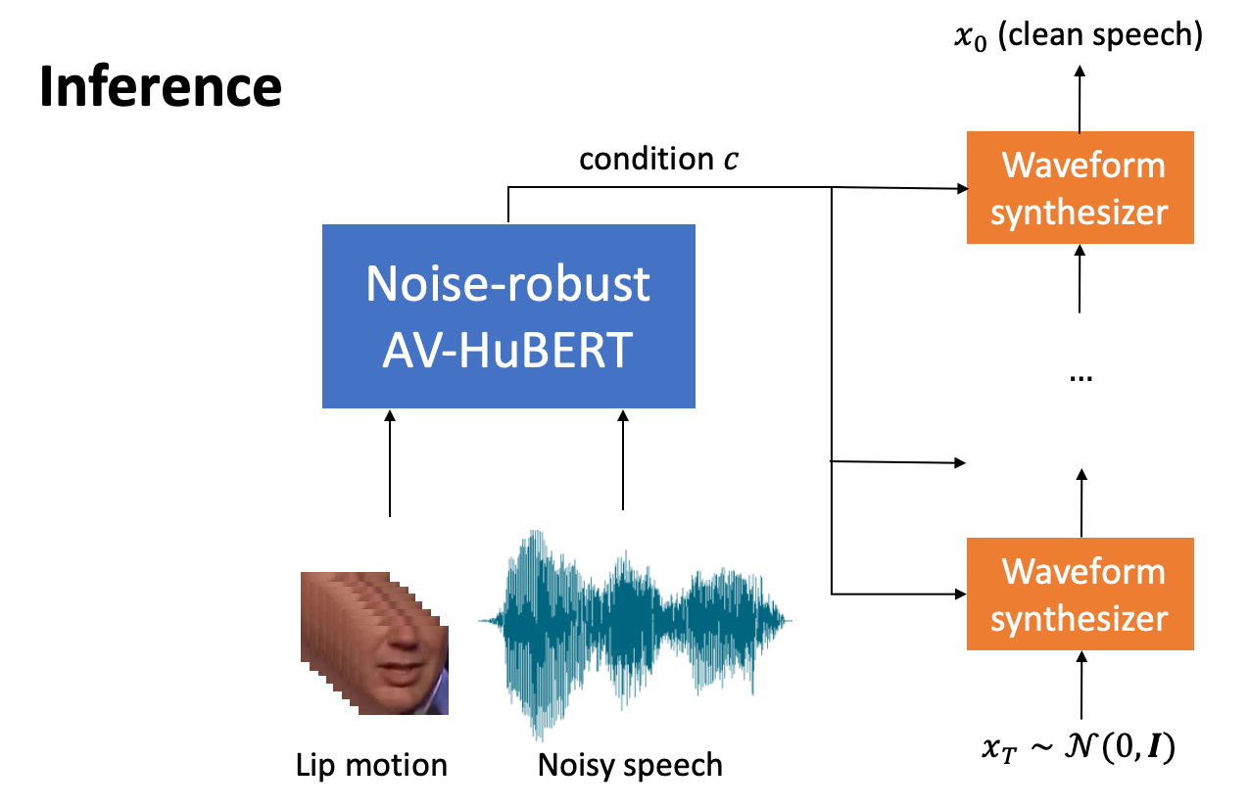
Inference

Slide 6
Background: Neural Quality estimator
NQE assigns scores in a reference-free manner, thus suitable for data selection.
Conventional Metric
NQE
Noisy speech
Score
Score
Noisy speech
Clean speech (reference)
[3] TorchAudio-Squim: Reference-less Speech Quality and Intelligibility measures in TorchAudio, Kumar, et.al

Slide 7
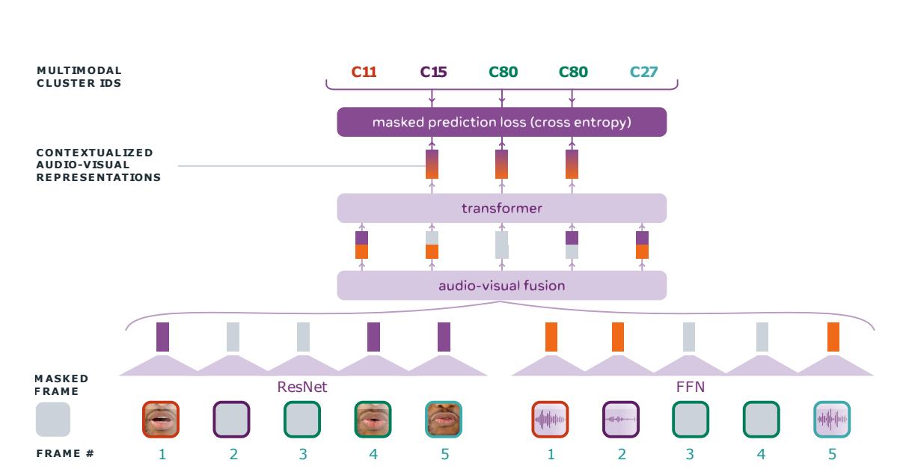
Background: AV-HuBERT
AV-HuBERT is a SSL model trained to predict cluster IDs given audio and visual sequences.
Noise-robust AV-HuBERT: trained with noisy speech input, but predicts cluster IDs from clean speech.
+NOISE
[5] Shi et al., Learning Audio-Visual Speech Representation by Masked Multimodal Cluster Prediction, ICLR 2022.
[6] Shi et al., Robust Self-Supervised Audio-Visual Speech Recognition, Interspeech, 2022.

Slide 8
Training
First stage (reconstruction): training to reconstruct clean waveform conditioning on AV-HuBERT representations from clean speech.
Second stage (denoising): fine-tuning AV-HuBERT and waveform synthesizer using clean speech + noise as input to generate clean speech output.
With the first stage alone, the model can already perform speech enhancement. Reason:
AV-HuBERT is noise-robust
Waveform synthesizer only sees clean speech during training so it can only generate clean speech
Notes:
Stage 2 reason: (1) improve robustness (unseen during training) (2) unseen speakers

Slide 9
Experiment setup
Data: 1967 hours from LRS3 + VoxCeleb2, 616 hours after data selection.
Noisy/clean pairs: AVSE challenge 2, 113 hours with various sources of noise.

Slide 10
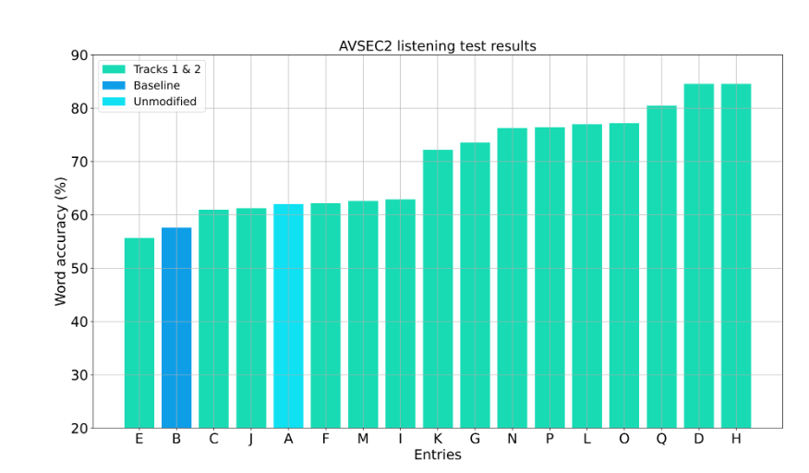
Evaluation
Conventional metrics
Conventional metrics (e.g. STOI, SI-SDR) are disadvantageous for generative models (signal-level dissimilarity).
Instead, we use NQE predicted SI-SDR to measure audio quality, and WER from Whisper to measure intelligibility.
Listening test
Notes:
Say: all other approaches are masking-based.

Slide 11
Demo
Masking-based baseline: interferers bleed through.
First stage: voice and prosody changed slightly with the first stage alone.
Mixed
Ground truth
Masking-based
baseline
AV2Wav first stage
AV2Wav ft on noisy/clean
Speech interferer:
(VisualVoice)
Noise interferer:
Demo page
(baseline from AVSE challenge)

Slide 12
Result: compare to baseline
AV2Wav outperforms a masking-based baseline.
WER (↓)
P-SI-SDR (↑)

Slide 13
Result: effectiveness of data selection (first stage alone)
AV2Wav-25: using P-SI-SDR > 25 as the data selection criteria.
AV2Wav-random: randomly sampling a similar size of data.
WER (↓)
P-SI-SDR (↑)

Slide 14
Result: usefulness of visual information (first stage alone)
Without visual cues, the model won’t be able to handle speech interferers.
With visual cues, the WER improves for noise interferers.
WER (↓)
Speech
Noise

Slide 15
Result: fine-tuning on clean/noisy pairs (second stage)
Fine-tuning jointly improves speech interferer cases.
WER (↓)
Speech
Noise
Notes:
Show AV-HuBERT can do SE

Slide 16
Conclusion and future work
Data selection is important for AVSE.
Noise robust AV-HuBERT can be used as a “denoiser”, and the speech can be reconstructed from the representations.
Future work:
further noise robust training for AV-HuBERT.
fast inference for diffusion models on speech.
better objective metrics to evaluate generative models for speech.

Slide 17
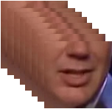
Prior work on AVSE
Re-synthesis: synthesizing discrete codes instead of raw speech.
Problem: with coarse discrete codes, the speaker information get lost.
This work: using continuous representations to keep as much information as possible.
Enc
Dec
Clean speech
Clean speech
Discrete codes
Lip motions
AVSE
Model
Noisy speech
[1] Yang et al., Audio-Visual Speech Codecs: Rethinking Audio-Visual Speech Enhancement by Re-Synthesis, CVPR, 2022.
[2] Hsu et al., ReVISE: Self-Supervised Speech Resynthesis with Visual Input for Universal and Generalized Speech Enhancement,CVPR, 2023.

