Slide 1
NEURAL VARIATIONAL IDENTIFICATION AND FILTERING
Henning Lange, Mario Bergés, Zico Kolter

Slide 2
Variational Filtering
Dynamical Systems
Variational Filtering
Statistical Inference
(Expectation Maximization, Variational Inference)
Deep Learning

Slide 3
Variational Filtering
Dynamical Systems
This makes it unsupervised
Statistical Inference
(Expectation Maximization, Variational Inference)
Deep Learning

Slide 4
Variational Filtering
This provides the structure
Dynamical Systems
Statistical Inference
(Expectation Maximization, Variational Inference)
Deep Learning

Slide 5
Variational Filtering
Dynamical Systems
This is the optimization engine
Statistical Inference
(Expectation Maximization, Variational Inference)
Deep Learning

Slide 6
Variational Filtering
For statistician:
Expectation Maximization…
… but with a Neural Network that tells us where to look.

Slide 7
Variational Filtering
For ML researcher:
Deep Neural Network…
… that learns to perform posterior inference.

Slide 8
Variational Filtering
For dynamical system guy:
Non-linear Kalman filter…
… that is unbiased* and quite fast to evaluate.

Slide 9
Recap
Monte Carlo Integration
Importance sampling
$$E_{p\left(z\right)}f\left(z\right)=\frac{1}{N}\sum_{i}^{N}{f(z^{\left(i\right)})}$$
with
$$z^{(i)}∼p(z)$$
$$E_{p\left(z\right)}f\left(z\right)=E_{q\left(z\right)}\frac{p\left(z\right)}{q\left(z\right)}f(z)$$

Slide 10
Outline
1. Statistics
Expectation Maximization
Variational Inference
2. Deep Learning
Distributions parameterized by Neural Nets
3. Dynamical Systems
Additional challenges from intractable joint distributions
4. Variance Reduction

Slide 11
Expectation Maximization in one slide
EM is a technique to perform ML inference of parameters $θ$ in a latent variable model (unsupervised learning)
Latent variable $z$: state of appliances on/off
Coordinate Ascent on: $F\left(θ, \tilde{P}\right)= Ε_{\tilde{p}(z)}\log{p\left(x,z|θ\right)}−Ε_{\tilde{p}\left(z\right)}\log{\tilde{p}(z)}$
E-Step: $\tilde{p}\left(z\right)=p\left(z | x,θ\right)$
M-Step: Increase $log p\left(x | θ\right)$
Neal, Radford M., and Geoffrey E. Hinton. "A view of the EM algorithm that justifies incremental, sparse, and other variants." Learning in graphical models.

Slide 12
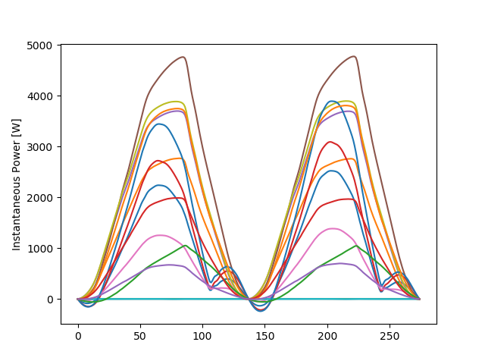
Example: Non-Intrusive Load Monitoring
$p\left(x,z|θ\right)=p\left(x | z,θ\right)p\left(z\right)$
$p(x│z,θ)=𝒩(x;μ=θz,σ=I)$
$p(z)$ = some prior, e.g. sparsity
Expectation Maximization allows for learning $θ$
$θ$ could constitute reactive/active power of appliances or waveforms
$$θ=$$

Slide 13
Intractable posterior distributions
EM requires computation of $p(z|x,θ)$
For many interesting latent variable models, computing $p(z|x,θ)$ is intractable
$$p\left(z | x,θ\right)=\frac{p(z,x|θ)}{p(x|θ)}=\frac{p(z,x|θ)}{\sum_{z′∈Z}{p(z′,x|θ)}}$$

Slide 14
Intractable posterior distributions
For many interesting latent variable models, computing $p(z|x,θ)$ is intractable
NILM is one of them : $Z={\{0,1\}}^{A}$ the latent domain grows exponentially with number of appliances
$$p\left(z | x,θ\right)=\frac{p(z,x|θ)}{p(x|θ)}=\frac{p(z,x|θ)}{\sum_{z′∈Z}{p(z′,x|θ)}}$$

Slide 15
Variational Inference in two slides
Expectation Maximization:
$$F\left(θ, \tilde{P}\right)= Ε_{\tilde{p}(z)}\log{p\left(x,z|θ\right)}−Ε_{\tilde{p}\left(z\right)}\log{\tilde{p}(z)}$$
Variational Inference:
$$F\left(θ, ψ\right)= Ε_{q(z|ψ)}\log{p\left(x,z|θ\right)}−Ε_{q\left(z | ψ\right)}\log{q\left(z | ψ\right)}$$
Jordan, M. I., Ghahramani, Z., Jaakkola, T. S., & Saul, L. K. (1999). An introduction to variational methods for graphical models.

Slide 16
Variational Inference in two slides
Variational Inference:
$$F\left(θ, ψ\right)= Ε_{q(z|ψ)}\log{p\left(x,z|θ\right)}−Ε_{q\left(z | ψ\right)}\log{q\left(z | ψ\right)}$$
$$=\log{p\left(x|θ\right)}−D_{KL}(p(z|x,θ)||q\left(z | ψ\right))$$
Evidence Lower BOund (ELBO)

Slide 17
Variational Inference in two slides
Variational Inference:
$$F\left(θ, ψ\right)= Ε_{q(z|ψ)}\log{p\left(x,z|θ\right)}−Ε_{q\left(z | ψ\right)}\log{q\left(z | ψ\right)}$$
$$=\log{p\left(x|θ\right)}−D_{KL}(p(z|x,θ)||q\left(z | ψ\right))$$
Extract waveforms that best explain data!

Slide 18
Variational Inference in two slides
Variational Inference:
$$F\left(θ, ψ\right)= Ε_{q(z|ψ)}\log{p\left(x,z|θ\right)}−Ε_{q\left(z | ψ\right)}\log{q\left(z | ψ\right)}$$
$$=\log{p\left(x|θ\right)}−D_{KL}(p(z|x,θ)||q\left(z | ψ\right))$$
Posterior Inference!

Slide 19
Connection Deep Learning
We choose $q\left(z | ψ\right)$ to be parameterized by a Neural Networks
More detail:

Slide 20
Connection: Dynamical Systems
Appliances evolve over time
The temporal dynamics are important (overfitting)
$$p\left(x_{1:T},z_{1:T}\right)=p(z_{0})\prod_{t=1}{p\left(x_{t} | z_{t}\right)p(z_{t}|z_{t−1})}$$
$$z_{0}$$
$$z_{1}$$
$$z_{2}$$
…
$$z_{T}$$
$$x_{1}$$
$$x_{2}$$
$$x_{T}$$

Slide 21
Variational Filtering
Variational Filtering:
$$F= Ε_{q(z_{t}|x_{1:t})}\log{p\left(x_{t},z_{t}|x_{1:t−1}\right)}−Ε_{q\left(z_{t} | x_{1:t}\right)}\log{q\left(z_{t} | x_{1:t}\right) }$$
$$=\log{p\left(x_{t}|x_{1:t−1}\right)}−D_{KL}(p(z_{t}|x_{1:t})||q\left(z_{t} | x_{1:t}\right))$$

Slide 22
Variational Filtering
Variational Filtering:
$$F= Ε_{q(z_{t}|x_{1:t})}\log{p\left(x_{t},z_{t}|x_{1:t−1}\right)}−Ε_{q\left(z_{t} | x_{1:t}\right)}\log{q\left(z_{t} | x_{1:t}\right) }$$
$$=\log{p\left(x_{t}|x_{1:t−1}\right)}−D_{KL}(p(z_{t}|x_{1:t})||q\left(z_{t} | x_{1:t}\right))$$
$$\sum_{t}{\log{p\left(x_{t}|x_{1:t−1}\right)}}{=\log{p(x_{1:T})}}$$

Slide 23
Intractable Joint distribution
When modeling temporal dependencies, even the joint becomes intractable
$$p\left(x_{t},z_{t}|x_{1:t−1}\right)=p\left(x_{t} | z_{t}\right)\sum_{z′∈Z}{p\left(z_{t} | z^{′}\right) p(z^{′}|x_{1:t−1})}$$

Slide 24
Intractable Joint distribution
When modeling temporal dependencies, even the joint becomes intractable
$$p\left(x_{t},z_{t}|x_{1:t−1}\right)=p\left(x_{t} | z_{t}\right)\sum_{z′∈Z}{p\left(z_{t} | z^{′}\right) p(z^{′}|x_{1:t−1})}$$
Intractable for two reasons!

Slide 25
Reason 1: Intractable Joint distribution
When modeling temporal dependencies, even the joint becomes intractable
$$p\left(x_{t},z_{t}|x_{1:t−1}\right)=p\left(x_{t} | z_{t}\right)\sum_{z′∈Z}{p\left(z^{′} | x_{1:t−1}\right)p\left(z_{t} | z^{′}\right) }$$
Importance sampling and MC integration!

Slide 26
Reason 1: Intractable Joint distribution
When modeling temporal dependencies, even the joint becomes intractable
$$p\left(x_{t},z_{t}|x_{1:t−1}\right)=p\left(x_{t} | z_{t}\right)Ε_{q(z′|x_{1:t−1})} \frac{p\left(z′|x_{1:t−1}\right)}{q(z′|x_{1:t−1})}p\left(z_{t}|z′\right)$$
Importance sampling and MC integration!

Slide 27
Reason 2: Intractable Joint distribution
When modeling temporal dependencies, even the joint becomes intractable
$$p\left(x_{t},z_{t}|x_{1:t−1}\right)=p\left(x_{t} | z_{t}\right)Ε_{q(z′|x_{1:t−1})} \frac{p\left(z′|x_{1:t−1}\right)}{q(z′|x_{1:t−1})}p\left(z_{t}|z′\right)$$
Importance sampling and MC integration!

Slide 28
Reason 2: Approximating the data likelihood
$$p\left(z|x\right)=\frac{p(x,z)}{p(x)}$$
$p\left(x\right)=\sum_{z∈Z}{p(z,x)}$ =$Ε_{q(z)}\frac{p(z,x)}{q\left(z\right)}$
Importance sampling and MC integration!

Slide 29
Reason 2: Approximating the data likelihood
$$p\left(z|x\right)=\frac{p(x,z)}{p(x)}$$
$p\left(x\right)=\sum_{z∈Z}{p(z,x)}$ =$Ε_{q(z)}\frac{p(z,x)}{q\left(z\right)}$
$$p\left(z|x\right)=\frac{p(x,z)}{p(x)}=\frac{p(x,z)}{Ε_{q(z)}\frac{p(z,x)}{q\left(z\right)}}$$

Slide 30
Putting the pieces together
$w\left(z|x\right)=$ $\frac{p(x,z)}{Ε_{q(z)}\frac{p(z,x)}{q\left(z\right)}} \frac{1}{q(z|x)}$
$$p\left(x_{t},z_{t}|x_{1:t−1}\right)=p\left(x_{t} | z_{t}\right)Ε_{q(z′|x_{1:t−1})}w(z′|x_{1:t−1})p\left(z_{t}|z′\right)$$

Slide 31
Putting the pieces together
$w\left(z|x\right)=$ $\frac{p(x,z)}{Ε_{q(z)}\frac{p(z,x)}{q\left(z\right)}} \frac{1}{q(z|x)}$
$$p\left(x_{t},z_{t}|x_{1:t−1}\right)=p\left(x_{t} | z_{t}\right)Ε_{q(z′|x_{1:t−1})}w(z′|x_{1:t−1})p\left(z_{t}|z′\right)$$
$$F= Ε_{q(z_{t}|x_{1:t})}\log{p\left(x_{t},z_{t}|x_{1:t}\right)}−Ε_{q\left(z_{t} | x_{1:t}\right)}\log{q\left(z_{t} | x_{1:t}\right)}$$
This is tractable!

Slide 32
Are we done?
Sadly no, the gradient estimator w.r.t. $ψ$ has high variance.
However, there is remedy.

Slide 33
VI: Variance
$$\underset{\begin{aligned} \\ KL−divergence\end{aligned}}{\underbrace{𝔼_{q_{θ}(z|x)}∇_{ψ}log{\frac{p(x|z)}{q_{ψ}(z|x)}}}}=\underset{\begin{aligned} \\ ELBO\end{aligned}}{\underbrace{𝔼_{q_{θ}(z|x)}∇_{ψ}\log{\frac{p(x,z)}{q_{ψ}(z|x)}}}}$$

Slide 34
VI: Variance
$$\underset{\begin{aligned} \\ KL−divergence\end{aligned}}{\underbrace{𝔼_{q_{θ}(z|x)}∇_{ψ}log{\frac{p(x|z)}{q_{ψ}(z|x)}}}}=\underset{\begin{aligned} \\ ELBO\end{aligned}}{\underbrace{𝔼_{q_{θ}(z|x)}∇_{ψ}\log{\frac{p(x,z)}{q_{ψ}(z|x)}}}}$$
Unbiased but high variance!

Slide 35
VI: Variance
More general if $c$ is independent of $z$:
$𝔼_{q_{θ}(z|x)}∇_{θ}\log{\frac{p(x|z)}{q_{θ}(z|x)}}$ = $𝔼_{q_{θ}(z|x)}∇_{θ}\log{\frac{p\left(x,z\right)/c}{q_{θ}(z|x)} }$

Slide 36
VI: Variance
More general if $c$ is independent of $z$:
$𝔼_{q_{θ}(z|x)}∇_{θ}\log{\frac{p(x|z)}{q_{θ}(z|x)}}$ = $𝔼_{q_{θ}(z|x)}∇_{θ}\log{\frac{p\left(x,z\right)/c}{q_{θ}(z|x)} }$
What’s an appropriate $c$?

Slide 37
VI: Variance Reduction
The inability to compute $p(x)$causes high variance
Why don’t we just use an approximation of $p(x)$as a control variate?

Slide 38
Variance reduction
Samples are drawn without replacement from Q
This is not a trivial problem!

Slide 39
Variance reduction
Samples are drawn without replacement from Q
In order to reduce the variance of the estimator, we subtract $log p(x_{t}|x_{1:t−1})$ (control variate)
$$F= Ε_{q(z_{t}|x_{1:t})}\log{\frac{p\left(x_{t},z_{t}|x_{1:t}\right)}{p(x_{t}|x_{1:t})}}−Ε_{q\left(z_{t} | x_{1:t}\right)}\log{q\left(z_{t} | x_{1:t}\right) }$$

Slide 40
Variance reduction
Samples are drawn without replacement from Q
In order to reduce the variance of the estimator, we subtract $log p(x_{t}|x_{1:t−1})$ (control variate)
$$F= Ε_{q(z_{t}|x_{1:t})}\log{\frac{p\left(x_{t},z_{t}|x_{1:t}\right)}{p(x_{t}|x_{1:t})}}−Ε_{q\left(z_{t} | x_{1:t}\right)}\log{q\left(z_{t} | x_{1:t}\right) }$$
$$= Ε_{q(z_{t}|x_{1:t})}\log{w(z_{t}|x_{1:t})}$$

Slide 41
Variational Filtering: algorithmically
t-1 | t | …
$$w\left(z^{\left(1\right)}\right|x_{1:t−1})$$
$$w\left(z^{\left(2\right)}\right|x_{1:t−1})$$
$$w\left(z^{\left(3\right)}\right|x_{1:t−1})$$
$$w\left(z^{\left(4\right)}\right|x_{1:t−1})$$
$$w\left(z^{\left(5\right)}\right|x_{1:t−1})$$

Slide 42
Variational Filtering: algorithmically
t-1 | t | …
$$w\left(z^{\left(1\right)}\right|x_{1:t−1})$$ | $$z^{(1)}∼q\left(z\right|x_{1:t})$$
$$w\left(z^{\left(2\right)}\right|x_{1:t−1})$$
$$w\left(z^{\left(3\right)}\right|x_{1:t−1})$$
$$w\left(z^{\left(4\right)}\right|x_{1:t−1})$$
$$w\left(z^{\left(5\right)}\right|x_{1:t−1})$$

Slide 43
Variational Filtering: algorithmically
t-1 | t | …
$$w\left(z^{\left(1\right)}\right|x_{1:t−1})$$ | $$z^{(1)}∼q\left(z\right|x_{1:t})$$
$$w\left(z^{\left(2\right)}\right|x_{1:t−1})$$ | $$z^{(2)}∼q\left(z\right|x_{1:t})$$
$$w\left(z^{\left(3\right)}\right|x_{1:t−1})$$ | $$z^{(3)}∼q\left(z\right|x_{1:t})$$
$$w\left(z^{\left(4\right)}\right|x_{1:t−1})$$ | $$z^{(4)}∼q\left(z\right|x_{1:t})$$
$$w\left(z^{\left(5\right)}\right|x_{1:t−1})$$ | $$z^{(5)}∼q\left(z\right|x_{1:t})$$

Slide 44
Variational Filtering: algorithmically
t-1 | t | …
$$w\left(z^{\left(1\right)}\right|x_{1:t−1})$$ | $$p\left(x_{t,}z^{(1)}\right|x_{1:t−1})$$
$$w\left(z^{\left(2\right)}\right|x_{1:t−1})$$ | $$z^{(2)}∼q\left(z\right|x_{1:t})$$
$$w\left(z^{\left(3\right)}\right|x_{1:t−1})$$ | $$z^{(3)}∼q\left(z\right|x_{1:t})$$
$$w\left(z^{\left(4\right)}\right|x_{1:t−1})$$ | $$z^{(4)}∼q\left(z\right|x_{1:t})$$
$$w\left(z^{\left(5\right)}\right|x_{1:t−1})$$ | $$z^{(5)}∼q\left(z\right|x_{1:t})$$
$$p\left(x_{t},z_{t}|x_{1:t−1}\right)$$
$$=p\left(x_{t} | z_{t}\right)Ε_{q(z′|x_{1:t−1})}w(z′|x_{1:t−1})p\left(z_{t}|z′\right)$$

Slide 45
Variational Filtering: algorithmically
t-1 | t | …
$$w\left(z^{\left(1\right)}\right|x_{1:t−1})$$ | $$p\left(x_{t,}z^{(1)}\right|x_{1:t−1})$$
$$w\left(z^{\left(2\right)}\right|x_{1:t−1})$$ | $$p\left(x_{t,}z^{(2)}\right|x_{1:t−1})$$
$$w\left(z^{\left(3\right)}\right|x_{1:t−1})$$ | $$z^{(3)}∼q\left(z\right|x_{1:t})$$
$$w\left(z^{\left(4\right)}\right|x_{1:t−1})$$ | $$z^{(4)}∼q\left(z\right|x_{1:t})$$
$$w\left(z^{\left(5\right)}\right|x_{1:t−1})$$ | $$z^{(5)}∼q\left(z\right|x_{1:t})$$
$$p\left(x_{t},z_{t}|x_{1:t−1}\right)$$
$$=p\left(x_{t} | z_{t}\right)Ε_{q(z′|x_{1:t−1})}w(z′|x_{1:t−1})p\left(z_{t}|z′\right)$$

Slide 46
Variational Filtering: algorithmically
t-1 | t | …
$$w\left(z^{\left(1\right)}\right|x_{1:t−2})$$ | $$p\left(x_{t,}z^{(1)}\right|x_{1:t−1})$$
$$w\left(z^{\left(2\right)}\right|x_{1:t−2})$$ | $$p\left(x_{t,}z^{(2)}\right|x_{1:t−1})$$
$$w\left(z^{\left(3\right)}\right|x_{1:t−2})$$ | $$p\left(x_{t,}z^{(3)}\right|x_{1:t−1})$$
$$w\left(z^{\left(4\right)}\right|x_{1:t−2})$$ | $$p\left(x_{t,}z^{(4)}\right|x_{1:t−1})$$
$$w\left(z^{\left(5\right)}\right|x_{1:t−2})$$ | $$p\left(x_{t,}z^{(5)}\right|x_{1:t−1})$$

Slide 47
Variational Filtering: algorithmically
t-1 | t | …
$$w\left(z^{\left(1\right)}\right|x_{1:t−2})$$ | $$p\left(x_{t,}z^{(1)}\right|x_{1:t−1})$$
$$w\left(z^{\left(2\right)}\right|x_{1:t−2})$$ | $$p\left(x_{t,}z^{(2)}\right|x_{1:t−1})$$
$$w\left(z^{\left(3\right)}\right|x_{1:t−2})$$ | $$p\left(x_{t,}z^{(3)}\right|x_{1:t−1})$$
$$w\left(z^{\left(4\right)}\right|x_{1:t−2})$$ | $$p\left(x_{t,}z^{(4)}\right|x_{1:t−1})$$
$$w\left(z^{\left(5\right)}\right|x_{1:t−2})$$ | $$p\left(x_{t,}z^{(5)}\right|x_{1:t−1})$$
$${p\left(x\right)=Ε}_{q(z)}\frac{p(z,x)}{q\left(z\right)}$$
compute

Slide 48
Variational Filtering: algorithmically
t-1 | t | …
$$w\left(z^{\left(1\right)}\right|x_{1:t−2})$$ | $$w\left(z^{\left(1\right)}\right|x_{1:t−1})$$
$$w\left(z^{\left(2\right)}\right|x_{1:t−2})$$ | $$w\left(z^{\left(2\right)}\right|x_{1:t−1})$$
$$w\left(z^{\left(3\right)}\right|x_{1:t−2})$$ | $$w\left(z^{\left(3\right)}\right|x_{1:t−1})$$
$$w\left(z^{\left(4\right)}\right|x_{1:t−2})$$ | $$w\left(z^{\left(4\right)}\right|x_{1:t−1})$$
$$w\left(z^{\left(5\right)}\right|x_{1:t−2})$$ | $$w\left(z^{\left(5\right)}\right|x_{1:t−1})$$
$w\left(z|x\right)=$ $\frac{p(x,z)}{Ε_{q(z)}\frac{p(z,x)}{q\left(z\right)}} \frac{1}{q(z|x)}$

Slide 49
NVIF: Results

Slide 50
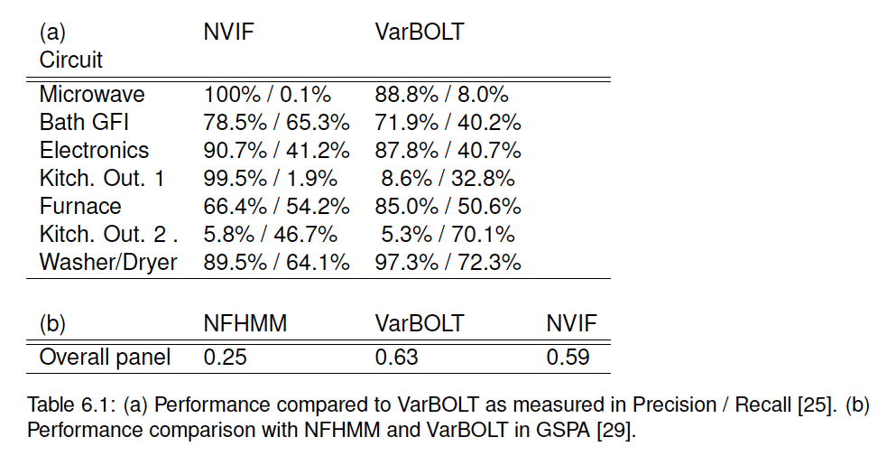
Performance NVIF

