Slide 1
Fundamental Limits Of Steganographic Capacity For Multivariate-Quantized-Gaussian-Distributed Multimedia
Hassan Y. El-Arsh, Amr Abdelaziz, Ahmed Elliethy, Hussein A. Aly
Dept. of Computer Engineering, Military Technical College, Cairo, Egypt
Presented by: Hussein A. Aly
COM-03: Image & Video Processing for Watermarking and Security

Slide 2
Agenda
Introduction
System Model
Problem Statement
Main Results
Experimental Results
Conclusion & Future Work
Questions

Slide 3
Agenda
Introduction
System Model
Problem Statement
Main Results
Experimental Results
Conclusion & Future Work
Questions

Slide 4
Introduction
Steganography is the art and science of hiding data within innocent looking cover objects.

Slide 5
Introduction
Alice
Bob
Eve

Slide 6
Introduction
Multimedia such as images and videos are attractive types of cover.

Slide 7
Agenda
Introduction
System model
Problem Statement
Main results
Experimental results
Conclusion & Future Work
Questions

Slide 8
System Model
Alphabet
Statistical distribution of stego-objects
Statistical distribution of message’s codebook
Statistical distribution of cover
P_{s}
P_{c}
P_{m}

Slide 9
Agenda
Introduction
System Model
Problem Statement
Main Results
Experimental Results
Conclusion & Future Work
Questions

Slide 10
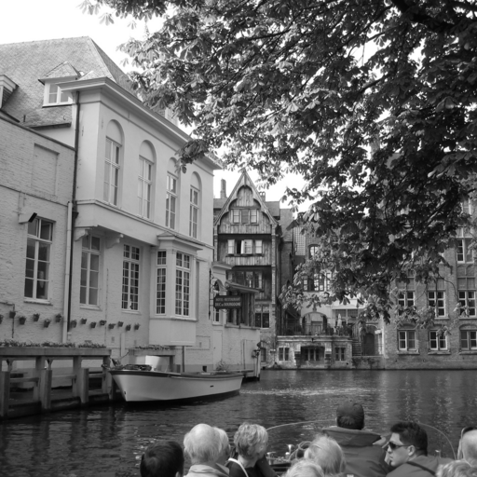
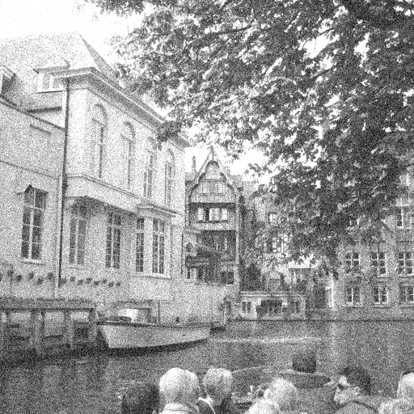
Problem Statement
Mutual information
KL-divergence
Threshold
$${}_{{ P}_{m }}^{argmax} I\left(P_{m ; }P_{s}\right) s.t D(P_{s} ∥P_{c}) ≤2 δ^{2}$$
Alice wishes to send as much data as possible
Maximum mutual information
Objective
Maximum mutual information
data
More data
Challenge
Minimum detection error probability
With more data embedded, Alice shall be detected
Minimum detection error probability

Slide 11
Problem Statement
$${}_{{ P}_{m }}^{argmax} I\left(P_{m ; }P_{s}\right) s.t D(P_{s} ∥P_{c}) ≤2 δ^{2}$$
Conditional Entropy
Entropy
$$I\left(P_{m}; P_{s}\right)= H\left(P_{s}\right)− H\left(P_{s} | P_{m} \right)$$
$= H\left(P_{s}\right)− H\left(P_{c}\right)$
$${}_{{ P}_{m }}^{argmax} H\left(P_{s}\right) s.t D\left(P_{s}∥P_{c}\right)≤ 2 δ^{2}$$
The Lagrangian
$$L\left(P_{s}, λ\right)= L\left(\vec{μ_{s}}, Σ_{s}, λ\right)= H\left(P_{s}\right)− λ\left(D\left(P_{s}∥P_{c}\right)− 2 δ^{2}\right)$$

Slide 12
Problem Statement
Type I error
probability of detection error
probability of correct detection
Type II error
Total variation distance
$$P_{e}= 1− P_{D}= α+ β= 1 − ν\left(P_{s},P_{c}\right)$$
Threshold
$$ν(P_{s} , P_{c}) = \frac{1}{2}‖{P_{s}−P_{c}‖}_{1} ≤ δ$$
KL-divergence
Pinsker’s inequality
$$ν\left(P_{s},P_{c}\right) ≤ \sqrt{\frac{1}{2}D\left(P_{s}∥P_{c}\right)}$$
$$D(P_{s} ∥P_{c}) = \sum_{i=1}^{n}{P_{s_{i^{}}}} ln \frac{P_{s_{i^{}}}}{P_{c_{i^{}}}} ≤2 δ^{2}$$

Slide 13
Agenda
Introduction
System Model
Problem Statement
Theoretical Results
Experimental Results
Conclusion & Future Work
Questions

Slide 14
Theoretical Results
Theorem.1: KL-Divergence between two quantized distributions F(X) and G(X) is defined as:
$$D\left( F\left(X\right) , G\left(X\right)\right)≈D\left( f\left(x\right) , g\left(x\right)\right)$$
Where $f$ and $g$ are the continuous versions of $F$ and $G$, respectively, and $X$ is the quantized version of the continuous random variable $x$.
This theorem is valid only if both $f\left(x\right) ln⁡(f\left(x\right))$ and $f\left(x\right) ln⁡(g\left(x\right))$are Riemann integrable.

Slide 15
Theoretical Results
Theorem.2: With the assumptions used above, the distribution of P_{m} must be MQGD (same as cover and stego-object), with the parameters (mean and variance) as:
$\vec{μ_{s}}=0$
$Σ_{m}= \left( −W\left(−4δ^{2}−1 −iπ\right)−1 \right)×Σ_{c}$
Mean
Y + ln(Y) = Z
Y = W(Z)
Wright Omega Function
Covariance Matrix
$$δ$$
$$Σ_{c}$$

Slide 16
Theoretical Results
a ≥ 1
$$a= \left( −W\left(−4δ^{2}−1 −iπ\right)−1 \right)$$
$$δ$$
$$H\left(P_{m}\right) ≈H\left(P_{c}\right)+ \frac{1}{2}\ln\left(a−1\right)$$
The optimal embedding rate
$$Θ= \frac{H\left(P_{m}\right)}{H\left(P_{c}\right)} = 1 + \frac{\ln\left(a −1\right)}{2×H\left(P_{c}\right)}$$

Slide 17
Agenda
Introduction
System Model
Problem Statement
Main Results
Experimental Results
Conclusion & Future Work
Questions

Slide 18
Experimental Results
We demonstrate the relationship between the embedding rate corresponding to cover statistics and min. probability of error for any steganalyzer.
Two images are selected from the BOWS-dataset representing the two extremes: very high and very low texture images.

Slide 19
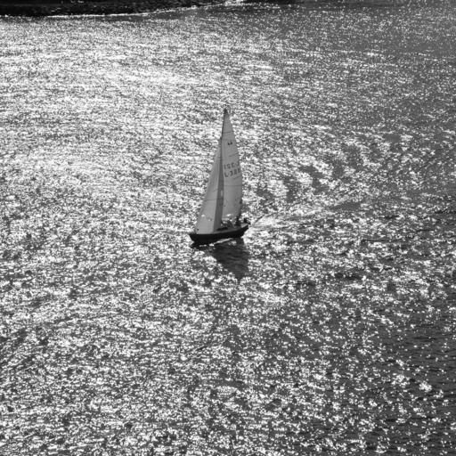
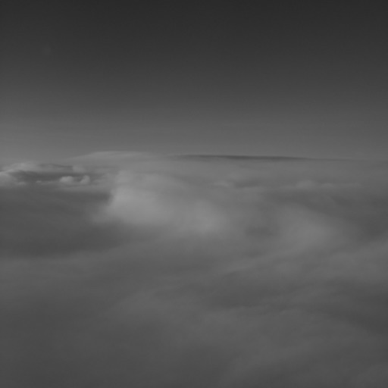
Experimental Results
High textured image
low textured image
6184.pgm
9549.pgm

Slide 20
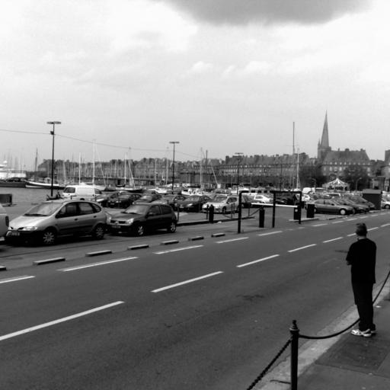
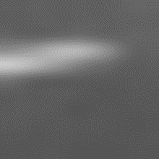
Experimental Results
Original
Image
After de-noising filter
Residue
Original
Image
De-noising filter
$r= z −F(z)$
Number of quantization bits
$r \sim N\left(0,σ\right)$ [1]
$$H\left(P_{c}\right)≈\frac{1}{2} ln\left(2πe \left|Σ_{c}\right|\right)+ b$$
[1] V. Sedighi, R. Cogranne, and J. Fridrich, “Content-adaptive steganography by minimizing statistical detectability”, IEEE Transactions on Information Forensics and Security, , vol. 11, no. 2, pp. 221–234, 2016.

Slide 21
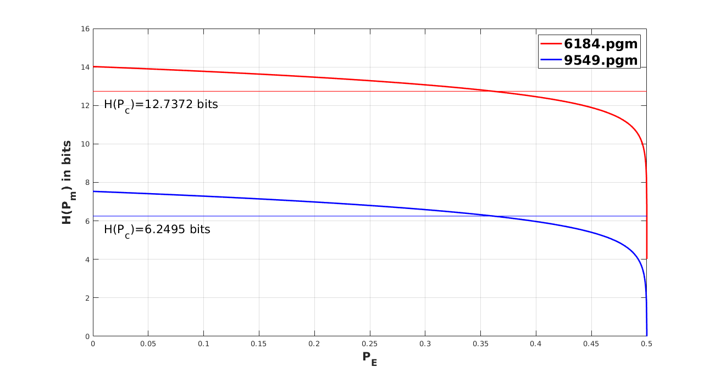
Experimental Results
0.3615

Slide 22
Agenda
Introduction
System Model
Problem Statement
Main Results
Experimental Results
Conclusion & Future Work
Questions

Slide 23
Conclusion
We have established an information theoretic limit of message steganography for MQGD multimedia covers providing an exact scaling constant for the embedding rate w.r.t cover statistics.
We have provided an experiment for a real world MQGD cover illustrating our analytical results.

Slide 24
Future Work
When Alice and Bob don’t share the same cover, there must be an achievability and a converse proofs to complete our solution.
These proofs are omitted due to limited space, but will be provided in future publication.

