Slide 1
Low-Latency Lossless Compression of Monochrome Images
Beenish Zia*, Palanivel Guruvareddiar *, Yong Tong Chua*, Xiang Guo*, Jian Sun* and Jerome Knoplioch⁺
*Intel Corporation , ⁺GE HealthCare
March 2023

Slide 2
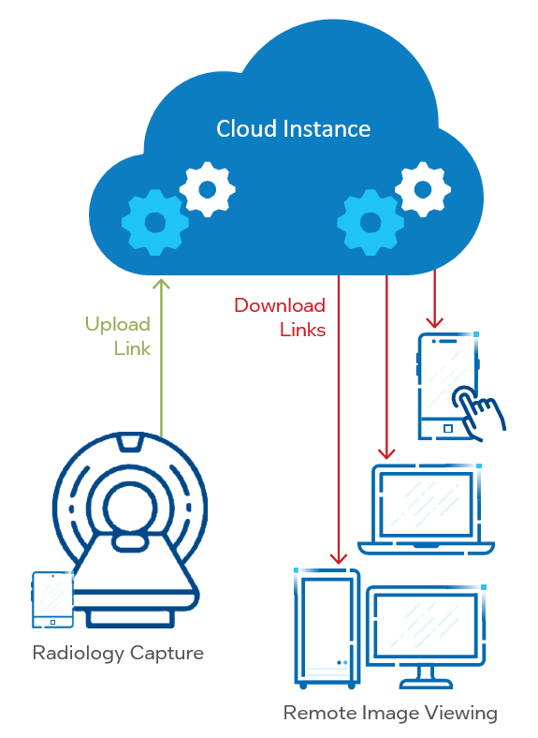
Problem Statement and Analysis
Problem Statement:
Remote Radiologists
Medical Images (Monochrome, 16-bit, RAW format)
Lossless compression (compression ratio >2)
Low-latency (~1 millisecond for a 512x512 image)
Analysis:
JPEG-2000 and JPEG-LS (Lossless) standards offer lossless compression
JPEG-XL (Long Term)
successor to the JPEG-2000 scheme
supported by the DICOM (Digital Imaging and Communications in Medicine) standard
High-Throughput JPEG 2000 (HTJ2K)
order of magnitude improvement over JPEG-2000
Optimized HTJ2K
Takes advantage of the Intel Xeon architecture such as the AVX-512 instruction set and massively parallel compute
Reduce encode timings by up to 7x - 12x without any impact to the compression efficiency
Notes:
The JPEG 2000 standard provides both lossless and lossy compression in a single compression architecture. Lossless compression is provided by the use of a reversible integer wavelet transform in JPEG 2000.
FFMPEG - You can add openJPEG, but that allows JPEG2000 compression doesn’t support RAW input file format. We did try few patchworks but weren’t able to get it to work.
Raw→ JPEGLS , good compression ratio, latency not met
JPEGXL by default doesn’t support raw file, however we were able to find libjxl library on FFMPEG and were able to complete the analysis, results of which we will show in next slide.

Slide 3
Results & Call To Action
 | JPEG-XL |  | HTJ2K |  | Optimized HTJ2K
Image resolution | Compression Ratio§ | Encoding Time (ms) | Compression Ratio§ | Encoding Time (ms) | Compression Ratio§ | Encoding Time (ms)
512x512 | 4.2 | 81 | 3.3 | 15.63 | 3.3 | 1.3
2394x3062 | 3.2 | 462 | 2.9 | 210.21 | 2.9 | 30.5
1024x1407 | 14.2 | 127 | 12.5 | 23.1 | 12.5 | 2.9
2000x4164 | 2.4 | 411 | 2.3 | 179.88 | 2.3 | 28.8
§ Original Size / Compressed Size; Higher the better.
Call To Action
Connect with speakers over LinkedIn
Checkout: Low Latency Lossless Compression White Paper
Notices & Disclaimer: JPEGXL Results: Testing completed 6/15/2022 by Intel. System under test: 2x Intel® Xeon® Gold 6252N processors (24 cores per socket @ 2.30 GHz), 192 GB DDR4, 1.92 TB storage, BIOS version: 5.14, OS: Ubuntu 18.0.4.
HTJ2K Results: Testing completed 8/3/2022 by Intel. System under test: 2x 4th Gen Intel® Xeon® Scalable processors, (48 cores per socket @ 3.6 GHz), CPU QDF=QY5E, D0 stepping, PCH WDF=QY0U, Intel® Speed Select Technology disabled, 64 GB DDR5 4800, OS: Red Hat 8.5.0-3 Linux version 4.18.0-348.el8.x86_64.
Performance varies by use, configuration and other factors. Learn more at www.intel.com/PerformanceIndex.
Performance results are based on testing as of dates shown in configurations and may not reflect all publicly available updates. See configuration disclosure for configuration details. No product or component can be absolutely secure. All testing was performed by Intel.
Intel does not control or audit third-party data. You should consult other sources to evaluate accuracy. Your costs and results may vary.
Intel technologies may require enabled hardware, software or service activation.
© Intel Corporation. Intel, the Intel logo and other Intel marks are trademarks of Intel Corporation or its subsidiaries. Other names and brands may be claimed as the property of others.

