Slide 1
An Efficient Beam-Sharing Algorithm for RIS-aided Simultaneous Wireless Information and Power Transfer Applications
Nguyen Minh Tran, Muhammad Miftahul Amri, Je Hyeon Park, Dong In Kim, and Kae Won Choi
Sungkyunkwan University
Department of Electrical and Computer Engineering
Wireless Communication Laboratory & Convergent IoT Laboratory
2023 IEEE International Conference on Acoustics, Speech and Signal Processing
09 JUNE, RHODES ISLAND, GREECE
Notes:
Hello everyone, this is Nguyen Minh Tran from Sungkyunkwan University. It is my honor to be here today to present my work in 2023 IEEE International Conference on Acoustics, Speech and Signal Processing. My talk today is “An Efficient beam-sharing algorithm for RIS-aided SWIPT applications” This is a co-work with Muhammad Miftahul Amri, Je Hyeon Park, Dong In Kim, and Kae Won Choi.
So, let’s get started

Slide 2
Contents
Background and Motivation
Problem Formulation
Numerical Results
Conclusion and Remarks
Notes:
This is the content of my presentation today
First, I would give background and motivation of our work.
Then, I will formulate the problem that we consider
Next, I will give some simulation results that we got
Finally, I will conclude my talk.
Let’s move on the first part,

Slide 3
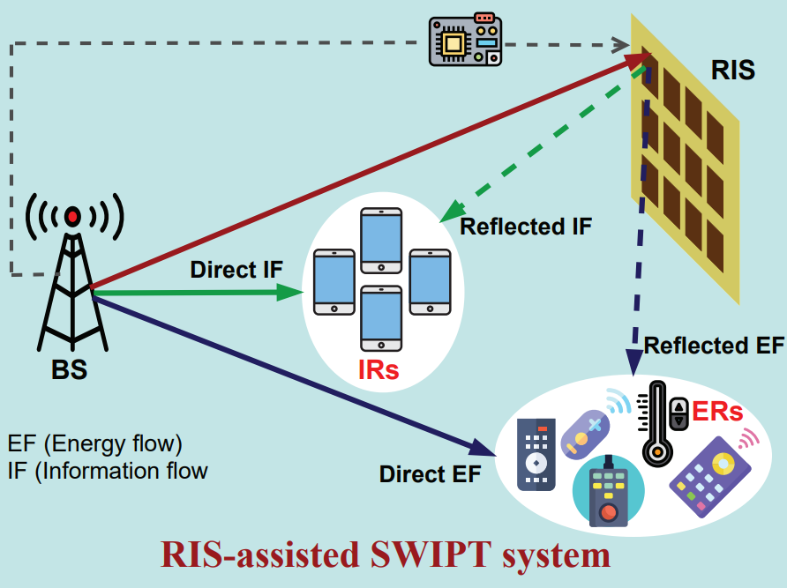
Background and Motivation
I.
Massive of low-power IoT devices deployment poses new challenges:
Massive energy consumption for sustainable sensing
Surging cost in battery replacement
Simultaneous wireless information and power transfer (SWIPT) is a potential candidate for tackling this difficulty.
The Internet of Everything (IoE) Source: techopedia.com/
RIS-assisted SWIPT [1]
[1] S. Basharat, et. al., "Reconfigurable Intelligent Surfaces: Potentials, Applications, and Challenges for 6G Wireless Networks," IEEE Wireless Communications, vol. 28, no. 6, pp. 184-191, December 2021.
Notes:
Soon, massive of low-power IoT devices will be deployed, which poses new challenges to service providers such as - Massive energy consumption will be required for ensuring sustainable sensing ability of those massive connection.
Moreover, battery replacement or maintenance cost will be surging
Therefore, SWIPT can be a potential solution to deal with this difficulty.

Slide 4
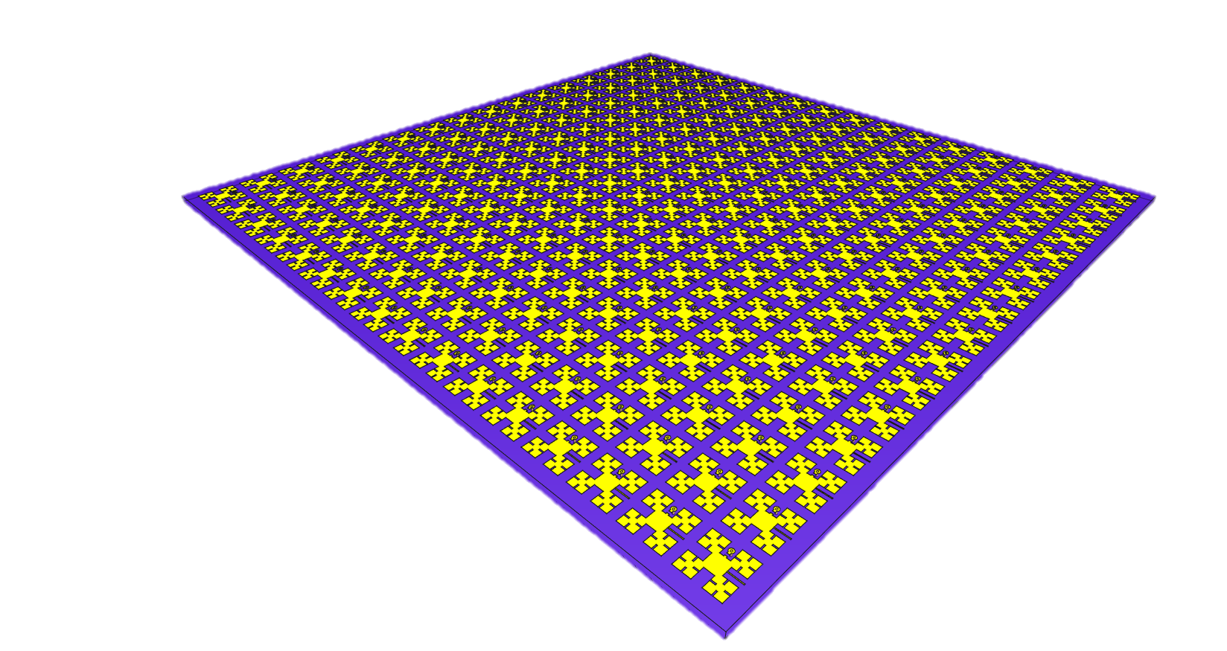
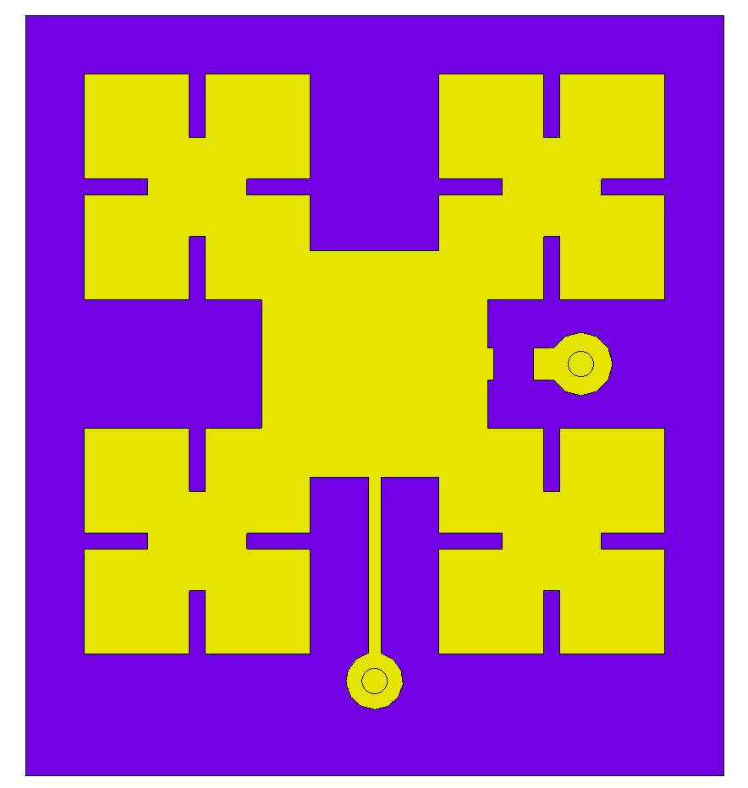
Background and Motivation
I.
Reconfigurable intelligent surface (RIS) is an emerging technology for wireless communications (6G), SWIPT.
Known as: intelligent reflecting surface (IRS), large intelligent surface (LIS), software-controlled metasurface, programmable coding metasurface.
Comprising hundreds to thousands of passive reflecting unit cells.
Control elements (e.g., PIN diode, varactor) → no active, power-hungry components.
Capability: passive beamforming, beam focusing, multiple beams, scattering.
Pin Diode
Notes:
Recently, reconfigurable intelligent surface or RIS is emerging as a promising technology for wireless communications, for example 6G, or even SWIPT
It also know as intelligent reflecting surface, large intelligent surface, software-controlled metasurface, programmable coding metasurface
It is actually an artificial surface that comprises hundreds to thousands of passive reflecting unit cells, in which each unit cell is integrated with one or several control elements, such as PIN diode or varactor, to control the characteristics of the incoming waves.
By properly controlling each unit cell in the RIS, one can passive form a beam, focus a power beam, form multiple beams, or even scatter the incoming EM waves without active and power-hungry component.
These features make RIS promising technology for future wireless technology.

Slide 5
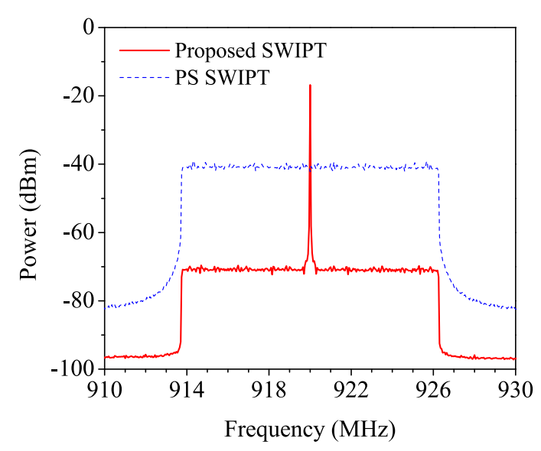
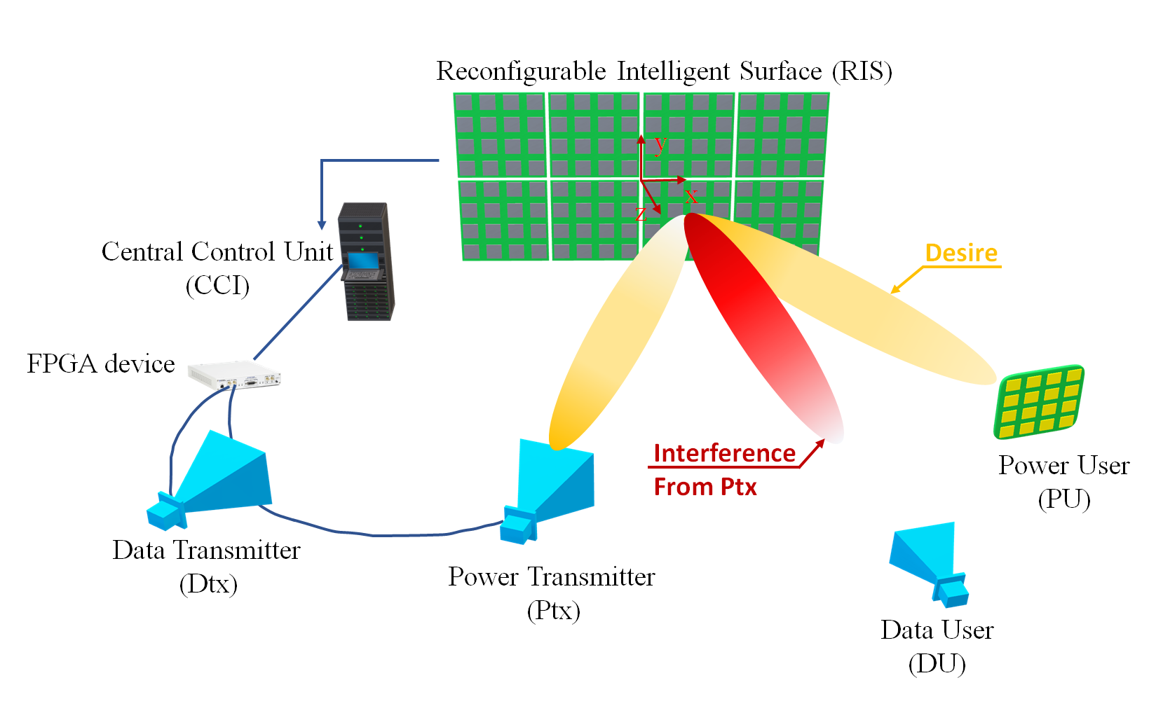
Background and Motivation
I.
Power Signal
Motivation
Power transfer: sending high power with single tone
Information transfer: relatively low power, vulnerable
Power leakage from power transmitter (Ptx) to data user (DU) → fatal damage
Objectives:
Maximize power from Ptx to power user (PU)
Maximize the received signal from data transmitter (Dtx) to data user (DU)
Limit the leakage power delivered from Ptx to DU → Nulling technique.
OFDM signal
Notes:
In an RIS-aided SWIPT, we have two parts: power transfer and information transfer. In power transfer, transmitter and receiver are normally within the near-field region of the RIS, and we often send a single tone with very high power to the end-use to ensure reasonable transfer efficiency.
However, in the information transfer, transmitter and receiver are located in the far-field region of the RIS, in far location. Moreover, we usually send relatively low power in information transfer.
The data user normally is equipped with vulnerable components which has limited input power level.
Hence, the power leakage from Ptx to DU can cause fatal damage
Therefore, in this work, we aim to minimize the leakage power from Ptx to DU by enabling NULLing ability of the RIS, and at the same time maintain maximum power from Ptx to PU and Dtx to DU.

Slide 6
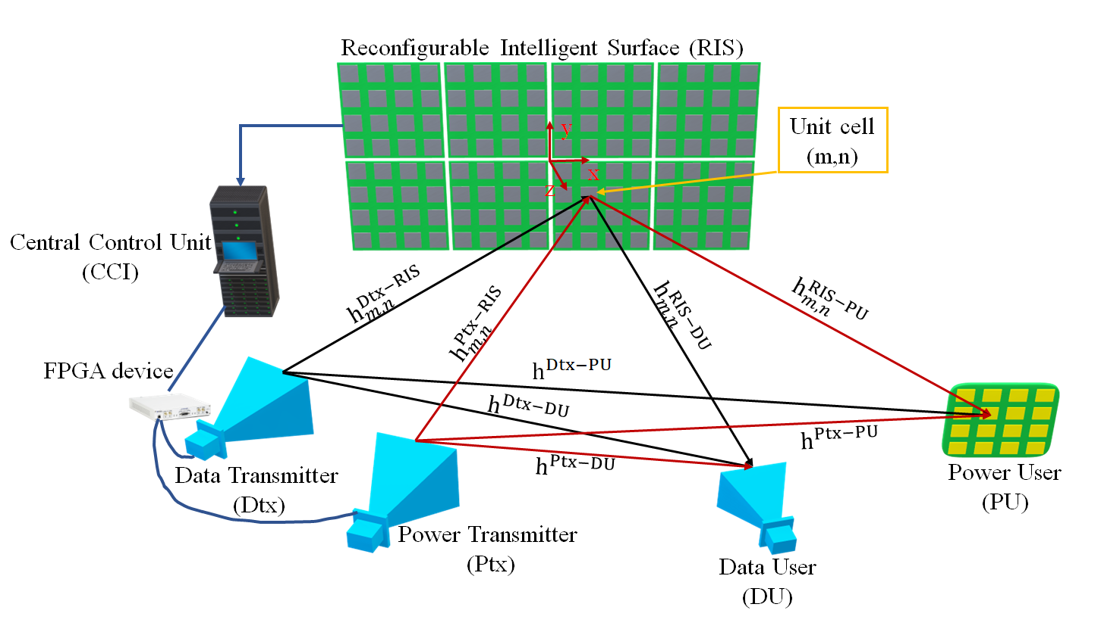
Problem Formulation
II.
Consider a RIS-assisted SWIPT system
$h^{A−B}$: direct channel between A and B [2]
$$h^{A−B}=\frac{λ_{c}\sqrt{G^{A}G^{B}}}{4πd}\exp\left(−j\frac{2π}{λ_{c}}d\right)$$
RIS-aided SWIPT system model
[2] N. M. Tran, et al., "Reconfigurable-Intelligent-Surface-Aided Wireless Power Transfer Systems: Analysis and Implementation," in IEEE Internet of Things Journal, vol. 9, no. 21, pp. 21338-21356, 1 Nov.1, 2022.
Notes:
Actually, we consider a RIS-aided SWIPT system with one data transmitter (Dtx) which send OFDM modulated signal to an intended data user (DU), where the DU has one single antenna.
We have one power transmitter (Ptx) which sends a single tone signal with high power to a power user which is equipped with array of rectennas to effectively harvest the EM energy.
We consider one RIS and divide the RIS into K smaller RIS tiles.
As I mentioned before, in power transfer, Ptx and PU are usually in the near-field region of the RIS. Hence, near-field beam focusing is preferable compared to far-field beamforming to enhance the transfer efficiency. And there is only power information at the PU since the phase information has been removed by rectennas. To enable near-field beam focusing of the entire RIS, we need scan and find the optimal far-field beam of each smaller RIS tiles.
I recommend you read our recent paper below for more details of the power based near-field beam focusing technique.
We can define the channel between two antenna/unit cell as the equation here.
Then, we can define channels between each transmitter to unit cell of RIS, and each user.

Slide 7
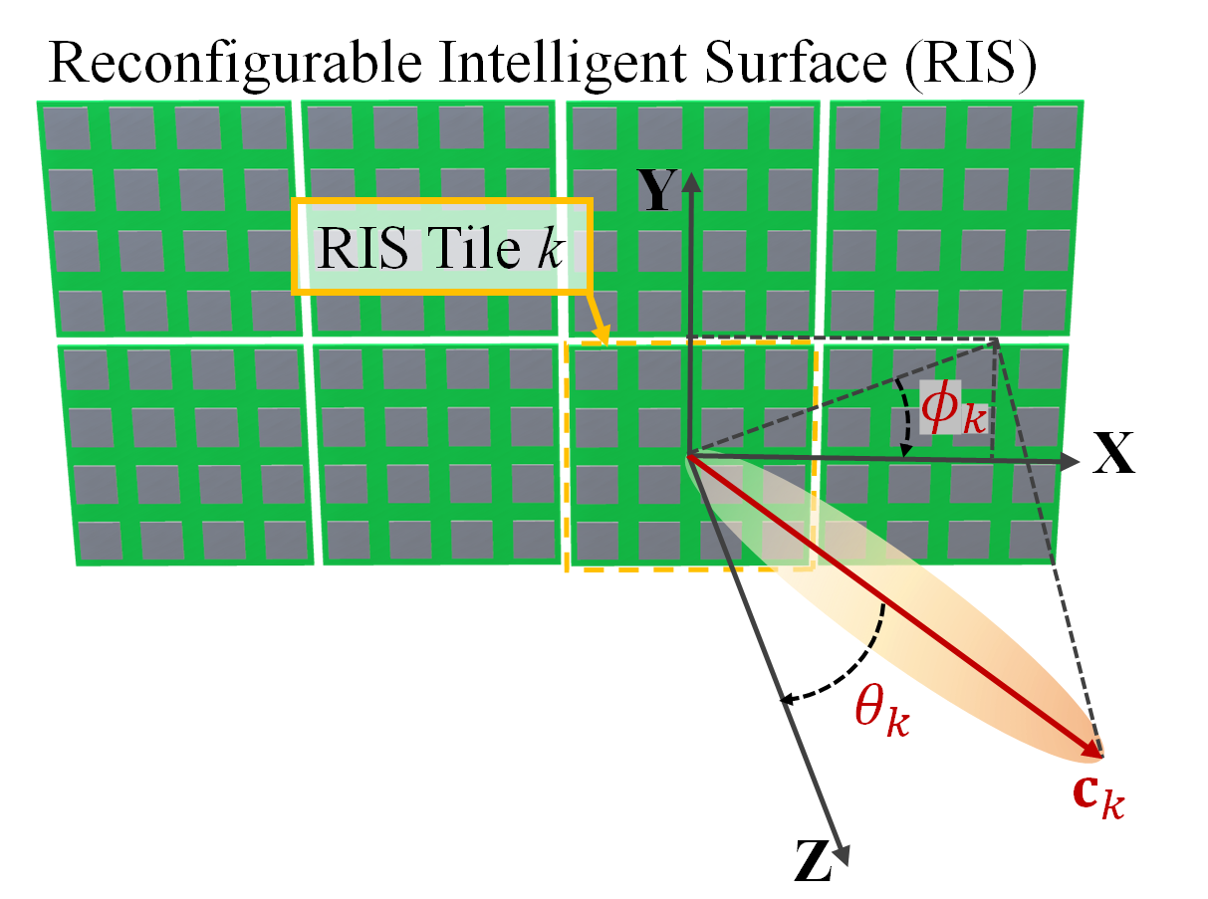
Problem Formulation
II.
Reflection coefficient of unit cell (m,n) in RIS tile k
$$Γ_{k,m,n}=Γ_{0}\exp\left(−j\frac{2π}{λ_{c}}c_{k}^{T}q_{k,m,n}^{RIS}\right)$$
$$Γ_{k}={\left(Γ_{k,1,1},…, Γ_{k,m,1},Γ_{k,m,2},…Γ_{k,m,n}\right)}^{T}$$
Total receive signal at DU is
$$y^{D}=\sum_{k=1}^{K}{Γ_{k}^{T}\left(h_{k}^{D−D}+h_{d}^{D−D}\right)x^{D}+\sum_{k=1}^{K}{Γ_{k}^{T}\left(h_{k}^{P−D}+h_{d}^{P−D}\right)x^{P}}+η^{D}}$$
Similarly,
$$y^{P}=\sum_{k=1}^{K}{Γ_{k}^{T}\left(h_{k}^{P−P}+h_{d}^{P−P}\right)x^{P}+\sum_{k=1}^{K}{Γ_{k}^{T}\left(h_{k}^{D−P}+h_{d}^{D−P}\right)x^{D}}}$$
$c_{k}^{T}=(\sin{θ_{k}}\sin{φ_{k}},\sin{θ_{k}}\cos{φ_{k}},\cos{θ_{k}})$
$q_{k,m,n}^{RIS}$: position of unit cell (m,n) in RIS tile k
$$y^{D−D}$$
$$y^{P−D}$$
$$q_{k,m,n}^{RIS}$$
RIS tile control parameters
Notes:
The reflection coefficient of unit cell (m,n) in the RIS tile k can be given as this equation, where we define c_k is the high-level control parameter which control the reflected beam of the RIS tile to a specific direction
The relay signal from Dtx/Ptx and RIS tile k to DU can be expressed as …
And the total receive signal at DU is the summation of signal relayed from all RIS tiles in the RIS to the DU which can be given in this equation here
Where bold Gamma_k here is the reflection coefficient vector of the RIS tile k.
Then, similarly we can obtain the total relay signal at the PU.

Slide 8
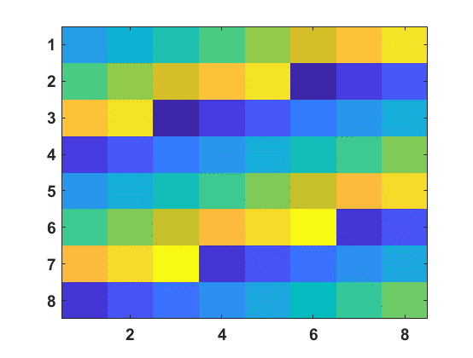
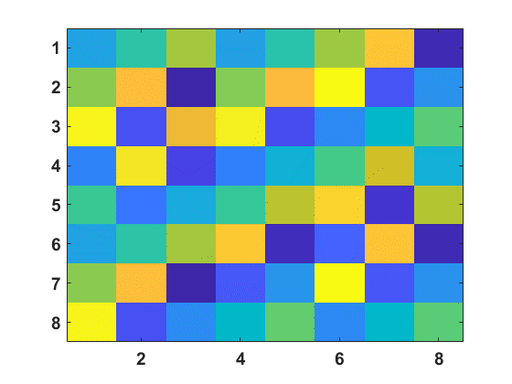
Problem Formulation
II.
The reflection coefficient vector of RIS tile k is
$$Γ_{k}=ω_{k}^{T}G_{k},$$
where $ω_{k}={\left(ω_{k}^{P−P}, ω_{k}^{P−D}, ω_{k}^{D−D}\right)}^{T}$, $G_{k}={\left[Γ_{k}^{P−P}, Γ_{k}^{P−D}, Γ_{k}^{D−D}\right]}^{T}$,
${ Γ}_{k}^{A−B}$and $ω_{k}^{A−B}$ are the reflection coefficient of RIS tile k for a single beam from A through RIS to B and corresponding complex weight factor.
Sidelobe
$$Γ_{k}^{P−P}$$
P-P Desired Beam
Interference
Ptx to Du
$$Γ_{k}$$
P-P Desired Beam
Interference
Ptx to Du
D-D Desired Beam
RIS tile with single beam and multiple beam reflection coefficient vector
Notes:
Assume that we have the reflection coefficient vector of RIS tile k for a single beam from Ptx to PU, Ptx to DU, and Dtx to DU.
Then, the optimal reflection coefficient vector can be obtained by controlling the weight given to each reflection coefficient vector of single beam to meet our objective.
The receive power at PU from Ptx can be calculated as
Similarly, we can obtain the power from Ptx to DU, and Dtx to DU.
Now our problem can be formulated as problem P1 here, in which we aim to minimize the power from Ptx to DU under a threshold and maximize the power from Ptx to PU and from Dtx to DU
However, the problem P1 is non-convex problem with intricately decoupled variables, which is hard to be solved.

Slide 9
Problem Formulation
II.
The received power at PU from Ptx is expressed by
$$P^{P−P}\left(ω_{k}\right)=\frac{{\left|ω_{k}^{T}G_{k}h_{k}^{P−P}x^{P}+Υ^{P−P}\right|}^{2}}{2},$$
where $Υ^{P−P}=\sum_{\overline{k},\overline{k}≠k}^{K}{\left({\left(Γ_{\overline{k}}^{P−P}\right)}^{T}h_{\overline{k}}^{P−P}+h_{d}^{P−P}\right)x^{P}}$ is the relayed signal from all other RIS tiles and direct signal from Ptx to PU.
Problem formulation
$$\left(P1\right): \max_{ω_{k}, ∀k}{P^{P−P}\left(ω_{k}\right)+P^{D−D}\left(ω_{k}\right)}$$
$$subject to P^{P−D}\left(ω_{k}\right)≤P^{thres},$$
where $P^{thres}$ is the safety threshold of DU.
P-P Desired Beam
Interference
Suppressed
D-D Desired Beam
$$Γ_{k}^{opt}$$
Notes:
Assume that we have the reflection coefficient vector of RIS tile k for a single beam from Ptx to PU, Ptx to DU, and Dtx to DU.
Then, the optimal reflection coefficient vector can be obtained by controlling the weight given to each reflection coefficient vector of single beam to meet our objective.
The receive power at PU from Ptx can be calculated as
Similarly, we can obtain the power from Ptx to DU, and Dtx to DU.
Now our problem can be formulated as problem P1 here, in which we aim to minimize the power from Ptx to DU under a threshold and maximize the power from Ptx to PU and from Dtx to DU
However, the problem P1 is non-convex problem with intricately decoupled variables, which is hard to be solved.

Slide 10
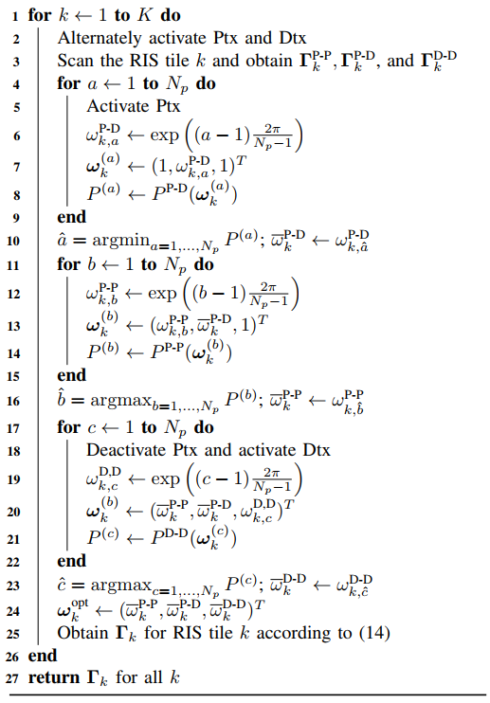
Problem Formulation
II.
Algorithm 1: Beam sharing algorithm
Efficient Beam Sharing
Alternatively optimize each complex weight (e.g., $ω_{k}^{A−B}$) for each RIS tile by scanning one weight while keeping the others fixed.
Scan the RIS tile k
Obtain $Γ_{k}^{P−P}, Γ_{k}^{P−D}, Γ_{k}^{D−D}$
Scan the RIS tile k
Obtain 𝚪_𝑘^(P−P), 𝚪_𝑘^(P−D), 𝚪_𝑘^(D−D)
Fix $ω_{k}^{P−P}, ω_{k}^{D−D}$
Scan $ω_{k}^{P−D}$, obtain ${\overline{ω}}_{k}^{P−D}$
Fix 𝜔_𝑘^(P−P), 𝜔_𝑘^(D−D)
Scan 𝜔_𝑘^(P−D), obtain 𝜔 ̅_𝑘^(P−D)
Fix ${\overline{ω}}_{k}^{P−D}, ω_{k}^{D−D}$
Scan $ω_{k}^{P−P}$, obtain ${\overline{ω}}_{k}^{P−P}$
Fix 𝜔 ̅_𝑘^(P−D), 𝜔_𝑘^(D−D)
Scan 𝜔_𝑘^(P−P), obtain 𝜔 ̅_𝑘^(P−P)
Load the optimal pattern to RIS tile k
Repeating the process for all RIS tiles
Activate Ptx Deactivate Dtx
Fix ${\overline{ω}}_{k}^{P−D}, {\overline{ω}}_{k}^{P−P}$
Scan $ω_{k}^{D−D}$, obtain ${\overline{ω}}_{k}^{D−D}$
Fix 𝜔 ̅_𝑘^(P−D), 𝜔 ̅_𝑘^(P−P)
Scan 𝜔_𝑘^(D−D), obtain 𝜔 ̅_𝑘^(D−D)
Deactivate Ptx Activate Dtx
Flow chart of the proposed algorithm
Notes:
Hence, in this work, we propose an efficient beam sharing algorithm to achieve our goal.
Indeed, we optimize each RIS tile by alternatively optimize each complex weight by scanning one weight why keeping the others fixed as given in this flow chart.
Particularly, we first scan the RIS tile k to obtain the reflection coefficient for single beam, then we activate Ptx and deactivate Dtx to optimize the weight for minimize the power from Ptx to DU and maximize the power at PU.
Next, we deactivate Ptx and activate Dtx to optimize the weight for the beam from Dtx to DU.
After getting the optimal reflection coefficient vector, we load to the RIS tile k and repeating this process for all other RIS tiles.

Slide 11
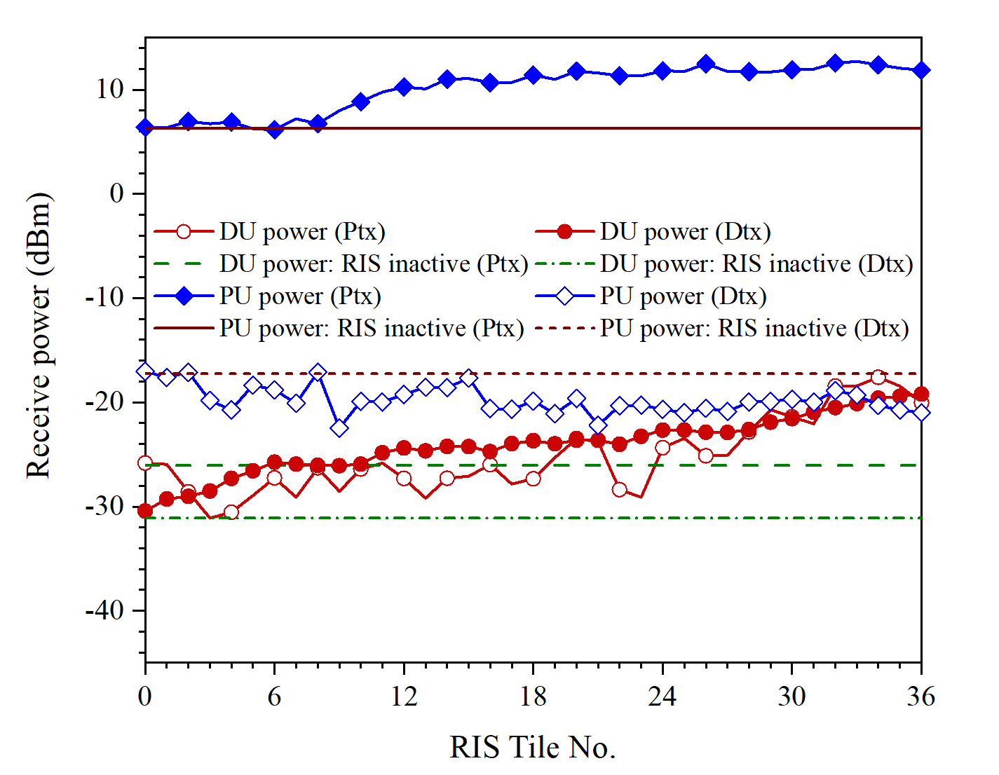
Numerical Results
III.
Ptx at (-1 m, 1 m, 4 m)
Dtx at (-1 m, 0 m, 4 m)
PU at (1 m, -1.5 m, 8 m)
DU at (5 m, 0 m, 20 m)
RIS at the origin (0 m, 0 m, 0 m)
Ptx power: 5 watts
Dtx power: 0.05 watts
Receive power of DU and PU over number of optimized RIS tiles
(with Ptx-DU power cancellation)
Receive power of DU and PU over number of optimized RIS tiles
(without Ptx-DU power cancellation)
Notes:
To verify the proposed algorithm, we have simulated the algorithm and here are some results that we got.
The left-hand side figure shows the receive power of DU and PU over number of optimized RIS tiles with the Ptx-DU minimization and the right one shows the results without Ptx-PU power cancellation.
We can observe that when the algorithm implemented, the power received at Du from Ptx is minimized to around -35 dBm, on the other hand, it is -20 dBm in the case not implemented.
Moreover, the power from Ptx to PU and from Dtx to DU are maximized at the same time.

Slide 12
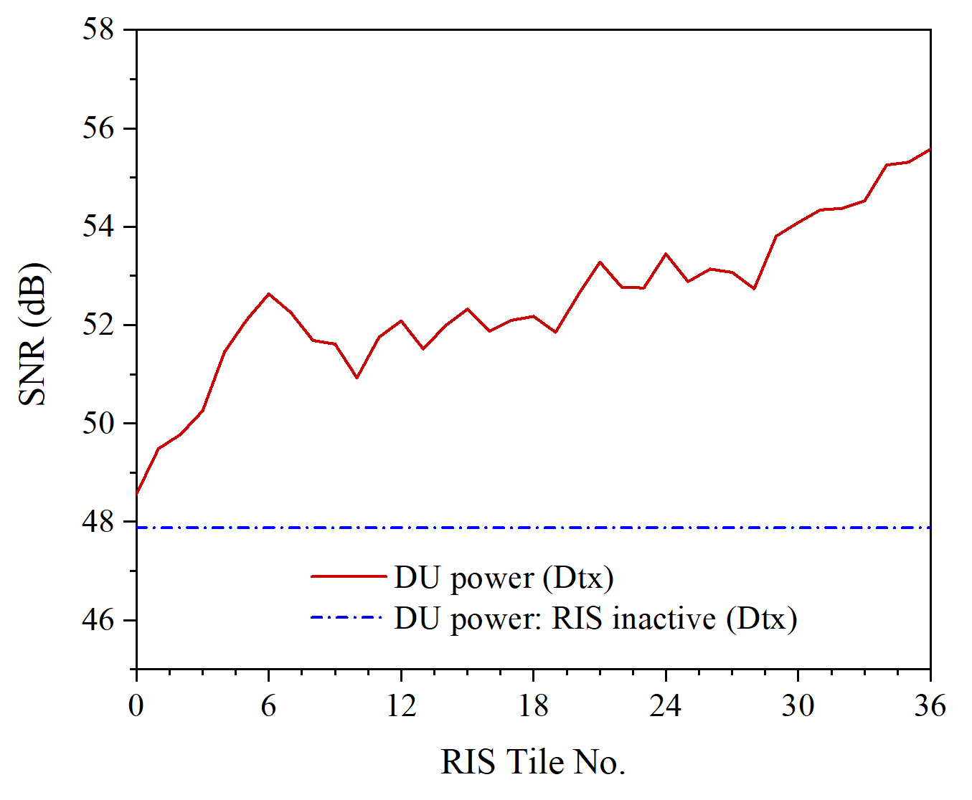
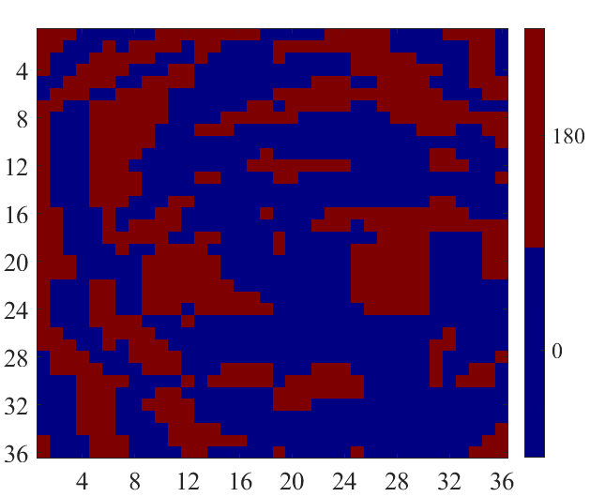
Numerical Results
III.
SNR of DU
RIS optimal phase
Notes:
This is the SNR of the DU with respect to the number of optimized RIS tiles and the optimal RIS reflection phase after executing the algorithm.
It is clear that the SNR of DU increases over number of optimized RIS tiles.

Slide 13
IV.
Conclusion & Remarks
Conclusion
We proposed a beam-sharing algorithm for RIS-assisted simultaneous wireless information and power transfer system.
A thorough analysis of receive power at PU and DU is derived and a beam-sharing algorithm (BSA) is elaborated with alternating optimization method.
Simulation results demonstrated that the RIS-aided SWIPT with the BSA can effectively minimize the power from Ptx to DU, while maintaining the maximum power from Ptx to PU and Dtx to DU.
Please visit us for more details
Convergent IOT Lab. https://ciot.skku.edu
Wireless Communication Lab. http://wireless.skku.edu/english/portal.php
YouTube Channel: Convergent IoT Systems Lab
Thank you!
Notes:
In this work, we have studied and proposed an efficient beam sharing algorithm for RIS-assisted SWIPT system.
We have thoroughly analyzed the receive power at PU and DU, and elaborated the beam sharing algorithm.
Simulation results demonstrate that the proposed algorithm can effectively set the RIS to minimized the power from Ptx to DU while ensuring maximal power from Ptx to PU and Dtx to DU.
If you are interested in our work, please visit us on the two websites and YouTube channel here.
Thank you so much and I am very happy to receive any comments and questions!

