Slide 1
GLDM: Hit Molecule Generation with Constrained Graph Latent Diffusion Model
Conghao Wang, Hiok Hian Ong, Jagath C. Rajapakse
School of Computer Science and Engineering, NTU
Apr 2024

Slide 2
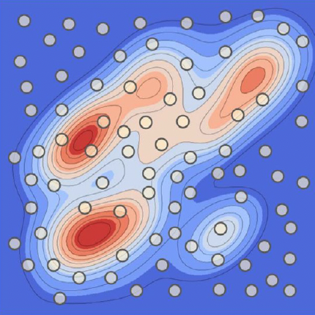
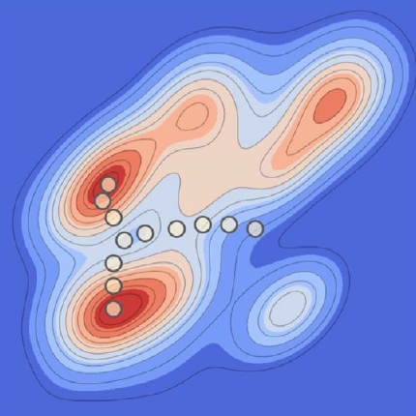
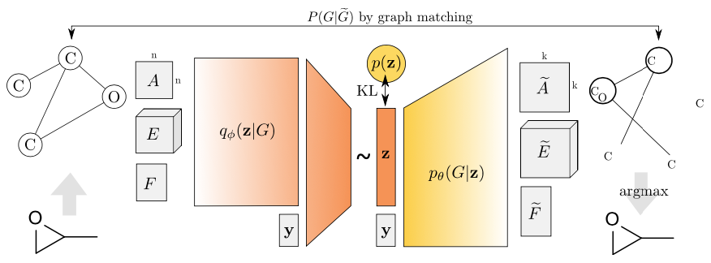
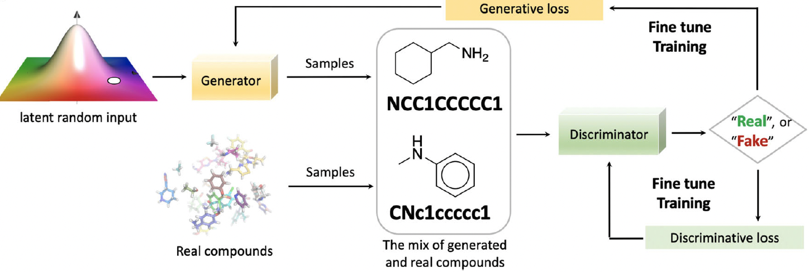
Deep Learning-aided Drug Design
Virtual Screening
Deep Learning
Meyers et al., 2021
Discover molecules with optimal properties in a directed manner
LSTM
VAE
GAN
Simonovsky et al., 2018
Bian et al., 2018
C=1C=CC=NC1(CC(O)(C)C=1C=CC=CC1)
C
=
1
…
)
LSTM
LSTM
LSTM
…
LSTM
C
=
…
1
Notes:
Recently, deep learning has been popular in computer-aided drug design. Compared with traditional computer-aided drug design methods such as virtual screening, which needs to enumerate candidates in a large chemistry library, deep learning methods can be used to model the relationship between molecule structures and the the target chemical or biological properties, and generate novel molecules in a directed manner.
Depending on how we represent the molecule data, there have been various deep learning approaches to generating novel molecules. For example, a few works compiled the molecules into a string notation called SMILES vector, and then applied long short term memory networks to generate the symbols one by one. The problem is that the chemical rules are broken during this kind of generation and the generated molecules could have an invalid structure.
Then researchers started investigating direct generation of molecular graphs, which ensures the chemical validity. And works based on graph variantional autoencoders and generative adversarial networks have emerged.

Slide 3
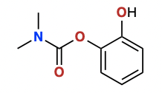
Diffusion Models
$$q(z_{t}|z_{data})$$
…
$$p(z_{t−1}|z_{t})$$
…
$$𝒩(0,I)$$
$$z_{t}$$
$$z_{t−1}$$
$$z_{data}$$
Gaussian noise
Original data
Diffusion process: gradually add noise to the data
Denoising process: recover the data from noise
Grid-like data such as text and image embeddings
Molecular graphs
Challenge: How to apply diffusion models to graph data?
Latent diffusion model
Notes:
Besides LSTM, VAEs and GANs, recently another generative model called diffusion model has achieved huge success on many tasks such image and text generation. In this work, we would like to adapt this approach in drug discovery and see it performs.
Generally, a diffusion model is composed of 2 processes. Starting from the original data on the right side of the flow, first a diffusion process is applied to adding noise to the data gradually, and after many steps, we hope to get a Gaussian noise in the end. Then a denoising process is applied to recover the data from the noise step by step. Once the model is trained, we can randomly sample noise vectors from the standard Gaussian distribution and apply the denoising process to generate new data samples. But as you see, this method is orginally designed for grid-like data such as embeddings of texts and images. So how can we use this method for generation of molecules represented as 2D graphs?

Slide 4
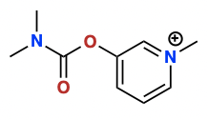
Constrained Latent Diffusion Model
Latent space modelling
Encoder: Compile the molecule graphs into a latent representation with GNN
Diffusion process: Add noise to the latent representation
Denoising process: Recover the latent representation constrained by gene expression profile
Decoder: Construct the molecule structure from the latent representation
Encoder
Decoder
$$z_{0}$$
$$z_{t−1}$$
$$q(z_{t}|z_{t−1})$$
$$ε_{θ}$$
$$p_{θ}(z_{t−1}|z_{t})$$
$$z_{t}$$
$$z_{T}$$
Gene expression profile
Diffusion process
Denoising process
Notes:
In this work, we propose a solution that only applies the diffusion and denoising operations in a latent space modelled by an encoder.
Specifically, our model involves 4 components:
first an encoder built with GNN is used to convert the molecular graphs into latent representations
then the diffusion process adds noise to the original latent representation gradually, until it follows the standard Gaussian distribution
and the denoising process tries to reverse the diffusion process and recover the latent representation. Notably, in order to discover hit-like molecules with desirable biological activities, we use the gene expression profiles as the condition to remove the noise at each step
finally, a decoder is used to reconstruct the 2D molecule graph from the latent representation

Slide 5
Training the encoder and decoder
Decoder Algorithm (MoLeR)
Encoder
Decoder
Discriminator
Real / Fake
Maziarz et al., 2022
Encoder: FiLMConv layer
$$h_{i}′=\sum_{r ∈ R}{\sum_{j ∈ N_{i}^{\left(r\right)}}{\left(γ_{i}^{\left(r\right)} ⊙ W^{\left(r\right)} h_{j}+ β _{i}^{\left(r\right)}\right)} }$$
Reconstruction loss: $ℒ_{rec}\left(x\right)=E_{z∼q\left(z | x\right)}E_{i∼U}−\log{p}\left(s_{i} | z,M_{i}\right)$
Adversarial loss: $ℒ_{GAN}\left(x\right)=E_{z∼p\left(z\right)}\log{D}\left(z\right)+E_{x∼p_{d}\left(x\right)}\log\left(1−D\left(E\left(x\right)\right)\right)$
VAE loss: $ℒ_{VAE}\left(x\right)=ℒ_{rec}\left(x\right)+λ_{reg}ℒ_{GAN}\left(x\right)$
Notes:
Training of our model involves two stages
first we train the encoder and decoder in the VAE paradigm. Our encoder is composed of FiLMConv layer which is a type of relational GNN. Chemical bonds in the molecular graphs are modelled as relations, so that the weights for different bonds are distinct.
Our decoder algorithm is adapted from a work called MoLeR. Basically, the decoder is composed of 3 MLPs deciding the attached fragments or atoms, which point on the selected fragment will be connected with the partially constructed structure, and the chemical bond used to connect the two structures
intuitively, the reconstruction loss is the expectation of the negative log probability over all the generation steps. and we use the adversarial loss as the regulation term in this work by training another discriminator to discern the sampled latent representations and the real ones. And the overall loss function is to combine these two terms.

Slide 6
Training the latent diffusion model
Latent space modelling
Diffusion process:
$$q\left(z_{1:T} | z_{0}\right)=\prod{q\left(z_{t} | z_{t−1}\right)}$$
$$q\left(z_{t} | z_{t−1}\right)=𝒩\left(z_{t};\sqrt{1−β_{t}}z_{t−1},β_{t}I\right)$$
Encoder
Decoder
Denoising process:
$$p_{θ}\left(z_{0:T}\right)=p\left(z_{T}\right)\prod_{t=1}^{T}{p_{θ}\left(z_{t−1} | z_{t}\right)}$$
$$z_{0}$$
$$z_{t−1}$$
$$p_{θ}\left(z_{t−1} | z_{t}\right)=𝒩\left(z_{t−1};μ_{θ}\left(z_{t},t\right),σ_{t}^{2}I\right)$$
$$q(z_{t}|z_{t−1})$$
$$ε_{θ}$$
$$p_{θ}(z_{t−1}|z_{t})$$
Loss function (informal):
$$z_{t}$$
$$ℒ=\sum_{t}{D_{KL}(q\left(z_{t−1} | z_{t}, z_{0}\right)||p_{θ}\left(z_{t−1} | z_{t}\right))}$$
$$z_{T}$$
$$ℒ_{DM}\left(θ\right)=E_{z_{0},t,ϵ,y}\left[|ϵ−ϵ_{θ}\left(z_{t},y,t\right)|^{2}\right]$$
Gene expression profile
After simplification:
Diffusion process
Denoising process
Notes:
After training the encoder and decoder, we proceed to train our latent diffusion model
In the diffusion process, we gradually add noise to the original latent representation according to a variance schedule beta, and then we try to reverse this process in the denoising process by training a neural network to recover the distribution at each time step. Our goal is to approximate the diffusion process q with the denoising process p, so naturally, the loss function is designed to be the sum of KL Divergence between the diffusion and denoising process over all time steps
Since we try to make sure the data distribution at each step follows a Gaussian distribution, when computing the KL Divergence, we can directly compare the mean and variance of the two distributions. and after a series of simplification, here is the final loss function. In short words, we are going to train this neural network called epsilon_theta to predict the noise epsilon that has been added to the data representation at each time step. And this y here refers to the gene expression profile

Slide 7
Unconditional generation task
Evaluated by GuacaMol distribution learning benchmarks
VAE-based method
Diffusion-based method
Validity: if the chemical structure is valid
Uniqueness: if the generated molecule is not repeated
Novelty: if the molecule never exists in the training set
KL Divergence: if the distribution of physicochemical properties is close to training set
Frechet Chemnet Distance (FCD): if the distribution of biological features is close to training set
Notes:
Now I’m going to present our experiments and results.
First we evaluated our method on an unconstrained generation task using the GuacaMol distribution learning benchmarks. This benchmark evaluates five metrics: …
validity assesses if the molecule structure is chemically valid, uniqueness assesses if the generated molecule is repeated or not, novelty measures if the molecule does not exist in the training set, meaning it is a brand-new structure, KLD and FCD evaluate if the distribution of the physicochemical or biological features of the generated molecules is close to the training set
We compared our method with 2 VAE-based and 2 diffusion based generative models. Most of these models worked well on validity, uniqueness and novelty, but only DiGress and our method achieved high scores on KLD and FCD. However, DiGress is the only method that cannot generate 100% valid strutures. This demonstrates that our method could generate more versatile and valid molecules

Slide 8
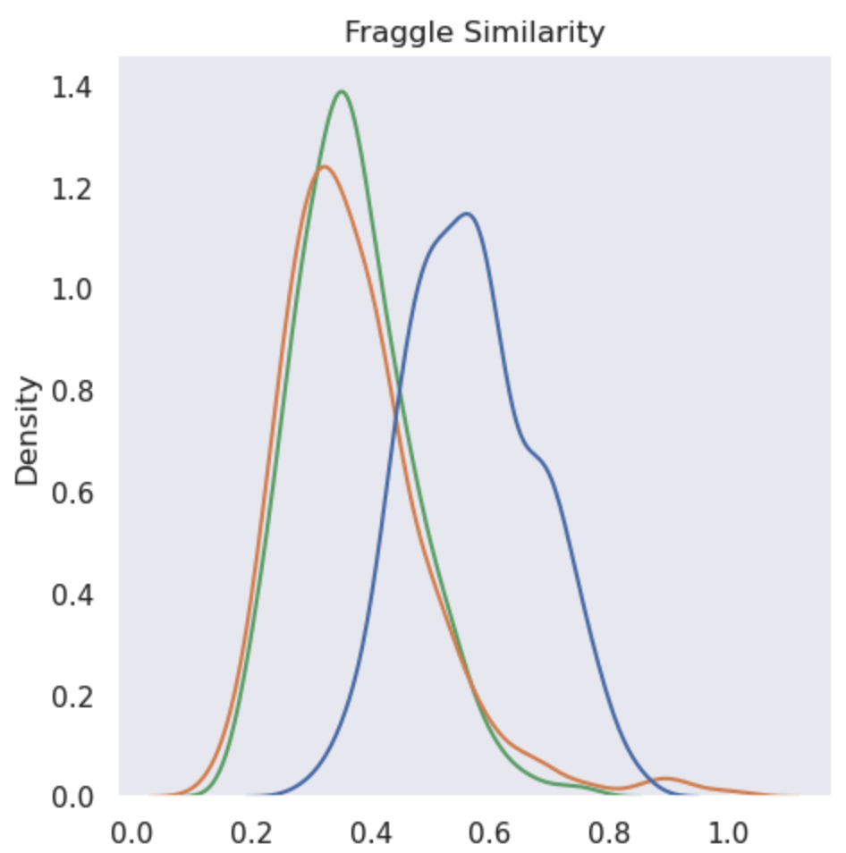
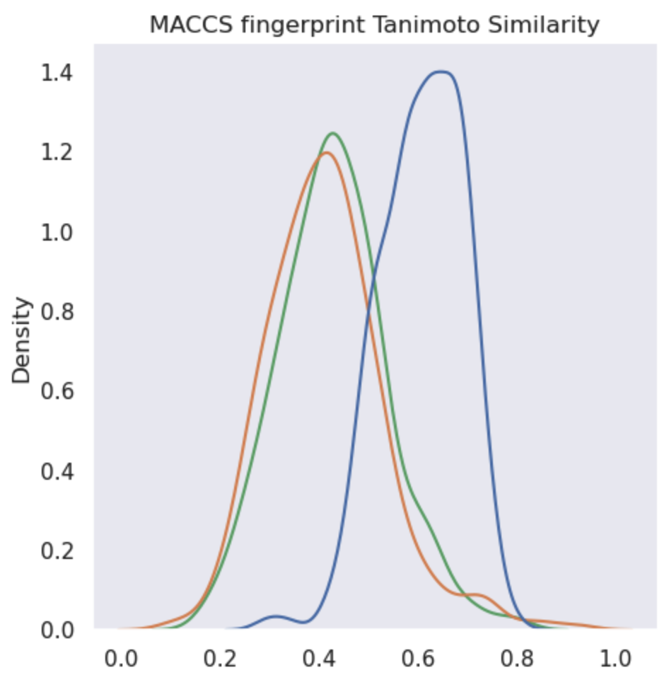
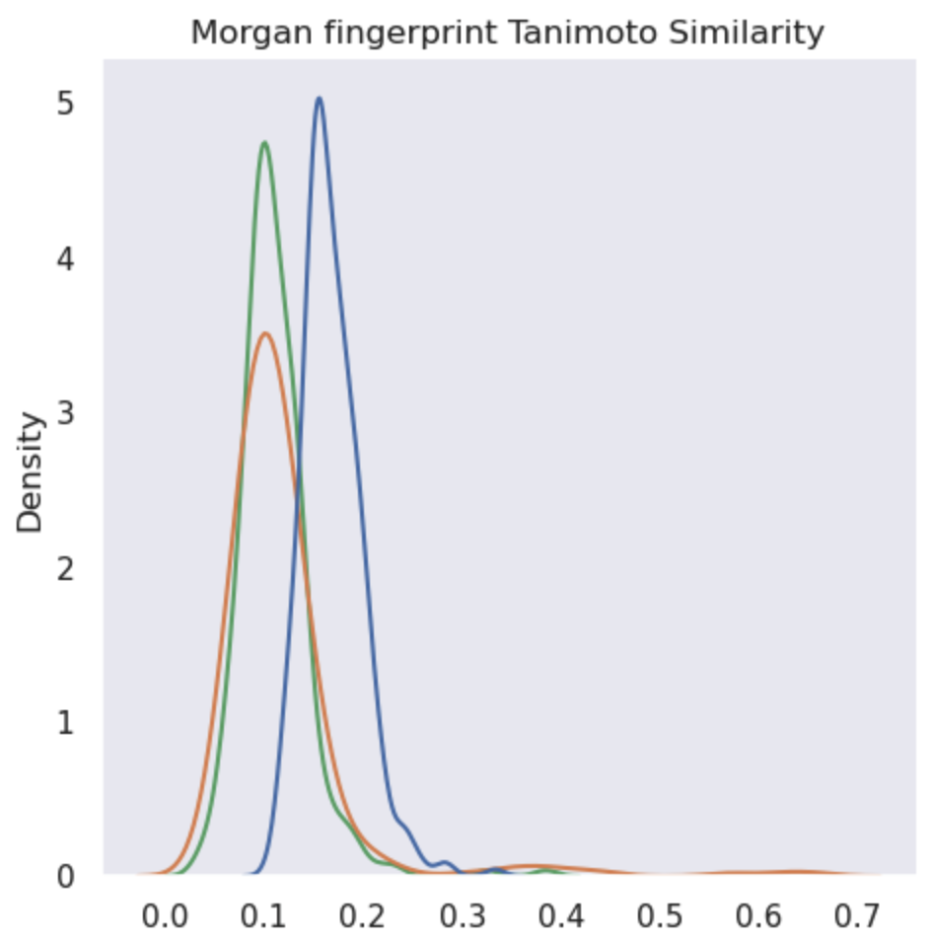
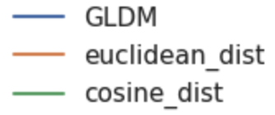
Constrained generation
Goal: Generate hit-like molecules that can induce desired biological activities
Approach: Constrain the generation with gene expression changes caused by a known drug
Metrics: Structural similarity with the known drug
Our method
Similarity search
A virtual screening method
Similar structures => similar biological functions
Our method is able to generate molecules with higher similarities
Notes:
in the next section of experiments, we intend to investigate if our method is able to generate hit-like molecules inducing desired biological activities. So we use the gene expression changes caused by active compounds as the condition of generation, and since similar structures indicate similar biological functions, we evaluated the structural similarity between generated molecules and the known drugs, which is computed by fraggle and tanimoto algorithms based on MACCS and morgan fingerprints. We compared our method with similarity search (which is a virtual screening method), and our method can always generate molecules with higher similarities

Slide 9
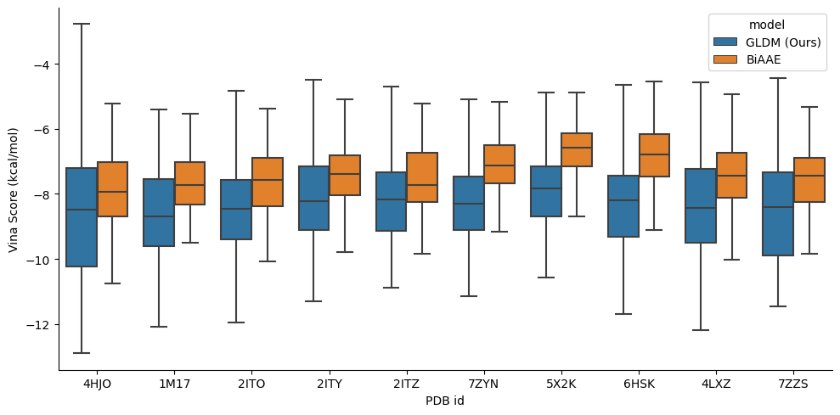
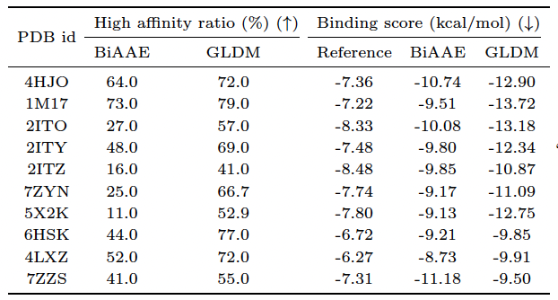
Binding affinity evaluation
the strength of the binding interaction between the drug molecule and its target protein
Ratio of molecules with higher affinity than the reference drug
EGFR
HDAC8
HDAC2
Notes:
Besides the structural similarity experiment, we also performed a more intuitive evaluation on molecules’ binding affinity with the target protein. Since we used gene expression profile caused by reference drugs to constrain the generation, we can assume that the generated molecules have the same protein targets with the active drugs.
So we selected ten protein-drug binding structures belonging to 3 famous drug target genes (EGFR, HDAC8 and HDAC2), and docked our generated molecules to the binding pocket of these structures to assess the binding affinity. We compared our method with a baseline called biaae, which can also generate novel molecules based on gene expression signature.
Our method always achieved lower vina score distributions, which means higher binding affinity, than the baseline method. And our method can also generate a high ratio of molecules with better binding affinity than the original reference drug.

Slide 10
Generated samples

Slide 11
Conclusion
Developed latent diffusion model that generates hit candidates with
Optimal properties (100% validity, high novelty, etc.)
High structural similarity with existing drugs
High binding affinity with protein targets
Future work
Extend our work to
Constrain on binding pocket of target protein rather than gene expression profile
Generate 3D structures rather than 2D molecular graphs
Notes:
For a brief summary, we developed a latent diffusion model that generates hit-like molecules with optimal properties such as 100% validity and high novelty, high structural similarity with existing drugs and high binding affinity with potential protein targets
For future works, we shall consider extending our method to constrain the generation on the binding pocket structure of the target protein, and also generate 3D structures rather than 2D graphs for a more accurate description of the structure

Slide 12
Thank you!

