Slide 1
Epileptogenic Brain Connectivity Patterns Using Scalp EEG
Panuwat Janwattanapong
Center of Advance Technology and Education
Department of Electrical and Computer Engineering

Slide 2
Introduction
EPILEPSY is a chronic disorder and is one of the most common neurological disorders affecting approximately 0.5 – 1 % of the entire population. The major characteristic which defines the disorder is the recurrent unprovoked seizures.
Enhancing epilepsy diagnosis or even predict the occurrence of seizures through Electroencephalogram (EEG) recordings could lead to a better planning and therapeutic protocols.
of epilepsy patient have had difficulty with a daily life activity due to epilepsy, including …
59% Driving
57% Working
52% Socializing
Due to the unpredictable occurrence of seizures, the quality of life of epileptic patients might be greatly impacted by this uncertainty.

Slide 3
Introduction
FUNCTIONAL CONNECTIVITY
is a study of neurological event occurring in the regions of the cortex.
For analyzing the pattern of epileptiform discharges, functional connectivity would provide useful information where it is perceived that the characteristics of different types of epileptiform discharges will be distinct from each other creating a pattern that will be as classification parameters.

Slide 4
Objective
FUNCTIONAL CONNECTIVITY
is a study of neurological event occurring in the regions of the cortex.
For analyzing the pattern of epileptiform discharges, functional connectivity would provide useful information where it is perceived that the characteristics of different types of epileptiform discharges will be distinct from each other creating a pattern that will be as classification parameters.
Study features of different epileptiform discharges namely, Interictal Spike, Spike and Slow Wave Complex, and Repetitive Spike and Slow Wave complex.
Extract functional connectivity patterns generated from each type of epileptiform discharges.
Patterns are examined in specific frequency bands, Delta band [0.1 - 4 Hz], Theta band [5 – 8 Hz], Alpha band [9 – 13 Hz], and Beta band [14 – 25 Hz].

Slide 5
Objective
IS
SSC
RSS
Epileptiform Discharges
Interictal Spike
Spike and Slow Wave Complex
Repetitive Spike and Slow Wave complex

Slide 6
Algorithm
EEG Data
Segmentation
Delta Band
(0.1 ~ 4 Hz)
Determine functional connectivity using cross-correlation
Theta Band
(5 ~ 8 Hz)
Plot the functional connectivity maps based on the strength of the links
Processing
Average Montage Conversion and Baseline Removal
Alpha Band
(9 ~ 13 Hz)
Count the number of connections the regions of interest
Bandpass Filter
Beta Band
(14 ~ 25 Hz)
Analyze statistically the functional connectivity pattern

Slide 7
Algorithm
Functional Connectivity Extraction with Cross Correlation Analysis
Cross-correlation coefficients between all pairwise montages of all 19 EEG channels were computed independently in the environment of MATLAB.
The cross-correlation coefficient as measured between any two vectors x and y with length n, with a lag of m can be determined using the relation given in the equation.
IS
SSC
RSS

Slide 8
Algorithm
Functional Connectivity Extraction with Cross Correlation Analysis
$$\hat{R_{xy}}\left(m\right)= \left\{\begin{aligned}&\sum_{n=0}^{n−m−1}{x_{n+m}y_{n}^{∗} m≥0} \\ &\hat{R_{xy}^{∗}}\left(m\right) m<0\end{aligned}\right.$$
Where x and y represent a vector of the EEG data of a pair of electrodes, with each containing 200 data points (n) assuming the 1s window of the EEG segments.
The algorithm searches for the maximum cross-correlation coefficient over the lags (m) of ± 500ms and selects the maximum value in the range to be the strength of the functional connectivity representing each pair

Slide 9
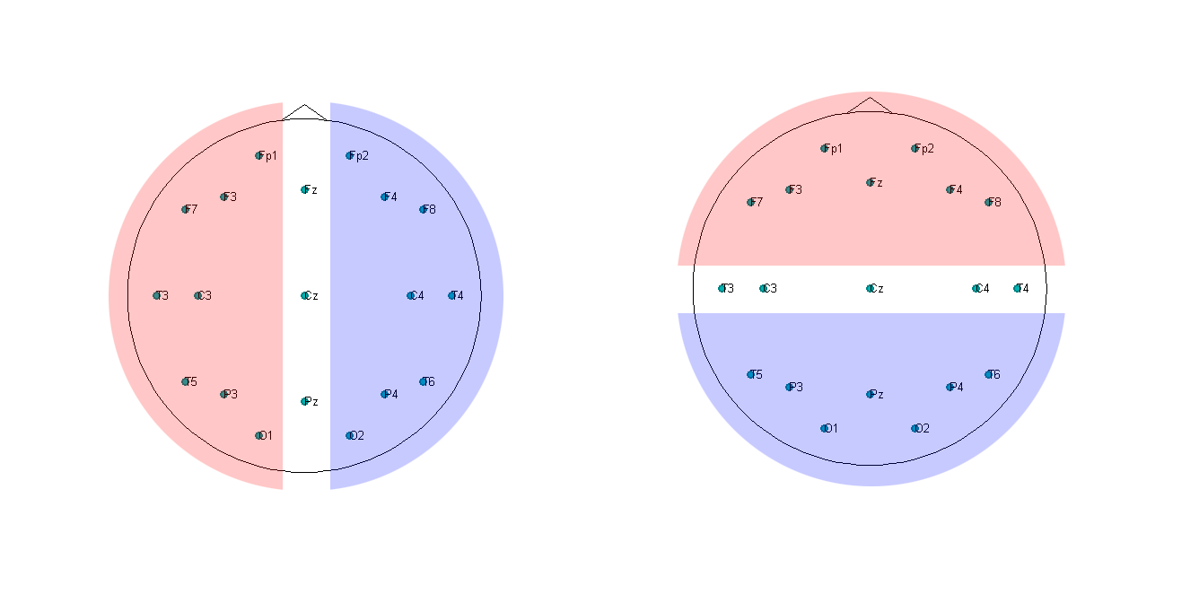
Algorithm
Quantification of Functional Connectivity
Left-Right Hemisphere
Anterior-Posterior Axis

Slide 10
Results
The connectivity results from the feature extraction are displayed for each frequency band.
The head map average connectivity plots were obtained by taking an average of the connectivity matrices from the extracted 10 segments.
The color in the maps indicate the strength of the connection, where dark red indicates strong connections and dark blue indicates weak connections.

Slide 11
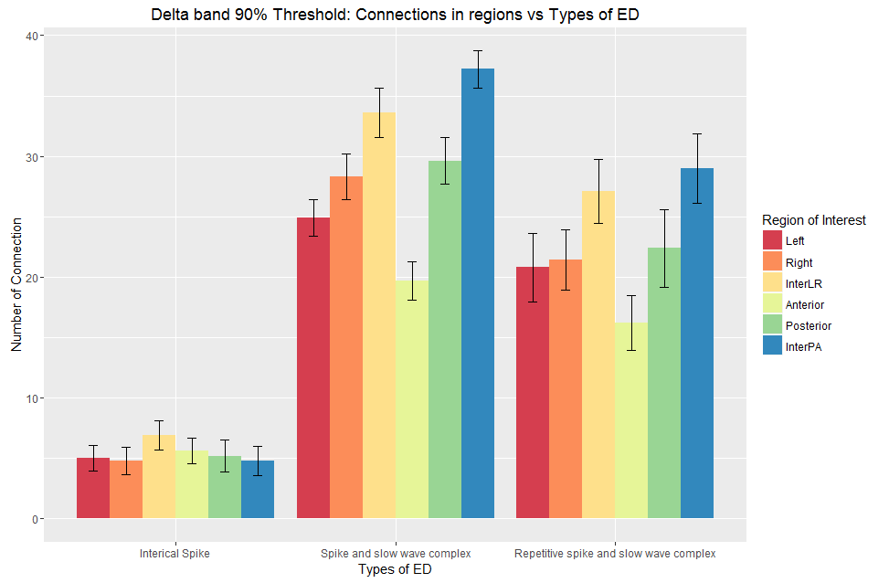
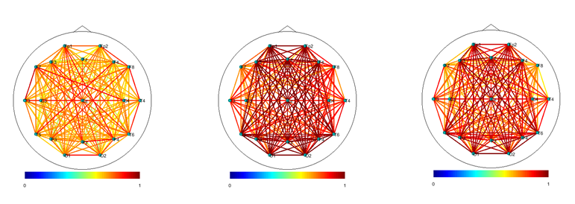
Results
Delta Band
Head map average connectivity plots for
(a) interictal spike
(b) spike with slow wave complex
(c) repetitive spikes and slow wave complex

Slide 12
Results
Delta Band
The ANOVA was calculated for each type of EDs with the null hypothesis that, the number of strong connections of the different ROIs is the same within each type of EDs.
For IS, the analysis is not significant (level of significant α = 0.05, F (5, 54) = 0.4746, p-value = 0.7936).
The analysis for SSC and RSS are significant with F (5, 54) = 12.511, p-value = 0.00 and F (5, 54) = 2.8677, and p-value = 0.023 respectively
Head map average connectivity plots for
(a) interictal spike
(b) spike with slow wave complex
(c) repetitive spikes and slow wave complex

Slide 13
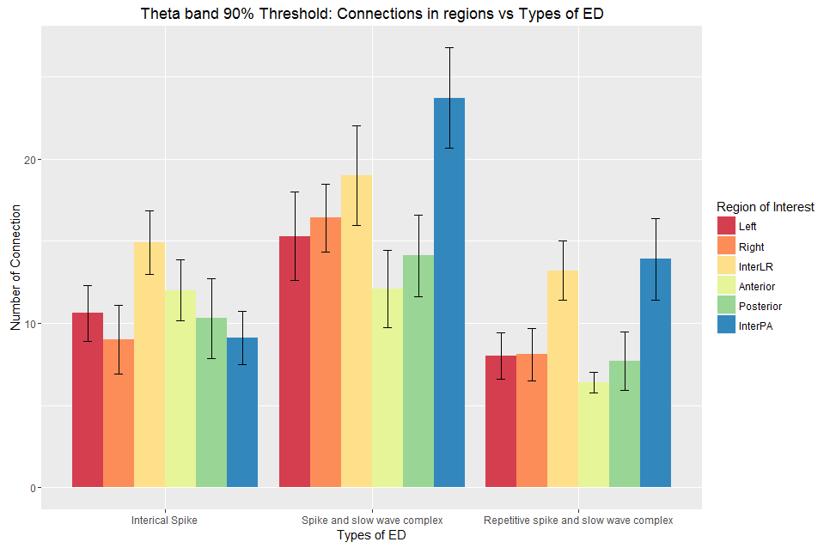
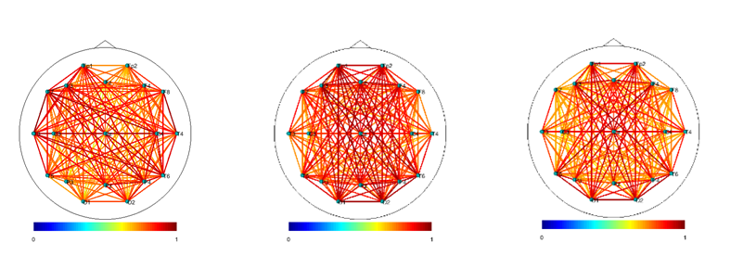
Results
Theta Band
Head map average connectivity plots for
(a) interictal spike
(b) spike with slow wave complex
(c) repetitive spikes and slow wave complex

Slide 14
Results
Theta Band
The ANOVA was calculated for each type of EDs with the null hypothesis that, the number of strong connections of the different ROIs is the same within each type of EDs.
For IS, the analysis was not significant at the level of significant α = 0.05, F (5, 54) = 1.2764, p-value = 0.2876.
Where the analysis for SSC and RSS were significant, F (5, 54) = 2.4218, p-value = 0.047 and F (5, 54) = 3.4375, p-value = 0.01 respectively
Head map average connectivity plots for
(a) interictal spike
(b) spike with slow wave complex
(c) repetitive spikes and slow wave complex

Slide 15
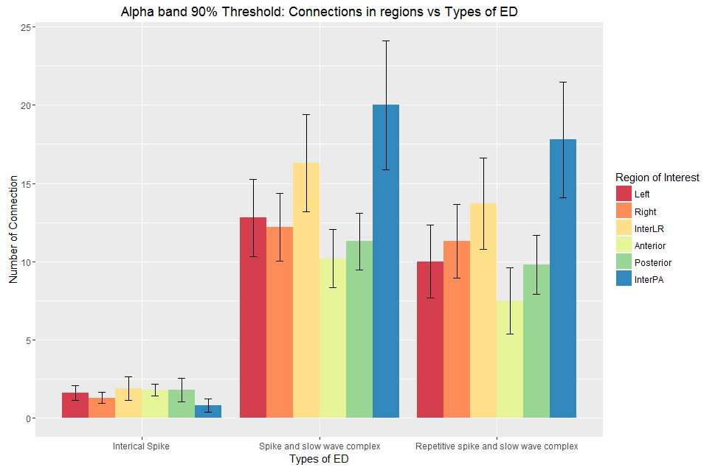
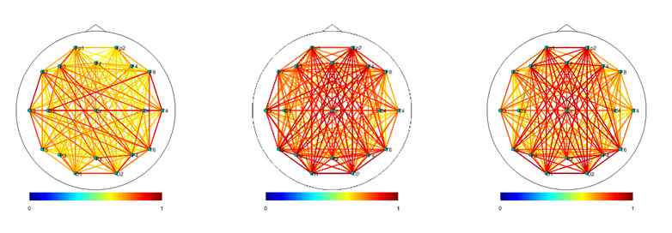
Results
Alpha Band
Head map average connectivity plots for
(a) interictal spike
(b) spike with slow wave complex
(c) repetitive spikes and slow wave complex

Slide 16
Results
Alpha Band
ANOVA indicated that the strongest connections for each type of ED in different ROIs for these bands are not statistically different. Thus the null hypothesis is not rejected
the analysis where the connections were categorized into each type of ED showed that the analysis was significant with F (2, 177) = 49.84, p-value = 0.00 )
Head map average connectivity plots for
(a) interictal spike
(b) spike with slow wave complex
(c) repetitive spikes and slow wave complex

Slide 17
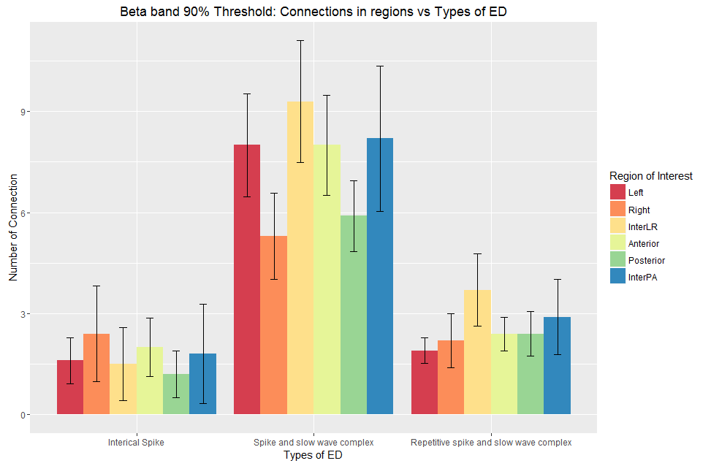
Results
Beta Band
Head map average connectivity plots for
(a) interictal spike
(b) spike with slow wave complex
(c) repetitive spikes and slow wave complex

Slide 18
Results
Beta Band
ANOVA indicated that the strongest connections for each type of ED in different ROIs for these bands were not statistically different. Thus the null hypothesis was not rejected
the analysis where the connections were categorized into each type of ED showed that the analysis was significant with F (2, 177) = 40.28, p-value = 0.00
Head map average connectivity plots for
(a) interictal spike
(b) spike with slow wave complex
(c) repetitive spikes and slow wave complex

Slide 19
Conclusion
The quantification and extraction of functional connectivity patterns using scalp EEG can generate important features that can be used to classify the type of epilepsy. The patterns extracted by performing coherence analysis revealed different characteristics of each type of Epileptic Discharges (EDs) exhibited in different frequency bands.
The outcome of the connectivity analysis by using cross-correlation has to be interpreted with care. This method does not provide causality assessment, where the flow of information cannot be determined. The aforementioned case leads to the limitation of the interpretation of the results

Slide 20
References
Fisher, R. S., Boas, W. V. E., Blume, W., Elger, C., Genton, P., Lee, P., & Engel, J. (2005). Epileptic seizures and epilepsy: definitions proposed by the International League Against Epilepsy (ILAE) and the International Bureau for Epilepsy (IBE). Epilepsia, 46(4), 470-472.
van Mierlo, P., Papadopoulou, M., Carrette, E., Boon, P., Vandenberghe, S., Vonck, K., & Marinazzo, D. (2014). Functional brain connectivity from EEG in epilepsy: Seizure prediction and epileptogenic focus localization. Progress in neurobiology, 121, 19-35.
Brodie, M. J., & Kwan, P. (2002). Staged approach to epilepsy management. Neurology, 58(8 suppl 5), S2-S8.B.
S. Sargolzaei , M. Cabrerizo, M. Goryawala, A. Salah Eddin, “Scalp EEG Brain Functional Connectivity Networks in Pediatric Epilepsy”, Computers in Biology and Medicine, Vol. 56 pp. 158-166, Jan. 2015.
S. Sargolzaei, M. Cabrerizo, A. Sargolzaei, S. Noei, H. Rajaei, A. Salah Eddin, A. Pinzon-Ardila, S. M. Gonzalez Arias, P. Jayakar and M. Adjouadi, “A probabilistic approach for pediatric epilepsy diagnosis using brain functional connectivity networks,” BMC Bioinformatics, Vol. 16, Suppl. 7, April 2015
Salah Eddin, J. Wang, W. Wu, S. Sargolzaei, B. Bjornson, R. Jones, W.D. Gaillard, and M. Adjouadi, “The Effects of Pediatric Epilepsy on a Language Connectome”, Human Brain Mapping, Vol. 35 (12), pp. 5996–6010, December 2014
Delorme, A., & Makeig, S. (2004). EEGLAB: an open source toolbox for analysis of single-trial EEG dynamics including independent component analysis. Journal of neuroscience methods, 134(1), 9-21.
Shafi, M. M., Westover, M. B., Oberman, L., Cash, S. S., & Pascual-Leone, A. (2014). Modulation of EEG functional connectivity networks in subjects undergoing repetitive transcranial magnetic stimulation. Brain topography, 27(1), 172-191.
Dodel, S., Herrmann, J. M., & Geisel, T. (2002). Functional connectivity by cross-correlation clustering. Neurocomputing, 44, 1065-1070.
Siggiridou, E., Kugiumtzis, D. and Kimiskidis, V.K., 2014. Correlation networks for identifying changes in brain connectivity during epileptiform discharges and transcranial magnetic stimulation. Sensors, 14(7), pp.12585-12597.
Cascino, G. D. (2004). Surgical treatment for epilepsy. Epilepsy research,60(2), 179-186
Wendling, F., Ansari-Asl, K., Bartolomei, F., & Senhadji, L. (2009). From EEG signals to brain connectivity: a model-based evaluation of interdependence measures. Journal of neuroscience methods, 183(1), 9-18.
Friston, K. J. (1994). Functional and effective connectivity in neuroimaging: a synthesis. Human brain mapping, 2(1‐2), 56-78.
Waites, A. B., Briellmann, R. S., Saling, M. M., Abbott, D. F., & Jackson, G. D. (2006). Functional connectivity networks are disrupted in left temporal lobe epilepsy. Annals of neurology, 59(2), 335-343.
Stam, C. J., Nolte, G., & Daffertshofer, A. (2007). Phase lag index: assessment of functional connectivity from multi-channel EEG and MEG with diminished bias from common sources. Human brain mapping, 28(11), 1178-1193.

Slide 21
Thank you
Q&A

