Slide 1
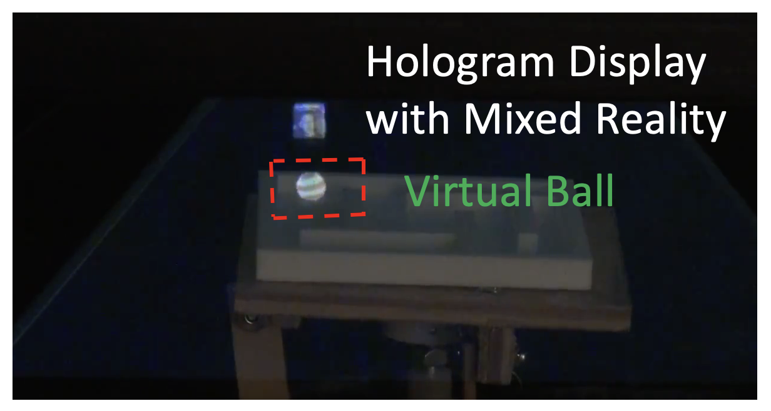
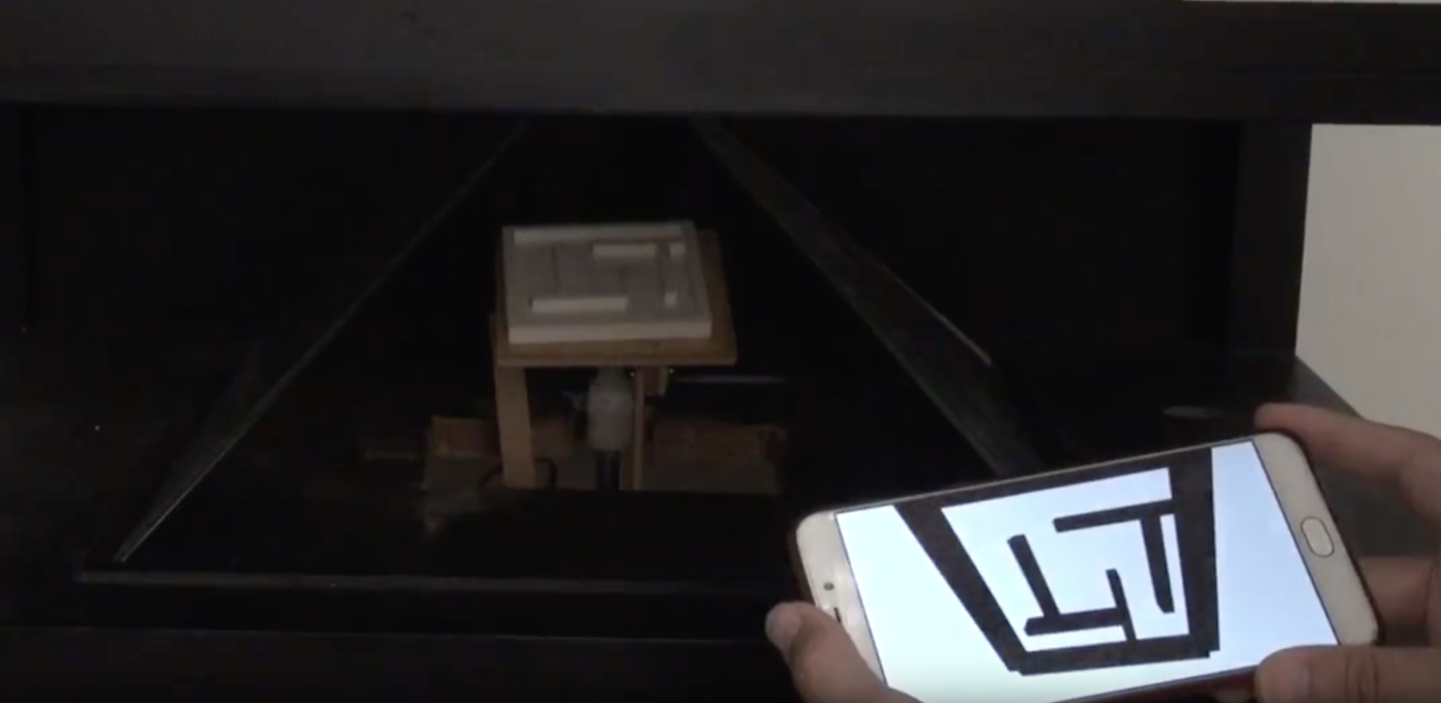
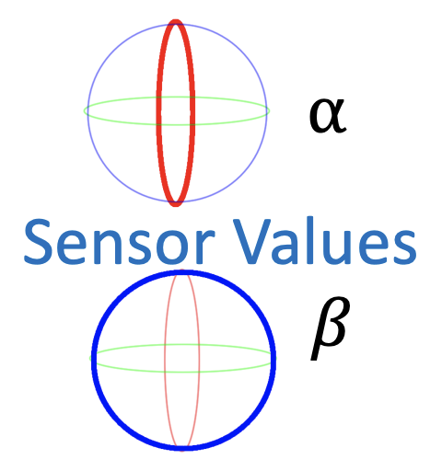
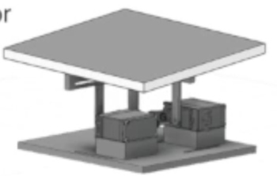
SMART: A SENSOR-TRIGGERRED INTERACTIVE MR DISPLAY
Y.S. Lan¹, C.D. Chen¹, S.W. Sun¹, W.C. Yen¹, Y.T. Wang¹, Y.H. Yang¹, J.M. Day¹, and K.L. Hua^{2,3}
¹ Department of New Media Art, Taipei National University of the Arts, Taiwan.
²Dept. Computer Science and Information Engineering, Natl. Taiwan Univ. of Sci. and Tech., Taiwan ³ Samurai Spirit Inc.
Interactive Mixed Reality Prototype
Applications
Party Game
Controlling
Boss: Maze
User: Virtual avatar
Sensors on a mobile device
Trigger the real maze
Reference
[1] Takenori Hara and Masafumi Oda, “Mixed reality
mirror display,” ACM SIGGRAPH Asia, 2012.
[2] Hanyuool Kim, Shun Nagao, Satoshi Maekawa,
and Takeshi Naemura, “Mrsioncase: A glasses-
free mixed re- ality showcase for surrounding
multiple viewers,” ACM SIGGRAPH Asia, 2012.
[3] Jia-Wei Lin, Ping-Hsuan Han, Jiun-Yu Lee, Yang-
Sheng Chen, Ting-Wei Chang, Kuan-Wen Chen,
and Yi-Ping Hung, “Visualizing the keyboard in
virtual reality for enhancing immersive
experience,” ACM SIGGRAPH, 2017.
[4] Ce ́dric Kervegant, Fe ́lix Raymond, Delphine
Graeff, and Julien Castet, “Touch hologram in
mid-air,” ACM SIGGRAPH, 2017.
2 Motors
Maze in the Physical World
The Device Elements
MR Glass
Physical maze
Displaying Screen
Virtual object
Mobile devices

