Slide 1
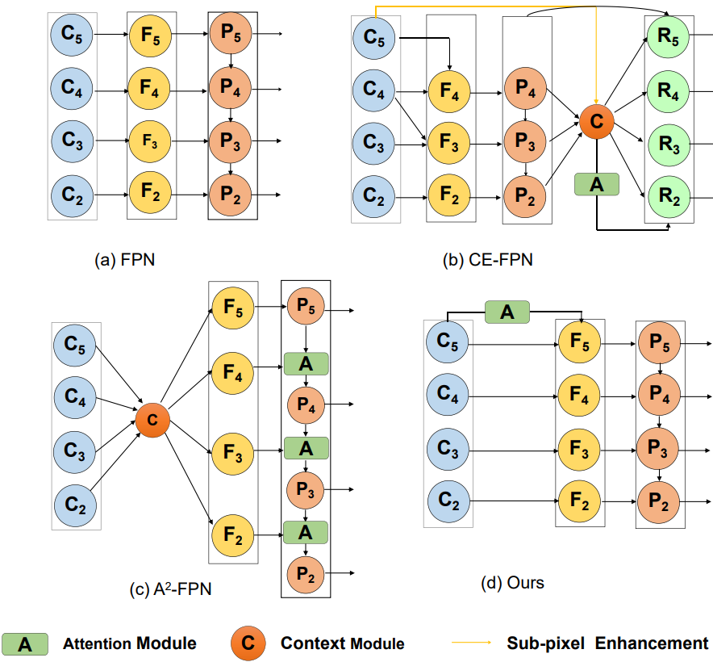
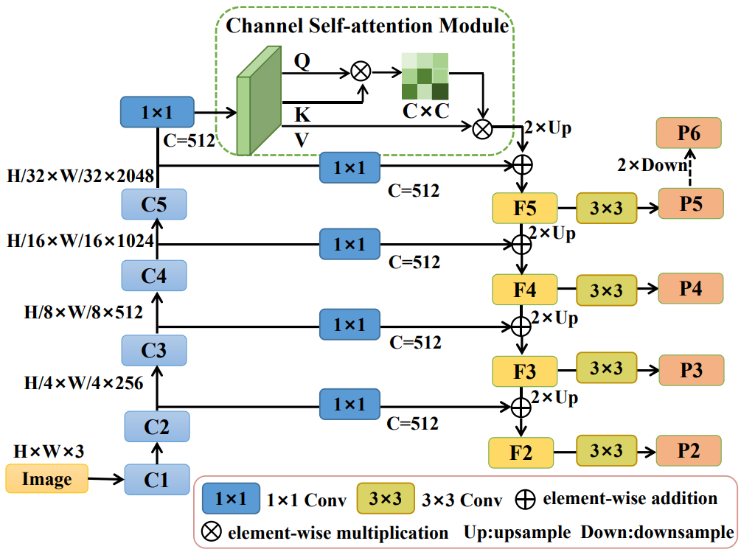
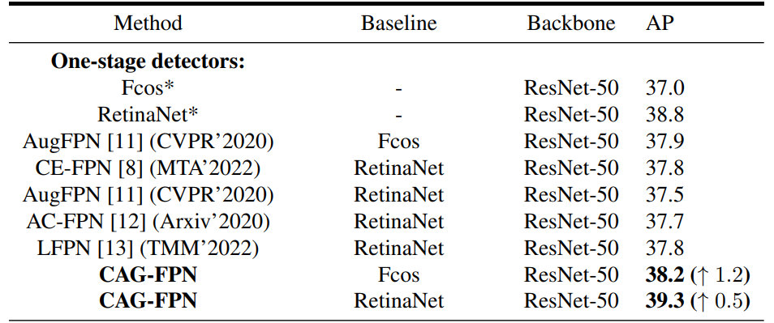
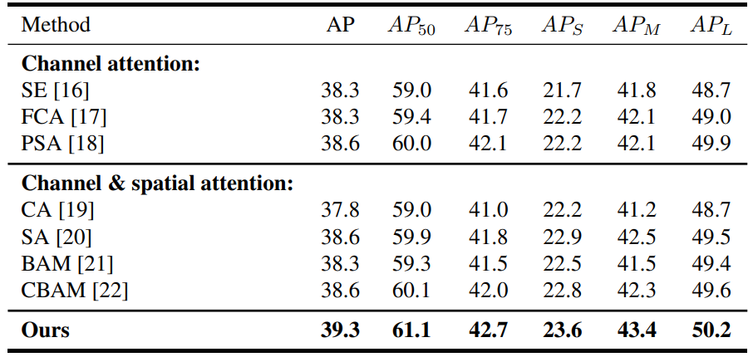
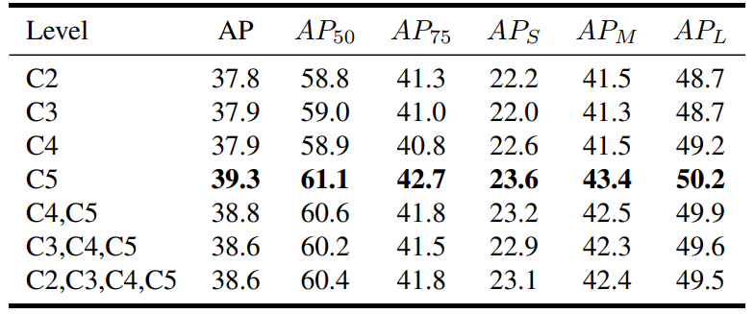
CAG-FPN: CHANNEL SELF-ATTENTION GUIDED FEATURE PYRAMID NETWORK FOR OBJECT DETECTION
Jie Chang, Huhe Dai and Yuan Zheng
Introduction
Feature Pyramid Network (FPN) plays a critical role and is indispensable
for object detection methods.
In recent years, attention mechanism has been utilized to improve FPN
due to its excellent performance.
In view of this, we propose a novel Channel Self-Attention Guided
Feature Pyramid Network (CAG-FPN), which not only has a simple
structure but also consistently improves detection accuracy.
We observe that introducing channel self-attention to the features at
the highest level is helpful for object detection, since modeling long-range
dependencies between channels triggers an implicit clustering of the same
categories of objects, enhancing the semantic continuity.
Fig. 1. Comparison of existing attention-based FPN methods.
Methodology
1. Channel self-attention module
Given an input feature X, X ∈ R^{C×H×W} , a channel self-attention map A, A ∈ R^{C×C} , can be obtained after applying a softmax layer
where a_{ij} denotes the relationship between the i-th and j-th elements, and Conv^{1×1}(·) denotes 1×1 convolution to adjust the number of channels. Next, a matrix multiplication of A and V is performed to obtain an output feature Y
where Y ∈ R^{C×H×W} . Obviously, the output feature is a weighted sum of the input feature via self-attention mechanism.
Fig. 2. Overview of the proposed CAG-FPN that utilizes a channel self-attention module and several convolutions to enhance semantic continuity and refine feature representations, respectively.
2. Network architecture
Considering the feature C₅ contains the richest semantic information, we introduce a channel self-attention module into C₅ to model long-distance semantic dependencies between channels, which enhances semantic continuity and results in an implicit clustering of the same categories of objects. Then, we combine the feature generated by the channel self-attention module with its input feature C₅ via an elementwise addition operation to form a new feature F₅, which can be expressed by
Following the top-down pathway in FPN, other features{F₄, F₃, F₂} can be expressed by
where UP(·) means upsampling operation. For fusion operation, we choose the simple element-wise addition rather than the concatenation. To generate a feature pyramid, we employ 3 × 3 convolutions for feature refinement and the output features of our CAG-FPN is formulated by
where Conv^{3×3}(·) denotes 3 × 3 convolution.
Our CAG-FPN adopts a top down pathway and introduces a channel self-attention module into a high-level C₅ feature, resulting in simpler structure and better detection performance. Benefit from its efficiency and effectiveness, our CAG-FPN can be readily applied to both one-stage and two-stage FPN-based detectors.
$$A=(a_{ij})=Softmax({QK}^{T})$$
$$Q={Conv}^{1×1}(X),K={Conv}^{1×1}(X)$$
$$F_{5}=AV+C_{5}=A∙{Conv}^{1×1}(C_{5})+C_{5}$$
$$Y=AV=A∙{Conv}^{1×1}(X)$$
$F_{i}=UP(F_{i+1})+{Conv}^{1×1}(C_{i}$) i=4,3,2
$$P_{i}={Conv}^{3×3}(F_{i}) i=2,3,4,5$$
Experiments
Comparison with the state-of-the-art methods on COCO test-dev .
Ablation study of attention modules on COCO val2017.
Ablation study of the placement of channel self-attention module on COCO val2017.

