Slide 1
ICASSP 2024
Feature Mixing-based Active Learning for Multi-label Text Classification
$Xue Han$, $Qing Wang, Yitong Wang$, $Jiahui Wang$, $Chao Deng$, ${Junlan Feng}^{✉}$
$$JIUTIAN Team, China Mobile Research Institute, Beijing , China$$
Signal Processing: The Foundation for True Intelligence
@ 2024 IEEE International Conference on Acoustics, Speech, and Signal Processing, Seoul, Korea

Slide 2
01 Background
02 Motivation
Outline
03 Methodology
CONTENTS
04 Experiments
05 Conclusion

Slide 3
Background
Active learning (AL) aims to reduce labeling costs by picking the most valuable samples to annotate iteratively during the training process in order to improve predictive performance
Challenging: multi-label data usually exhibits label space sparsity and high dimensionality
Existing methods
fail to capture label correlations, resulting in label imbalances in the selected samples
suffer significant computing costs, when analyzing the informative potential of unlabeled samples
Exploiting label correlations: an example of the Go emotions dataset

Slide 4
Motivation
How to select the most valuable samples to annotate, while saving computational cost?
How to mine the potential label correlations in multi-label data?

Slide 5
Methodology
ALMuLa-mix
First identify unlabeled samples with novel features by employing a time-efficient feature-mixing method in conjunction with label correlations
Then leverages the minority class in the labeled set to select a small batch of candidate unlabeled samples out of the candidates with novel features, resulting in higher inter-class diversity
capture both samples' novelty and diversity with label correlations, all while minimizing the computational burden

Slide 6
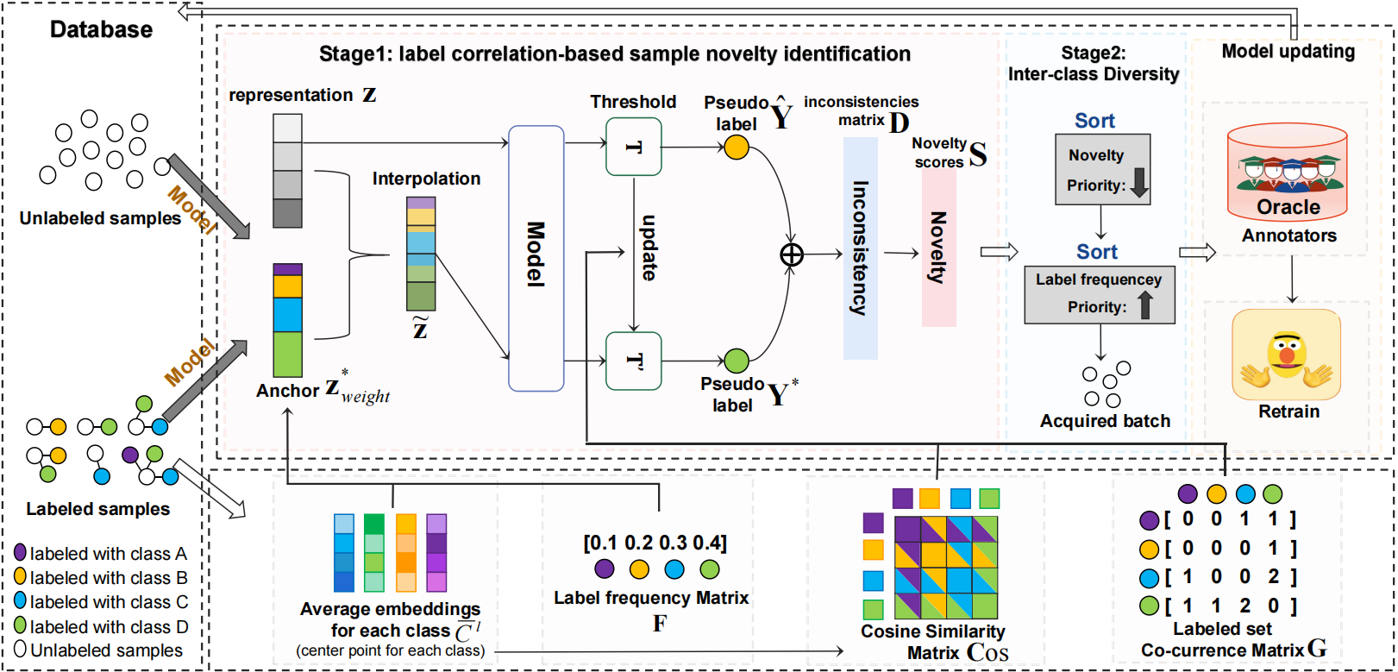
two-stage sample acquisition strategy
Stage 1: Use interpolations leveraging label correlations to measure the novelty of unlabeled samples.
Stage 2: Employ inter-class diversity combined with novelty to select the most informative samples.
iteratively select the unlabeled samples to annotate by oracles, and update the classifier with the new labeled set

Slide 7
Stage 1: label correlation-based sample novelty identification
the difference between the representation features of the unlabeled and labeled samples
the gradient of the classifier with respect to the characteristics at the unlabeled samples
For each unlabeled sample j
label frequency matrix F
$$F=\{f_{1},…,f_{k}\}$$
average embedding anchor set
weighted-average anchor:
interpolated feature representation
its prediction distribution

Slide 8
Stage 1: label correlation-based sample novelty identification
the difference between the representation features of the unlabeled and labeled samples
the gradient of the classifier with respect to the characteristics at the unlabeled samples
For each unlabeled sample j
hyper-parameter Threshold T
< T, $k_{th}$ label of j is 0
> T, $k_{th}$ label of j is 1
Pseudo label
(without interpolation)
(with interpolation)
Especially, T is dynamically updated

Slide 9
Stage 1: label correlation-based sample novelty identification
An example of how to calculate the inconsistencies matrix D and finally get the novelty scores S of unlabeled samples.
inconsistencies matrix D: the unlabeled sample possesses novel features for the relevant class
SUM
novelty scores S

Slide 10
Stage 2: lnter-class Diversity
utilize the class frequency to ensure inter-class diversity, preventing the severe label imbalance and redundant information caused by sample acquisition solely based on novelty features
sort samples by the inconsistencies matrix D
select the candidates based on the minority label set
:sorted by the
label frequency matrix F

Slide 11
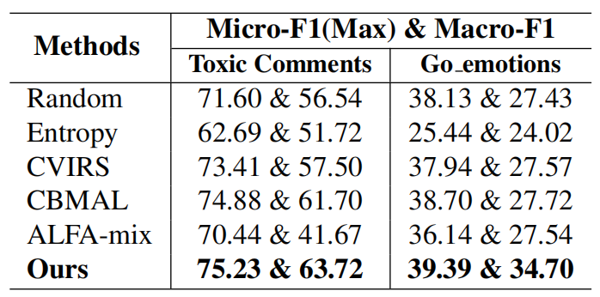
Experiments
Dataset
Toxic Comment & GO emotions
Implementation Details
Base classifier: distilBERT
Baseline methods
Entropy, CVRIS, CBMAL, Random, ALFA-Mix
Results and Analysis
ALMuLa-mix exceeds all baselines across all datasets, indicating its robustness.
Toxic Comment has a more severe class imbalance issue.

Slide 12
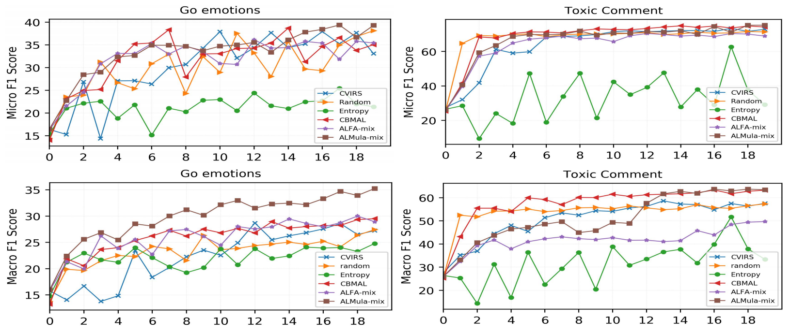
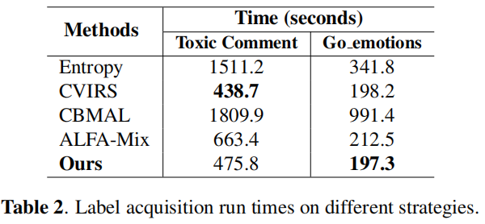
Experiments
Results and Analysis
Results and Analysis
weighted anchor we employ to make interpolation and identify novel features at a minimal computing cost
The number of iterations increases, ALMuLa-mix is gradually ahead of other strategies
Our strategy is good at considering the balance among labels.

Slide 13
Conclusion
We propose an efficient two-stage sample acquisition strategy for multi-label active learning, called ALMuLa-mix.
For saving the computational costs, ALMuLa-mix first attempts to identify unlabeled samples with novel features by employing a time-efficient feature-mixing method in conjunction with label correlations.
Regarding the label imbalance, ALMuLa-mix then leverages the minority class in the labeled set to select a small batch of candidate unlabeled samples with greater inter-class diversity from the candidates with novel features.
Experimental results on publicly available datasets show that ALMuLa-mix is superior to other strong baselines for handling multi-label text classification tasks.

Slide 14
Thanks for your listening!
hanxueai@chinamobile.com

