Slide 1
Focus on the present: a regularization method for the ASR source-target attention layer
Nanxin Chen¹, Piotr Żelasko^{1,2}, Jesús Villalba^{1,2}, Najim Dehak^{1,2}
1)
2)

Slide 2
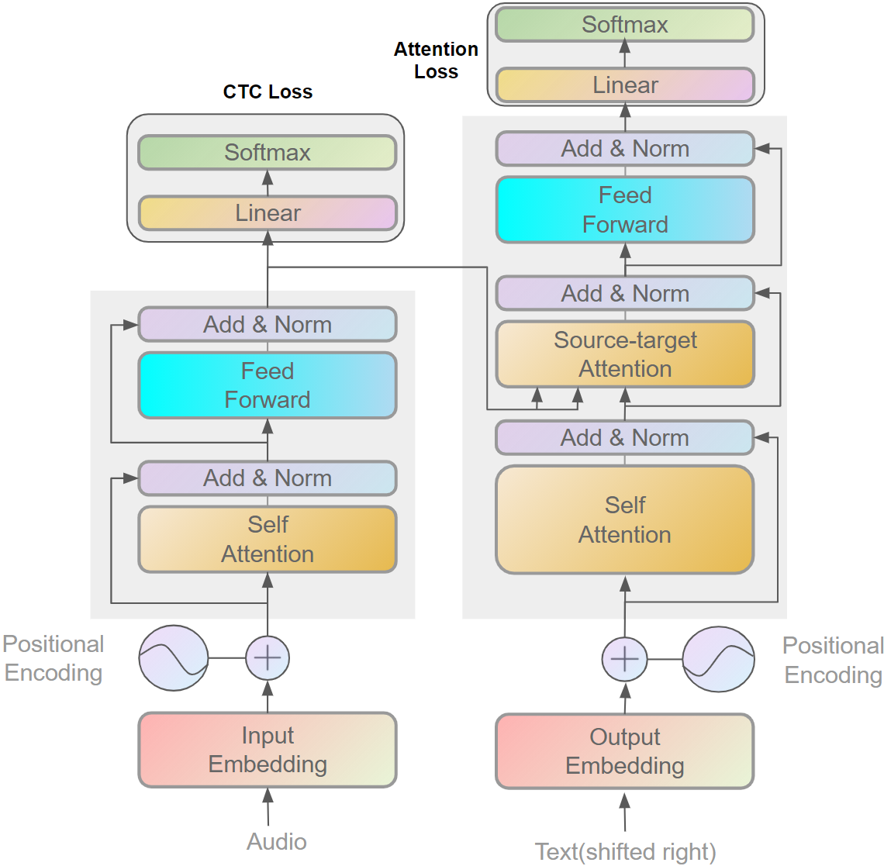
State-of-the-art E2E System
Self-attention

Slide 3
State-of-the-art E2E System
Source-target attention
(cross attention)

Slide 4
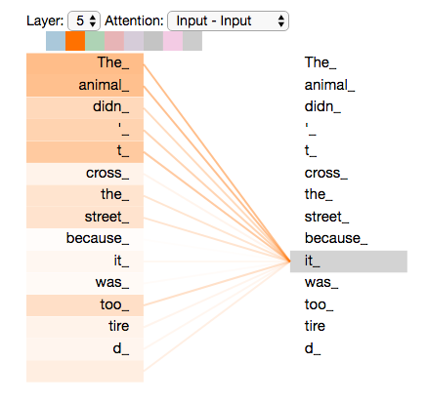
Analysis(BERT)
Based on self-attention (Encoder)

Slide 5
Our Analysis(Speech)
Not very useful without alignment!

Slide 6
Our Analysis(Speech)
The meaning of individual frames are not clear without alignment.

Slide 7
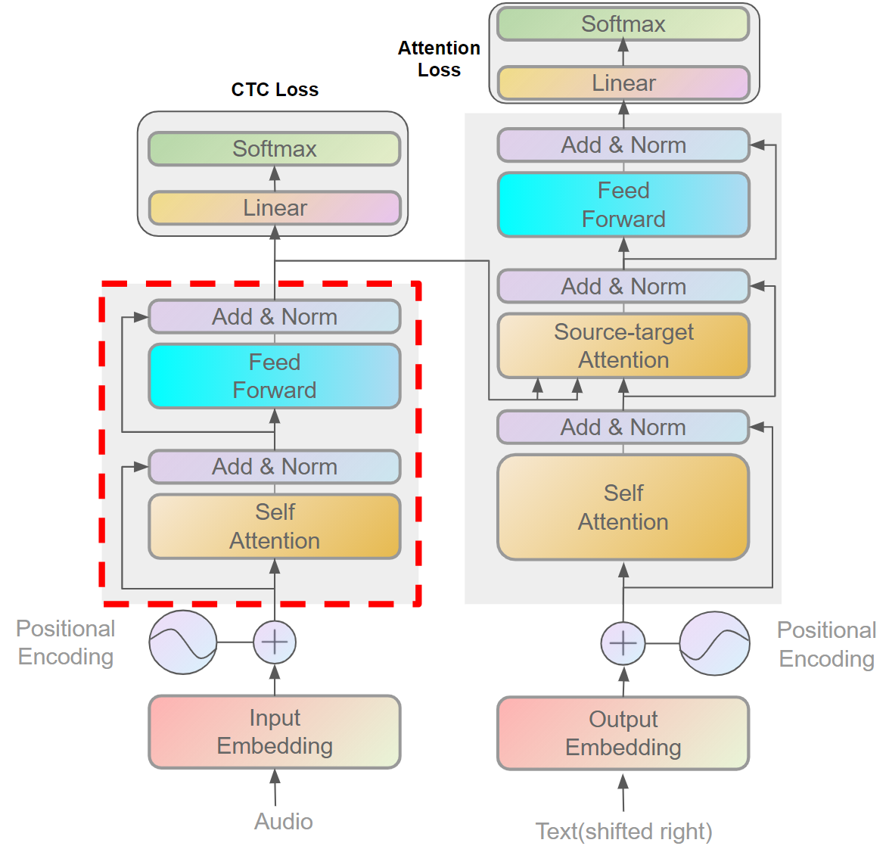
Our Analysis
Our analysis is based on the source-target attention
CTC can guide us to understand frames

Slide 8
Connectionist Temporal Classification(CTC)
You can understand CTC as a classifier
For example, if the vocabulary includes {c, a, t}, CTC predicts the posterior $p(\{c, a, t, ε\}|h_{i})$
Collapsing rule:
$$caat→cat$$
$$caaεat→caat$$

Slide 9
Using CTC to understand attention predictions
CTC predicts $p(∎|h_{t})$
Source-target attention output is related to
$$d_{i}=\sum_{t}{w_{i,t}h_{t}}$$
Where $\sum_{t}{w_{i,t}}=1$
$$\arg{\max{p(∎|d_{i})}}$$

Slide 10
Example

Slide 11
Example

Slide 12
Example

Slide 13
Observations
From the table, source-target attention in the lower layers of the decoder can only find 1-2 unique tokens on average within one utterance. In comparison, the last two layers can find more than 10 different tokens.
This indicates source-target attention in lower decoder layers isn’t strong and suggests those layers are more responsible for language modeling.

Slide 14
Regularization
CTC posterior logit from single head $att$:
$$l_{i}^{att}=W^{CTC}d_{i}+b^{CTC}$$
Overall focus of target token $y_{i}$
$${\text{focus}}_{i}=\max_{att}{l_{i}^{att}}$$
which is maximized over all layers and attention heads

Slide 15
Regularization
Attention probability $q_{i}$
$$q_{i}=\frac{exp⁡({\text{focus}}_{i,c^{′}})}{\sum_{c^{′}≠ε}{exp⁡({\text{focus}}_{i,c^{′}})}}$$
which is normalized over all tokens except $ε$.
This allows attention heads to predict $ε$.

Slide 16
Regularization
The regularization we proposed is the cross-entropy between the overall attention probability $q_{i}$ and target sequence $y$
$$L_{\text{reg}}=−λ\sum_{i}{\ln{q_{i,y_{i}}}}$$
Note: We don’t update CTC parameters from this loss.

Slide 17
Experiments
We conducted experiments on TED-LIUM 2 and Librispeech using ESPnet. We used 80 dimension mel-scale filterbank coefficients in addition to three-dimensional pitch features. Following the standard setups, we applied speed perturbation, SpecAugment for TED-LIUM 2 and SpecAugment for Librispeech.
In all experiments, the encoder included 12 blocks starting with convolutional layers for down-sampling. The decoder consisted of 6 blocks which included 4 attention heads, 256 hidden units and 2048 feed-forward units.The network was trained for 100 epochs with single NVIDIA GTX1080TI GPU. Warmup is used for the first 25,000 steps.

Slide 18
Experiments (TED-LIUM2)
TED-LIUM2 WER | dev | Test
Baseline | 9.3 | 8.1
$$λ=0.1$$ | 8.7 | 7.8
$$λ=0.2$$ | 8.8 | 7.7
$$λ=0.3$$ | 9.6 | 8.0

Slide 19
Experiments (LibriSpeech)
LibriSpeech WER | Dev_clean | Dev_other | Test_clean | Test_Other
Baseline | 3.7 | 9.8 | 4.0 | 10.0
$$λ=0.1$$ | 3.8 | 8.6 | 4.1 | 8.7

Slide 20
Thank you for your time

