Slide 1
A REGRESSION APPROACH TO BINAURAL SPEECH
SEGREGATION VIA DEEP NEURAL NETWORK
Nana Fan Jun Du Li-Rong Dai
National Engineering Laboratory of Speech and Language Information Processing, USTC
Presented by Nana Fan
2016.10.18

Slide 2
Outline
Background
Noisy speech segregation
Mask based binaural noisy speech segregation
A regression approach to segregation
Proposed method
The monaural and binaural features design
Experiments and analysis
Conclusion and future work

Slide 3
Outline
Background
Noisy speech segregation
Mask based binaural noisy speech segregation
A Regression approach to segregation
Proposed method
The monaural and binaural features design
Experiments and analysis
Conclusion and future work

Slide 4
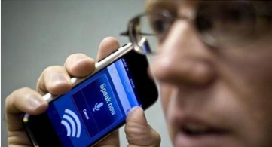
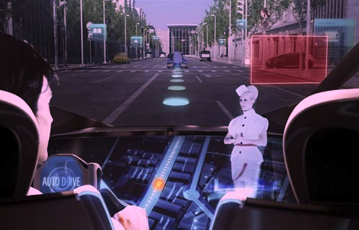
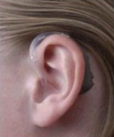
Noisy speech segregation
Denoising: get clean speech from noisy input
Application: mobile phone communication, hearing aids, speech recognition systems...

Slide 5
Outline
Background
Noisy speech segregation
Mask based binaural noisy speech segregation
A Regression approach to segregation
Proposed method
The monaural and binaural features design
Experiments and analysis
Conclusion and future work

Slide 6
Mask based binaural noisy speech segregation
IBM: ideal binary mask
*: Y. Jiang, D. Wang, R. Liu, and Z. Feng, “Binaural classification for reverberant speech segregation using deep neural networks,” Audio, Speech, and Language Processing, IEEE/ACM Transactions on, vol. 22, no. 12, pp. 2112–2121, 2014.

Slide 7
Mask based binaural noisy speech segregation
Speech segregation based on classification approaches
segregation
classification
Label=1
target
noisy speech
T-F units
reconstruction
Label=0
non-target
DNN training
IBM label
DNN1
DNN
noisy speech
DNN2
feature extraction
each frequency channel
.
.
.
monaural: GFCC
binaural: CCF, ITD, ILD
DNNn
RBM pre-training
*: Y. Jiang, D. Wang, R. Liu, and Z. Feng, “Binaural classification for reverberant speech segregation using deep neural networks,” Audio, Speech, and Language Processing, IEEE/ACM Transactions on, vol. 22, no. 12, pp. 2112–2121, 2014.

Slide 8
Outline
Background
Noisy speech segregation
Mask based binaural noisy speech segregation
A regression approach to segregation
Proposed method
The monaural and binaural features design
Experiments and analysis
Conclusion and future work

Slide 9
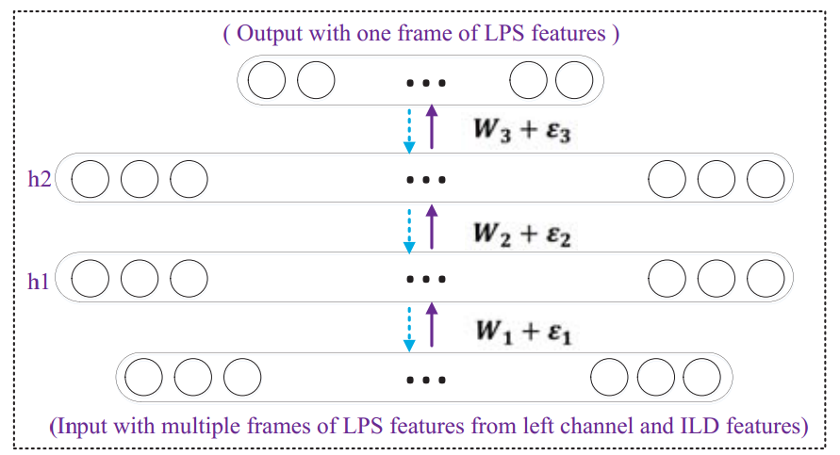
Proposed method
Motivation
Using a single DNN rather than multiple sub-channel DNNs, to simplify the model and the training procedure .
Using regression approach rather than classification, to achieve better quality of segregated speech.
Regression DNN
two hidden layers: h1, h2
input: noisy speech features (binaural & monaural)
output: segregated clean speech features
LPS feature: Log-power spectral feature

Slide 10
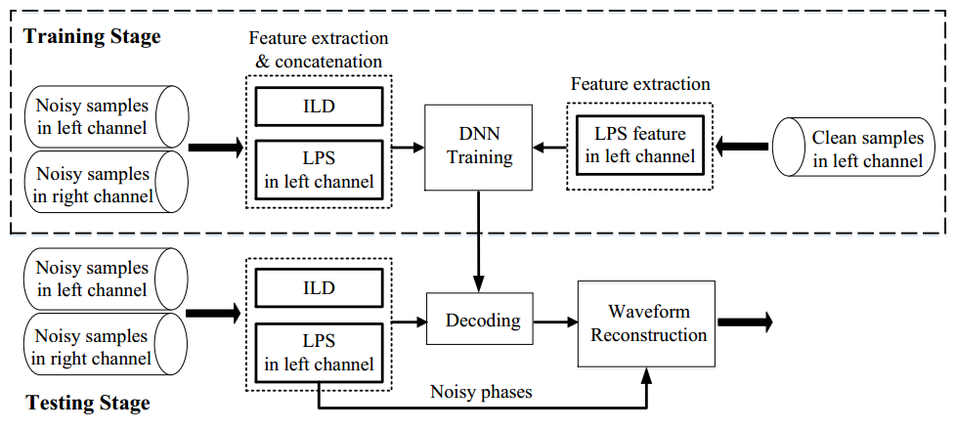
Proposed method
Overview
Notes:
this is the overall block diagram of my proposed regression DNN system

Slide 11
Proposed method
Main features
A single regression DNN model for binaural speech segregation
Utilization of information from both channels
Waveform reconstruction as a post-processing of DNN output
Simple and effective
layers | input* | hidden 1 | hidden 2 | output
parameter size | (257+k)*n_frame | 2048 | 2048 | 257
training mode | algorithm | iterations
supervised | SGD | 50
*: the input feature dimension would depend on the binaural feature we choose (k will be discussed later)
257: log-power spectral feature dimension
n_frame: frame expansion

Slide 12
Outline
Background
Noisy speech segregation
Mask based binaural noisy speech segregation
A regression approach to segregation
Proposed method
The monaural and binaural features design
Experiments and analysis
Conclusion and future work

Slide 13
The monaural and binaural features design
Monaural feature
window length: 20ms
frame shift: 10ms
sample frequency: 16kHz
log-power spectral feature: 257
Binaural feature in LPS domain
Traditional binaural features
CCF, ITD, ILD <- Gammatone filterbank (non-linear frequency bins)
Our proposed
LPS <- DFT (linear frequency bins)
ILD (interaural level difference): using LPS features of both channels to calculate new ILD
different frequency channels

Slide 14
The monaural and binaural features design
Binaural feature
Global ILD: one-dimensional ratio between the sum of full-band LPS features from two channels
Full-band ILD: an ILD vector as the ratios between full-band LPS features from two channels
Sub-band ILD: an ILD vector as the ratios between the sub-band LPS features from two channels

Slide 15
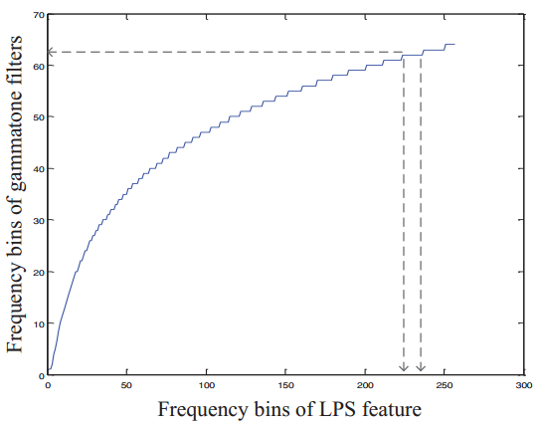
The monaural and binaural features design
Binaural feature
ILDs | Global | Full-band | Sub-band*
dimension | 1 | 257 | 61
Sub-band ILD:
designed as a tradeoff
mapping linear frequency bins to gammatone bins
simulate the frequency selectivity of human ears
Feature concatenation
input feature: LPS+ILD
input dimension: (257+k)*n_frame, k=1, 257, 61
Notes:
x-axis refer to the linear 257 frequency bins.
y-axis refer to the nonlinear gammatone frequency bins

Slide 16
Outline
Background
Noisy speech segregation
Mask based binaural noisy speech segregation
A regression approach to segregation
Proposed method
The monaural and binaural features design
Experiments and analysis
Conclusion and future work

Slide 17
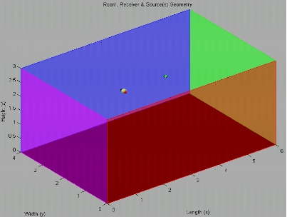
Experiments and analysis
Data set
Using TIMIT corpus as clean speech data set.
Using “Roomsim” Toolkit to simulate reverberate noisy speech.
Noise type: babble noise
Reverberation time (T60): 0s (anechoic), 0.3s
Source direction: (clean speech), (noise)
Room
clean speech
noise
binaural microphone

Slide 18
Experiments and analysis
DNN systems in experiments
IBM-DNN
the IBM-based binaural classification approach as the baseline
R-DNN
the regression DNN approach using only monaural LPS features
R-DNN-Global
the regression DNN approach using monaural LPS features and binaural global ILD features
R-DNN-Full
the regression DNN approach using monaural LPS features and binaural full-band ILD features
R-DNN-Sub
the regression DNN approach using monaural LPS features and binaural sub-band ILD features
Notes:
（需要介绍这些方法）

Slide 19
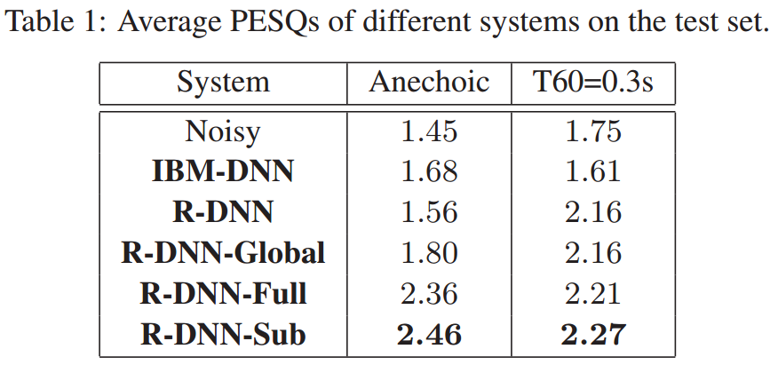
Experiments and analysis
Listening quality: PESQ Results
Most of the regression DNN based systems outperformed the IBM-DNN system.
PESQ: Perceptual evaluation of speech quality

Slide 20
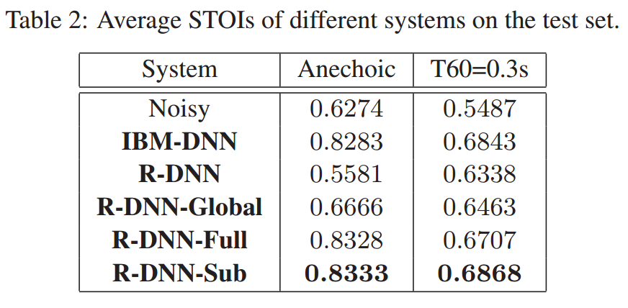
Experiments and analysis
Speech Intelligibility: STOI results
STOI: Short-time objective intelligibility

Slide 21
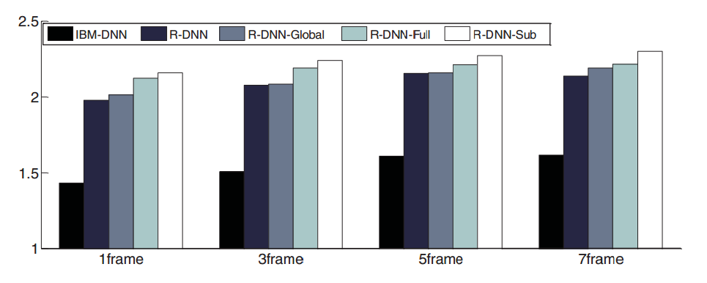
Experiments and analysis
Frame expansion
little gain due to high-dimension problem
sub-band ILDs make a good tradeoff
Figure 1: Average PESQ results on test set using different input acoustic contexts. Test SNR = 0dB. T60 = 0.3s
Notes:
sub-band ILDs made a good tradeoff between the information insufficiency (R-DNN-Global) and high dimensional problem (R-DNN-Full).

Slide 22
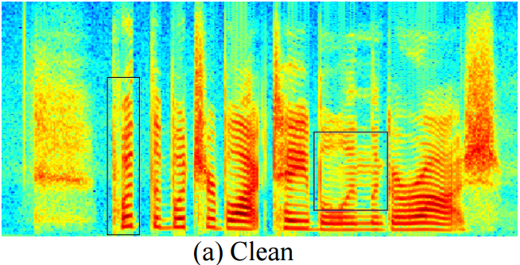
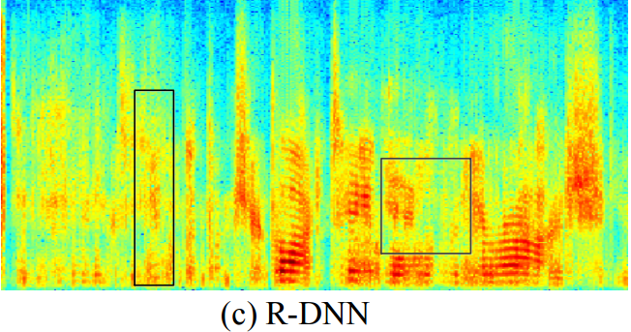
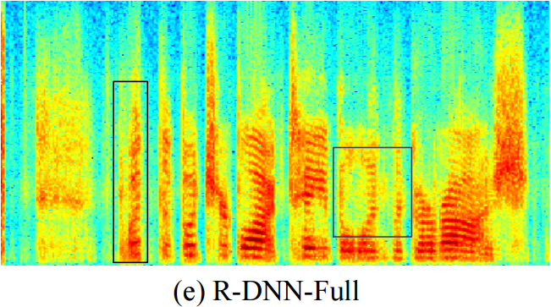
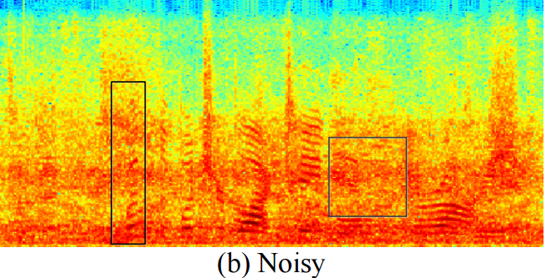
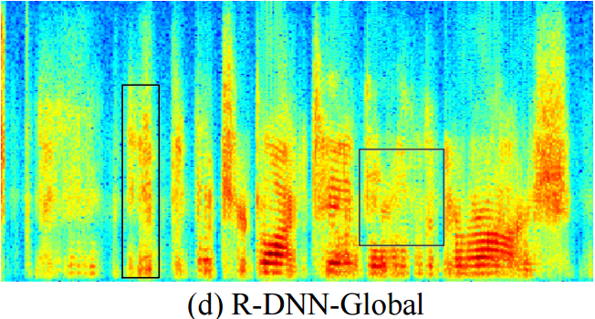
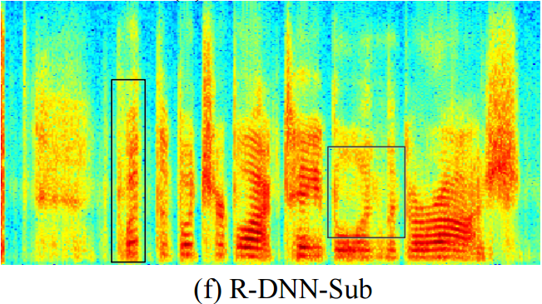
Experiments and analysis
Spectrogram example
the fine structures
can be well recovered
The spectrograms of a segregated speech

Slide 23
Outline
Background
Noisy speech segregation
Mask based binaural noisy speech segregation
A regression approach to segregation
Proposed method
The monaural and binaural features design
Experiments and analysis
Conclusion and future work

Slide 24
Experiments and analysis
Conclusion
We propose a regression approach to binaural speech segregation via DNN.
The direct mapping using the regression DNN can yield a better reconstructed speech in terms of speech quality and intelligibility.
Sub-band binaural feature achieves the best performance.
Future work
Increase dataset: Larger training set, variant noises condition, etc.

Slide 25
Thank you

