Slide 1
Visual Adapt For RGBD Tracking
Guangtong Zhang^{a,b}, Qihua Liang*^{a,b}, Zhiyi Mo^{a,b,c}, Ning Li^{a,b}, Bineng Zhong^{a,b}
a.Key Laboratory of Education Blockchain and Intelligent Technology Ministry of Education,
Guangxi Normal University, Guilin 541004, China.
b.Guangxi Key Lab of Multi-Source Information Mining & Security,
Guangxi Normal University, Guilin 541004, China.
c.Guangxi Key Laboratory of Machine Vision and Intelligent Control,Wuzhou University,
Wuzhou 543002, China.

Slide 2
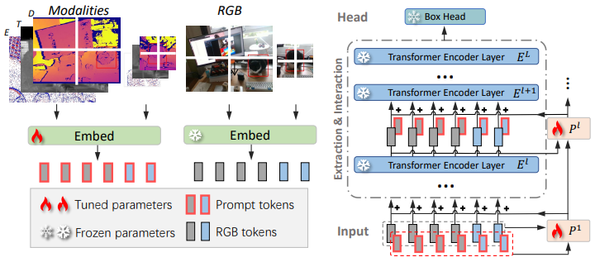
RGB Future
Extract
RGB
Future
Fusion
Depth
Depth Future
Extract
RGBD Tracking (existing)
DMTrack Pipeline
Depth
Template
RGB
Feature Extract
RGB
Search
Depth
Prompt RGBD Tracking
ViPT(CVPR2023) pipeline

Slide 3
RGB Module Encoder × 6
RGB
Template Frame
Template
Template
Depth
Fusion
Model
Depth Adapt
Model
Transformer
Encoder Layer
Transformer
Encoder Layer
...
Predict
Depth
Fusion
Model
Search Region
Search
Search
RGB
Tuned parameters
Frozen parameters
• We propose a novel Adapt RGBD tracker named Visual Adapt for RGBD Tracking (VADT). This frame work maintains RGB images as input to the RGB-based model and efficiently employs Depth information to assist RGB tracking via model fine-tuning.
• We introduce a data pathway called Depth Adapt Model (DAM), capable of efficiently extracting highly relevant features from RGBD data, thereby reducing the introduction of interference information caused by direct overlay of Depth features onto RGB features.
• The proposed VADT achieves state-of-the-art performance on two popular RGBD tracking benchmarks, including DepthTrack and VOT-RGBD2022.

Slide 4
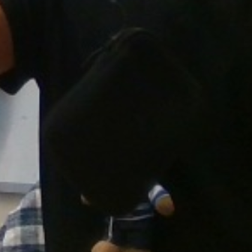
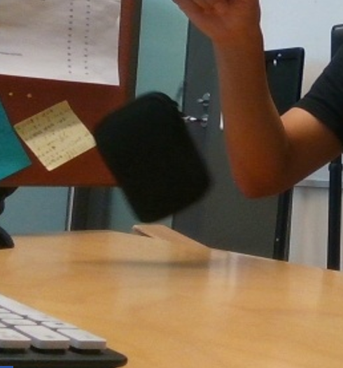
RGB
Template
Template
...
Visual Encoder
Visual Encoder
Visual Encoder
Depth
Search
Search
Fusion
Module
DAM
DAM
RGB
Template
Spatial Fovea
Template
Conv Layer
Depth Template
Adapt Template
Spatial Fovea
Conv Layer
RGB
Search
Search
Conv Layer
Depth
Search
Fusion Module
Adapt Search

Slide 5
RGB
Template
Template
...
Visual
Encoder
Visual Encoder
Visual Encoder
Depth
Search
Search
Fusion
Module
DAM
DAM
Depth Adapt Model
Conv Layer
Conv Layer
Adapt Temlpate
Cross
Attention
Filter
Attention
Adapt
Feature Map
Top
Adapt Search
Linear

Slide 6
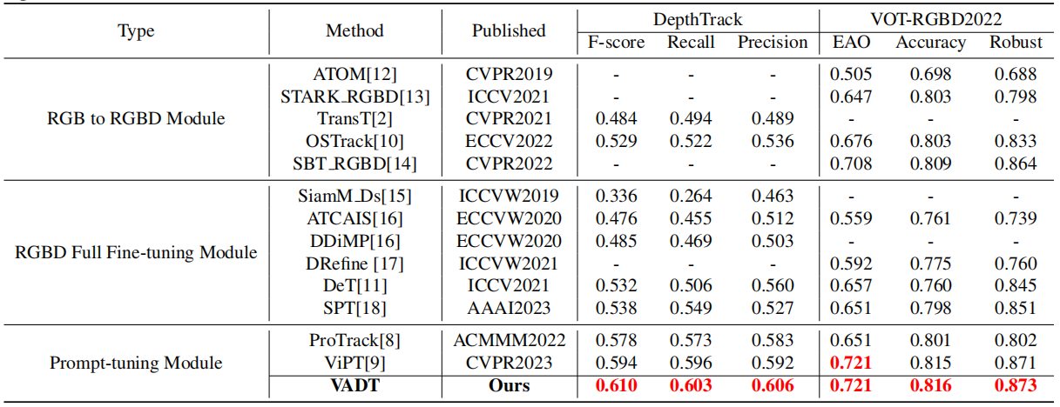
Experiments
We compare our model with state-of-the-art models on the DepthTrack and VOT-RGBD2022 datasets. The best result is highlighted in red.

Slide 7
Thanks!

