Slide 1
WASE: Learning When to Attend for Speaker Extraction in Cocktail Party Environments
Yunzhe Hao, Jiaming Xu, Peng Zhang, Bo Xu
haoyunzhe2017@ia.ac.cn
Institute of Automation, Chinese Academy of Sciences (CASIA)
April 2021

Slide 2
Background
With the rapid development of deep learning, various models have been proposed to solve the cocktail party problem.
Blind source separation aims to estimate multiple speakers simultaneously, which bring two problems:
Uncertain number of source problem;
Label permutation problem.
Speaker extraction identifies and estimates the speaker of interest with the help of the additional information ^{[1]} .
The information includes voiceprint (pitch) ^{[2]}, visual information (lip movement, facial expression, gender, age) ^{[3]}, spatial information (azimuth) ^{[4]} et al.
[1]. Dong Yu: Solving Cocktail Party Problem - From Single Modality to Multi-Modality
[2]. Quan Wang: VoiceFilter: Targeted Voice Separation by Speaker-Conditioned Spectrogram Masking
[3]. Ariel Ephrat: Looking to listen at the cocktail party: A speaker-independent audio-visual model for speech separation
[4]. Dong Yu: Neural spatial filter: Target speaker speech separation assisted with directional information

Slide 3
Motivation
However, less attention is paid on the cue of sound onset, which has been emphasized in the auditory scene analysis and psychology.
The onset signal is an important cue in the auditory scene analysis;
Even infants can take advantage of the onset cue and benefit from when to hear.
We propose a novel model that can learn When to Attend for Speaker Extraction (dubbed WASE).
Extract the target speaker based on onset cue;
Extend onset cue to onset / offset cues;
Combine onset (onset / offset) cues with voiceprint.
Advantages:
Achieve competitive performance compared to other cues;
First combine speaker separation and speaker-dependent voice activity detection;
First utilize two kinds of perception cues above simultaneously to promote the integrity of the auditory object.

Slide 4
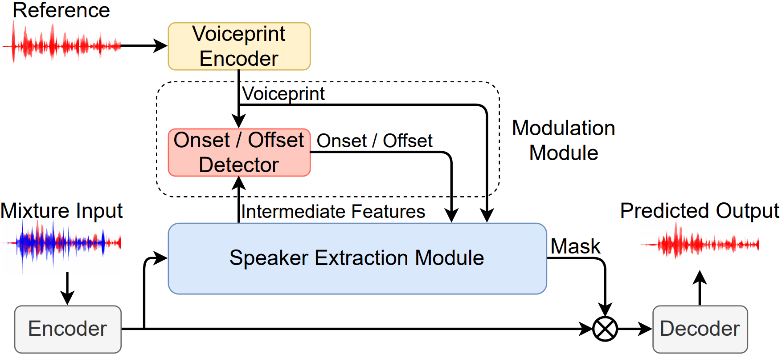
Model Structure
WASE detects the onset (onset / offset) cue induced from the voiceprint cue and regards the onset (onset / offset) cue as important guidance.

Slide 5
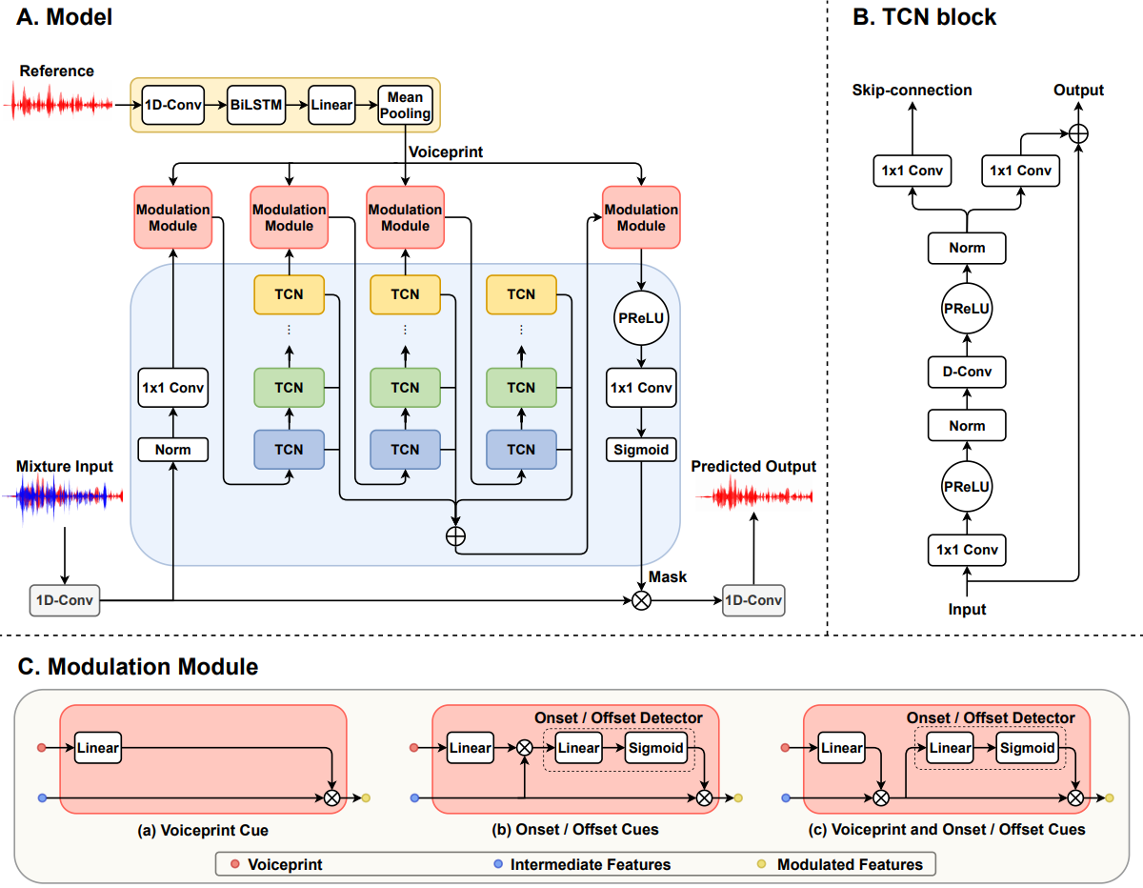
Details of Model Structure
Voiceprint Encoder
Two-layer BLSTM, mean-pooling.
Speech Encoder & Decoder
1-D convolutional layer & 1-D transpose convolutional layer.
Extraction Module
TCN blocks.

Slide 6
Details of Model Structure
Modulation Module
Only voiceprint vector is used;
Only onset (onset / offset) cue induced from voiceprint cue is used;
Voiceprint vector and onset (onset / offset) vector are used in sequence.
We apply the reference voice to the intermediate features to detect the onset (onset / offset) cue, then use it for modulation.
time
batch
feature
Intermediate Features
Voiceprint Cue
Onset (Onset / Offset) Cue

Slide 7
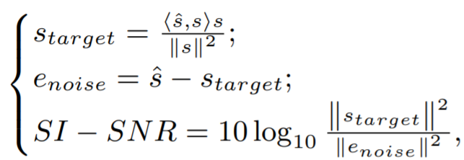
Details of Model Structure
Joint Optimization
Scale-invariant source-to-noise ratio (SI-SNR) loss between predicted speech and the clean speech:
Cross entropy loss between predicted onset (onset / offset) vector and the oracle.
The oracle onset (onset / offset) is generated from VAD results of clean voice.

Slide 8
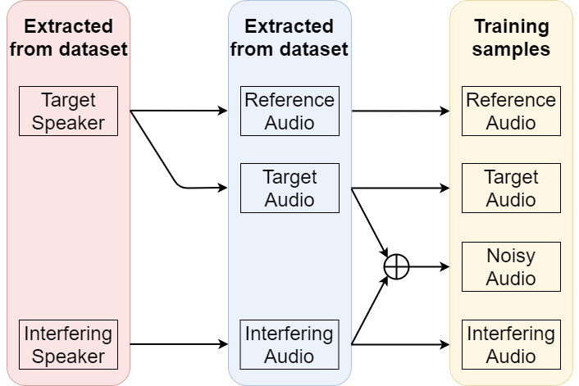
Experimental Setting
Evaluating on WSJ0-2mix dataset.
All samples are down sampled to 8 kHz.
SIR is between -2.5 dB and 2.5 dB.
Dynamic mix different speakers as data augmentation.
To ensure the existence of the offset, we pad silence with a random length of [200, 800] ms as the end of the target / interfering voice.
Add enrolled speech to the test dataset to match the speaker extraction task.

Slide 9
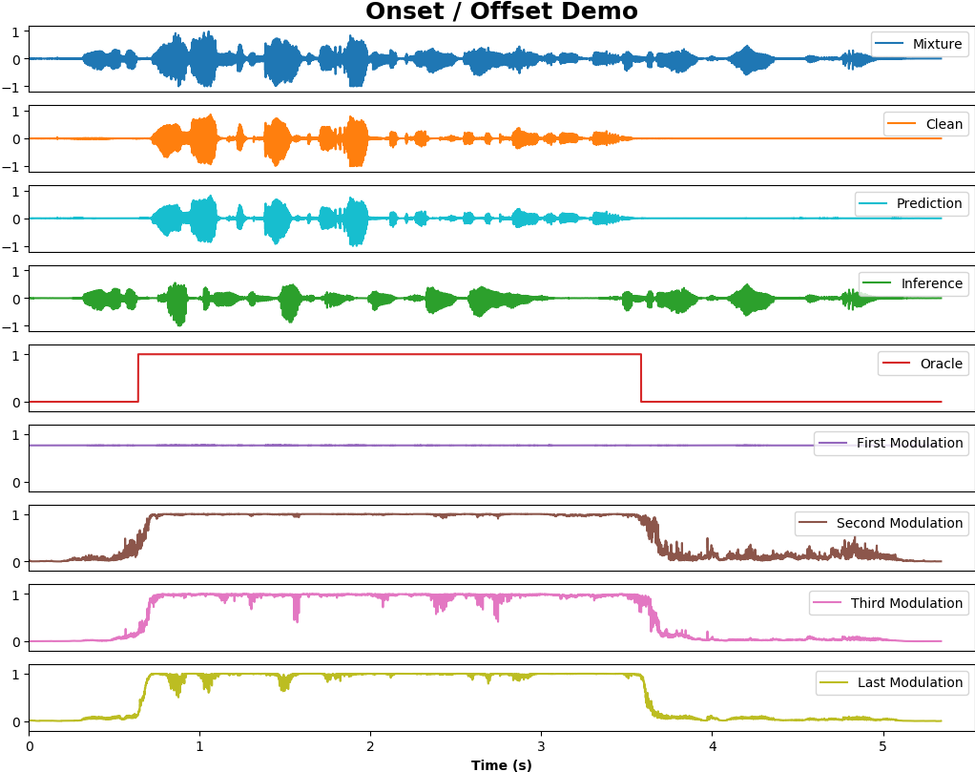
Experimental Result
Four modulation modules and their corresponding curves.
The first curve does not show the signal of onset / offset as the position of first modulation module in the framework might be too early for onset/offset detection.
Other modulation phenomena are in line with expectations.
The last modulation is most similar to the oracle.

Slide 10
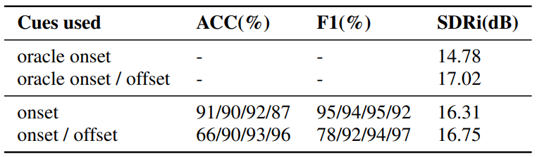
Experimental Result
SDR improvements (dB) with onset (onset / offset) cues on WSJ0-2mix dataset.
The ACC and F1 metrics, frame-level evaluation of accuracy and F-score, show that our model can perform SDVAD task well.
The performance of the model trained with given oracle onset (onset / offset) cues showed that the onset (onset / offset) information is enough to guide speaker extraction task.
The predicted onset / offset cues performs slightly worse than oracle onset / offset cues; The case in the predicted onset cue is opposite.

Slide 11
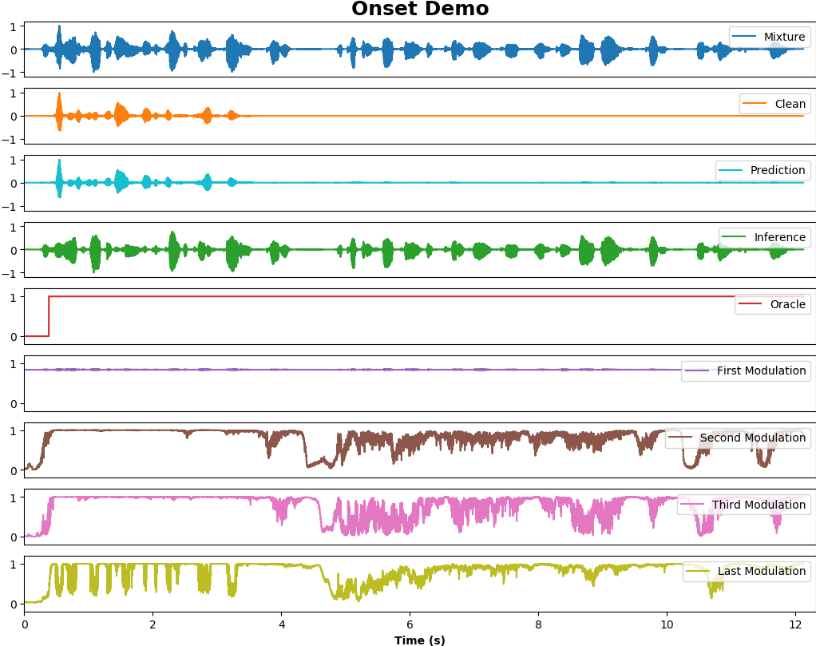
Experimental Result
We could achieve the similar effect of onset / offset cues with only onset cue used, because the network have learned the offset cue spontaneously at the absence of the target speech, especially when the target speech is much shorter than the interfering speech.

Slide 12
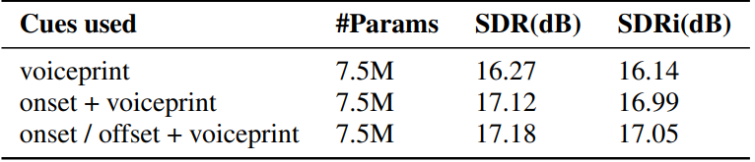
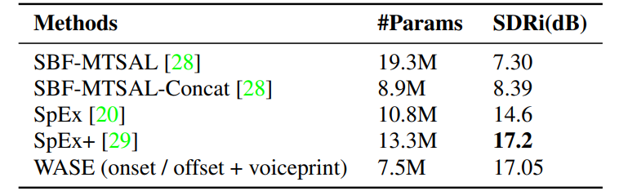
Experimental Result
SDR improvements (dB) with two cues on WSJ0-2mix dataset.
Compared with the voiceprint cue used alone, the performance of the model with two cues is improved while its additional parameters are negligible.
Although our best performance is slightly worse than SpEx+, the quantity of the parameters is nearly half of its.

Slide 13
Conclusion
Verify the effectiveness of onset cue in the speaker extraction.
Successfully extend onset cue to onset / offset cues, which verify mutual benefits between the speaker extraction and the speaker-dependent voice activity detection.
Combine the time (onset, onset / offset) cue and voiceprint cue and verify the benefits of multi-cue integration.
Support that multi-cue can promote the integrity of auditory objects.
The demo and code will be available in https://github.com/aispeech-lab/WASE.

Slide 14
THANKS!
Send email to haoyunzhe2017@ia.ac.cn if you have any questions.

