Slide 1
A PROPERTY-GUIDED DIFFUSION MODEL FOR GENERATING MOLECULAR GRAPHS
Changsheng Ma, Taicheng Guo, Qiang Yang, Xiuying Chen, Xin Gao, Shangsong Liang, Nitesh Chawla, Xiangliang Zhang
Presenter: Changsheng Ma

Slide 2
Outline
Background
Model
Issue
Experiment
Analysis
Conclusion

Slide 3
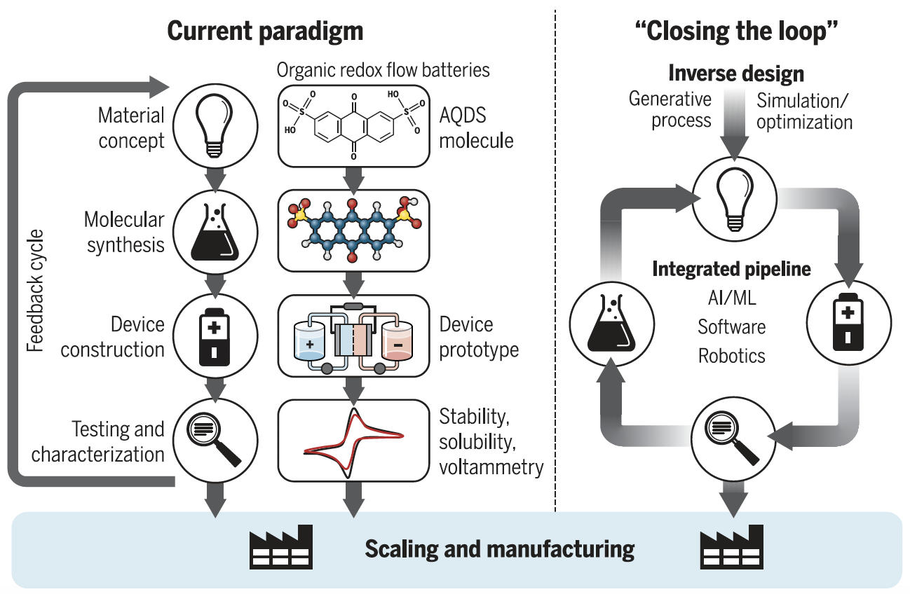
Background
Generating
Synthesis
Integrating
evaluation
😁
$${10}^{60}$$
😭
Notes:
First, Why molecular generation?
The development of new materials provides effective solutions to many challenges of the latest century, Such as energy production, personalized healthcare, and beyond.
the traditional process of wet-lab experiments usually consists of four steps, and this process is repeated until satisfactory results are obtained.
This paradigm looks professional, but it rely heavily on enumeration. If you know that the number of drug-like molecules is about 10 to the 60th power, the fact is it is impossible to enumerate all possible molecules.
In order to address the issue to speed up this process, researches tried to apply DGM to narrow down the searching space and explore the chemical space in a more intelligent way.

Slide 4
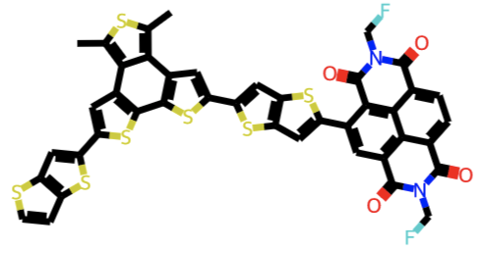
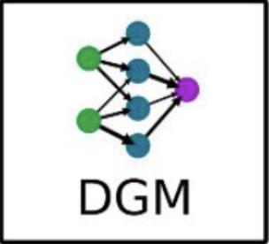
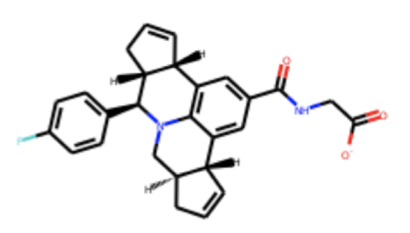
Background
Mol
D.B.
$$𝒩(μ,σ)$$
training
generation
Notes:
The basic idea of molecular generation mode is to approximate one data distribution, which could capture the patterns that are presented in the given data set.
The process can be separated into two steps, for training step, the model learn knowledge from molecular database and try to reconstruct the original molecular.
For the generating step, we sample from some easy accessible distribution, put into model and get generated molecular.

Slide 5
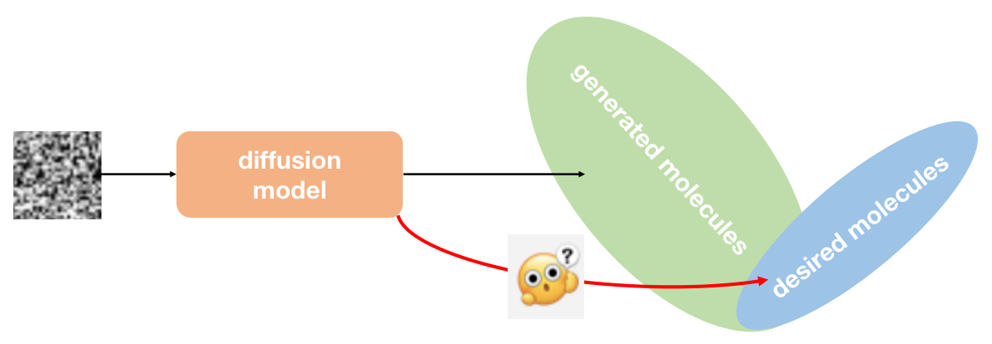
Issues
Notes:
One of the drawback of this paradigm is generating molecules similar to the training set, ignoring deviations from the desired molecular distribution.
Althouth great success were achieved by diffusion-based methods, they failed to generate molecules with desired properties.

Slide 6
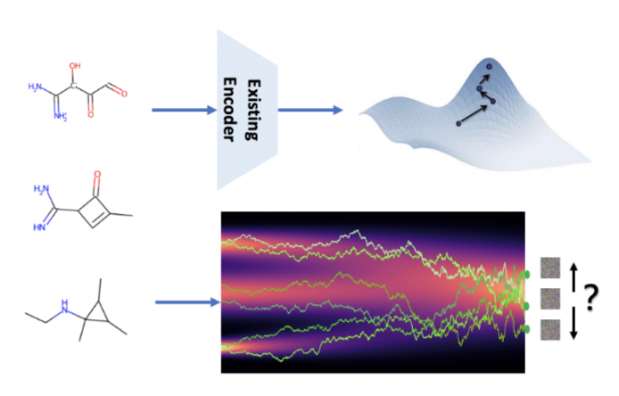
Issues
Notes:
as shown in the upper parts, in order to generate desired molecules, the previous models are able to encode the original dataset into a latent space, and Bayesian optimization is then conducted in this latent space, leveraging the semantic meaning embedded in the learned space.
But, the latent space of diffusion models lacks semantics. So, interpolation along a specific direction in this latent space results in unpredictable changes and fails to produce the desired molecules.

Slide 7
Analysis
$$y$$
[Prafulla Dhariwal et al. 2021]
Notes:
the intuitive way to address the issue is to do conditional generation, which add property category information while training.
Originally, the reverse process is like this, given an class label y, based on the Bayes’rule, the sampling distribution becomes this and Z is a normalizing constant. It is proven by recent work that the new distribution after incorporating the label y can be approximated by a Gaussian distribution with a shifted mean like this,
and the unknown parameters in the formular are mean μθt, variance σθt, and the shift coefficient g
We take this inspiration and exploit a diffusion generator to obtain the μ and σ, and train a classifier to get the value g, and introduce a property-guided diffusion model for molecular graph generation.

Slide 8
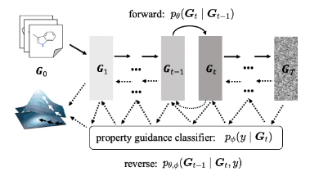
Model
stochastic differential equation view
Notes:
This is the overview of our model: the solid arrow represents the forward process, and the dashed arrows shows the property-guided reverse process.
We model our diffusion process through stochastic differential equation like this. And the reverse process is also a diffusion process and given by the reverse-time SDE like this,
In order to obtain our generation model, we need to estimate these two values to derive the reverse diffusion process.
The first value p_t(G_t) is the probability density of G_t, and this score will learned by our generator.
The second value p_t(y|G_t) is the conditional probability, and this value will be derived from our classifier.

Slide 9
Model
$$X_{t}$$
$$A_{t}$$
Notes:
For our generator, Due to we capture the graph features via its feature matrix and adjacency matrix, For the convenience of computation, we further decompose the reverse-time SDEs into two components, and two neural networks were applied separately to estimate them.

Slide 10
Model
[Yang Sone et al. 2020]
Notes:
Therefore, our graph diffusion generator comprises two neural networks separately to estimate these two values and the objective function is like this.
However, the ground-truth of these two scores are not analytically tractable. we employ the denoising score matching method proposed by this work and replace pt (Gt) by p0t (Gt | G0), which is the transition distribution from p0 to pt induced by the forward diffusion process.
due to the linearity of the drift coefficient, this transition distribution can be expressed as .
Due to Sample from these Gaussian distributions is straightforward since the means and variances are tractable and determined by the coef- ficients of the forward diffusion process. Thus, the objective functions can be expressed as follows:

Slide 11
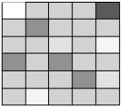
Model
$$A_{t}$$
$$X_{t}$$
$$X_{t}$$
$$A_{t}$$
GMH
GCN
MLP
MLP
Notes:
Now we can calculate this value.
For value with respect to Xt, we utilize multiple layers of GCN, followed by mlp to estimate it.
For value with respect to At, It is crucial to consider the structural dependencies between nodes due to the significant impact of bonds on the chemical structure of a molecule. However, conventional pooling methods employed in GNNs treat all node features uniformly, To address this and better model the bond feature, , we leverage graph multi-head attention to capture node interactions based on their structural dependencies.

Slide 12
Model
$$X_{t}$$
$$A_{t}$$
$$\hat{y_{t}}$$
$$y$$
GCN
MLP
MLP
Notes:
For our classifier, it is very similar to the normal classifier, but there is one difference. This is because the reverse process are time-dependent, Therefore, our classifier must consider the timestep t as an additional input and undergo training on noisy graphs from various timesteps.
Considering that molecular properties are global features , we leverage GCN to capture the atom level features, and apply the gated recurrent unit to learn the graph level features to develop our classifier, and the gradient of the classifier at each timestep t is this value.
This design comes with two additional advantages,
one is to generate the desired molecule without an additional optimization process,

Slide 13
Model
$$ρ_{1}$$
$$ρ_{2}$$
$$ρ_{n}$$
$$\hat{y_{1_{t}}}$$
$$y_{1}$$
$$\hat{y_{2_{t}}}$$
$$y_{2}$$
$$\hat{y_{n_{t}}}$$
$$y_{n}$$
Notes:
and the other is to generate molecules with multi-objective properties simply by linearly integrating a weighted sum of multiple property classifiers, and ρi is the weighting factors.
.

Slide 14
Model
$$ρ_{1}$$
$$ρ_{2}$$
$$ρ_{n}$$
$$\hat{y_{1_{t}}}$$
$$y_{1}$$
$$\hat{y_{2_{t}}}$$
$$y_{2}$$
$$\hat{y_{n_{t}}}$$
$$y_{n}$$
Notes:
For our classifier, it can generate both single-property optimized molecules and multi-properties optimized molecules by linearly integrating weighted sums of multiple property classifiers

Slide 15
Experiments
Generation Performance
Property guidance Performance
Notes:
We evaluate our model from these two aspect.

Slide 16
Experiments
Dataset:
Metrics:
VwoC is the percentage of valid molecules without correction process.
FCD is to evaluate the distance between the real and generated sets.
NSPDK calculates the mean maximum discrepancy between real and generated set. Validity is the percentage of chemically valid molecules.
Uniqueness is the percentage of unique molecules.
Novelty is the percentage of novel molecules with reference to the training set.
V.U.N is the production of these three metrics.
Notes:
We experiment on QM9 [10], utilizing plogP as guidance properties.
FCD and NSPDK are two distance metrics, so a smaller value indicates better performance.
others are The larger the value, the better the performance.

Slide 17
Experiments
Notes:
We assess the performance of all the evaluated models on 10,000 randomly generated molecules and present the means and the standard deviations of the results over 3 runs. Our model out-performing baselines in almost all metrics.
% The highest VwoC value highlights the ability of our model to grasp the chemical valency rule
the top NSPDK and FCD values indicate its capability to capture the underlying distribution in terms of topological space and chemical space.
the best V.U.N value shows our model can generate more valid, unique, and novel molecules.

Slide 18
Experiments
inter-class evaluation
intra-class evaluations
$$G_{A}$$
$$G_{B}$$
$$G_{C}$$
$$G_{D}$$
Uniqueness
?%
?%
?%
?%
$$G_{A}$$
$$G$$
Novelty
Notes:
To investigate the property guidance performance of our model, we perform inter-class and intra-class evaluations.
As for the property category, We apply quartiles of the property value of the training set to divide, We train corresponding classifiers for each category and perform the sampling process under the guidance of these classifiers.
The inter-class evaluation centers on assessing the proportion of generated molecules belonging to the desired property class out of all generated molecules.
And the intra-class evaluation aims to assess the quality of generated molecules within each individual class.

Slide 19
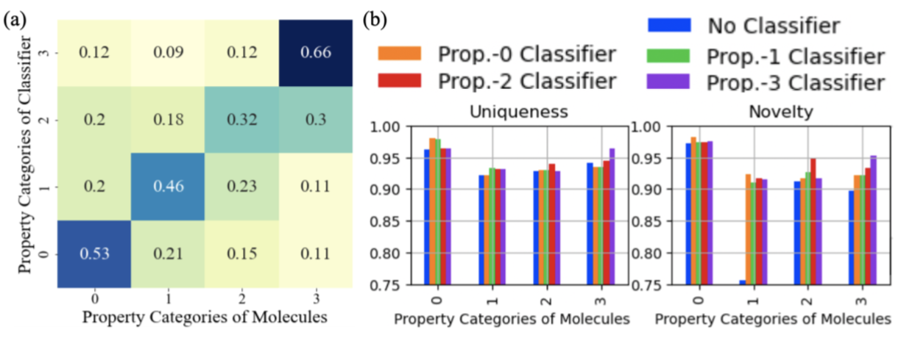
Experiments
Notes:
Fig. (a) shows that different property classifiers can guide the generation of a greater number of molecules within their respective categories, providing satisfactory results in inter-class evaluation.
Fig. (b) shows molecules generated under corresponding property guidance, within each class, exhibit improved uniqueness and novelty, demonstrating high quality in intra-class evaluation.

Slide 20
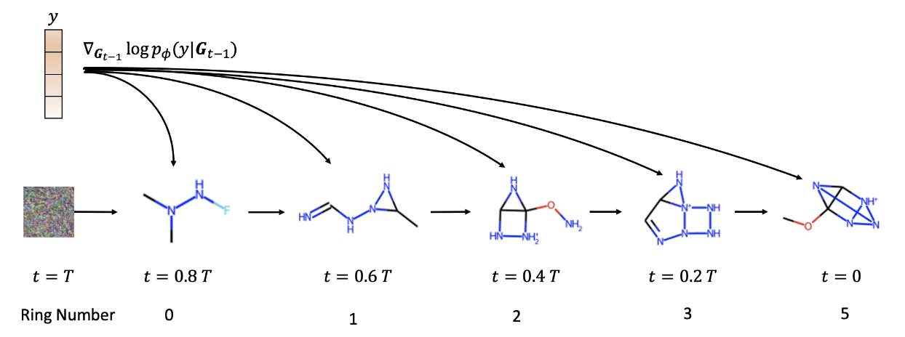
Experiments
Notes:
We next show some examples of single property guidance and multi properties guidance.
In this example the property category is the number of molecular rings bigger than three.
We can see with the decrease of the timestep t, the ring number of the generated molecules are increased until bigger than 3.

Slide 21
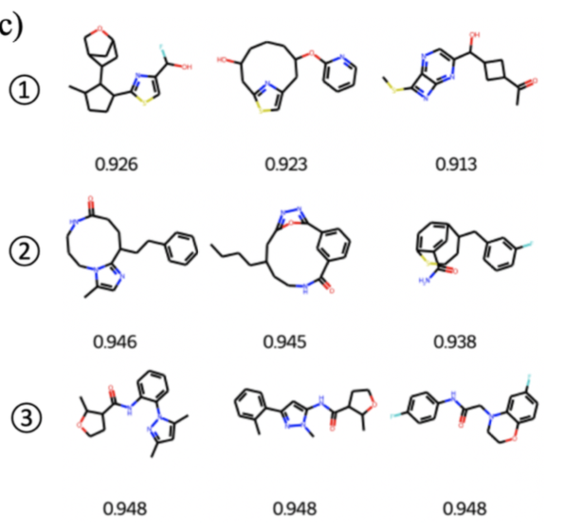
Experiments
Top 3 molecules with QED values out of 10,000 randomly generated molecules by different guidance models:
Without guidance
QED-guided
QED & Ring-guided
Notes:
For multi properties guidance, we show Top 3 molecules with QED values out of 10,000 randomly generated molecules by different guidance models .
We introduce QED and ring-guided diffusion, setting the guidance for the ring number to three. This choice is motivated by the empirical observation that molecules with high QED values typically exhibit a characteristic of three rings.

Slide 22
Conclusion
To the best of our knowledge, we are the first to propose the property-guided diffusion model for molecular graph generation, providing an effective solution to generate desired molecules via diffusion models.
For more practical use, we extend our model to multi-property-guided molecular generation, enabling the concurrent satisfaction of multiple properties.
Experimental results demonstrate the superior performance of our method over state-of-the-art baselines.

Slide 23
Thanks!

