Slide 1
Active Explainable Recommendation with Limited Labeling Budgets
(Jingsen Zhang, Xiaohe Bo, Chenxi Wang, Quanyu Dai,
Zhenhua Dong, Ruiming Tang, Xu Chen)
Jingsen Zhang
GSAI, Renmin University of China
18 Apr, 2024

Slide 2
Content
Background
Motivation
Methods
Experiments
Conclusion

Slide 3
Content
Background
Motivation
Methods
Experiments
Conclusion

Slide 4
Background
Explainable Recommendation (EXR)
Why are the items recommended?
Improve the transparency of the recommendation system and increase user satisfaction.
Music Recommendation
E-commerce Recommendation

Slide 5
Background
Techniques for EXR
Attention mechanism、knowledge graph …
Natural language explanation is an important method, which can deliver more flexible and user-accessible information
Template-based | ﻿“You might be interested in [feature], on which this product performs well. ”
Retrieval-based | A few reviews selected from the target item’s review collection
Neural generation | Encoder-decoder: ﻿reviews, tips and explanations generation

Slide 6
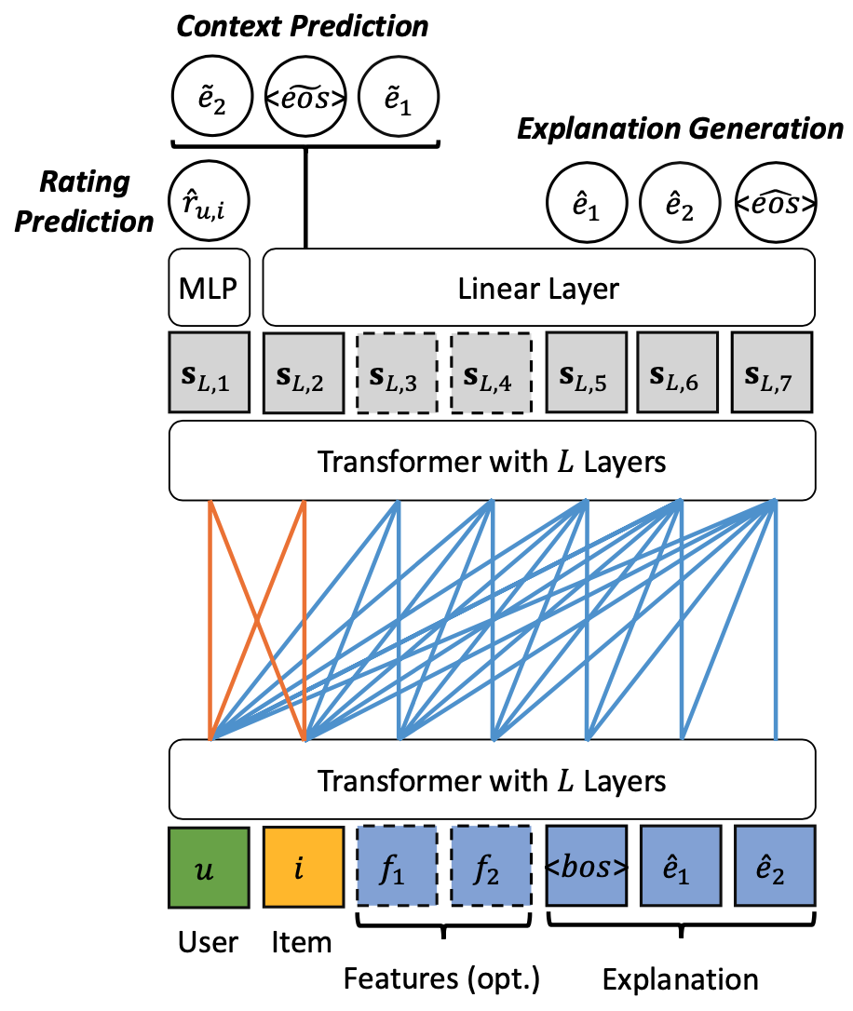
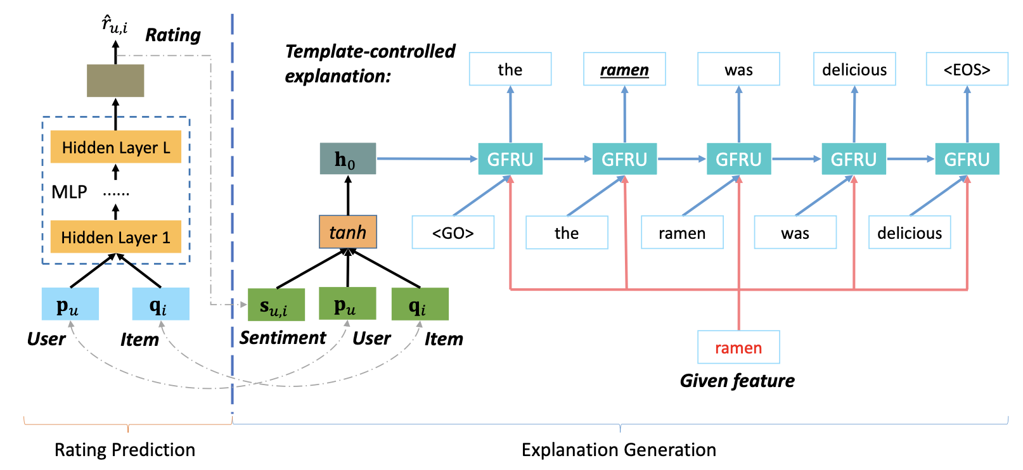
Background
Techniques for EXR
NETE (Li et al., CIKM2020)
PETER (Li et al., ACL2021)

Slide 7
Content
Background
Motivation
Methods
Experiments
Conclusion

Slide 8
Motivation
Previous studies focus on refining model architectures to generate more informative explanations, assuming that the explanation data is sufficient and easy to acquire.
In practice, obtaining the ground truth for explanations can be costly, since individuals may not be inclined to put additional efforts to provide behavior explanations.
Obtaining the ground truth for explanations can be costly !
Given a limited budget, how to effectively collect the explainable user behavior data?

Slide 9
Content
Background
Motivation
Methods
Experiments
Conclusion

Slide 10
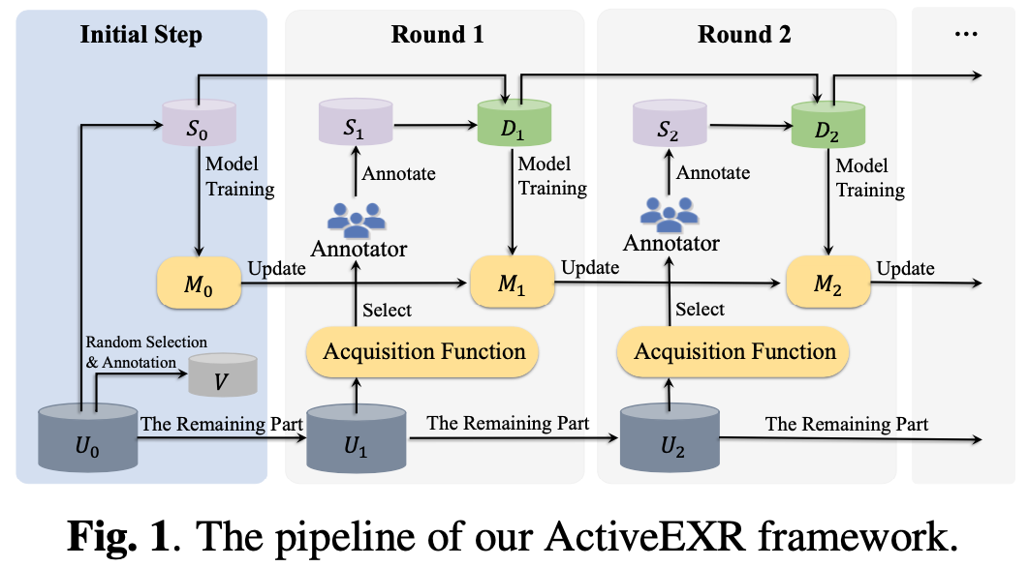
Methods
The formal definition of the active explainable recommendation task.
Unified active learning framework for explainable recommendation.
Acquisition function to determine which user-item pairs should be collected.
Explainable recommendation model to determine which user-item pairs should be collected.

Slide 11
Methods
Acquisition Function
Uncertain-based Strategy: straightforwardly selects the least certain samples, making it especially suitable for probabilistic models.
$p(s_{ui}^{t}|u,i,s_{ui}^{1:(t−1)})$ represents the predicted probability distribution for the t-th word.
Samples with higher entropy values indicate greater uncertainty.

Slide 12
Methods
Acquisition Function
Influence-based Strategy: we employ influence function to evaluate the impact of a sample $(u, i)$ on the model’s ability to generate explanations.
It measures the change in loss on the validation set V when upweighting this sample:
is the Hessian matrix based on training points, which is positive definite by assumption.
In our active learning task, the explanation ground truth of $(u, i)$ is unknown, making it impractical to calculate directly.
$p(s_{ui}^{t}|u,i,s_{ui}^{1:(t−1)})$ represents the predicted probability distribution for the t-th word.
Samples with higher entropy values indicate greater uncertainty.

Slide 13
Methods
Acquisition Function (Influence-based Strategy)
We replace with the expected gradient:
We utilize the K sentences with the highest probabilities as explanation labels to calculate the loss at point $(u, i)$, and $s_{k}$ denotes the sentence with the k-th highest posterior probability $p(s_{k}|u,i)$.
The final influence calculation
More negative value, the greater the influence of the sample.

Slide 14
Methods
Acquisition Function
Importance Calculation for the sample $(u, i)$
$α$ is the regularization weight for balancing the effects of the two strategies in data collection.

Slide 15
Content
Background
Motivation
Methods
Experiments
Conclusion

Slide 16
Experiments
Datasets
TripAdvisor-Hong Kong、YELP2019
We process the data according to the task setting of active learning. For each dataset:
Randomly select 100,000 samples as the unlabeled set for key sample selection, where the reviews of each sample are masked.
Randomly select 500 samples to form the seed set for initial model training.
Randomly select 10,000 samples for model validation and testing.
Metrics
RMSE for rating prediction
BLEU and ROUGE for explanation generation

Slide 17
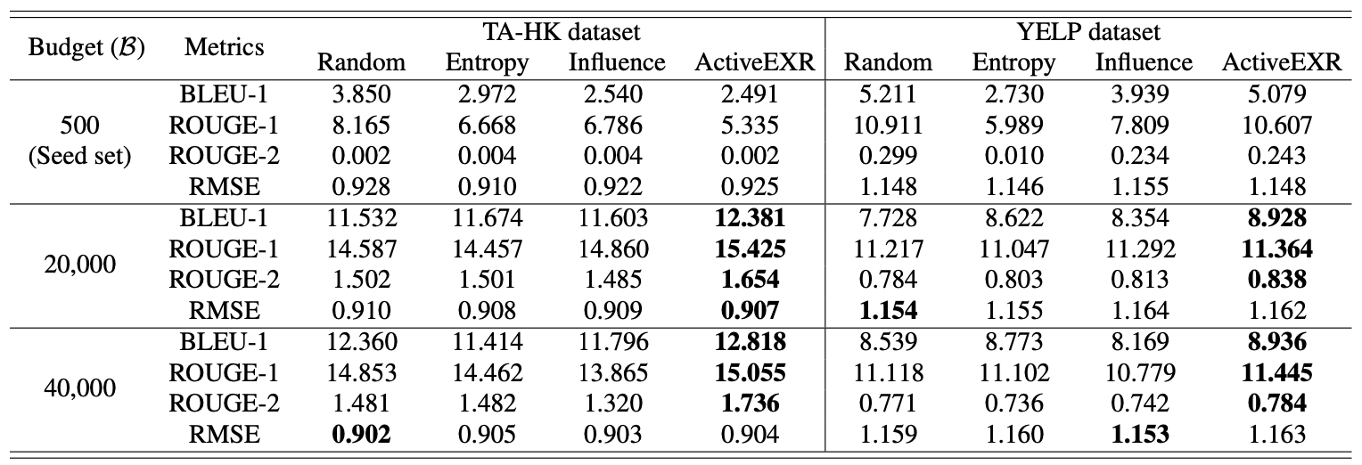
Experiments
Overall Comparison

Slide 18
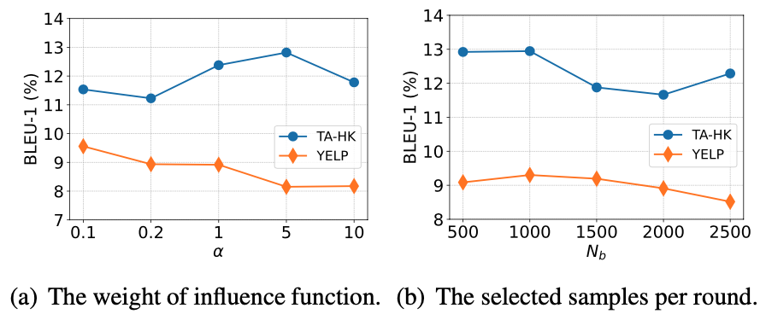
Experiments
Influence of the key parameters

Slide 19
Content
Background
Motivation
Methods
Experiments
Conclusion

Slide 20
Conclusion
We investigate the challenge posed by costly explanation ground truth acquisition
We introduce a unified active explainable recommendation framework. To this end, we propose two acquisition strategies based on uncertainty and influence.
Empirical results on real-world datasets validate the effectiveness of our framework.

Slide 21
Thank you!
Jingsen Zhang
E-mail: zhangjingsen@ruc.edu.cn
Homepage: jingsenzhang.github.io
18 Apr, 2024

