Slide 1
Title: 3D Speaker Tracking with Video-Assisted Multi-Channel Audio Optimization Functions
ICASSP 2024 Paper ID: 5172
Xinyuan Qian, Zexu Pan, Qiquan Zhang, Kainan Chen, Shoufeng Lin
University of Science and Technology Beijing (USTB), China

Slide 2
Introduction
Importance of speaker tracking in human-robot interaction (HRI) applications
Challenges in speaker tracking: speech pauses, reverberation, visual occlusions
Objective: Propose a novel method based on the Generalized Labelled MultiBernoulli (GLMB) filter for improved speaker tracking

Slide 3
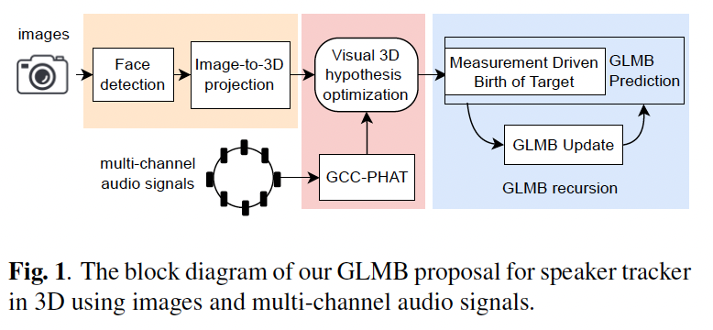
Proposed Method
Use of audio information from a microphone array and video streams from a monocular camera
GLMB-based tracker for handling outliers and maintaining tracking during missed detections
Experiments on the AV16.3 dataset and comparison with competitive methods

Slide 4
Key contributions
We explore the complementary and interactive characteristics of heterogenous audio-visual signals for 3D localization.
We formulate a GLMB-based tracker which takes multimodal location estimates as inputs for smoothed speaker trajectory estimation under challenging scenarios.
We use the target survival and detection models to adaptively track speaker locations online, and suppress outliers and misses for improved performance.

Slide 5
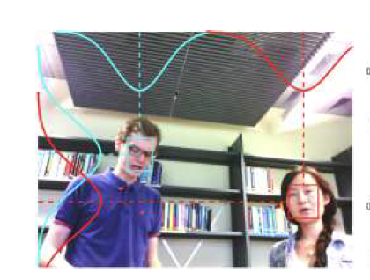
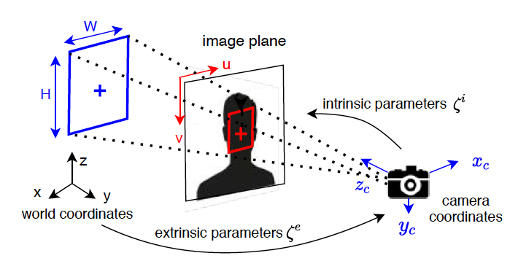
Visual Localization - Face Detection
Extraction of face bounding box from input images
Estimation of lip location for 3D speaker localization
Use of the pin-hole camera model and image-to-3D projection

Slide 6
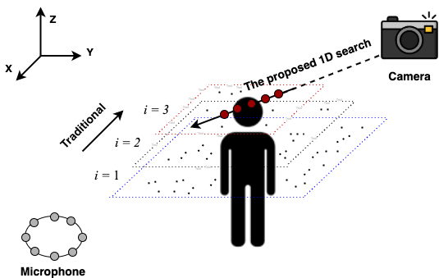
Audio Refined Visual Estimation - Linear Search
Utilization of multi-channel audio signals for localization
Introduction of the Generalized Cross Correlation with Phase Transform (GCC-PHAT) technique
Creation of location hypotheses and refinement through Multi-channel Cost Function (MCF) and Global Likelihood Function (GLF)

Slide 7
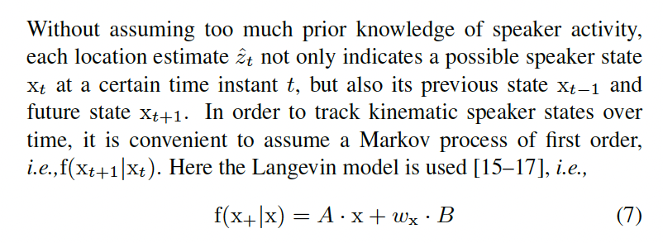
Speaker State Model - First Order Markov Process
Assumption of first-order Markov process for tracking kinematic speaker states
Description of the Langevin model and state transition function
Explanation of the speaker state as a labeled random finite set (RFS)

Slide 8
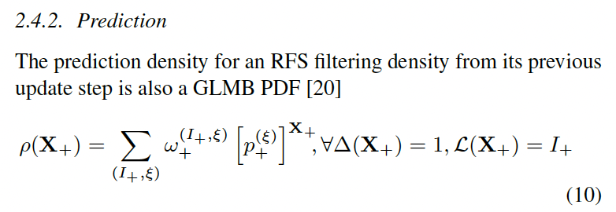
GLMB Recursion
Assumption of first-order Markov process for tracking kinematic speaker states
Description of the Langevin model and state transition function
Explanation of the speaker state as a labeled random finite set (RFS)

Slide 9
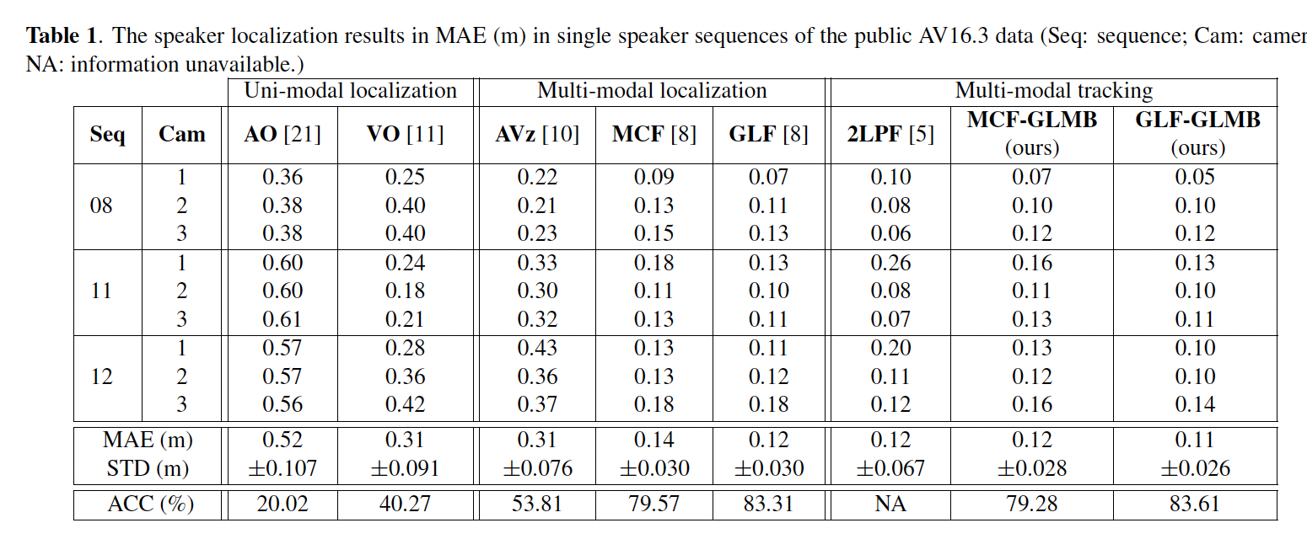
Experiments and Results
Description of the AV16.3 dataset and experimental setup
Metrics used for evaluation: MAE, STD, and ACC
Comparison of proposed method with state-of-the-art approaches

Slide 10
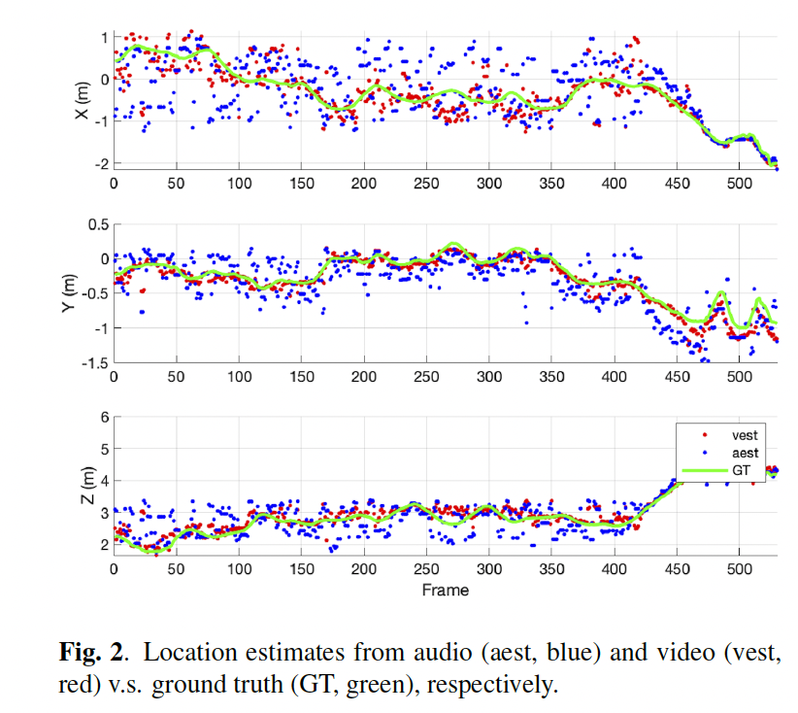
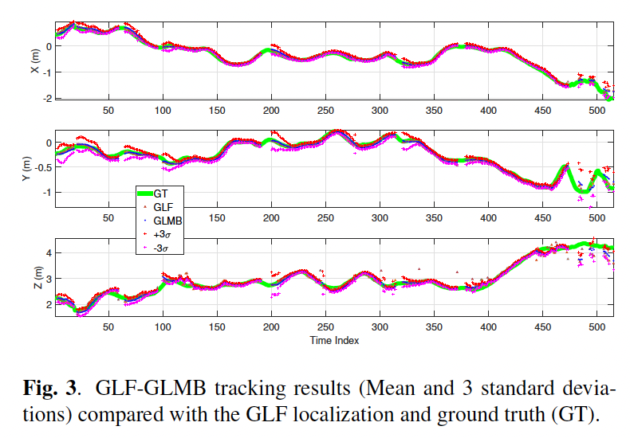
GLF-GLMB Tracking Results

Slide 11
Conclusion
Summary of the proposed GLMB-based 3D speaker tracking method
Video-guided linear search + GLMB algorithm
Achievement of state-of-the-art results on the AV16.3 dataset
Addressal of common issues in speaker tracking such as missed detections and spurious estimates
Acknowledgement:
CCF-Tencent Rhino-Bird Open Research Fund;
National Natural Science Foundation of China (NSFC)
Eigenspace GmbH

