Slide 1
Wide-Angle Image Stitching Using Multi-Homography Warping
Bin Xu, Yunde Jia
Beijing Institute of Technology

Slide 2
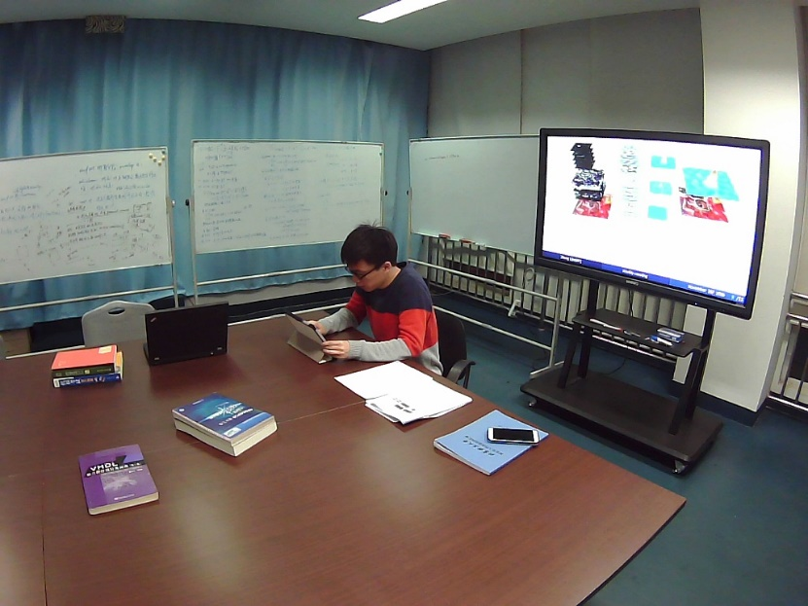
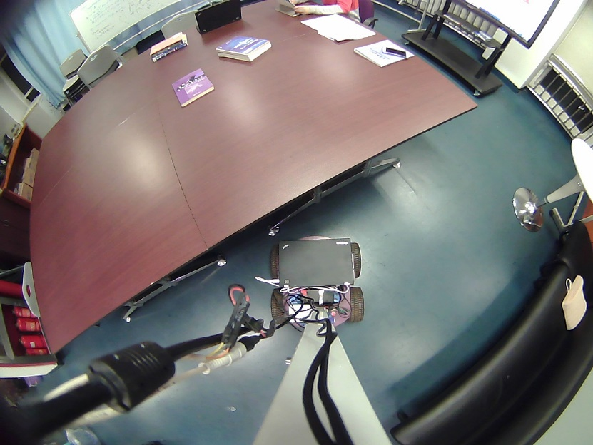
Wide-angle image stitching

Slide 3
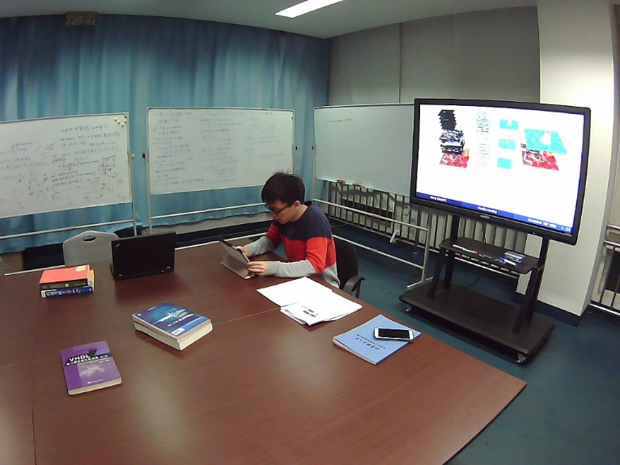
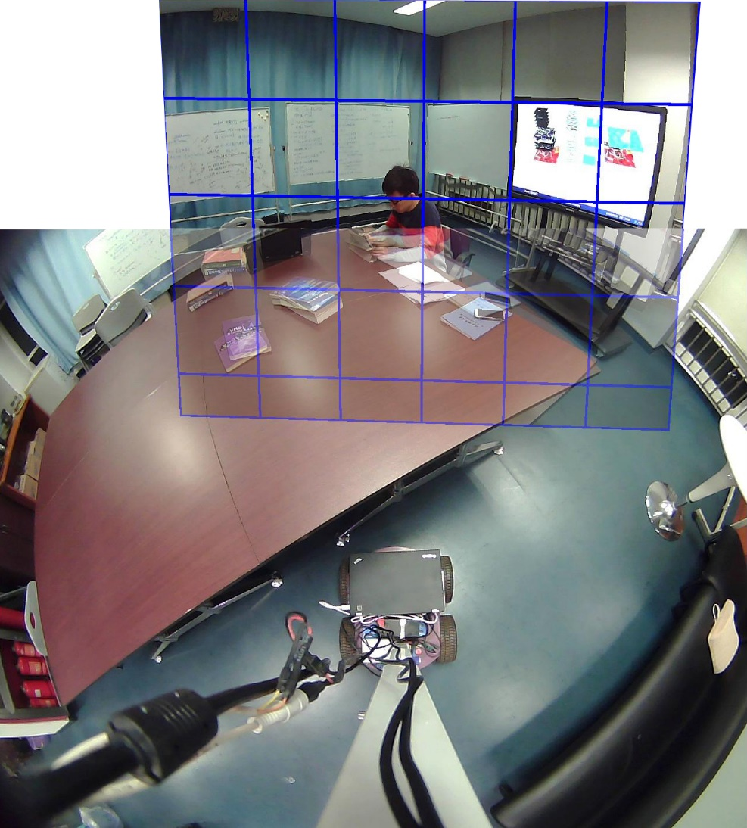
Projective transformation
(Homography)

Slide 4
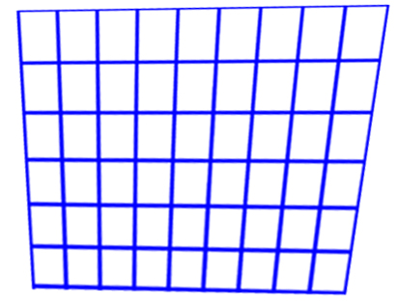
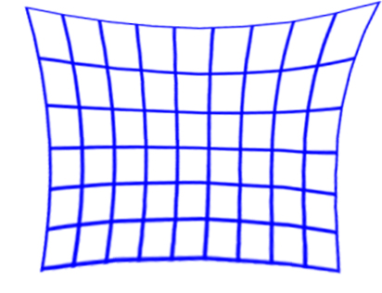
Single global homography
Misalignment
Division model
Shape and area distortion

Slide 5
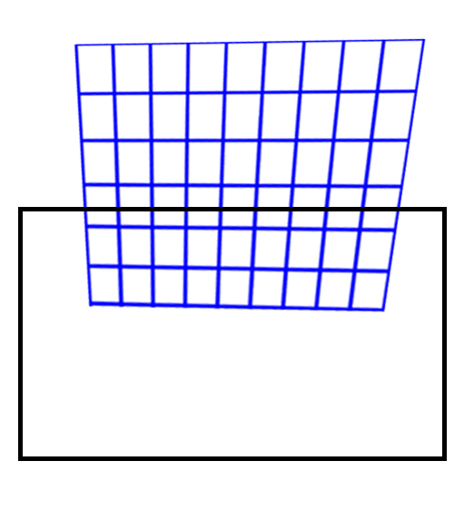
Globally similar
(Shape-Preserving Half-Projective Warp)
Locally aligned
(As-Projective-As-Possible Warp)

Slide 6
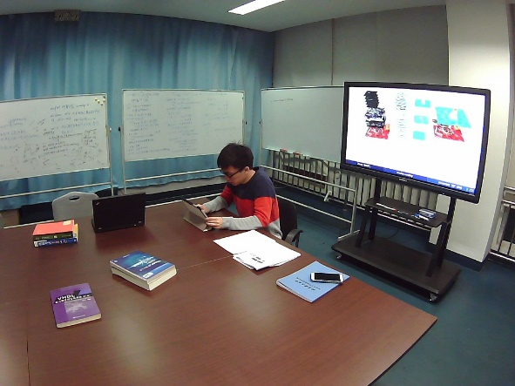
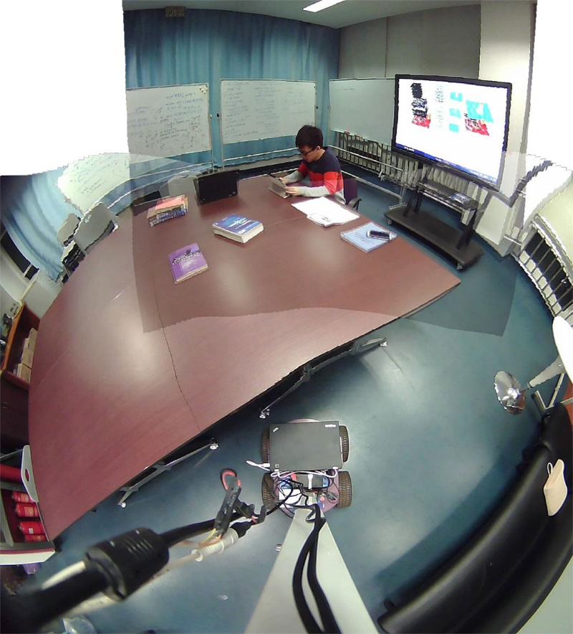
We propose a multi-homography warping,
which integrates multiple local homographies
with a global homography
for accurate alignment and shape preservation.

Slide 7
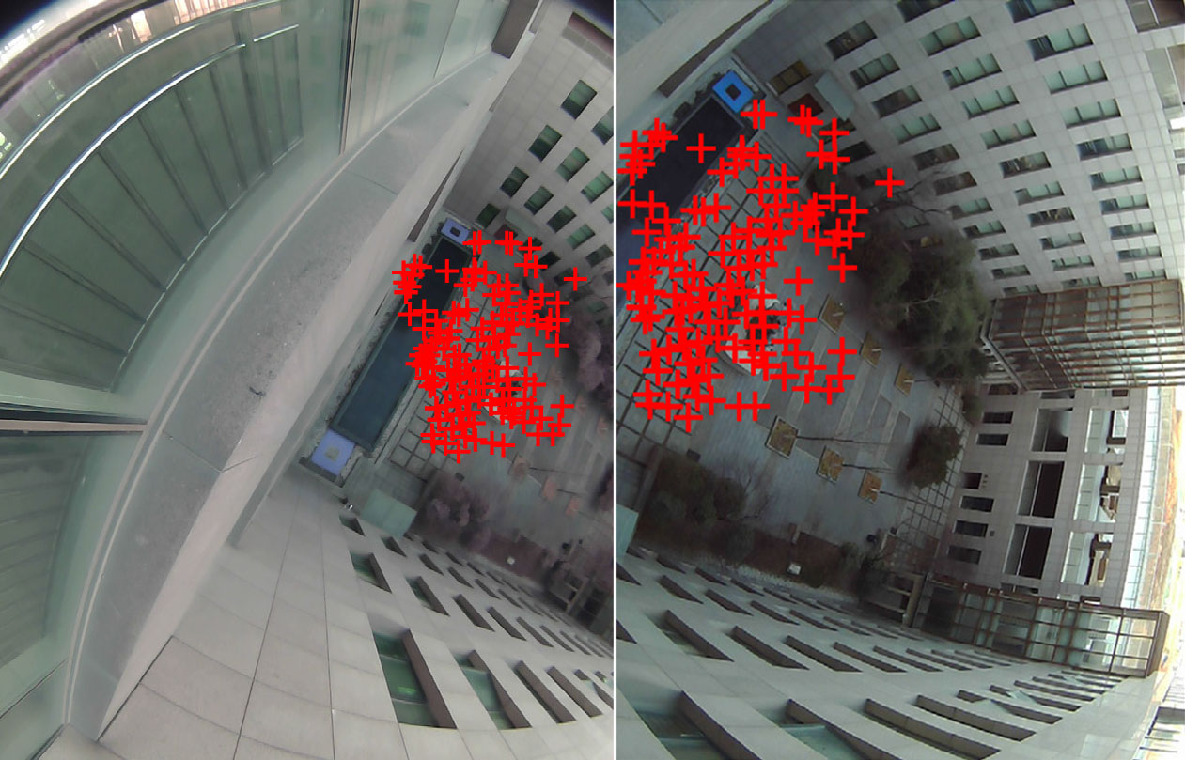
Inlier selection
Inliers selected by RANSAC
(random sampling)

Slide 8
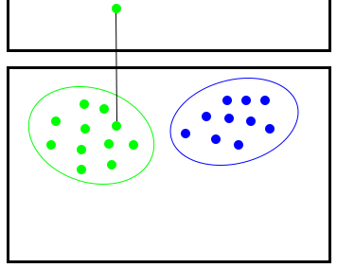
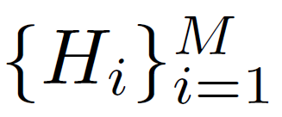
Key idea: random sampling
conditional sampling
p’
H1
H2
p
homography hypotheses

Slide 9
Based on Multi-GS, we use residual sorting information to perform a conditional sampling.
For
, we rank the
as .
If has been chosen, the probability of choosing as the next sample is

Slide 10
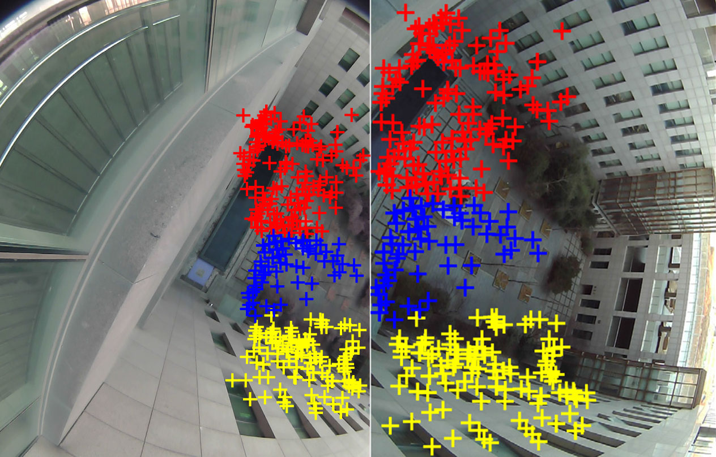
H1
Conditional sampling
H2
H3

Slide 11
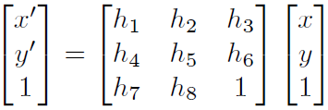
Global homography
Direct Linear Transformation (DLT)

Slide 12
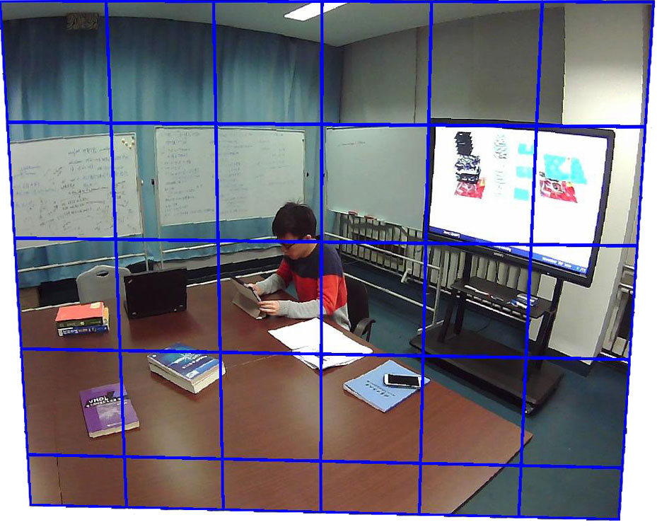
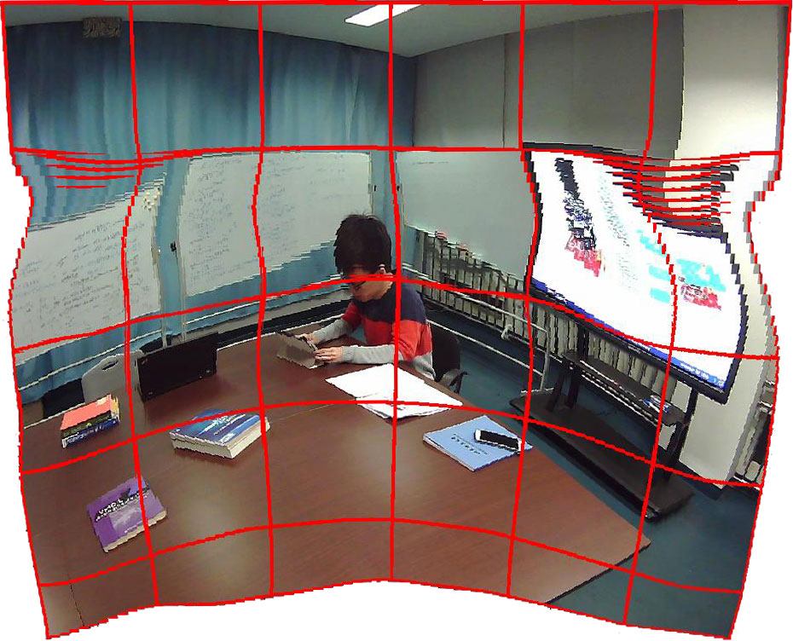
DLT
Moving DLT
Local homographies

Slide 13
We integrate the local with global
as our multi-homography warping
U
V

Slide 14
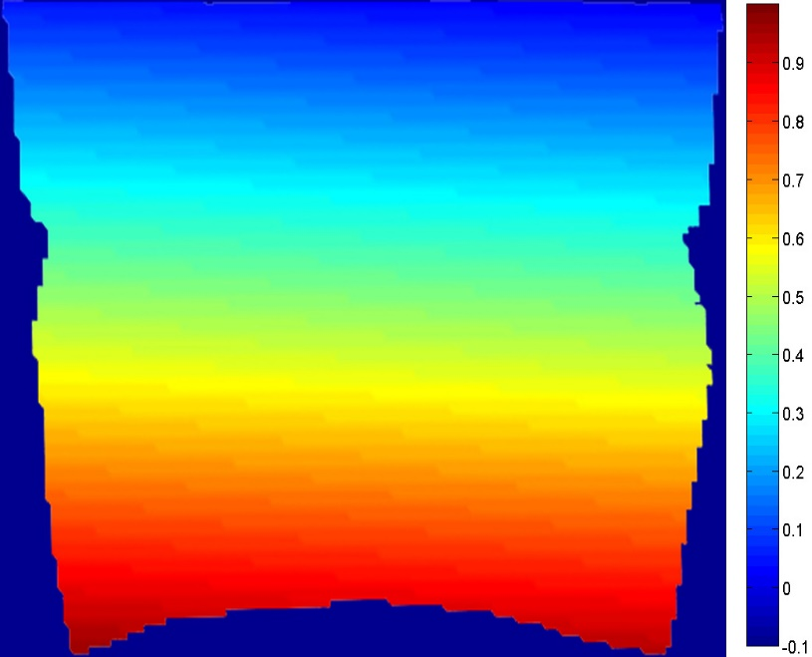
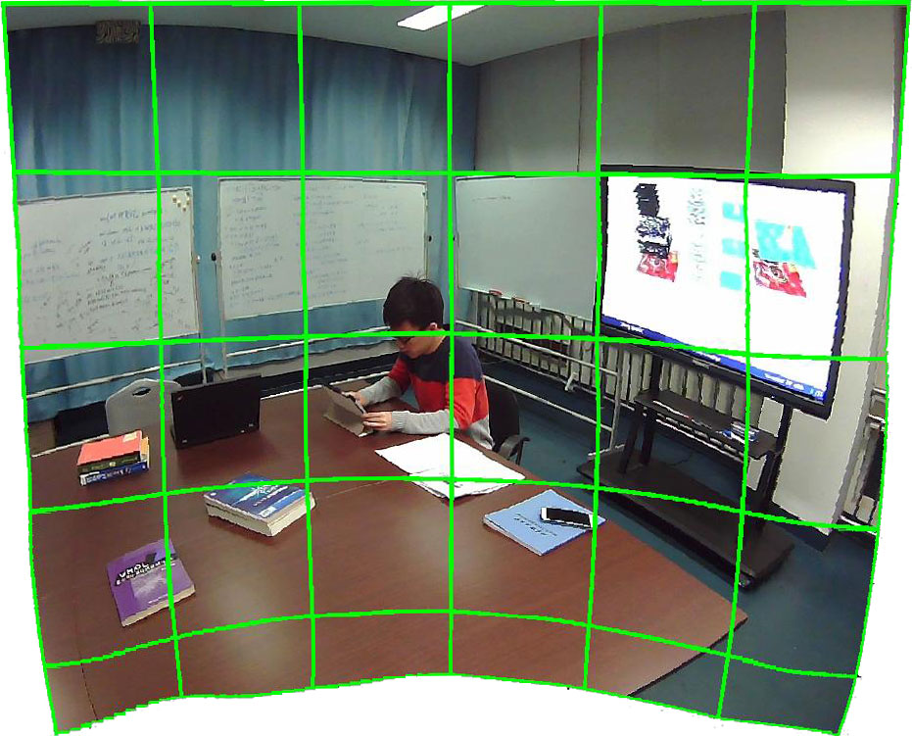
Result
We warp the reference image I’ by using

Slide 15
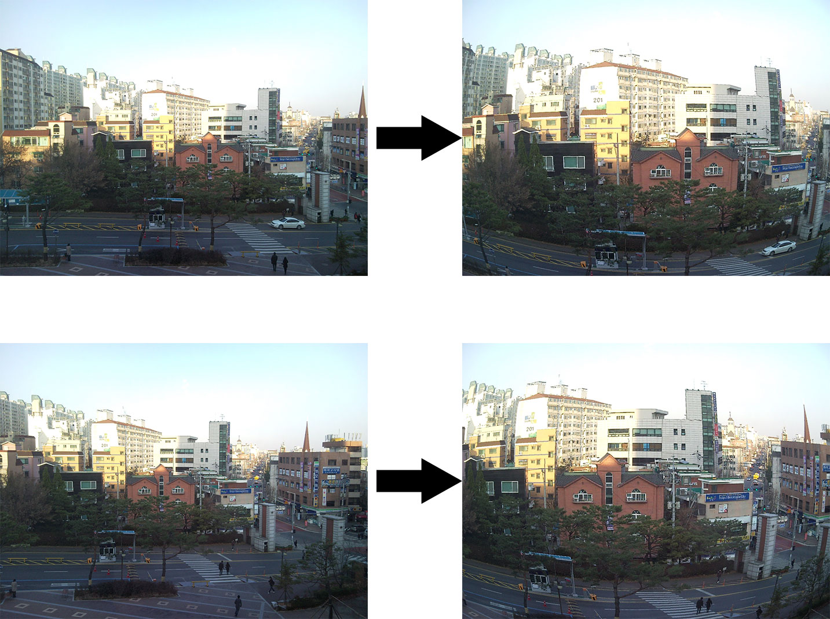
Two-view stitching

Slide 16
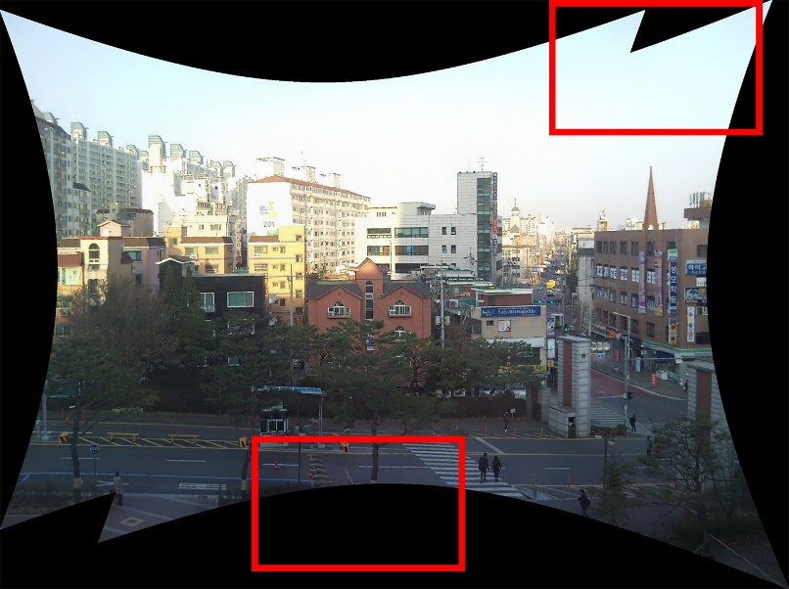
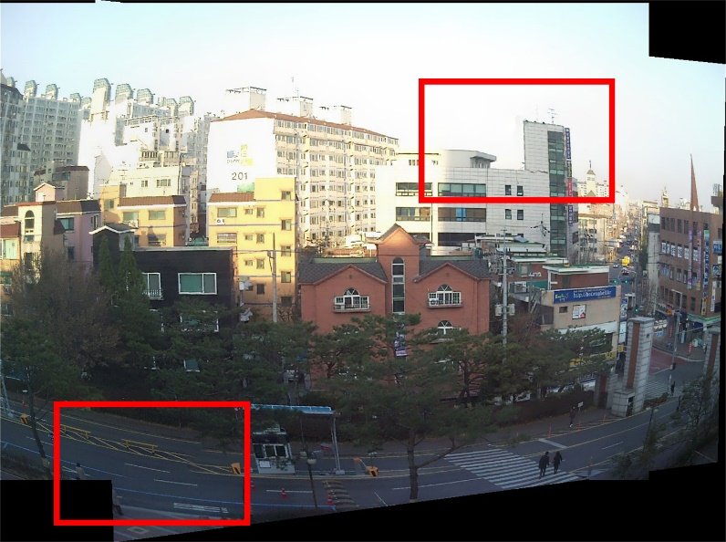
Ju et al.
Stitching3pt

Slide 17
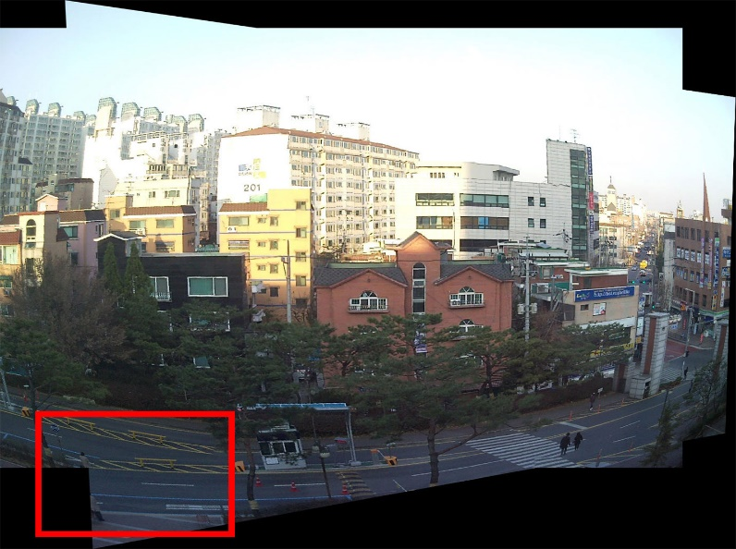
Autostitch
Microsoft ICE

Slide 18
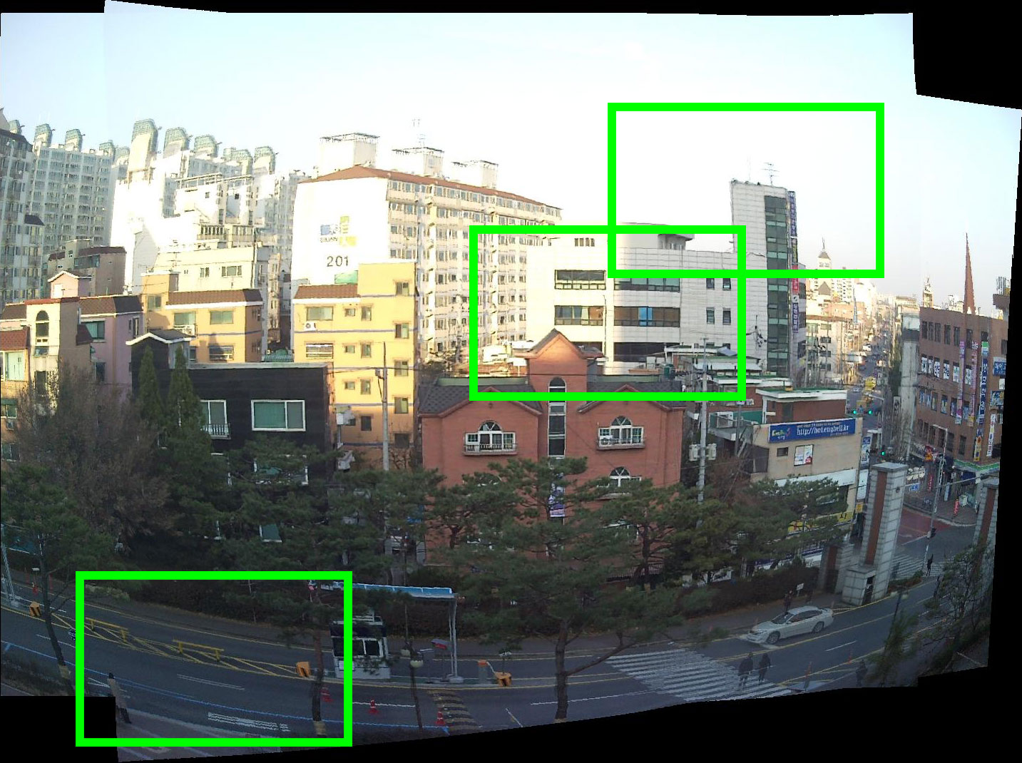
Ours

Slide 19
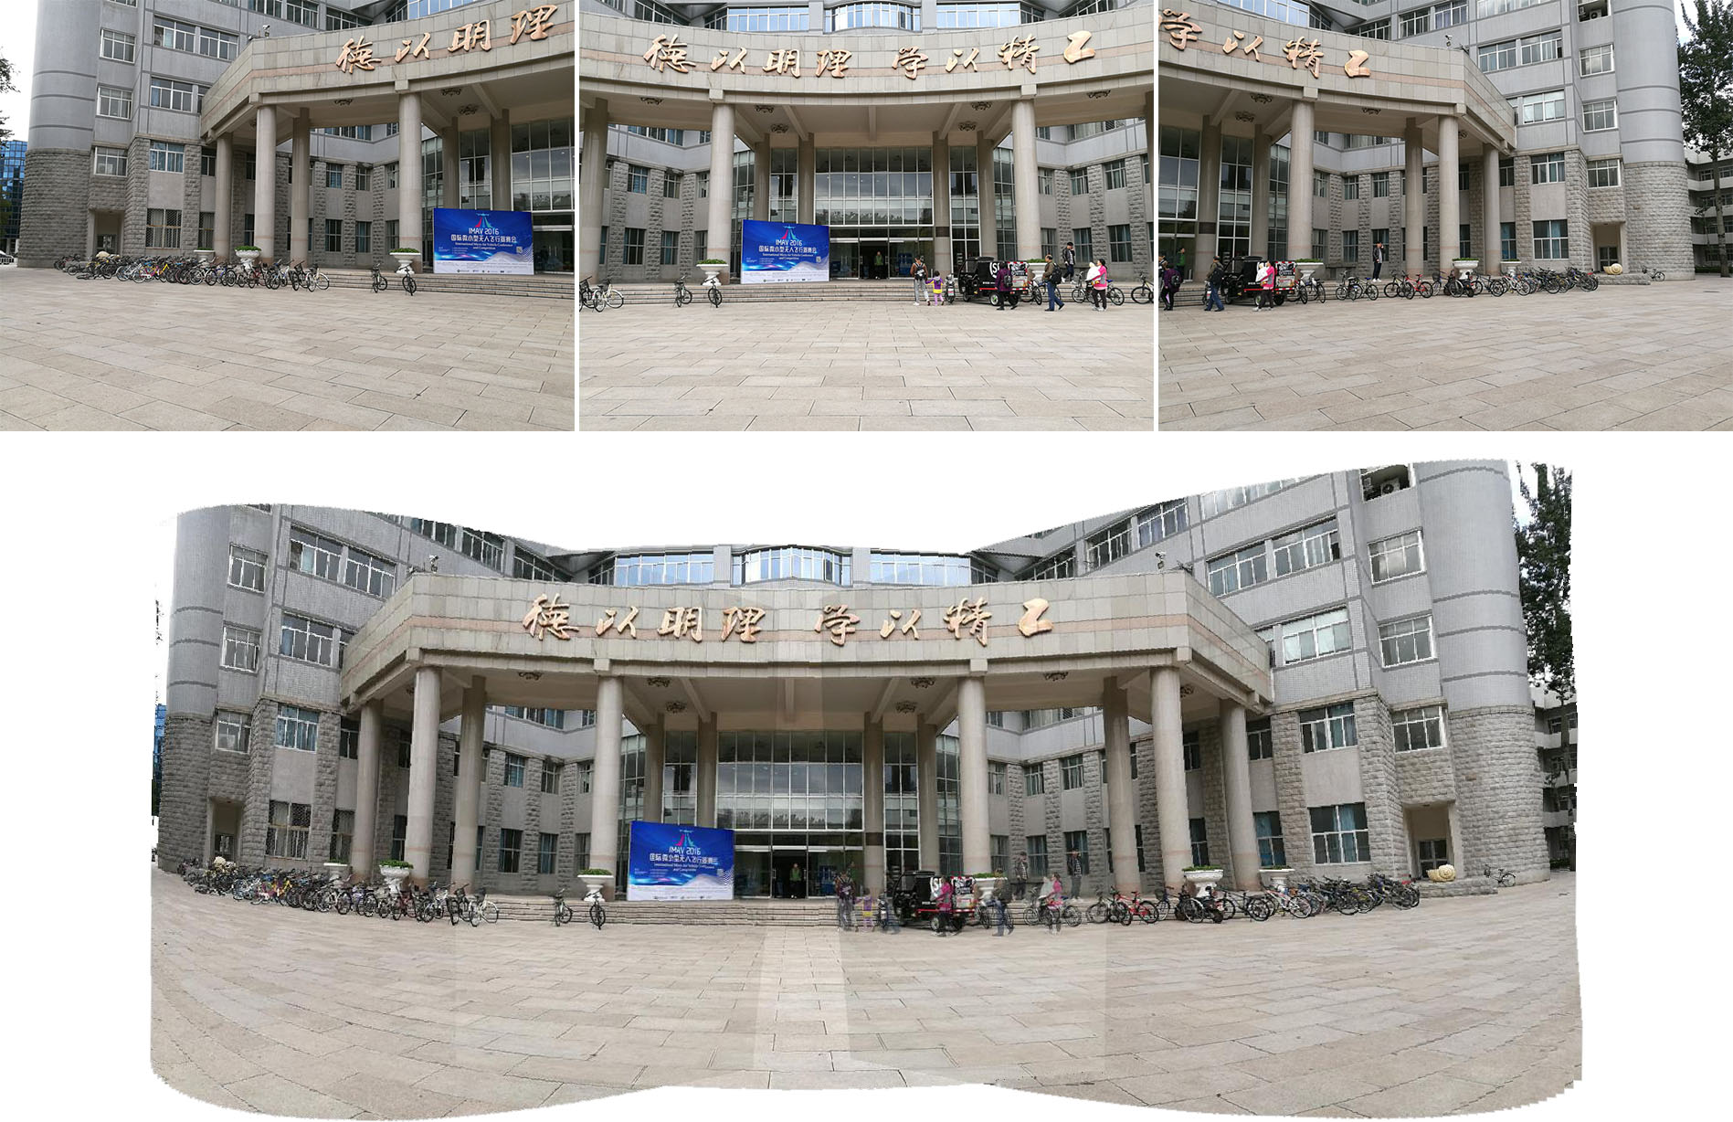

Slide 20
Thank you!

