Slide 1
2019 GlobalSIP
Beam Alignment-Based mmWave Spectrum Sensing in Cognitive Vehicular Networks
He Zhang, Caili Guo
Beijing University of Posts and Telecommunications, China.

Slide 2
Introduction
Model
Algorithm
Simulation
Conclusion
Notes:
My presentation will include these five parts. In the first part of the report, I would like to introduce some background knowledge, and then describe in detail the system model and the signal model, then I will describe the algorithm. Finally, I will compare the probability of detection of this algorithm and existing algorithm and put forward some conclusions.

Slide 3
Background
Why we do mmWave spectrum sensing in vehicular networks?
The shortage of spectrum resources in vehicular networks
MmWave as a major candidate for V2X
In response to high expected traffic demand of vehicular networks, spectrum sharing mechanism is applied to use the mmWave spectrum resources more efficiently.
Spectrum sensing is a supporting technology to realize spectrum sharing
Notes:
At the beginning, I will introduce the background of my research by answering why we do mmWave spectrum sensing in vehicular networks.
Over the years, the number of vehicle- mounted sensors has increased steadily, which potentially leads to more volume of critical data communications in a short time. Also, emerging applications such as remote/autonomous driving and infotainment such as high-definition movie streaming require data-rates on the order of multiple Gb/s. Such high data rates require a large system bandwidth, but very limited bandwidth is available in the sub-6 GHz cellular bands. This has sparked research interest in the millimeter wave (mmWave) band (10 GHz-300 GHz), where a large bandwidth is available to support the high data rate and low latency communications envisioned for emerging vehicular applications.
In response to high expected traffic demand of vehicular networks, spectrum sharing mechanism is applied to use the mmWave spectrum resources more efficiently.
Spectrum sensing is a supporting technology to realize spectrum sharing by detecting whether a certain channel is occupied or not.

Slide 4
Problem
Problem
The propagation characteristics of mmWave are different from those of sub-6GHz ：
the characteristics of directional propagation
the regime of mmWave networks : noise and interference limited
Model the received signal by using beamforming vectors
the received signal x has a form of:
Notes:
The problem is that the propagation characteristics of mmWave are different from those of sub-6GHz, such as the directional propagation of mmWave signal and the regime of mmWave networks.
Therefore, it is necessary to develop new model and algorithm for spectrum sensing according to the propagation characteristics of mmWave signals.

Slide 5
Introduction
Model
Algorithm
Simulation
Conclusion
Notes:
We first construct the system model.

Slide 6
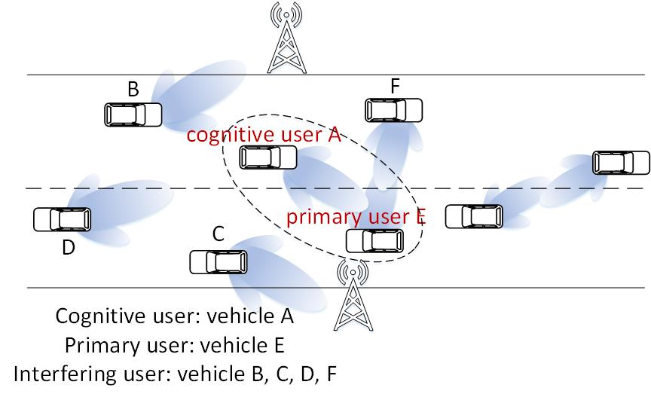
System Model
We focus on one cognitive vehicle, one primary vehicle and several interfering vehicles
Cognitive vehicle A desires to transmit signals in the direction of primary vehicle E
Before transmitting, vehicle A utilize signal received in the direction of vehicle E to do spectrum sensing
Fig1. System Model
Notes:
we focus on one cognitive vehicle, one primary vehicle and several interfering vehicles. Cognitive vehicle A desires to transmit signals in the direction of primary vehicle E. Before transmitting, vehicle A utilize signal received in the direction of vehicle E to do spectrum sensing. The received signal consists of signal transmitted by the primary vehicle E, interfering signals from vehicle B, C, D, F and noise.

Slide 7
Signal Model
The received signal x has a form of:
S represents the signal transmitted by the primary user:
is the noise part:
I is the interference part:
Channel H we applied is a typical mmWave channel and are the beamforming vectors used by the transmitter and the receiver
$$N_{w}$$
$$w_{T}$$
$$w_{R}$$
Notes:
Then we can obtain the signal model. The received signal x has a form of: S plus Nw plus I. S represents the signal transmitted by the primary user. Nw is the noise part and I is the interference part.

Slide 8
Hypothesis Model and Test Statistics
The binary hypothesis model is constructed as follows:
by analyzation, x follows Gaussian distribution:
obtain the test statistics by likelihood ratio
Notes:
On the basis of the previous analysis, the spectrum sensing model can be constructed as a hypothesis test. Then by analyzation, we can know , x follows Gaussian distribution. Then we apply the likelihood ratio test to obtain the test statistics T(x). When N is large enough, T (x) follows the Gaussian distribution approximately according to the Central Limit Theorem.

Slide 9
Introduction
Model
Algorithm
Simulation
Conclusion
Notes:
Then I will describe the algorithm.

Slide 10
Reconstruct the measurement
BA-VMSS Algorithm
Due to vehicular mobility, sensing results in different sensing periods are affected by different environment conditions
Vehicles obtain diversity gain
The performance of spectrum sensing will be improved
We use multiple test statistics in consecutive sensing periods to do the current test
Notes:
Then I will describe the algorithm. First, we reconstruct the measurement to adapt to the vehicular network. Then we derive the new test statistics. In vehicular networks, due to vehicular mobility, sensing results in different sensing periods are affected by different environment conditions, which results in less temporal correlation and enables vehicles to obtain diversity gain. Thus the performance of spectrum sensing will be improved.
So we use multiple test statistics in consecutive sensing periods to do the current test, which means every descision is made using historical test statistics and current test statistics. The detecting measurement of the proposed algorithm at instant n is constructed as yn. where Tn0 is the current test statistics, TnM-k is the test statistics in the M -k sensing period before current period.

Slide 11
BA-VMSS Algorithm
By analyzation, is M-variate Gaussian under both hypothesis:
$$y_{n}$$
By doing the likelihood ratio, the statistics is obtained:
Then Decision expression is obtained:
Notes:
Since the test statistics Tn0 and TnM-k follow the same Gaussian distribution as in (12), yn is M-variate Gaussian under both hypothesis. By doing the likelihood ratio, the statistics is obtained. Then Decision expression is obtained.

Slide 12
Theoretical Performance
Based on the test statistics , the probability of false alarm pf can be derived.
Then the decision threshold η subject to the desired pf can be derived as:
Then the probability of detection pd
Notes:
Based on the test statistics , the probability of false alarm pf can be derived. Then the decision threshold η subject to the desired pf can be derived. Then the probability of detection pd can be obtained.

Slide 13
Introduction
Model
Algorithm
Simulation
Conclusion
Notes:
Then we discuss the simulation results.

Slide 14
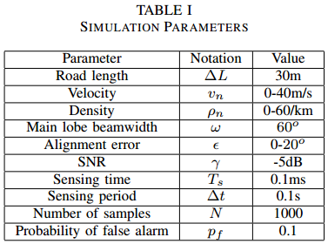
Simulation Setting
The simulation results are generated through a Monte Carlo test running for 10,000 iterations.
Parameters in our simulation are presented in Table 1.
The MRT-based algorithm in [1] is selected as the comparing algorithm.
[1] Y. Wang, Z. Zhang and H. Li, ”Universal Quickest Sensing of Spectrum Change in Millimeter Wave Communications: A Data Driven Approach,” GLOBECOM 2017 - 2017 IEEE Global Communications Conference, Singapore, 2017, pp. 1-6.
Notes:
The simulation results are generated through a Monte Carlo test running for 10,000 iterations.
Parameters in our simulation are presented in Table 1.
The MRT-based algorithm in [1] is selected as the comparing algorithm.
To the best of the our knowledge, the MRT-based algorithm is the only one that has been reported in literature recently. It proposed a spectrum sensing method based on the mean return time (MRT) of random processes by tactfully avoiding to derive the statistical characteristics of received mmWave signals.

Slide 15
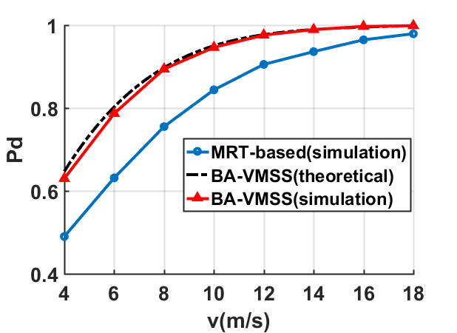
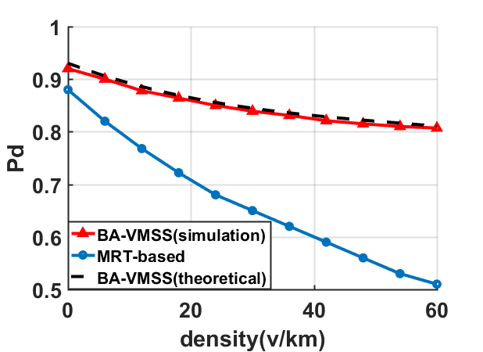
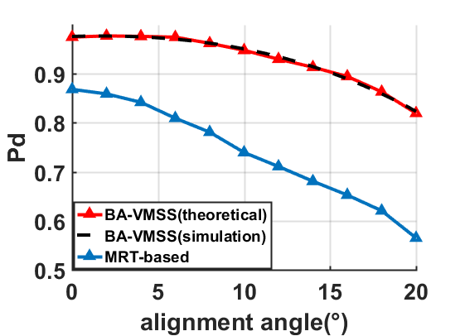
Simulation results
Fig2. Pd as a function of velocity
Fig3. Pd as a function of density
Fig4. Pd as a function of alignment angle
Pd for our BA-VMSS is higher than the MRT-based algorithm because our proposed algorithm models interference caused by surrounding vehicles into the received signal.
As ε increases, the uncertainty of the alignment gain increases as well, which means the uncertainty of test statistics grows. With ε increases, Pd of the MRT-based algorithm drops faster than Pd of our algorithm.
The BA-VMSS algorithm outperforms
the MRT-based algorithm because we take the mobility of vehicles into account by applying the temporal correlation.
Notes:
Let’s see the simulation results.
In Figure 2, we evaluate the Pd as a function of velocity for MRT-based algorithm and the proposed BA-VMSS algorithm. This figure reveals that as velocity increases, vehicles can get more diversity gain and thus performance of both algorithms improves. And the BA-VMSS algorithm outperforms the MRT-based algorithm because we take the mobility of vehicles into account by applying the temporal correlation.
Figure 3 illustrates Pd against traffic density. 1v/km means there is 1 vehicle per kilometer of road length. As the traffic becomes congested, the received signal experiences more interference and thus sensing performance will deteriorate. Even so, Pd for our BA-VMSS is higher than the MRT-based algorithm. The reason is that our proposed algorithm models interference caused by surrounding vehicles into the received signal.
Figure 4 shows the influence of alignment angle on Pd. As ε increases, the uncertainty of the alignment gain increases as well, which means the uncertainty of test statistics grows and thus performance of spectrum sensing decreases. With ε increases, Pd of the MRT-based algorithm drops faster than Pd of our algorithm.
From above three figures, we can conclude that our proposed BA-VMSS has a higher Pd than MRT-based algorithm.

Slide 16
Introduction
Model
Algorithm
Simulation
Conclusion
Notes:
At last, I give the conclusion of this research.

Slide 17
Conclusion
We innovatively construct the mmWave spectrum sensing model for vehicular networks and propose the BA-VMSS algorithm.
In the area of mmWave spectrum sensing, the characteristics of directional propagation has not been considered well, thus we model the beam alignment gain in the received signal and then according to the regime of mmWave networks to construct the sensing model.
Based on this model, we apply the temporal correlation to design the algorithm to make it adapt to vehicular networks.
Notes:
we innovatively construct the mmWave spectrum sensing model for vehicular networks and propose the BA-VMSS algorithm. In the area of mmWave spectrum sensing, the characteristics of directional propagation has not been considered well, thus we model the beam alignment gain in the received signal and then according to the regime of mmWave networks to construct the sensing model. Based on this model, we apply the temporal correlation to design the algorithm to make it adapt to vehicular networks. Simulation shows that the proposed algorithm outperforms the existing algorithm.

Slide 18
Thanks
Contact {zhanghe2017, guocaili}@bupt.edu.cn for questions.

