Slide 1
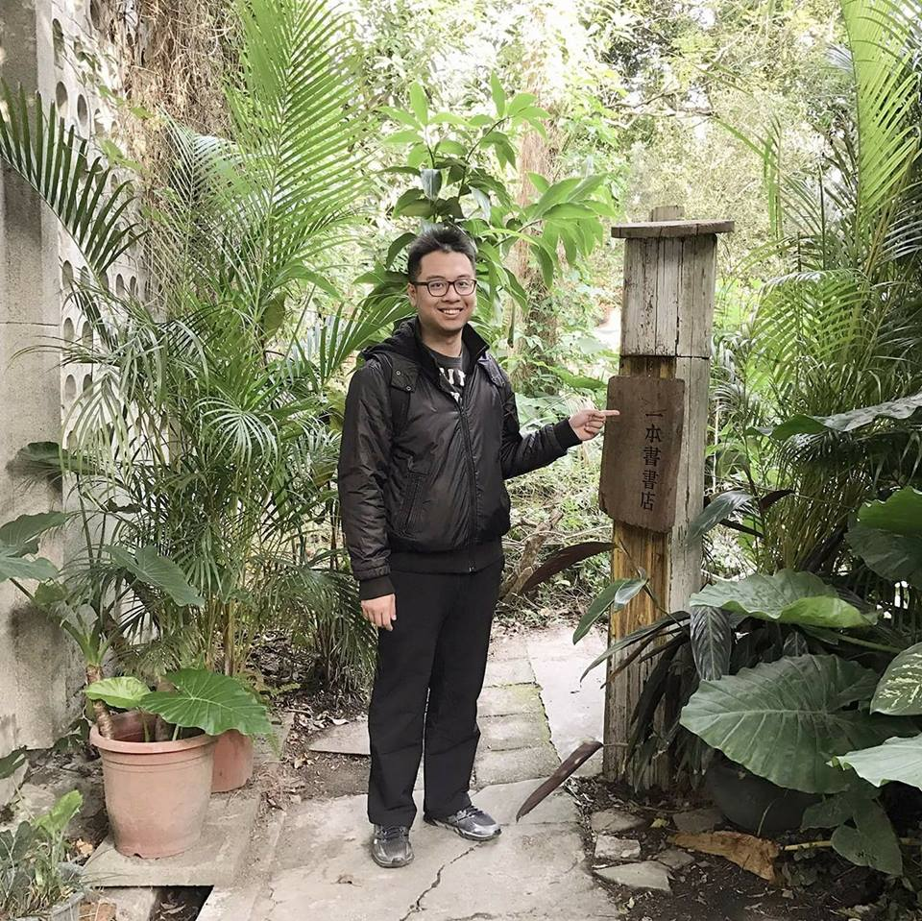
Domain independent key term extraction from spoken content based on context and term location information in the utterances
Hsien-Chin Lin, Chi-Yu Yang, Hung-Yi Lee, Lin-shan Lee
Speaker: Hung-yi Lee
Hsien-Chin Lin
Chi-Yu Yang
National Taiwan University
Notes:
Q: for speech error simulation, do we have ERR?
Q: Kaggle 怎樣?
Q: DNN?
Q: textrank
Q: how to determine th?
Open: 0:20

Slide 2
Task Introduction: Key Term Extraction

Slide 3
Task Introduction
Key term extraction is aimed to identify the important terms from a (spoken) document
DNN
model
LSTM
CNN
Plain Text or
ASR transcriptions

Slide 4
Key Term Extraction Approaches
Unsupervised approaches: using some rules to determine whether a term is a key term
Supervised approaches
→ Low accuracy
labelled data
model
Key term 1
Key term 3
Key term 2
Key term 2
Key term 4
Key term 5
?
Notes:
→ limited by training domain
Practically, we will need to extract key terms from documents in unseen domains

Slide 5
Supervised approaches
[Kamal Sarkar, et al., IJCSI, 2010][Wang, et al., SERC, 2014][Shen, INTERSPEECH, 2016]
Supervised approaches: key term extraction is usually formulated as multi-class classification problem.
Each key term is considered as a class.
Out-of-domain?
soup
recipe
ICASSP papers
model
Key term 1
Key term 3
Key term 2
Key term 2
Key term 4
Key term 5
?
soup
Key terms: LSTM, GAN, SLU, ……
Notes:
→ limited by training domain
Practically, we will need to extract key terms from documents in unseen domains
These approaches can never detect the key terms not in training data.

Slide 6
Towards Domain Independent
We proposed supervised key term extraction approach based on the context and the term location information.
Example
We focus on keyword extraction, but the proposed approach can be generalized to key phrase extraction.
“The subject of this lecture is primarily about Ricklantis. ”
Never see the term before
It is a key term.
Notes:
3:30

Slide 7
Proposed Models

Slide 8
Basic Idea
“The lecture is about GAN”
0
0
0
0
1
Predict each word position in the input sentence corresponds to a key word or not
word
Document:
$$x_{1}$$
$$x_{2}$$
$$x_{3}$$
……
$$x_{N}$$
Label:
$$y_{1}$$
$$y_{2}$$
$$y_{3}$$
……
$$y_{N}$$
0
0
0
1
0: The word at the specific position is NOT key term.
1: The word at the specific position is a key term.

Slide 9
Basic Model
It is a keyword.
Training Phase:
Testing Phase:
The lecture is about GAN
The lecture is about Ricklantis
Feature extraction
Feature extraction
$v_{1}$
$v_{2}$
$v_{3}$
$v_{4}$
$v_{5}$
$v_{1}$
$v_{2}$
$v_{3}$
$v_{4}$
$v_{5}$
Hidden Layer
Hidden Layer
Hidden Layer
Hidden Layer
Hidden Layer
Hidden Layer
Hidden Layer
Hidden Layer
Hidden Layer
Hidden Layer
Output Layer
Output Layer
$$o_{1}$$
$$o_{2}$$
$$o_{3}$$
$$o_{4}$$
$$o_{5}$$
$$0.0$$
$$0.1$$
$$0.0$$
$$0.0$$
$$0.9$$
0
0
0
0
1
Larger than a threshold th

Slide 10
Optimizing Evaluation Measure
This lecture … LSTM ... GAN …
Feature extraction
$v_{1}$
$v_{2}$
$v_{3}$
$v_{4}$
Hidden Layer
Hidden Layer
Hidden Layer
Hidden Layer
…
…
Output Layer
$$o_{1}$$
$$o_{2}$$
…
$$o_{3}$$
…
$$o_{4}$$
The training of basic model does not optimize the evaluation measure.
0
0
1
1

Slide 11
Optimizing Evaluation Measure
This lecture … LSTM ... GAN …
Can we directly optimize F-1 score during training?
Feature extraction
Issue: not differentiable
$v_{1}$
$v_{2}$
$v_{3}$
$v_{4}$
F-1 score = 0.25
Hidden Layer
Hidden Layer
Hidden Layer
Hidden Layer
…
…
LSTM
LSTM
Output Layer
GAN
lecture
0
0.7
…
0.9
…
0.3
Reference keywords
We use reinforcement learning!
Notes:
3:30

Slide 12
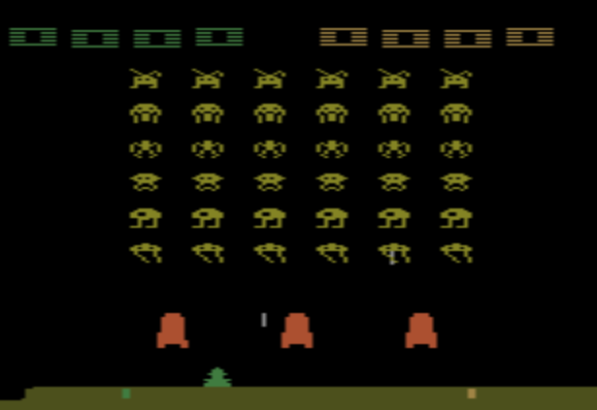
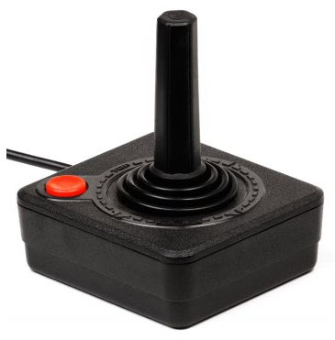
Example: Playing Video Game
Start with observation $s_{1}$
Observation $s_{2}$
Observation $s_{3}$
Action $a_{1}$: “right”
Action $a_{2}$: “fire”
Total reward:
$$R=\sum_{t=1}^{T}{r_{t}}$$
Agent learns to maximize total reward
Notes:
Usually there is some randomness in the environment

Slide 13
Each word is an observation.
This lecture … LSTM ... GAN …
Agent
Feature extraction
Use reinforcement learning
to learn the agent
$v_{1}$
$v_{2}$
$v_{3}$
$v_{4}$
Max
F-1 score = 0.25
Hidden Layer
Hidden Layer
Hidden Layer
Hidden Layer
…
…
Total Reward
LSTM
LSTM
Output Layer
GAN
lecture
…
…
N
Y
N
Y
Reference keywords
Action: a word is a key term or not
Notes:
2:00

Slide 14
Reinforcement Learning: Policy Gradient
$$\left\{\begin{aligned}P\left(z_{4}=1\right)=0.\text{8} \\ P\left(z_{4}=0\right)=0.2\end{aligned}\right.$$
$$\left\{\begin{aligned}P\left(z_{3}=1\right)=0.\text{5} \\ P\left(z_{3}=0\right)=0.5\end{aligned}\right.$$
$$\left\{\begin{aligned}P\left(z_{1}=1\right)=0.1 \\ P\left(z_{1}=0\right)=0.9\end{aligned}\right.$$
Using the basic model as initialization
For each word $x_{i}$ we have an output $o_{i}$
Obtain a sample value $z_{i}$ according to the $o_{i}$
All samples for input sentence $X$ form $\tilde{Z}$
Repeat this way k times (k=5 here)
$$X:$$
$$x_{1}$$
$$x_{2}$$
$$x_{3}$$
$$x_{4}$$
$$\left\{\begin{aligned}P\left(z_{2}=1\right)=0.\text{05} \\ P\left(z_{2}=0\right)=0.95\end{aligned}\right.$$
Feature extraction
$${\tilde{Z}}_{1}=[$$
$$0$$
$$0$$
$$0$$
$$1$$
$$]$$
$v_{1}$
$v_{2}$
$v_{3}$
$v_{N}$
$${\tilde{Z}}_{2}=[$$
$$0$$
$$0$$
$$0$$
$$0$$
$$]$$
$${\tilde{Z}}_{3}=[$$
$$0$$
$$0$$
$$1$$
$$0$$
$$]$$
Hidden Layer
Hidden Layer
Hidden Layer
Hidden Layer
$${\tilde{Z}}_{4}=[$$
$$0$$
$$0$$
$$1$$
$$1$$
$$]$$
$${\tilde{Z}}_{5}=[$$
$$1$$
$$0$$
$$0$$
$$1$$
$$]$$
Output value Sampling
Output Layer
$$O:$$
$$0.1$$
$$0.05$$
$$0.5$$
$$0.8$$

Slide 15
Reinforcement Learning: Policy Gradient
($α_{i}=reward$)
$$X:$$
$$x_{1}$$
$$x_{2}$$
$$x_{3}$$
$$x_{4}$$
$${\tilde{Z}}_{1}=[0, 0, 0, 1]$$
$$α_{1}=0.67$$
Evaluate the F-measure $α_{i}$ for each${\tilde{Z}}_{i}$
Assume $x_{3}$ and $x_{4}$ are key terms
$${\tilde{Z}}_{2}=[0, 0, 0, 0]$$
$$α_{2}=0$$
Feature extraction
$${\tilde{Z}}_{3}=[0, 0, 1, 0]$$
$$α_{3}=0.67$$
$v_{1}$
$v_{2}$
$v_{3}$
$v_{N}$
$$α_{4}=1$$
$${\tilde{Z}}_{4}=[0, 0, 1, 1]$$
$${\tilde{Z}}_{5}=[1, 0, 0, 1]$$
$$α_{5}=0.5$$
Hidden Layer
Hidden Layer
Hidden Layer
Hidden Layer
F measure Evaluation (Reward Function)
Output value Sampling
Output Layer
$$O:$$
$$0.1$$
$$0.05$$
$$0.5$$
$$0.8$$
Notes:
Environment: F-measure Reward: $α_{i}$

Slide 16
Reinforcement Learning: Policy Gradient
Total of 5 training pairs $\left(X,{\tilde{Z}}_{j}\right)$ with weight $α_{j}$ are used to retrain the model
Training pairs with higher F-measures will be weighted higher
The model tends to generate output with larger $α$
Define New Training Set
New Training Set
$$\left(X,{\tilde{Z}}_{1}\right) {\text{with} \text{weight} α}_{1}$$
$$\left(X,{\tilde{Z}}_{2}\right) {\text{with} \text{weight} α}_{2}$$
$$\left(X,{\tilde{Z}}_{3}\right) {\text{with} \text{weight} α}_{3}$$
$$\left(X,{\tilde{Z}}_{4}\right) {\text{with} \text{weight} α}_{4}$$
$\left(X,{\tilde{Z}}_{5}\right) {\text{with} \text{weight} α}_{5}$
$α_{1}, α_{2}, …, α_{5}$ (reward)
F measure Evaluation (Reward Function)
$${\tilde{Z}}_{1},{\tilde{Z}}_{2},…,{\tilde{Z}}_{5}$$
Output value Sampling
Update
Input $X$,
Output $O$,
Original Training Method
Train
model

Slide 17
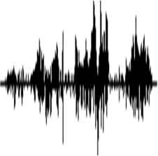
Spoken Documents
ASR
The lecture is about gang.
The lecture is about GAN
Feature extraction
$v_{1}$
$v_{2}$
$v_{3}$
$v_{4}$
$v_{5}$
Hidden Layer
Hidden Layer
Hidden Layer
Hidden Layer
Hidden Layer
Study the impact of speech recognition errors
Lack of spoken data for key term extraction
Output Layer
Simulate ASR errors
$$0.0$$
$$0.1$$
$$0.0$$
$$0.0$$
$$?$$
Notes:
0:30

Slide 18
Speech Recognition Error Simulation
Original words
Simulator trained on Librispeech
Original words: $X=\left[x_{1}, x_{2}, …, x_{N}\right]$
Transcriptions: $X^{′}=\left[x_{1}^{′}, x_{2}^{′}, …, x_{N}^{′}\right]$
Build a confusion matrix by $P\left(a | b\right)=\frac{count\left(x^{′}=a;x=b\right)}{Σ_{m}count\left(x^{′}=m,x=b\right)}$
The words in the same group have higher probabilities to be recognized to each other
The confusion matrix jointly reflects the functions of acoustic and language models
Hair
Her
Your
Want
Once
One
Won
Her
Transcriptions
Notes:
lack of spoken data for training and testing
Simulate recognition error to generate data from text
最多 11mins

Slide 19
Experiments
Notes:
For each domain, how much train and test (LSTM supervised train )
9:1
Keyphrase considered

Slide 20
Data sets
Kaggle Competition: https://www.kaggle.com/c/transfer-learning-on-stack-exchange-tags
Parsed from StackExchange, a website for Q&A community
Users post their questions and answers with some key terms
How can I get chewy chocolate chip cookies?
My chocolate chips cookies are always too crisp. How can I get chewy cookies, like those of Starbucks?
Key terms: baking, cookies, texture
What is the difference between white and brown eggs?
I always use brown extra large eggs, but I can't honestly say why I do this other than habit at this point. Are there any distinct advantages or disadvantages like flavor, shelf life, etc?
Key terms: eggs

Slide 21
Data sets
Kaggle Competition: https://www.kaggle.com/c/transfer-learning-on-stack-exchange-tags
Parsed from StackExchange, a website for Q&A community
Users post their questions and answers with some key terms
Contain 6 domains (Each domain divided into training and testing set)
Evaluate the ability of the proposed approach to extract the key terms in an unseen domain not existing in the training set
choose one domain for testing, the others to be training
Domain | biology | cooking | travel | robotics | crypto | DIY
# of documents | 13196 | 15404 | 19279 | 2771 | 10432 | 25918
Vocabulary size | 38257 | 24313 | 32072 | 17160 | 26792 | 32106
# of key terms | 678 | 736 | 1645 | 231 | 392 | 734
test
train

Slide 22
Data sets
Kaggle Competition: https://www.kaggle.com/c/transfer-learning-on-stack-exchange-tags
Parsed from StackExchange, a website for Q&A community
Users post their questions and answers with some key terms
Contain 6 domains (Each domain divided into training and testing set)
Evaluate the ability of the proposed approach to extract the key terms in an unseen domain not existing in the training set
choose one domain for testing, the others to be training
Domain | biology | cooking | travel | robotics | crypto | DIY
# of documents | 13196 | 15404 | 19279 | 2771 | 10432 | 25918
Vocabulary size | 38257 | 24313 | 32072 | 17160 | 26792 | 32106
# of key terms | 678 | 736 | 1645 | 231 | 392 | 734
test
train

Slide 23
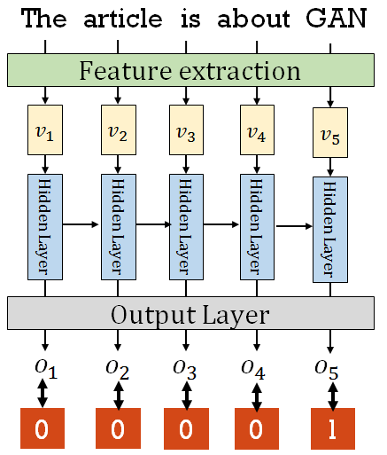
Feature extraction
Word statistics:
Term frequency
Inverse document frequency
Tf-idf
The word counts in the domain
Position of the word in the sentence
dim
=5
dim
=200
Word2Vec

Slide 24
Experimental results
Evaluation measure: F-1 score
Methods |  |  | DIY | biology | cooking | travel | robotics | crypto
Upper bound |  |  | 0.679 | 0.359 | 0.672 | 0.578 | 0.651 | 0.684
Baseline | Tf-idf sorting |  | 0.213 | 0.095 | 0.249 | 0.206 | 0.193 | 0.224
 | Text Rank |  | 0.195 | 0.084 | 0.242 | 0.154 | 0.151 | 0.178
 | Classification LSTM |  | 0.282 | 0.208 | 0.221 | 0.243 | 0.180 | 0.222
Proposed | Basic | Embedding only | 0.235 | 0.102 | 0.224 | 0.211 | 0.185 | 0.237
 |  | All features | 0.242 | 0.103 | 0.285 | 0.229 | 0.202 | 0.252
 | Optimizing F-1 (All fetures) |  | 0.272 | 0.113 | 0.318 | 0.215 | 0.246 | 0.255
The proposed approach cannot extract the key terms in the document.
Upper bound: The key terms appear in the documents are all correctly identified.
F-1 score of the upper bound is not 1.0 because some key terms do not appear in the documents.

Slide 25
Experimental results
Evaluation measure: F-1 score
Methods |  |  | DIY | biology | cooking | travel | robotics | crypto
Upper bound |  |  | 0.679 | 0.359 | 0.672 | 0.578 | 0.651 | 0.684
Baseline | Tf-idf sorting |  | 0.213 | 0.095 | 0.249 | 0.206 | 0.193 | 0.224
 | Text Rank |  | 0.195 | 0.084 | 0.242 | 0.154 | 0.151 | 0.178
 | Classification LSTM |  | 0.282 | 0.208 | 0.221 | 0.243 | 0.180 | 0.222
Proposed | Basic | Embedding only | 0.235 | 0.102 | 0.224 | 0.211 | 0.185 | 0.237
 |  | All features | 0.242 | 0.103 | 0.285 | 0.229 | 0.202 | 0.252
 | Optimizing F-1 (All fetures) |  | 0.272 | 0.113 | 0.318 | 0.215 | 0.246 | 0.255
Tf-idf sorting and Text Rank are unsupervised approaches.
Classification LSTM is a supervised approach.

Slide 26
Classification LSTM
The article is about GAN
Feature extraction
$v_{1}$
$v_{2}$
$v_{3}$
$v_{4}$
$v_{5}$
Classification LSTM is learned by in-domain data.
Hidden Layer
Hidden Layer
Hidden Layer
Hidden Layer
Hidden Layer
Output Layer
…
…
GAN
RNN
CNN

Slide 27
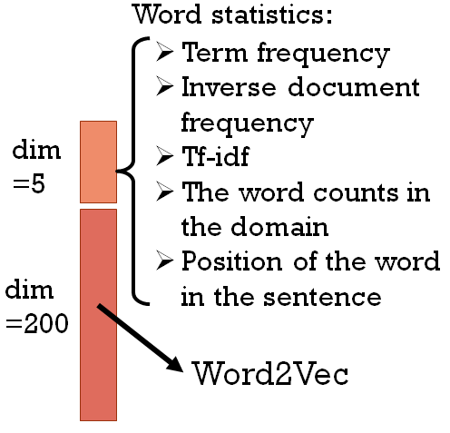
Experimental results
Evaluation measure: F-1 score
Methods |  |  | DIY | biology | cooking | travel | robotics | crypto
Oracle |  |  | 0.679 | 0.359 | 0.672 | 0.578 | 0.651 | 0.684
Baseline | Tf-idf sorting |  | 0.213 | 0.095 | 0.249 | 0.206 | 0.193 | 0.224
 | Text Rank |  | 0.195 | 0.084 | 0.242 | 0.154 | 0.151 | 0.178
 | Classification LSTM |  | 0.282 | 0.208 | 0.221 | 0.243 | 0.180 | 0.222
Proposed | Basic | Embedding only | 0.235 | 0.102 | 0.224 | 0.211 | 0.185 | 0.237
 |  | All features | 0.242 | 0.103 | 0.285 | 0.229 | 0.202 | 0.252
 | Optimize F-1 (All features) |  | 0.272 | 0.113 | 0.318 | 0.215 | 0.246 | 0.255
Adding word statistics is always helpful.

Slide 28
Experimental results
Evaluation measure: F-1 score
Methods |  |  | DIY | biology | cooking | travel | robotics | crypto
Oracle |  |  | 0.679 | 0.359 | 0.672 | 0.578 | 0.651 | 0.684
Baseline | Tf-idf sorting |  | 0.213 | 0.095 | 0.249 | 0.206 | 0.193 | 0.224
 | Text Rank |  | 0.195 | 0.084 | 0.242 | 0.154 | 0.151 | 0.178
 | Classification LSTM |  | 0.282 | 0.208 | 0.221 | 0.243 | 0.180 | 0.222
Proposed | Basic | Embedding only | 0.235 | 0.102 | 0.224 | 0.211 | 0.185 | 0.237
 |  | All features | 0.242 | 0.103 | 0.285 | 0.229 | 0.202 | 0.252
 | Optimize F-1 (All features) |  | 0.272 | 0.113 | 0.318 | 0.215 | 0.246 | 0.255
Optimizing F-1 score improved the performance in most cases.

Slide 29
Experimental results
Evaluation measure: F-1 score
Methods |  |  | DIY | biology | cooking | travel | robotics | crypto
Oracle |  |  | 0.679 | 0.359 | 0.672 | 0.578 | 0.651 | 0.684
Baseline | Tf-idf sorting |  | 0.213 | 0.095 | 0.249 | 0.206 | 0.193 | 0.224
 | Text Rank |  | 0.195 | 0.084 | 0.242 | 0.154 | 0.151 | 0.178
 | Classification LSTM |  | 0.282 | 0.208 | 0.221 | 0.243 | 0.180 | 0.222
Proposed | Basic | Embedding only | 0.235 | 0.102 | 0.224 | 0.211 | 0.185 | 0.237
 |  | All features | 0.242 | 0.103 | 0.285 | 0.229 | 0.202 | 0.252
 | Optimize F-1 (All features) |  | 0.272 | 0.113 | 0.318 | 0.215 | 0.246 | 0.255
The proposed approach always outperformed the unsupervised approach.

Slide 30
Experimental results
Evaluation measure: F-1 score
Methods |  |  | DIY | biology | cooking | travel | robotics | crypto
Oracle |  |  | 0.679 | 0.359 | 0.672 | 0.578 | 0.651 | 0.684
Baseline | Tf-idf sorting |  | 0.213 | 0.095 | 0.249 | 0.206 | 0.193 | 0.224
 | Text Rank |  | 0.195 | 0.084 | 0.242 | 0.154 | 0.151 | 0.178
 | Classification LSTM |  | 0.282 | 0.208 | 0.221 | 0.243 | 0.180 | 0.222
Proposed | Basic | Embedding only | 0.235 | 0.102 | 0.224 | 0.211 | 0.185 | 0.237
 |  | All features | 0.242 | 0.103 | 0.285 | 0.229 | 0.202 | 0.252
 | Optimize F-1 (All features) |  | 0.272 | 0.113 | 0.318 | 0.215 | 0.246 | 0.255
Classification LSTM used in-domain data, while the proposed approach used out-of-domain data only
Notes:
5:00

Slide 31
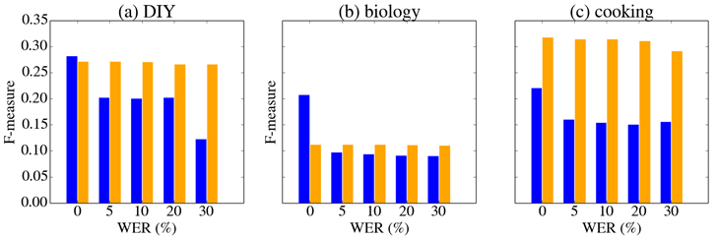
Speech Recognition Error
: Classification LSTM
: Proposed (Optimizing F-1 + all features)
As WER ranging from 5% to 30%, the performance of supervised baseline was seriously degraded.
On the other hand, the performance of proposed model was slightly degraded.

Slide 32
Conclusions
In this work, we proposed a novel domain independent approach to extract key term.
Once trained with data from several different domains, it can extract key terms in unseen domains.
The performance of this approach degrades only very slightly with speech recognition error.
Future work: key phrase extraction, key terms not existing in the documents
Hope that we can publish an ICASSP paper whose index terms are extracted by the proposed approach in the paper.

