Slide 1
Deficient Basis Estimation of Noise Spatial Covariance Matrix for Rank-Constrained Spatial Covariance Matrix Estimation Method in Blind Speech Extraction
46th International Conference on Acoustics, Speech, and Signal Processing (ICASSP) 2021
Yuto Kondo¹, Yuki Kubo¹, Norihiro Takamune¹,
Daichi Kitamura², Hiroshi Saruwatari¹
¹The University of Tokyo, Japan
²National Institute of Technology, Kagawa College, Japan
Notes:
Hello, everyone. I’m Yuto Kondo from the University of Tokyo, Japan.
I’d like to talk about
“Deficient Basis Estimation of Noise Spatial Covariance Matrix for Rank-Constrained Spatial Covariance Matrix Estimation Method in Blind Speech Extraction”

Slide 2
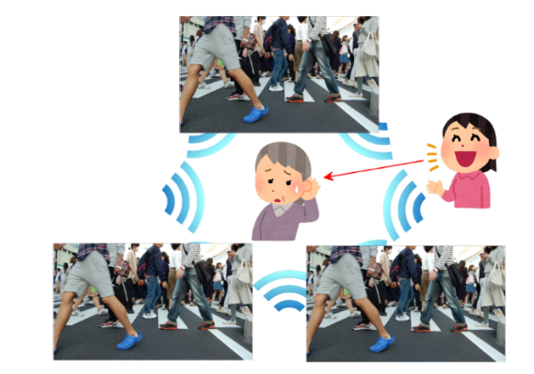
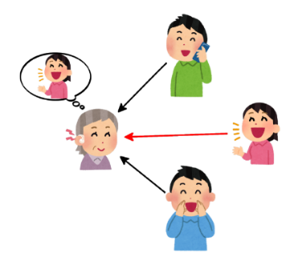
Background
Blind
Blind source extraction (BSE)
Extract a speech signal from observed noisy mixtures
Without prior information such as
Spatial locations of source signals and microphones
Application
Automatic speech recognition, hearing aid systems
Conventional multichannel BSE methods
Blind
Blind
Focus on this case
Interferences are point sources
Independent low-rank matrix analysis (ILRMA) [Kitamura+, 16]
Diffuse noise condition
Rank-constrained SCM estimation (RCSCME) [Kubo+, 19]
SCM: spatial covariance matrix
Notes:
First, I will tell you the background of our research.
Our theme(シーム) is blind source extraction. Blind source extraction, BSE in short, is a technique that extracts a speech signal from observed noisy mixtures.
The term `blind’ means that we do not know any prior information ,
such as spatial locations of source signals and microphones.
BSE can be utilized(ゆーたらいずど) for many applications
including automatic speech recognition and hearing aid systems.
If interference signals are point sources, some efficient BSE methods such as independent low-rank matrix analysis, ILRMA in short, provide good BSE performance.
These methods assume that the number of microphones is equal to or larger than that of sources, and the reverberation time is sufficiently short.
However, under diffuse noise conditions, these methods cannot extract a directional speech signal in principle.
So, Rank-constrained SCM estimation, RCSCME in short, has been proposed in this case, where the term ‘SCM’ means spatial covariance matrix.
It was shown that RCSCME can outperform ILRMA .
In this presentation, we focus on this case.

Slide 3
RCSCME
Blind
By preprocessing such as ILRMA under diffuse noise condition, we obtain
$M−1$ signals including only noise [Takahashi+, 09]
One signal including speech and noise
From these signals, we can get useful spatial information:
Steering vector of speech signal
Rank-($M−1$) SCM of noise
Estimate some parameters about
Source models
SCM
Extract a speech via multichannel Wiener filter (MWF)
Blind
Outline
Focus on this part
Notes:
This is the(di) outline of RCSCME.
At first, we utilize a preprocessing such as ILRMA under diffuse noise condition.
By ILRMA, we obtain M minus one signals including only noise and one signal including speech and noise, where M is the number of microphones.
From these signals, we can get useful spatial information, steering vector of speech signal and rank M minus one SCM of noise.
In the main part of RCSCME, we estimate some parameters about the source models and SCM.
At last, the(di) estimated target speech signal can be extracted
via multichannel Wiener filtering, MWF in short, using the(di) estimated parameters.
We focus on the part estimating parameters.

Slide 4
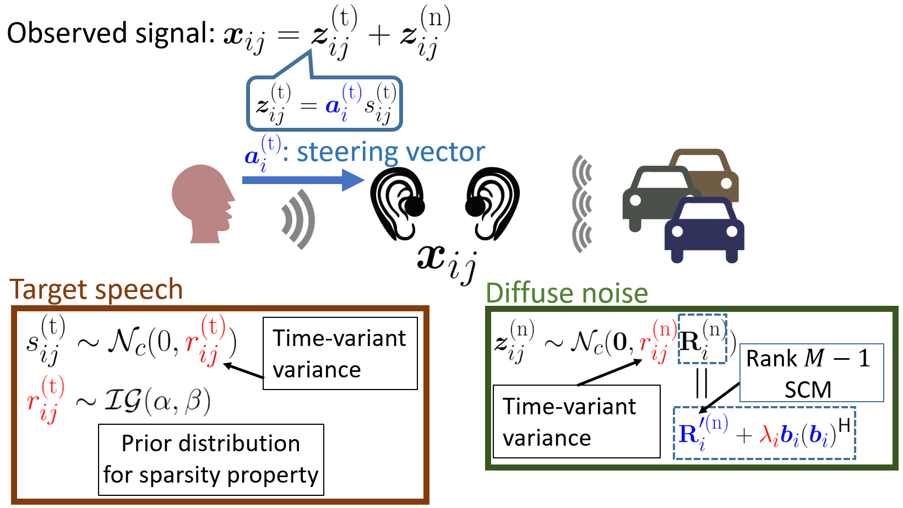
Conventional RCSCME [Kubo+, 19] (1/2)
Blind
Blind
The generative model of observed signal
$i=1,…,I$: frequency bin
$j=1,…,J$: time frame
Fixed parameters given by ILRMA in advance
Parameters to be estimated by RCSCME
加茂さんのslackにビデオあり
The full-rank SCM of diffuse noise is modeled by the fixed vector
The parameters , , and are estimated based on EM algorithm
Notes:
Next, I will explain the part estimating parameters in conventional RCSCME.
This is the generative model of observed signal.
We denote the frequency index by i, and time index by j.
Blue characters mean fixed parameters given by ILRMA in advance.
Conversely, red characters mean parameters to be estimated by RCSCME.
Observed M channel signal x is expressed as the sum of speech component zt and noise component zn.
Zt is modeled as the product of time-variant dry source s_t and time-invariant steering vector a_t.
Regarding Target speech, st is generated by zero-mean complex Gaussian distribution and its variance rt follows the inverse gamma distribution
, which is a prior distribution for sparsity property.
On the other hand, regarding Diffuse noise, zn is generated by zero-mean multivariate(もるてぃべりえいと) complex Gaussian distribution.
Its covariance matrix is a product of time-variant variance small rn and time-invariant SCM of noise.
Noise SCM R prime estimated by ILRMA has M-1 rank, so this deficient rank-1 matrix is added.
λ is the scalar which means the weight of addition.
In this way, the full-rank SCM Rn of diffuse noise is modeled by the fixed vector b.
The parameters small rt, small rn, and λ are estimated based on EM algorithm.

Slide 5
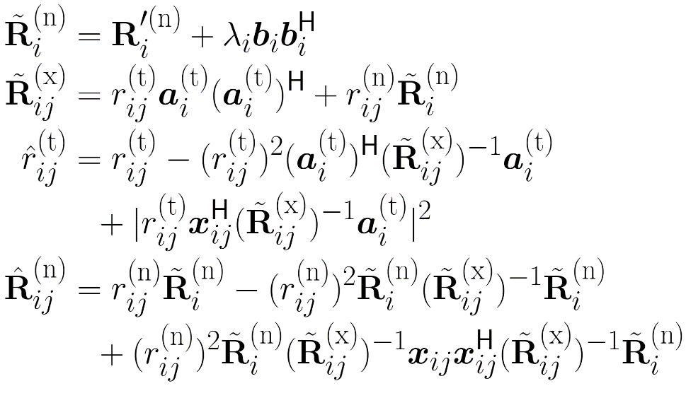
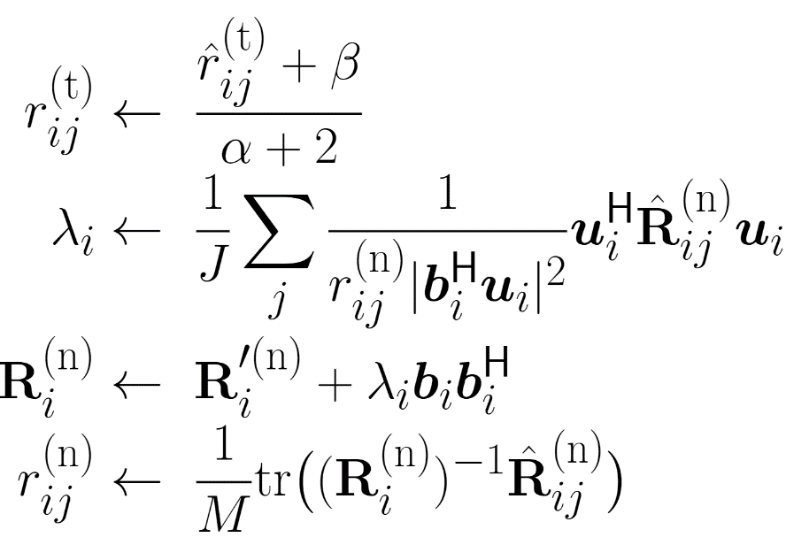
Conventional RCSCME (2/2)
Blind
Blind
Update rules based on EM algorithm
E step
M step
:the eigenvector of
the zero eigenvalue in
The M-step is considered as a scalar optimization problem for each parameter , , and
Notes:
This is the update rules based on EM algorithm.
In the(di) E-step, posterior statistics such as rt_hat and Rn_hat, which are expressed as the sum of posterior variance and the square of posterior mean, are cauculated.
Then, in the(di) M-step, parameters are updated in this way, where u is the eigenvector of the zero eigenvalue in R prime.
The(di) M-step is considered as a scalar optimization problem for each parameter rt,rn, and λ.

Slide 6
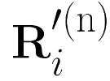
Proposed: Motivation
Blind
Blind
Point of our observation
In conventional RCSCME, deficient basis is fixed and only its scale is estimated
However, the candidate of is not unique
Any complex vector that is not included in the space spanned by column vectors of
e.g. the eigenvector of the zero eigenvalue of
We propose the new model in which not only the scale but also the deficient basis itself is estimated
The full-rank SCM of diffuse noise is modeled as
ポスター
40ポイント以上
Conventional model
Parameterize the deficient basis
and its scale simultaneously
World’s first spatial model extension of RCSCME
This extension is a difficult vector optimization problem
We can successfully give the effective solution
Notes:
From now, I will talk about the motivation of proposed method.
In conventional RCSCME, deficient basis b is fixed and only its scale λ is estimated.
However, the candidate of b is not unique; it can be utilized as b that any complex vector that is not included in the space spanned by column(コーロン) vectors of R prime.
For example, the(di) eigenvector of the zero eigenvalue of R prime is considered.
Then, in this research, we propose the new model in which not only the scale but also the deficient basis itself is estimated.
Concretely, the full-rank SCM of diffuse noise is modeled(モーダルド) as this. That is, we parameterize simultaneously the deficient basis and its scale by c.
The proposed RCSCME is interpreted as the world’s first spatial model extension of RCSCME.
This extension is a difficult vector optimization problem. However, we can successfully give an effective solution.

Slide 7
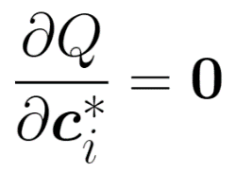
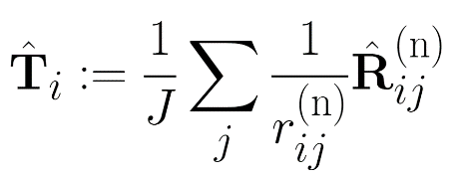
Proposed: Derivation(1/2)
Blind
Blind
Derivation of the update rule of based on EM algorithm
Posterior statistics obtained in the E-step
Q function
Wirtinger derivative
with respect to
From the equation
includes
This is not a simple eigenvalue problem
Next page
Notes:
Next, we derive the update rule of the proposed RCSCME based on EM algorithm.
In this presentation, we talk about the derivation of the(di) update rule of c more deeply
and skip all the(di) other parameters, which are updated in the same way as conventional RCSCME.
This is the calculation result of Q function. As latent variables, dry source of a target speech st and noise component zn are used. small r_n hat and large R_n hat are the posterior statistics obtained in the(di) E-step. Note that c is included in Rn.
First, we partially(パーしゃりぃ) differentiate the Q function with respect to c as follows.
T hat is the matrix which is the(di) weighted average of posterior statistics large R_n hat.
From the stationary point condition of c, we obtain this vector equation(えくいじゅん).
At first glance, the equation looks like a simple eigenvalue problem.
However, it does not because large Rn includes c.
On the next page, we solve this non-trivial vector equation.

Slide 8
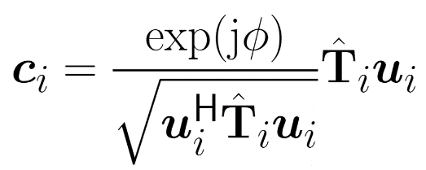
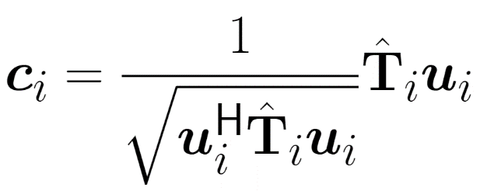
Proposed: Derivation(2/2)
Blind
Blind
Claim 1. Let be a vector that satisfies
Then, the following holds:
Proof.
As for the eigenvector corresponding to the zero eigenvalue of ,
All that is left is to obtain the scale
Multiply
An arbitrary constant
Use because of invariance with respect to (∵ Modeled by )
Interpretation
The vector direction adaptation
by rotating via composed of posterior
Notes:
In order to solve the equation, we use this Claim 1,
which says that regarding vector u, the(di) eigenvector of the zero eigenvalue in R prime, the following holds.
The claim is derived from this proof.
Utilizing Claim 1, this equation is obtained. We can see that the direction of vector c is equal to that of T_hat u. Therefore all that is left is to obtain the scale of vector c.
Multiplying(モルティプライング) u Hermitian(ハーミシャン) transpose, we get the squared magnitude of c Hermitian(ハーミシャン) transpose u. Hence, c Hermitian(ハーミシャン) transpose u is obtained, where phase phi is an arbitrary constant.
Therefore the general solution of c is as follows.
We use zero value as phase phi in our update rule because of invariance of SCM of diffuse noise with respect to phase phi.
Finally, this is the(di) update rule of c.
We can interpret the(di) update rule as the vector direction adaptation by rotating u via T_hat that composed of posterior.
Hence, we can expect that the observed signal is expressed in proposed RCSCME better than in conventional fixed-basis RCSCME.

Slide 9
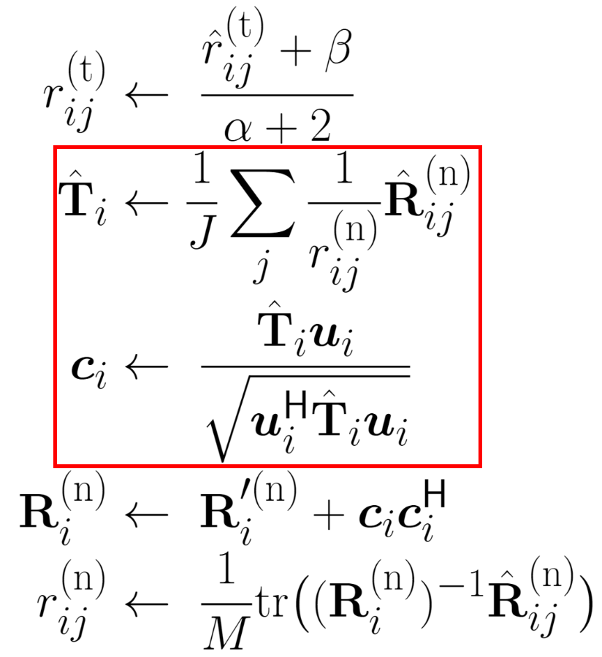
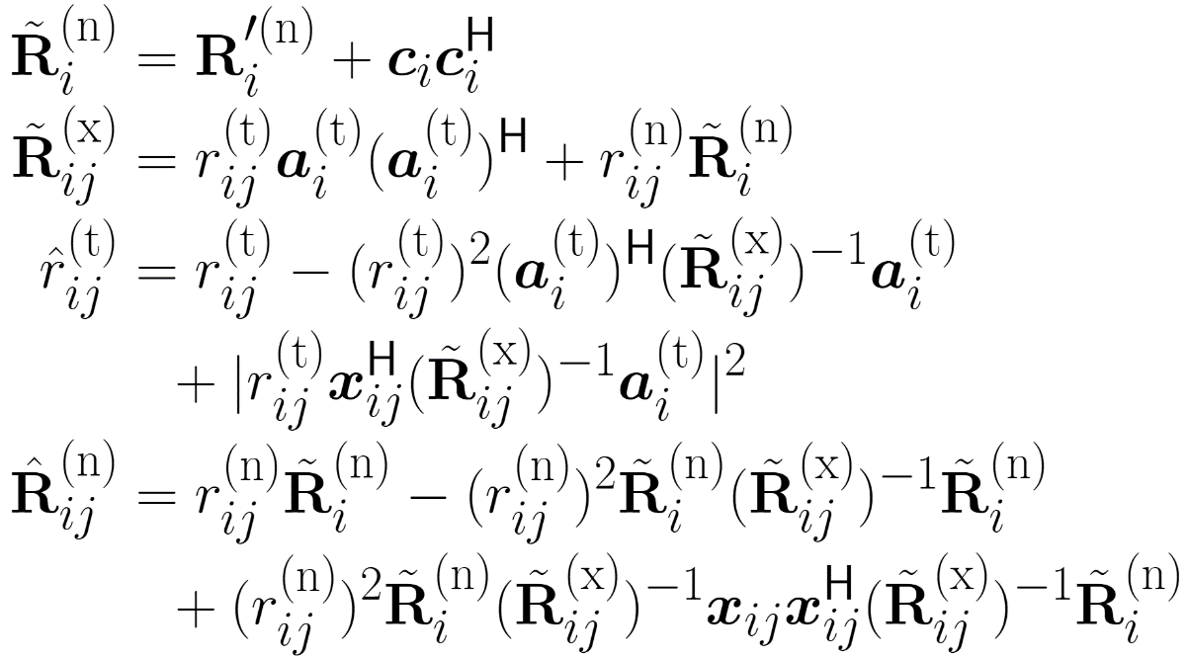
Proposed: Update rules
Blind
Blind
Update rules based on EM algorithm
E step
M step
The M-step is considered as a vector optimization problem for parameter
Notes:
This is the update rules of proposed RCSCME.
The updates of the(di) E-step in the proposed RCSCME are the same as those in the conventional RCSCME.
Then, in the(di) M-step, parameters are updated in this way.
The update rules of small r_t and small r_n are derived in the same way as the conventional RCSCME.
The difference between conventional RCSCME and proposed RCSCME is surrounded by the red frame.
The(di) M-step is considered as a vector optimization problem for parameter c.

Slide 10
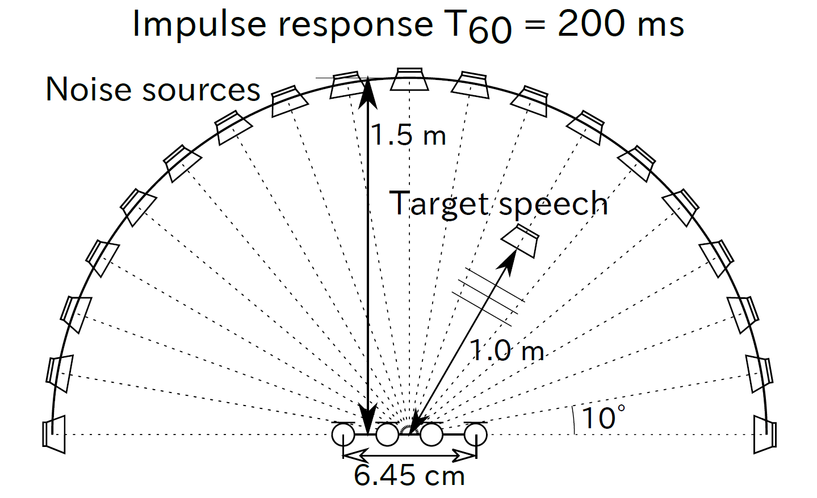
Experimental conditions
Blind
# of microphones | 4
Target speeches | 6 JNAS clean speech corpus sources
Noise sources | Babble (mixture of 19 JNAS speech signals), Station, Traffic, and Cafe (DEMAND)
# of parameter-initialization | 10
Speech-to-noise ratio | 0 dB
STFT conditions | 64 ms Hamming window with 32 ms shift
Evaluation measure | Source-to-distortion ratio (SDR) of target speech
Blind
Impulse response
, and 全部
Notes:
This is the(di) experimental conditions.
We used six JNAS clean speech corpus source as target speeches and four kinds of diffuse noises as noise sources.
The number of parameter initialization was set to ten.
We used source-to-distortion ratio, SDR in short, to evaluate the separation performance.
To simulate the diffuse noise, we convoluted dry sources with impulse responses from each position to microphones
as shown in the figure.
Other conditions are shown in this table.

Slide 11
Methods for comparison
Blind
ILRMA
After-50-iteration performance
Used for initialization or preprocessing of other methods
Blind spatial subtraction array (BSSA) [Takahashi+, 09]
MWF with single channel noise power estimation (MWF1)
[Cohen+, 01]
MWF with multichannel noise power estimation (MWF2)
[Miyazaki+, 11]
FastMNMF [Sekiguchi+, 19]
Note that ILRMA is not used (randomly initialized)
FastMNMF initialized with ILRMA (ILRMA+FastMNMF)
Conventional RCSCME
The deficient basis is fixed with
Proposed RCSCME
The deficient basis vector is initialized according to conventional RCSCME
Blind
全部の手法を言った後に，これはini，これはpreという
念押しで，上はfix，下はupdateという
Notes:
We compared these 6 methods.
ILRMA was evaluated by its after-fifty-iteration performance. It was used for initialization or preprocessing of other methods.
Blind spatial subtraction array, BSSA in short.
We used two kinds of MWF. We call MWF1 and MWF2.
In BSSA, MWF1, and MWF2, ILRMA was used as a preprocessing.
We tried two types of FastMNMF.
One was the FastMNMF randomly initialized, the other was that initialized by ILRMA.
In the conventional fixed-basis RCSCME, the deficient basis b was fixed with u, which is the(di) eigenvector of the zero eigenvalue in R prime.
We used this inverse gamma distribution parameters in the conventional RCSCME,
which showed the best extraction performance in a prior research.
In the proposed updated-basis RCSCME, the deficient basis vector was initialized according to conventional RCSCME.
We experimentally chose these inverse gamma distribution parameters in the proposed RCSCME.
In conventional and proposed RCSCME, ILRMA was also used as a preprocessing.

Slide 12
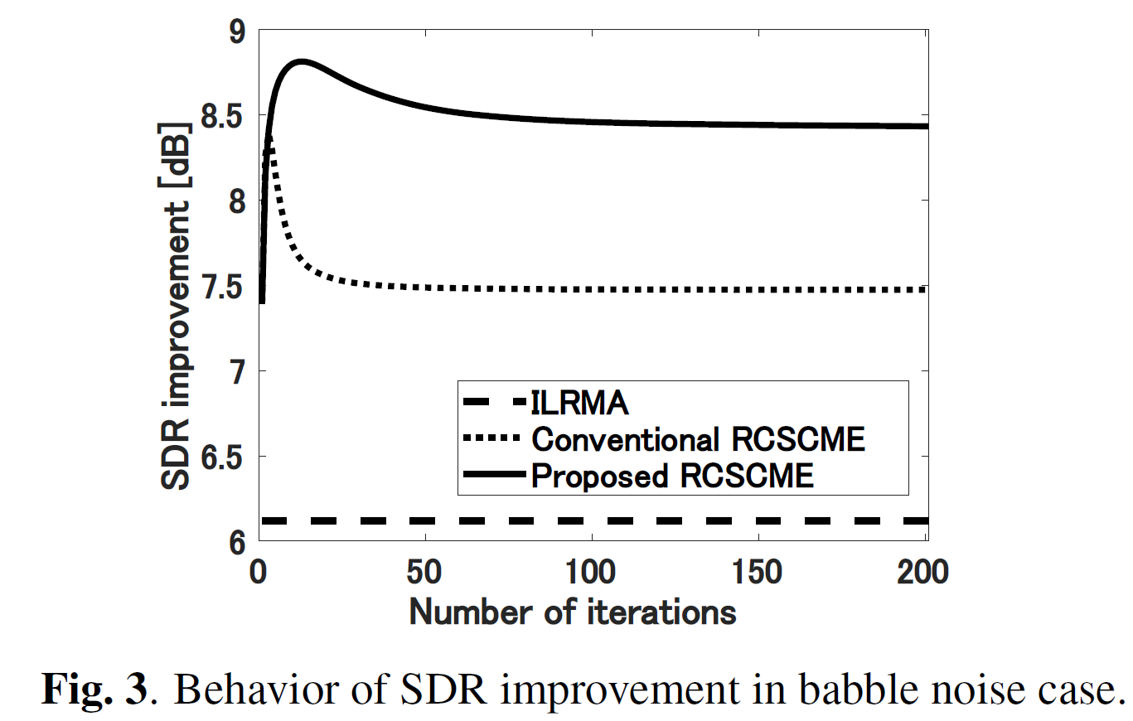
Experimental results (1/2)
Blind
Blind
Behavior of SDR improvement in babble noise case
Good
Bad
The proposed RCSCME outperforms the conventional RCSCME from the viewpoint of both the peak score and the score after 200 iterations
Notes:
We first show the behavior of the(di) averaged SDR improvements of the proposed and conventional RCSCME for each iteration under a babble noise condition.
We also show the(di) averaged SDR improvement of ILRMA after fifty iterations as a reference.
From the figure, it is revealed that the proposed RCSCME outperforms the conventional RCSCME from the viewpoint of both the peak score and the score after two hundred iterations.

Slide 13
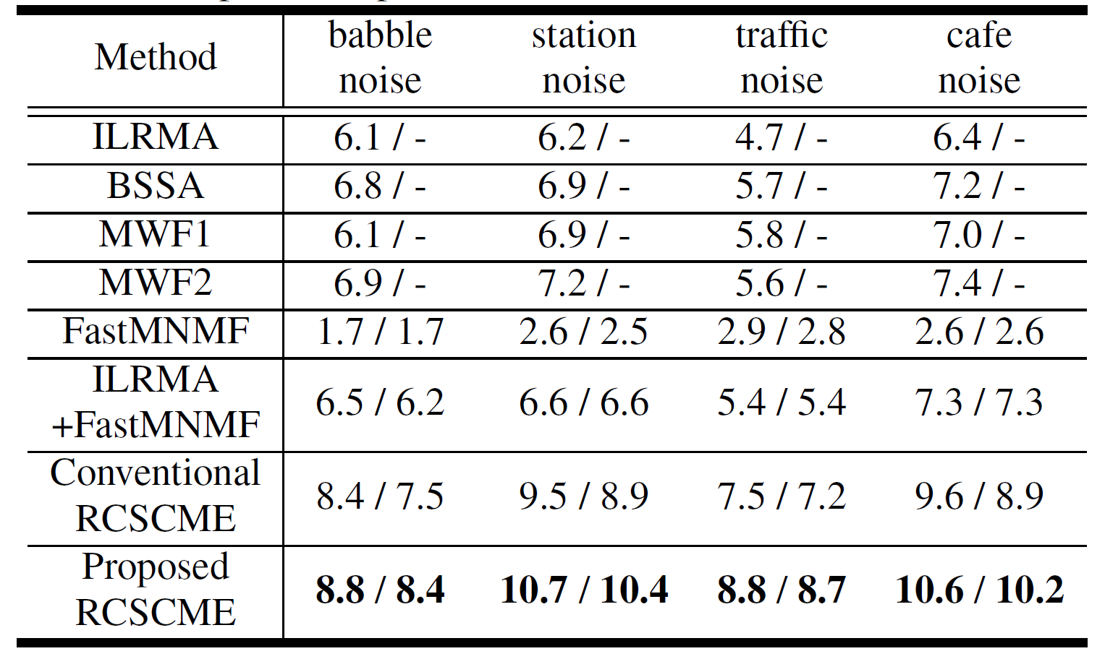
Experimental results (2/2)
Blind
Blind
SDR improvements [dB] for each method and noise case
Each term represents “peak score / score after 200 iterations”
The proposed RCSCME outperforms all the conventional methods under all the noise conditions
Notes:
This table shows SDR improvements for each method under each noise condition.
For FastMNMF, ILRMA plus FastMNMF, conventional RCSCME, and proposed RCSCME, which are iterative methods,
we display both the peak score and the score after two hundred iterations.
From this table, we reveal that the proposed RCSCME outperforms all the conventional methods under all the noise conditions.

Slide 14
Conclusion
Blind
Blind
RCSCME is a fast and stable BSE method for the diffuse noise condition
In the proposed RCSCME, we accurately estimated the deficient basis itself as a vector variable by solving a vector optimization problem
We derived new update rules based on the EM algorithm
We confirmed that the proposed method outperformed conventional methods under several noise conditions
Thank you for your attention!
Notes:
11:50 – 12:00
This is the conclusion of my presentation.
RCSCME is a fast and stable BSE method for the diffuse noise condition.
In the proposed RCSCME, we accurately estimated the deficient basis itself as a vector variable by solving a vector optimization problem.
We derived new update rules based on the EM algorithm.
We confirmed that the proposed method outperformed conventional methods under several noise conditions.
Thank you for your attention.

