Slide 1
X-RAY SPECTRAL ESTIMATION USING DICTIONARY LEARNING
Wenrui Liª, Venkatesh Sridhar^{b}, Aditya Mohan^{b}, Saransh Singh^{b}, Xin Liu^{b} , J.B. Forien^{b}
Gregery T. Buzzardª, Charles A. Boumanª
ªPurdue University
^{b}Lawrence Livermore National Laboratory
Presenter: Wenrui Li
Purdue University
Mentor: Aditya Mohan
Aug 3, 2023
Accepted by IEEE ICIP 2023: Li, W., Sridhar, V., Mohan, K.A., Singh, S., Forien, J.B., Liu, X., Buzzard, G.T. and Bouman, C.A., 2023. X-ray Spectral Estimation using Dictionary Learning. arXiv preprint arXiv:2302.13494.
Notes:
Hello, everyone! My name is Wenrui Li, and I am a Ph.D. student in ECE at Purdue University, where I am co-advised by professors Charles Bouman and Greg Buzzard. During the past year, I had the fantastic opportunity to work as an intern at LLNL, collaborating with Aditya and Venkatesh on an exciting project focused on X-ray spectral estimation. After completing my internship, we summarized our research, which led to a successful publication in ICIP (International Conference on Image Processing.

Slide 2
X-ray CT system
$$S_{sr}\left(E\right)$$
$$S_{ft}\left(E\right)$$
$$S_{dt}\left(E\right)$$
Source
Filter
Detector Filter
X-ray Source
Sample
Scintillator
Camera
Visible light with lens
Rotating sample stage
Notes:
X-ray CT system is composed of source, filter, and detector response.
X-ray source emits multiple photons with different level of energies.
Filter is used to absorb the lower energy x-ray photons that tend to scatter more.
The scintillator converts the x-ray photons to visible light.
Then, the system can measure the intensity of X-ray with and without object in the camera.

Slide 3
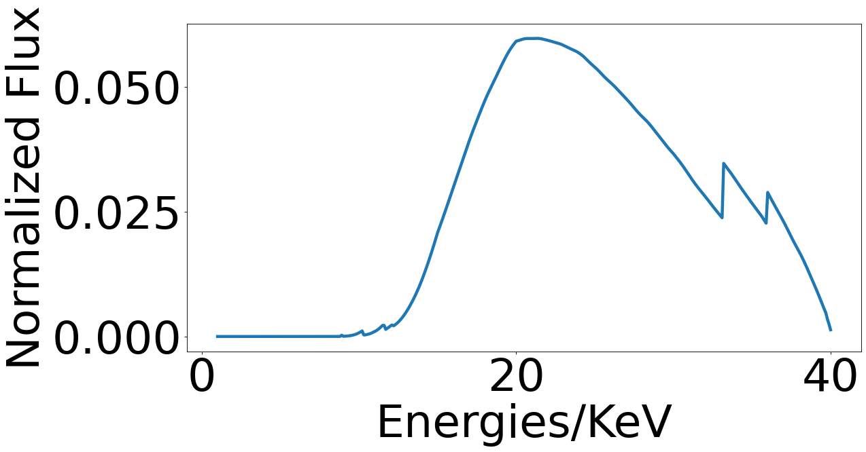
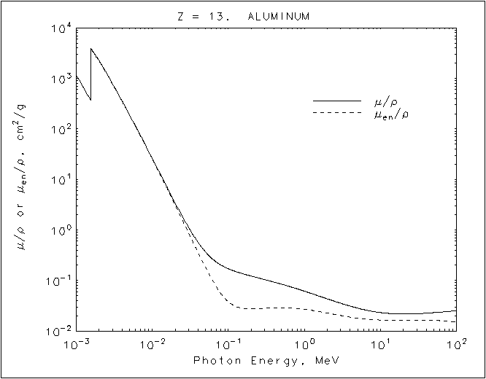
System response of a CT X-ray system
$$S_{sr}\left(E\right)$$
$$S_{ft}\left(E\right)$$
$$S_{dt}\left(E\right)$$
X-ray Source
Source
Filter
Sample
Detector Filter
Scintillator
Camera
Visible light with lens
Rotating sample stage
Normalized total system response
Mass attenuation of Al
grabbed From NIST
System response: refers to the relationship between the energy of X-ray photons and the corresponding ratio of energy transfer to visible light in a CT X-ray system.
Linear attenuation coefficient(LAC) and other properties of a material are energy-dependent.
Many critical NDE capabilities REQUIRE accurate estimate of spectrum [1]. For example
Reduce beam hardening artifact[2].
System-independent material characterization [3-6].
Notes:
In this work, we are trying to estimate the system response of the X-ray CT system.
System response shows relationship between the energy of X-ray photons and the corresponding ratio of energy transfer to visible light within the system.
In X-ray imaging, it is crucial to understand the properties of a material, such as the Linear Attenuation Coefficient (LAC). Those properties are energy-dependent. Let’s look at these figure. This is the normalized system response, combined with source, filter, detector response. The x-axis is x-ray photon energies. On the right is the LAC of Aluminum, which are energy-dependent.
Therefore, accurately determining the system response becomes incredibly important for various essential Non-Destructive Evaluation (NDE) capabilities.
Let me illustrate this with a few examples. Firstly, precise spectrum estimation aids in reducing the detrimental beam hardening artifact, a common challenge in X-ray imaging. Secondly, it enables system-independent material characterization, especially when two materials have similar value in reconstruction.

Slide 4
Estimate system response with normalized transmission data
Direct measurement of system response $\overline{S}\left(E\right)$ is hard.
We scan multiple objects with known material and known dimension.
For each material $k∈Φ$ and projection $i∈\left\{0,⋯,M−1\right\}$, based on the beer’s law we have that
where
$L_{i,k}$ - path length of $i^{th}$ projection through the $k^{th}$ material
$μ_{k}\left(E\right)$ - density of $k^{th}$ material at energy $E$
$$y_{i}=\frac{I}{I_{0}}=\int_{0}^{E_{max}}{\overline{S}\left(E\right) ⋅exp\left\{−\int_{L_{i}}{μ\left(E,r\right)dr}\right\}{dE}+τ_{i}}$$
$$=\int_{0}^{E_{max}}{\overline{S}\left(E\right) ⋅exp\left\{−\sum_{s∈Φ}{μ_{s}\left(E\right){ L}_{i, s}}\right\}{dE}}+τ_{i}$$
Homogeneous
$${\hat{y}}_{0}$$
$$L_{0}$$
$$L_{1}$$
$${\hat{y}}_{1}$$
source
$${\hat{y}}_{2}$$
Material A $k_{A}∈Φ$
Material B $k_{B}∈Φ$
$$L_{2}$$
Notes:
The goal of this speech is to quantify the source-detector spectral response for X-ray computed tomography (CT) using transmission data obtained from a collection of known homogeneous objects.
Since directly measuring the spectral response of a CT system is challenging, which is why we are motivated to estimate it from known objects.

Slide 5
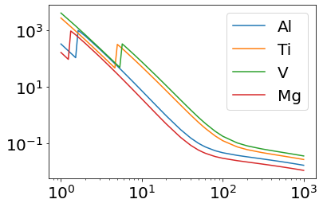
Discretization and challenges of the inverse problem
Discretization
Inverse problem
$$y_{i}=\int_{0}^{E_{max}}{\overline{S}\left(E\right) ⋅exp\left\{−\sum_{s∈Φ}{μ_{s}\left(E\right){ L}_{i, s}}\right\}{dE}}+τ_{i}$$
$$y=Fx$$
ILL-Conditioned
$$y_{i}≈\sum_{j=0}^{J−1}{F_{i,j}\int_{E_{j}}^{E_{j+1}}{\overline{S}\left(E\right)dE }}+τ_{i}=\sum_{j=0}^{J−1}{F_{i,j}x_{j}}+τ_{i}$$
Discretization
cm⁻¹
Linear Attenuation Coefficient
Discretize in energy by subdividing into non-overlapping bins $[E_{j},E_{j+1}]$
$F_{i,j}$ is attenuation ratio of $j^{th}$ energy bin with $i^{th}$ projection
$F_{i,j}=\exp{\{−\sum_{s∈Φ}{μ_{s}\left(E_{j}\right){ L}_{i, s}}\}}$
Approximate $μ_{s}\left(E_{j}\right)$ is a constant on each bin
Spectral weight $x_{j}=\int_{E_{j}}^{E_{j+1}}{\overline{S}\left(E\right)dE }$
High attenuation in low energy.
Energies/KeV
Low attenuation in high energy
Notes:
We discretize in energy by subdividing into multiple non-overlapping bins.
Also, we approximate the LAC to be a constant on each bin.
Then, we can build up our linear equations and find a way to solve this inverse problem.
One challenge is that the associated inverse problem is ill-conditioned, making accurate estimation of the spectrum challenging, particularly in the absence of a close initial guess.
If you look at the right figure, you can see there are high attenuation for low energy x-ray photons and low attenuation for high energy x-ray photons. This X-ray nature leads to the severe ill-conditioned

Slide 6
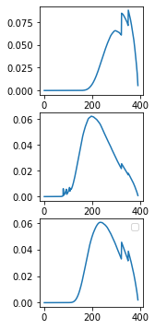
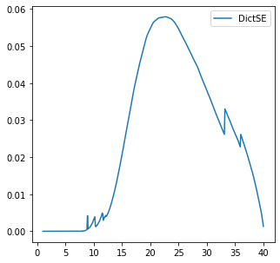
Previous Approaches to System response Reconstruction
Discretization reconstruction with least-square[7-8]:
Regularized reconstruction of energy vector
$$\hat{x}=\arg{\min_{x∈𝒮}\left\{\frac{1}{2M}{\left\|y−Fx\right\|}_{2}^{2}+λh_{1}\left(x\right)\right\}}$$
User need to fine tune regularization parameter.
Requires a good initial estimate since ill-conditioned and noise.
Hard to recover K-edge.
Discretization reconstruction with SVD[9-11]: $y−Fx$=0
Do not require good initial estimate.
Need prior to ensure smoothness.
Dictionary based reconstruction[12-13]:
Model the unknown spectrum as a linear combination of few basis system responses generated with simulated model.
Provides strong constraint that makes inverse well-posed.
$$ω_{1}$$
$$ω_{2}$$
+
$$ω_{3}$$
Notes:
Over the years, various approaches have been explored in the field of CT X-ray system response reconstruction. Reconstruction with least-square methods involves a regularized reconstruction of the spectrum, aiming to minimize the difference between the acquired data, 𝑦, and the forward projection. This technique introduces a regularization parameter, 𝜆, and a convex function, ℎ_1(𝑥), to improve the robustness of the reconstruction process. However, a major drawback is that the user's need to fine-tune the regularization parameter, which can be challenging and time-consuming. Otherwise, user should provide a good initial estimate since ill-conditioned and noise. Furthermore, although you find the trade-off between robust solution and user’s effort, it is still hard to recover the K-edge.
Singular Value Decomposition (SVD) [9-11] is also used to overcome the ill-conditioned challenge. Unlike the previous method, this technique does not require a good initial estimate , however, is more sensitive to the presence of noise. Therefore, the latest SVD method incorporate prior information to ensure smoothness in the reconstructed spectrum.
Recently, dictionary-based reconstruction methods [12-13] have gained attention. These methods model the unknown spectrum as a linear combination of basis system responses generated using simulated models. By doing so, they provide a strong constraint that stabilizes the inverse problem and makes it well-posed, allowing for improved accuracy in reconstructing the system response.

Slide 7
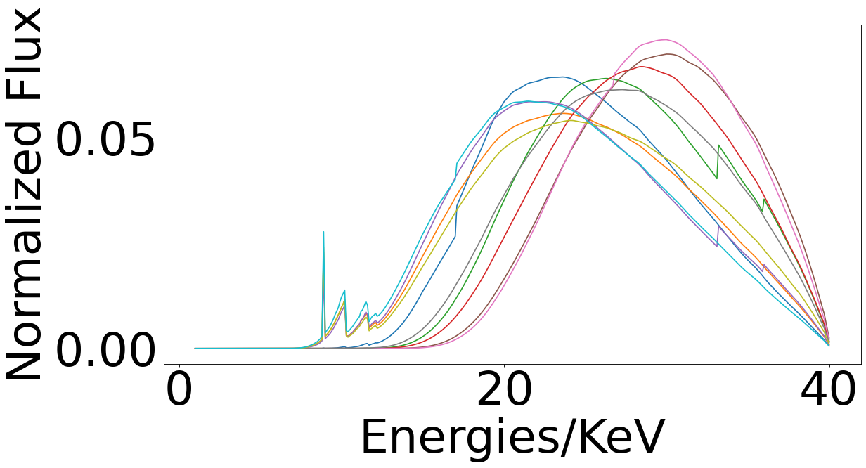
Dictionary-Based System Response Reconstruction
A MAP estimation framework with a physics-based forward model, an $L_{0}$ sparsity constraint and a simplex constraint on the dictionary coefficients.
The solution space is constrained to be sparse.
Do not need initial guess!
$$\overline{S}\left(E\right)=x=Dω$$
$$\hat{ω}=\arg{\min_{\begin{aligned}ω∈𝒮 \\ {\left\|ω\right\|}_{0}≤C\end{aligned}}\left\{{\frac{1}{2}\left\|y−FDω\right\|}_{Λ}^{2}\right\}}$$
2,000+ Different system responses
Estimated Spectrum when $C≤10$
$$D$$
$$ω$$
Estimated spectrum of Versa with 0.5mm Al filter.

Slide 8
Dictionary setup
The X-Ray source spectrum is provided by ALS device with max source voltage=100 kV.
The dictionary only contains spectra generated from Al/Cu filter with multiple linear spacing thickness as source filter and Lu3Al5O12 with multiple linear spacing thickness as scintillator.
At total, we have 60*36=2160 system responses in this dictionary to verify my method.
Filter response
Material | Thickness Range mm | Step mm | # of responses
Al | 0.1∼5.9 | 0.2 | 30
Cu | 0.2∼0.49 | 0.01 | 30
Detector response(Scintillator)
Lu3Al5O12 | 0.025∼0.095 | 0.002 | 36
Notes:
Instead of finding a linear combination of a few dictionary, we generate our dictionary with an analytical model considering different filter materials with different thickness and one scintillator with different thickness.
This large dictionary is reusable when user plans to change their filter during experiment.
However, because of a large dictionary, if we want to solve this prob

Slide 9
Overview of the DictSE algorithm
Problem to solve:
Constraints:
$L_{0}$ sparsity constraint
Simplex unit constraint
Strategy:
Maintain a set, $Ω$, that contains indices of nonzero coefficients.
$ε_{k^{∗}}$ is one-hot vector with same size of $\hat{ω}$ ; the $k^{∗th}$ element is 1 while other elements are 0.
$𝒮^{Ω}$ is a subset of $𝒮$ such that $∀s∈𝒮^{Ω}$ and $∀i∉Ω$, $s_{i}=0$.
$Initialize k^{∗}←arg \min_{k} {\frac{1}{2}\left\|y−FDω\right\|}_{Λ}^{2}$; $ω=ε_{k^{∗}}$; $Ω←\{k^{∗}\}$
While $len\left(Ω\right)<C$ {
$\left(k^{∗},β^{∗}\right)←arg \min_{\begin{aligned}k∉Ω, \\ β∈[0,1)\end{aligned}}\left\{{\frac{1}{2}\left\|y−βFDω−\left(1−β \right)FD_{∗,k}\right\|}_{Λ}^{2}\right\}$
$ω←$ $β^{∗}ω+\left(1−β^{∗}\right)ε_{k^{∗}}$
$Ω←Ω∪\{k^{∗}\}$
While not converge do pairwise ICD{
For $k∉Ω$ and $k≠k^{∗}$ do {
$α^{∗}←$ $arg \min_{α∈[{−ω}_{k},ω_{g}]}\left\{l\left(ω+α\left(ε_{k}−ε_{k^{∗}}\right)\right)\right\}$
$ω←ω+α^{∗}\left(ε_{k}−ε_{k^{∗}}\right)$
}
}
}
$\hat{ω}←ω$
$$\hat{ω}=\arg{\min_{\begin{aligned}ω∈𝒮 \\ {\left\|ω\right\|}_{0}≤C\end{aligned}}\left\{{\frac{1}{2}\left\|y−FDω\right\|}_{Λ}^{2}\right\}}$$
$$l\left(ω\right)={\frac{1}{2}\left\|y−FDω\right\|}_{Λ}^{2}$$
Notes:
Greedy support selection method and a new pair-wise iterated coordinate descent method.

Slide 10
Procedure of the algorithm with real dataset
$$\hat{ω}=\arg{\min_{\begin{aligned}ω∈𝒮 \\ {\left\|ω\right\|}_{0}≤C\end{aligned}}\left\{{\frac{1}{2}\left\|y−FDω\right\|}_{Λ}^{2}\right\}}$$
Step 1: Preprocess normalized transmission $y_{i}=\frac{{\overline{I}}_{i}}{{\overline{I}}_{0,i}}$, following postage stamp correction to make sure $y=1$ in background.
Step 2: Calculate the projection matrix $F$ with line path through the objects and LAC of object materials.
Step 3: Generate a large Dictionary $D$ by varying X-rays source $S_{r}\left(E\right)$, filter response $S_{f}\left(E\right)$, and detector response $D_{e}\left(E\right)$, $S\left(E\right)=S_{r}\left(E\right) S_{f}\left(E\right) D_{e}\left(E\right)$, then $\overline{S}\left(E\right)=$ $\frac{S\left(E\right)}{\int_{0}^{E_{max}}{S\left(E\right) dE}}$.
Step 4: Compute $\hat{ω}$ by solving for the constrained optimization problem.
DictSE is implemented with python and can work well with pyLTT and LTT(Livermore Tomography Tools).
Step 1:
Data Preprocess $y$
Step 2:
Estimate
Forward Matrix $F$
Step 3:
Generate Dictionary $D$
Step 4:
Run DictSE
Plugins Design allows different settings
Notes:
Transmission space instead of attenuation, range from 0 to 1.

Slide 11
Geometry of the ALS(Advanced Light Source) CT datasets
$$Y=\frac{I}{I_{0}}=\frac{I_{scan}−{\overline{I}}_{dark}}{{\overline{I}}_{bright}−{\overline{I}}_{dark}}$$
4 different scans on 4 1 mm-solid-material cylinders. [V, Ti, Mg, Al]
Each scan is generated by a same poly-energetic system with
ALS source with 100 KeV as max X-Ray energy.
Silicon filter
Lu3Al5O12 scintillator
15 bright scans at 0 degree, 2624 scans span from 0~360 degree, and 10 dark scans at 360 degree.
Geometry: Parallel beam
Detector pixel size: 0.00065 mm
Resolution of a scan: 100*2560
V
Ti
Mg
Al
4 different synchrotron scans

Slide 12
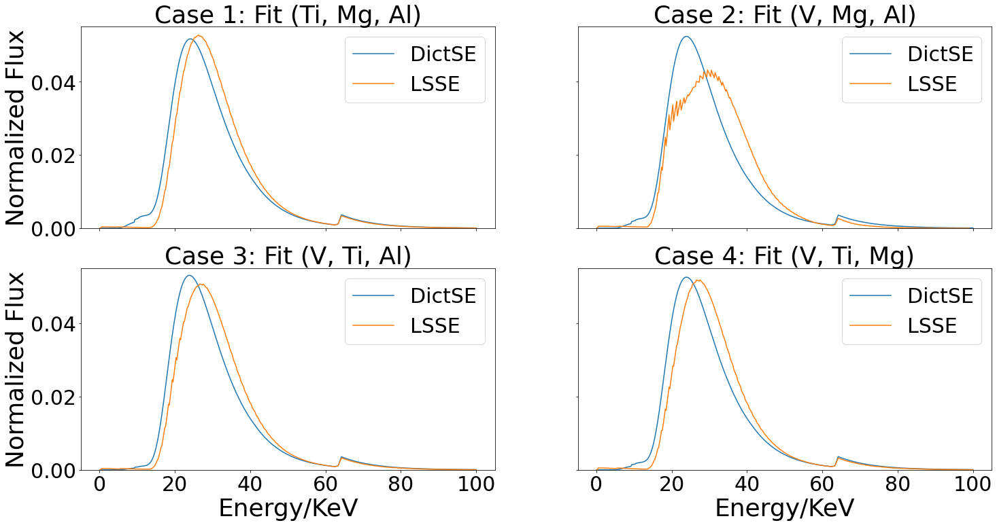
Result
We compare our DictSE with least-squares method (LSSE)[14].
Do Leave-One-Out Cross-Validation
Reconstructed Spectra with DictSE and LSSE
Leave-One-Out Cross-Validation NRMSE
Case | Fit | Test | LSSE | DictSE
1 | Ti, Mg, Al | V | 0.0331 | 0.0315
2 | V, Mg, Al | Ti | 0.0624 | 0.0242
3 | V, Ti, Al | Mg | 0.0343 | 0.0122
4 | V, Ti, Mg | Al | 0.0483 | 0.0093
Calculate NRMSE between transmission measurements and transmission value of forward model with estimated spectrum.
[14] Kyle M Champley, Stephen G Azevedo, Isaac M Seetho, Steven M Glenn, Larry D McMichael, Jerel A Smith, Jeffrey S Kallman, William D Brown, and Harry E Martz., "Method to extract system-independent material properties from dual-energy X-ray CT," IEEE Transactions on Nuclear Science, vol. 66, no. 3, pp. 674-686, 2019.

Slide 13
Takeaway
The system response estimation model using transmission data is ill-conditioned.
DictSE, a dictionary-based model, applies the $L_{0}$ sparsity constraint and simplex constraint to overcome the ill-conditioned nature of system response estimation.
DictSE uses a greedy method to deal with the $L_{0}$ sparsity constraint and reduce the number of parameters to estimate, which
does not need accurate initial guess of the system response.
enables efficient spectrum reconstruction.
DictSE outperforms LTT’s spectral estimation algorithm using least square.

Slide 14
Future work
Introduce different types of scintillator to the dictionary.
Design a separable spectral model to jointly estimate source response, filter response, and detector response.

Slide 15
Reference
[1] Liu, Bin, Hongrun Yang, Huanwen Lv, Lan Li, Xilong Gao, Jianping Zhu, and Futing Jing. "A method of X-ray source spectrum estimation from transmission measurements based on compressed sensing." Nuclear Engineering and Technology 52, no. 7 (2020): 1495-1502.
[2] Pengchong Jin, Charles A. Bouman, and Ken D. Sauer, "A model-based image reconstruction algorithm with simultaneous beam hardening correction for X-Ray CT," IEEE Transactions on Computational Imaging, vol. 1, no. 3, pp. 200-216, 2015.
[3] Matteo Busi, K Aditya Mohan, Alex A Dooraghi, Kyle M Champley, Harry E Martz, and Ulrik L Olsen, "Method for system-independent material characterization from spectral X-ray CT," NDT & E International, vol. 107, pp. 102136, 2019.
[4] Stephen G Azevedo, Harry E Martz, Maurice B Aufderheide, William D Brown, Kyle M Champley, Jeffrey S Kallman, G Patrick Roberson, Daniel Schneberk, Isaac M Seetho, and Jerel A Smith," IEEE Transactions on Nuclear Science, vol. 63, no. 1, pp. 341-350, 2016.
[5] Cynthia H McCollough, Shuai Leng, Lifeng Yu, and Joel G Fletcher, "Dual-and multi-energy CT: principles, technical approaches, and clinical applications," Radiology, vol. 276, no. 3, pp. 637-653, 2015.
[6] Aaron So and Savvas Nicolaou, "Spectral computed tomography: fundamental principles and recent developments," Korean Journal of Radiology, vol. 22, no. 1, pp. 86, 2021.
[7] Christopher Ruth and Peter M Joseph, “Estimation of a photon energy spectrum for a computed tomography scanner,” Medical Physics, vol. 24, no. 5, pp. 695–702, 1997.
[8] Chye Hwang Yan, Robert T Whalen, Gary S Beaupré, Shin Y Yen, and Sandy Napel, “Modeling of poly-chromatic attenuation using computed tomography reconstructed images,” Medical Physics, vol. 26, no. 4, pp. 631–642, 1999.
[9] Shoji Tominaga, “A singular-value decomposition approach to X-ray spectral estimation from attenuation data,” Nuclear Instruments and Methods in Physics Research Section A: Accelerators, Spectrometers, Detectors and Associated Equipment, vol. 243, no. 2, pp. 530–538, 1986.
[10] Benjamin Armbruster, Russell J Hamilton, and Arthur K Kuehl, “Spectrum reconstruction from dose measurements as a linear inverse problem,” Physics in Medicine & Biology, vol. 49, no. 22, pp. 5087, 2004.
[11] Carsten Leinweber, Joscha Maier, and Marc Kachelriess, “X-ray spectrum estimation for accurate attenuation simulation,” Medical physics, vol. 44, no. 12, pp. 6183–6194, 2017.
[12] Emil Y Sidky, Yu Lifeng, Pan Xiaochuan, Zou Yu, and Michael Vannier, “A robust method of X-ray source spectrum estimation from transmission measurements: Demonstrated on computer simulated, scatter-free transmission data,” Journal of Applied Physics, vol. 97, no. 12, 6 2005.
[13] Wei Zhao, Kai Niu, Sebastian Schafer, and Kevin Royalty, “An indirect transmission measurement-based spectrum estimation method for computed tomography,” Physics in Medicine & Biology, vol. 60, no. 1, pp. 339, 2014.
[14] Kyle M. Champley, Trevor M. Willey, Hyojin Kim, Karina Bond, Steven M. Glenn, Jerel A. Smith, Jeffrey S. Kallman, William D. Brown, Isaac M. Seetho, Lionel Keene, Stephen G. Azevedo, Larry D. McMichael, George Overturf, and Harry E. Martz, “Livermore tomography tools: Accurate, fast, and flexible software for tomographic science,” NDT & E International, vol. 126, pp. 102595, 2022.

Slide 16
Acknowledgement
This work was performed under the auspices of the U.S. Department of Energy by Lawrence Livermore National Laboratory under Contract DE-AC52-07NA27344 and LDRD project 22-ERD-011. The authors acknowledge Dula Parkinson for his support during beamtime. Charles Bouman was partially supported by the Showalter Trust, and Greg Buzzard was partially supported by NSF CCF-1763896.

Slide 17
Q & A

