Slide 1
Unsupervised Continual Learning of Image Representation via Rememory-based SimSiam
Feifei Fu, Yizhao Gao, Zhiwu Lu, Haoran Wu, Shiqi Zhao
RenMin University of China

Slide 2
Contents
Motivation
Idea
Methods
Experiments
Conclusion

Slide 3
Motivation
The pratical need of representation learning with unlabled data on sequential tasks -> Unsupervised Continual Learning, UCL.
Recent UCL methods focus on mitigating the catastrophic forgetting problem with a replay buffer to store previous data (i.e., rehearsal-based strategy), which needs much extra storage and thus limits their practical applications.

Slide 4
Idea
Based on contrastive learning via SimSiam, we propose a novel rememory-based SimSiam (RM-SimSiam) method to reduce the dependency on replay buffer under the UCL setting. The core idea of our RM-SimSiam is to store and remember the old knowledge with a data-free historical module instead of replay buffer.

Slide 5
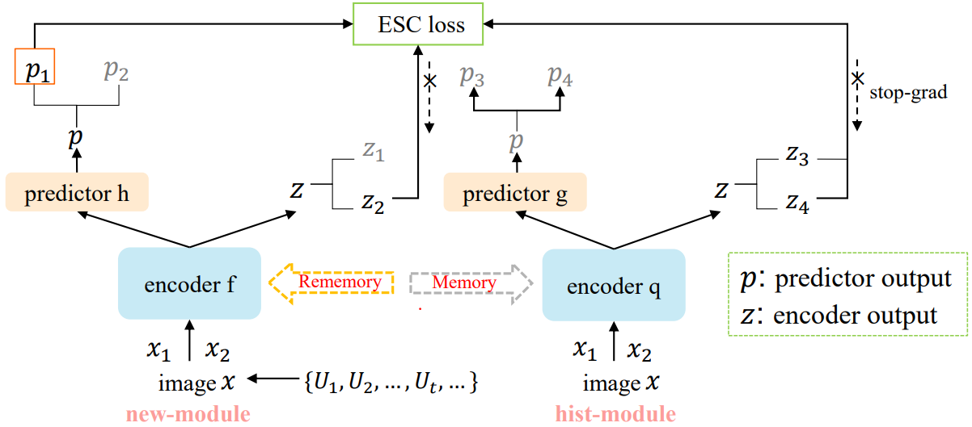
Method (RM-SimSiam)
Rememory Mechanism: consolidate (memory) and remember (rememory) old knowledge
Memeory process: The hist-module is designed to retain old knowledge by storing the historical average model of all previous models.
Rememory process: The hist-module is designed to then transfer the knowledge of the historical average model to the new-module.
Parameter transfer process (EMA strategy):
$θ_{q}^{e}$, $θ_{g}^{p}$ of the hist-module ->no gradient back-propagation.

Slide 6
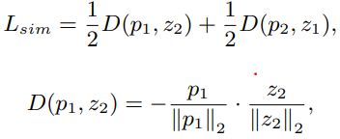
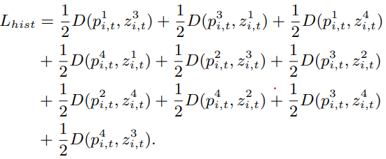
Method (RM-SimSiam)
Enhanced SimSiam-based Contrastive Loss
To improve the rememory ability of RM-SimSiam, by aligning the feature representations outputted by the historical and new models.
cosine-distance
(1) Original SimSiam
(2) RM-SimSiam
non-gradient property of the hist-module, impose the stop-gradient operation $sg(∙)$ on z.
(3) Simplified version
Total loss:

Slide 7
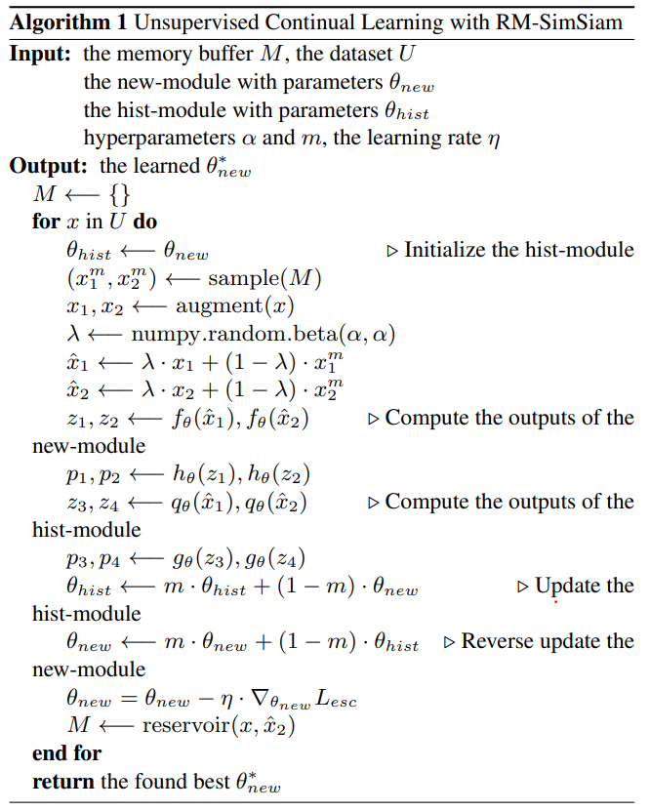
Method (RM-SimSiam)
Algorithm

Slide 8
Experiments
Experimental Setup
Datasets
Datasets | Classes | Class/Task | Resolution
Split CIFAR-10 | 10 | 2 classes/5 tasks | 32*32
Split CIFAR-100 | 100 | 5 classes/20 tasks | 32*32
Split Tiny-ImageNet | 100 | 5 classes/20 tasks | 64*64
Evaluation Metrics
Average accuracy:
Average forgetting:

Slide 9
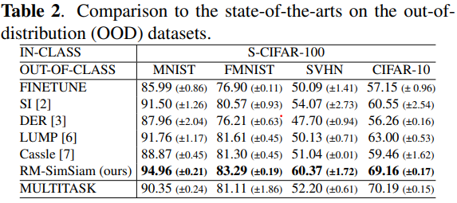
Experiments
Main Results
The effectiveness of our RM-SimSiam.
Our RM-SimSiam is indeed complementary to the rehearsal-based strategy and provides a new perspective to mitigate forgetting in UCL.
The obtained improvements on the OOD datasets show the superior generalization ability of our RM-SimSiam when unseen data distributions are encountered.

Slide 10
Experiments
Ablation Study
Our full RM-SimSiam achieves significant improvements over Base+Mixup, which means that we have made sufficient contributions by devising new rememory mechanism and enhanced SimSiam-based contrastive loss for UCL.

Slide 11
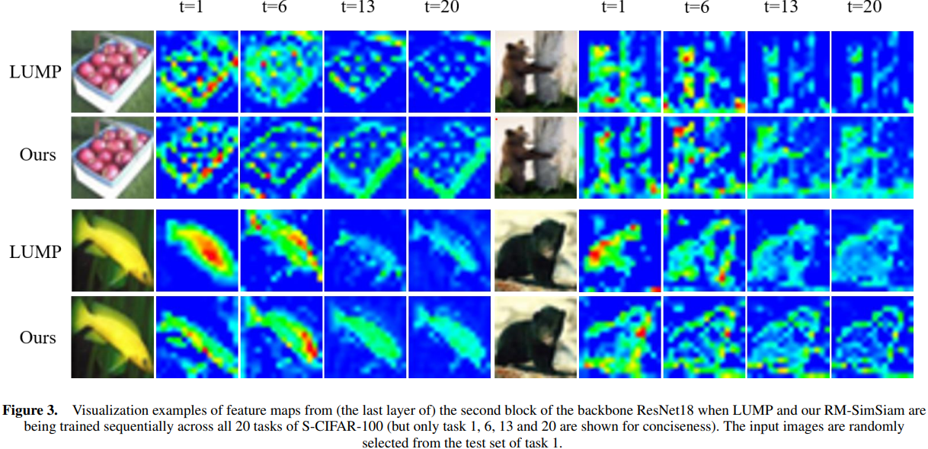
Experiments
Visualization Results
We can clearly observe that our RM-SimSiam can better locate the important areas of the objects and represent the key visual features more stably across sequential tasks as compared with LUMP.

Slide 12
Conclusion
We propose a novel rememory-based method termed RM-SimSiam for unsupervised continual learning by storing and remembering the old knowledge with a data-free historical module instead of replay buffer.
To effectively rememory the knowledge of previous tasks, we design a hist-module by storing the knowledge of previous models and transferring the knowledge of previous models to the new model.
To further improve the rememory ability of our RM-SimSiam, we devise an enhanced SimSiam-based contrastive loss by aligning the representations outputted by the historical and new models.
Extensive experiments on three benchmarks show that our RM-SimSiam achieves
new state-of-the-art under the UCL setting.

Slide 13
Thank you!

