Slide 1
Detecting Occlusion from Color Information to Improve Visual Tracking
Stephen Siena
B.V.K Vijaya Kumar
ICASSP 2016
March 22, 2016

Slide 2
Online Object Tracking
Challenging tracking scenario
Tracker is given minimal information
1st frame has target identified
No prior knowledge about type of object
Tracker must adapt to appearance of object in that video sequence alone

Slide 3
Why is occlusion so challenging?
Target appearance will change over time
Scale, illumination, rotation/deformation
Tracker needs to adapt to changing appearance
Typically done by retraining tracker using each new detection

Slide 4
Why is occlusion so challenging?
It is very hard to distinguish between changing target and an obscured target
One initial training example means we don’t know what a change in appearance really means (deformation or obstruction)

Slide 5
Why is occlusion so challenging?
One learning rate for different videos means:
Lower learning rate: tolerant to occlusion, but can’t keep up with rapidly changing objects
Higher learning rate: can learn new target appearance quickly, but prone to lock on and learn appearance of occlusion
Most trackers will strike a balance for overall good performance
A better option: one learning rate for unoccluded targets, another learning rate for occluded targets

Slide 6
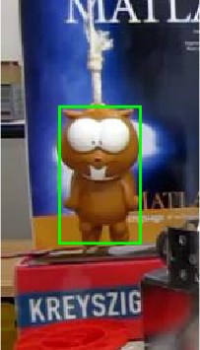
How can we detect occlusion?
Our proposal: color features
Target region: many brown hues, small amount of blue captured from background
Surrounding region: lots of red and blue hues, small amount of brown

Slide 7
Hue for Occlusion Detection
Observations:
The target won’t change colors (probably)
There’s a chance the target is a different color than its surroundings
Object that obscure the target may be a different color

Slide 8
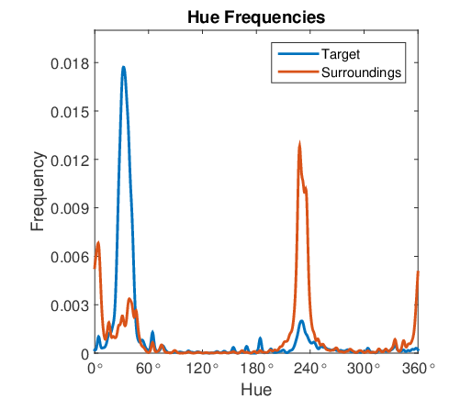
Learning Target Hues
Convert RGB to HSV
Create PDF of target/surrounding hues

Slide 9
Learning Target Hues
Convert pdfs to likelihoods
$$ℒ\left(target | H\right)=\log\left(\frac{P\left(H | target\right)+ε}{P\left(H | background\right)+ε}\right)$$

Slide 10
Applying Hue Likelihoods
Tracker will find most likely location in next frame
Take pixels in that region, and get average likelihood
$$OS_{raw}\left(n\right)=−\frac{\sum_{i=x_{n}}^{x_{n}+w_{n}}{\sum_{j=y_{n}}^{y_{n}+h_{n}}{ℒ(target|H\left(i,j\right))}}}{w_{n}h_{n}}$$

Slide 11
Applying Hue Likelihoods
$OS_{raw}(n)$ can mean different things, depending on hue contrast in initial frame
Normalize scores relative to first frame (ground truth) occlusion score
Helps normalize scores across videos and find a single good decision threshold
$$OS\left(n\right)=OS_{raw}\left(n\right)−OS_{raw}(1)$$

Slide 12
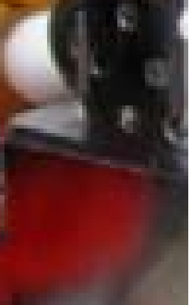
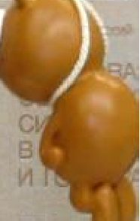
Applying Hue Likelihoods
If occlusion score is above threshold, we’ve detected occlusion, so we won’t update the tracker
Otherwise, update tracker as usual
Frame 296
$$OS_{raw} = −.73$$
Frame 338
$$OS_{raw} =1.13$$
Frame 971
$$OS_{raw} =−1.88$$

Slide 13
Experiment Results
20 videos, 21 targets
Subset of 2013 Online Object Tracking Benchmark dataset
RGB videos with occlusion

Slide 14
Experiment Results
Run 3 correlation trackers, with and without the occlusion detection
Circulant Structure Kernel (CSK) tracker (Henriques et al.)
Intensity features
Kernelized Correlation Filter (KCF) tracker (Henriques et al.)
HOG features
Discriminative Scale Space Tracker (DSST) (Danelljan et al.)
HOG features
2nd filter to estimate target scale

Slide 15
Experiment Results
Evaluation in two ways

Slide 16
Experiment Results
Overlap $\left(\frac{ground truth ∩ prediction}{ground truth ∪ prediction}\right)$ [AUROC]

Slide 17
Experiment Results
Center pixel error [20 pixel threshold]

Slide 18
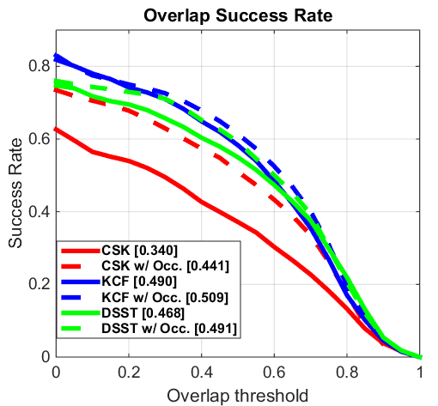
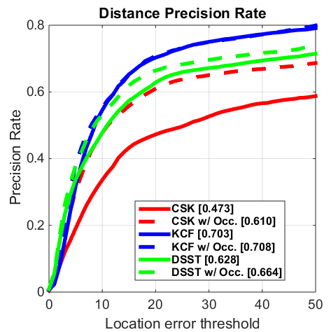
Frame-by-Frame Results

Slide 19
Track-by-Track Results
Count how many tracks have “errors”: critical mistakes that represent losing the target entirely
Tracker | Tracking Errors
 | Total | Corrected | Introduced
CSK | 17 | 4 (24%) | 1
KCF | 11 | 3 (27%) | 1
DSST | 11 | 4 (36%) | 1
Total | 39 | 11 (28%) | 3

Slide 20
Examples
CSK tracker – ‘jogging’ sequence

Slide 21
Examples
KCF tracker – ‘lemming’ sequence

Slide 22
Examples
DSST tracker – ‘girl’ sequence

Slide 23
Example of an Error
KCF tracker – ‘skating1’ sequence
Colored lighting changes over course of video
Frame 1

Slide 24
Conclusion
Color information of the estimated target can help detect occlusion to improve tracking
Fits with common tracker scheme that updates model every frame
Low computation cost

Slide 25
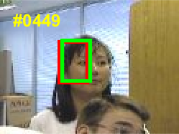
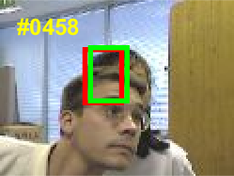
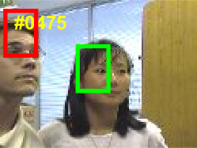
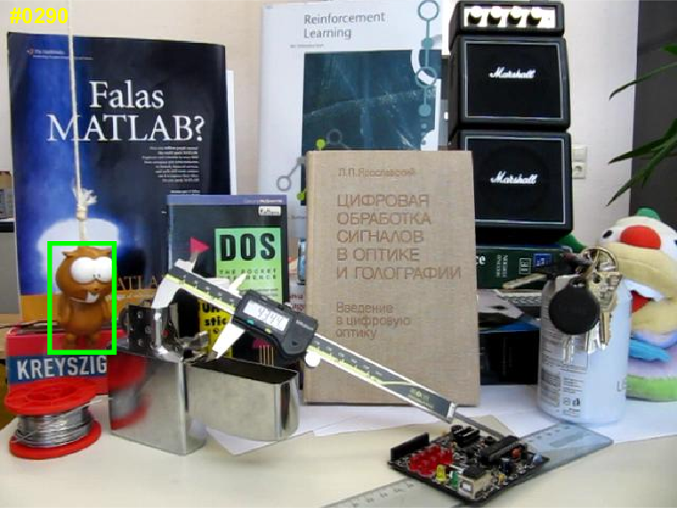
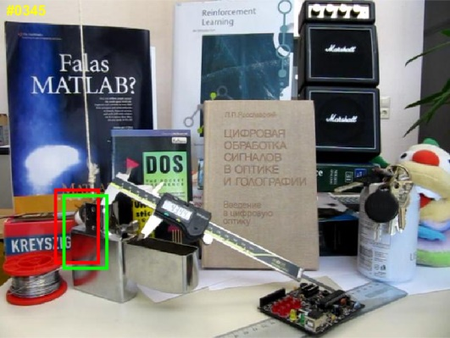
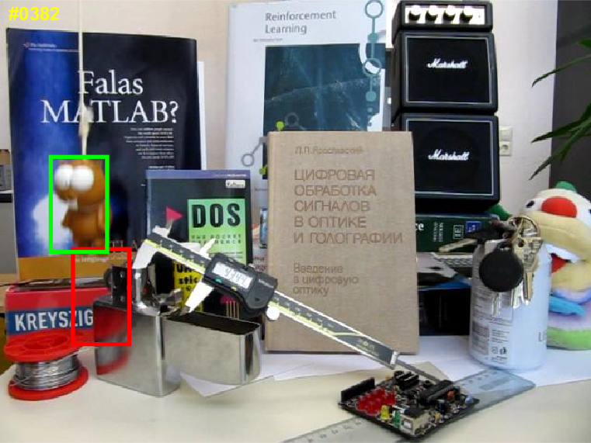
Examples (Stills)
DSST
‘girl’
KCF
‘lemming’

Slide 26
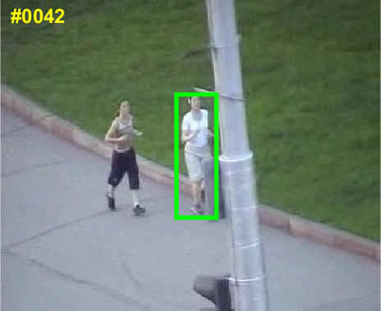
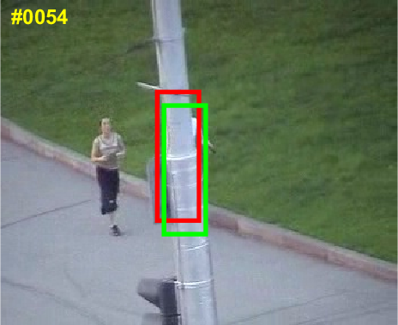
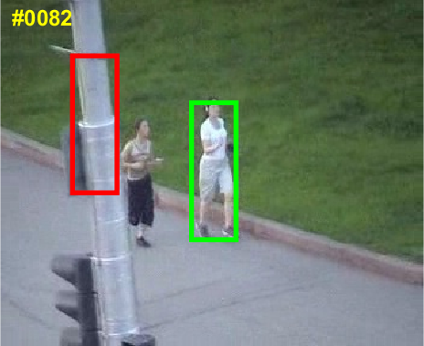
Examples (Stills)
CSK
‘jogging’

Slide 27
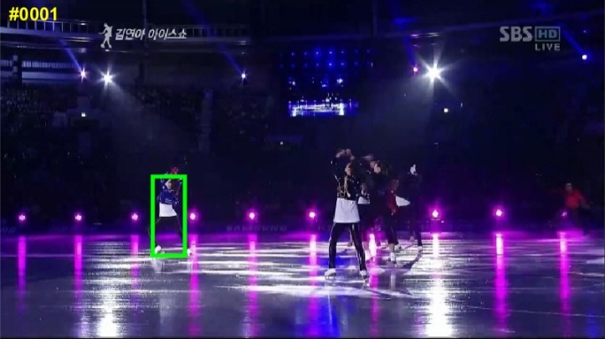
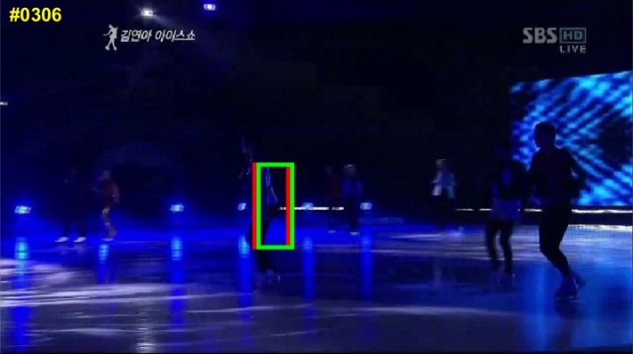
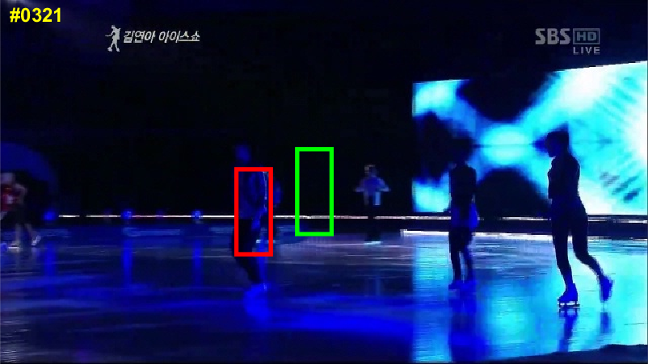
Examples (Stills)
KCF
‘skating1’
Occlusion detection causes mistake due to colored lighting

