Slide 1
Gradient Linear Model for Chroma Intra Prediction
Kwai Inc. & Alibaba Group
Che-Wei Kuo, Xinwei Li, Xiaoyu Xiu, Hong-Jheng Jhu, Ning Yan,
Xianglin Wang, Yan Ye, Jie Chen, and Ru-Ling Liao

Slide 2
Outline
Introduction
Gradient Linear Model
Two-parameter GLM
Three-parameter GLM
Experimental Results
Conclusion
References

Slide 3
Introduction
Finalized in July 2020, VVC provides 40% BD-rate savings over HEVC
Recently, JVET started to explore new coding technologies beyond VVC
Enhanced compression model (ECM) was established in Jan. 2021
Based on VVC test model (VTM) with new coding tools initially included [1]
ECM-5.0 has demonstrated 17% BD-rate savings over VTM [2]
In ECM, various cross-component technologies are applied in the prediction or loop filter stage
Cross-component Linear Model (CCLM), CCALF, CCSAO

Slide 4
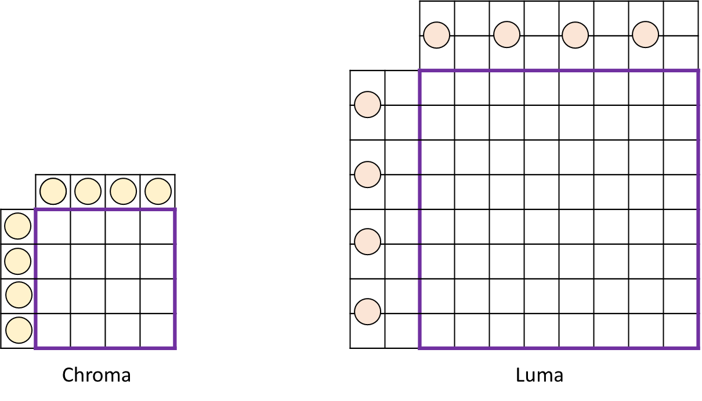
CCLM in VVC/ECM
Predict a chroma sample from its collocated luma sample using a linear model
For a video in 4:2:0 or 4:2:2 YUV format, collocated luma samples are first downsampled by a low-pass filter to match the luma resolution with chroma
E.g., 6-tap low-pass filter for YUV 4:2:0 type-0:
$C=α∙L+β$
$$C$$
$$L$$
$α, β$
to-be-predicted chroma sample
collocated reconstructed luma sample of the chroma sample
slope and offset of the 2-parameter linear model
$[ \begin{matrix}1 & 2 & 1 \\ 1 & 2 & 1\end{matrix}$] / 8

Slide 5
CCLM in VVC/ECM
$[ \begin{matrix}1 & 2 & 1 \\ 1 & 2 & 1\end{matrix}$] / 8
$C=α∙L+β$
Derive $α, β$ at decoder without explicit signaling
From luma/chroma samples in the top/left reconstructed region
In ECM, LMMSE is used for derivation to achieve better coding efficiency [3]
In VVC, a min-max method is adopted to approximate LMMSE with less computation [4]
Apply the derived model on reconstructed luma samples in the collocated block, to generate chroma prediction samples
Remarkable coding performance in VVC/ECM, but the correlation between luma and chroma components are not fully exploited
The low-pass downsampling procedure ignores relative spatial variations among luma samples in proximity, such as edge and gradient information
The low-pass filter blurs luma textures which are informative for video content containing sharp details such as screen content

Slide 6
Gradient Linear Model (GLM)
Propose to improve the chroma prediction quality by additionally utilizing the correlation between luma gradients and corresponding chroma values
Instead of a low-pass filter, utilize high-pass gradient filters to generate downsampled luma values
Provide two GLM schemes
2-parameter: keeps CCLM design but replaces the low-pass downsampling filter with gradient filters
3-parameter: consider both luma gradients and low-pass downsampled luma values to predict chroma values
Experimental results show ~1% additional coding gains on top of ECM-5.0

Slide 7
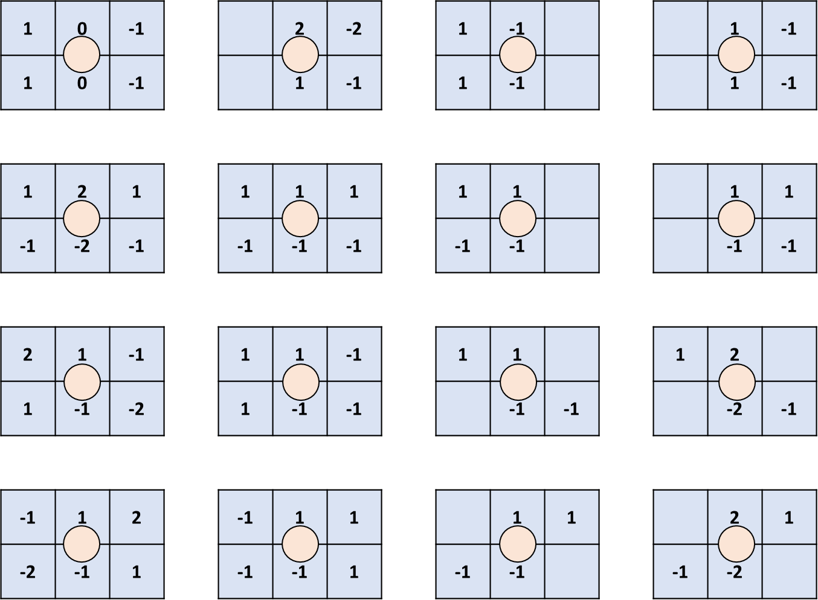
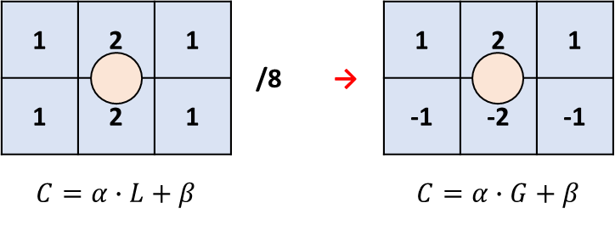
Two-parameter GLM
Instead of the low-pass filter used in the CCLM luma downsampling, utilizing high-pass gradient filters to generate downsampled luma values [5]
To capture luma high-frequency textures which may be correlated to chroma values
Only the input to the CCLM process (downsampled luma value $L$) is replaced by a luma sample gradient value $G$
Encoder switches among 16 gradient filters adaptively according to block characteristics
$G$ can be calculated by one of 16 Sobel/Prewitt-based gradient patterns with different directions

Slide 8
Two-parameter GLM
When the CCLM mode is enabled for the current CU
Signal two flags for Cb and Cr separately to indicate whether the 2-parameter GLM is enabled
Signal one syntax element to select one of the 16 gradient filters for the gradient calculation
Allow combination of the gradient coefficients with the low-pass coefficients in CCLM
Signal one extra flag to indicate the filter coefficients are calculated as sum of the two filters
Reuse design of existing CCLM: template region, linear model derivation/application
Nearly no complexity overhead for encoder and decoder hardware implementations
The long latency issue for supporting both the chroma separate tree (CST) and the CCLM in hardware decoding can be addressed in the same way as in VVC [6]

Slide 9
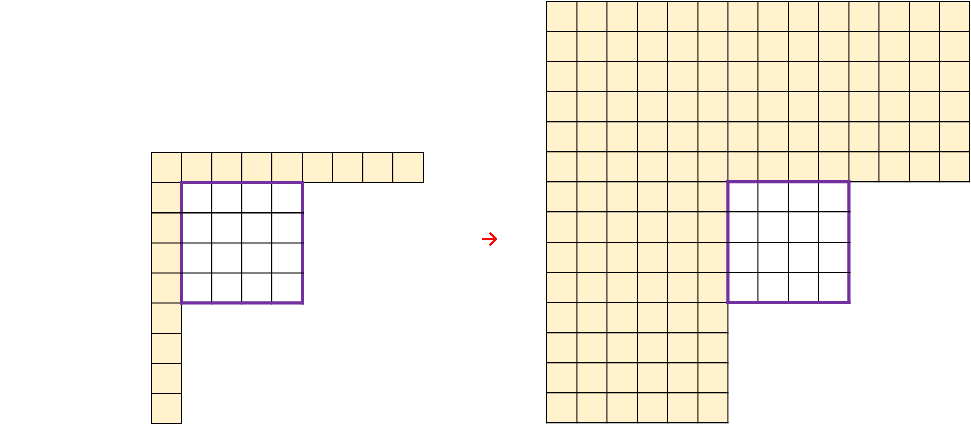
Three-parameter GLM
Combine high-pass luma gradients and low-pass luma values to predict chroma samples [7]
Extend the number of linear model parameters to 3
Luma gradient $G$ and downsampled luma value $L$ calculated the same as in 2-parameter GLM and CCLM
To increase robustness of the 3-parameter regression model, similar approach in [8] is applied
Expand reconstructed region for model derivation:
from 1 row/column of chroma samples in CCLM to 6 rows/columns
Derive model parameters $α_{0}$, $α_{1}$, and $β$
by solving a normal equation based on LDL decomposition
$$G$$
$$L$$
$$α_{0}, α_{1},β$$
from one of the 16 gradient patterns
from the low-pass downsampling filter
coefficients of the 3-parameter linear model
$C=α_{0}∙G+α_{1}∙L +β$

Slide 10
Three-parameter GLM
Implemented as an additional mode on top of 2-parameter GLM
Relative number of valid neighboring samples and block samples may affect the accuracy of the regression model
Give the encoder flexibility to select adaptively according to block conditions
When the CCLM mode is enabled for the current CU
Signal 1 flag to activate the GLM for both Cb and Cr components
Signal 1 flag to switch between the 2-parameter and 3-parameter GLM
Signal one syntax element to select one of the 16 gradient filters

Slide 11
Experimental Results
Implemented on top of ECM-5.0 with simulations conducted on test sequences defined in the JVET common test conditions (CTC) [9]
Significant improvement on sequences that luma gradients are highly correlated to chroma values
Screen content or sequences containing dramatic luma value change
Further improvements for switching 2 and 3-parameter scheme, especially in class F/TGM
Encoding/decoding time can be further optimized by SIMD
2-parameter GLM |  | All Intra |  |  | Random Access
 |  | Y | U | V | Y | U | V
Class Summary | Class A1 | -0.04% | 0.13% | 0.45% | 0.01% | 0.14% | 0.22%
 | Class A2 | -4.71% | -1.58% | -4.49% | -1.56% | -0.52% | -1.93%
 | Class B | -0.12% | -0.23% | 0.42% | -0.05% | -0.30% | -0.11%
 | Class C | 0.02% | 0.02% | 0.10% | 0.01% | 0.32% | 0.23%
 | Class D | 0.01% | 0.70% | 0.14% | -0.01% | 0.52% | 0.41%
 | Class E | -0.03% | -0.29% | 0.17%
 | Class F | -0.46% | -2.21% | -2.05% | -1.14% | -2.20% | -2.19%
 | Calss TGM | -3.44% | -9.38% | -9.35% | -2.30% | -4.37% | -4.58%
Overall Summary | Average | -1.01% | -1.66% | -1.81% | -0.69% | -0.95% | -1.12%
 | EncT | 103% |  |  | 101%
 | DecT | 99% |  |  | 100%
3-parameter GLM |  | All Intra |  |  | Random Access
 |  | Y | U | V | Y | U | V
Class Summary | Class A1 | -0.27% | -0.25% | -0.77% | -0.18% | -0.11% | -0.45%
 | Class A2 | -4.43% | -3.06% | -6.35% | -1.58% | -1.27% | -3.17%
 | Class B | -0.18% | -1.52% | -0.38% | -0.07% | -1.20% | -0.43%
 | Class C | 0.00% | -0.21% | -0.17% | 0.02% | 0.02% | -0.07%
 | Class D | 0.02% | 0.50% | -0.24% | 0.02% | -0.02% | -0.02%
 | Class E | -0.27% | -0.25% | -0.77%
 | Class F | -0.93% | -5.14% | -5.34% | -1.77% | -4.78% | -4.88%
 | Calss TGM | -4.88% | -14.12% | -13.12% | -3.07% | -7.45% | -7.06%
Overall Summary | Average | -1.28% | -3.23% | -3.28% | -0.92% | -2.19% | -2.26%
 | EncT | 106% |  |  | 102%
 | DecT | 100% |  |  | 100%

Slide 12
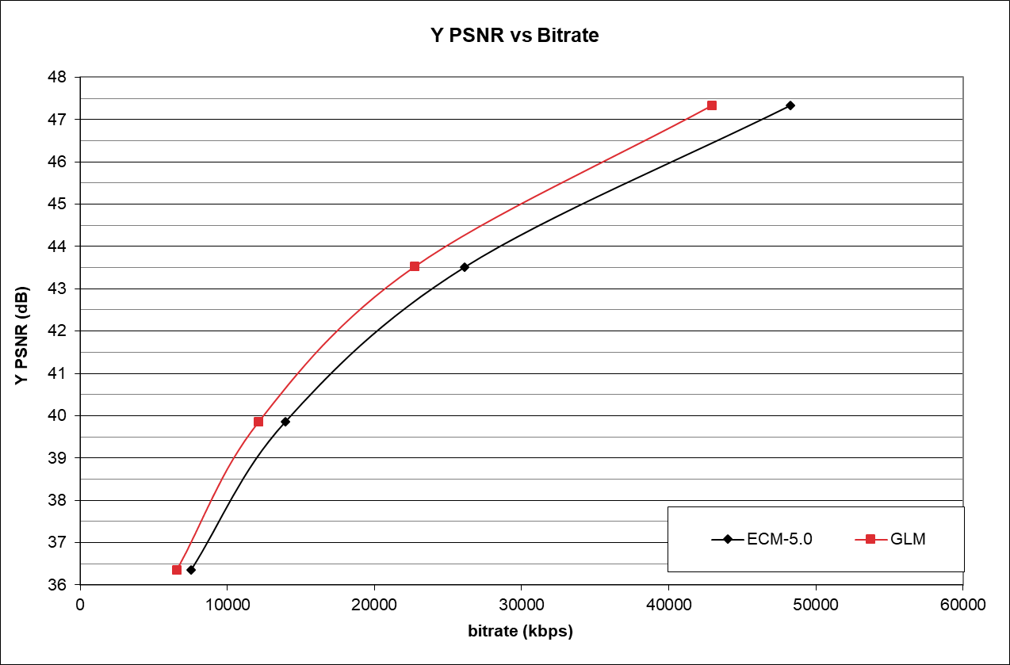
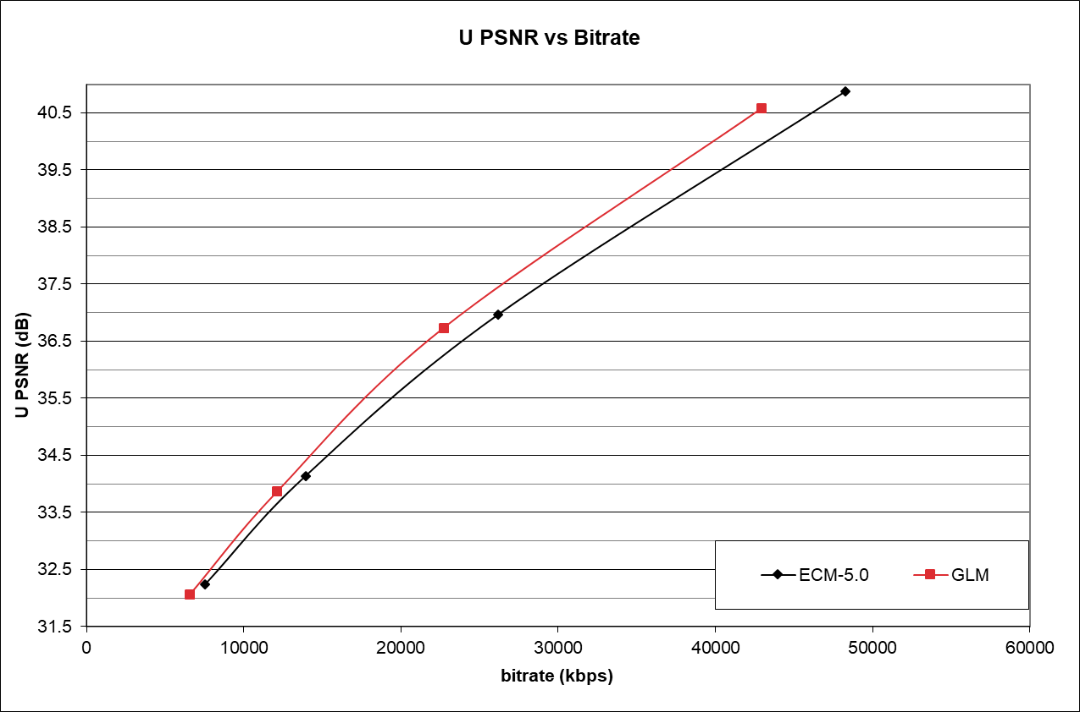
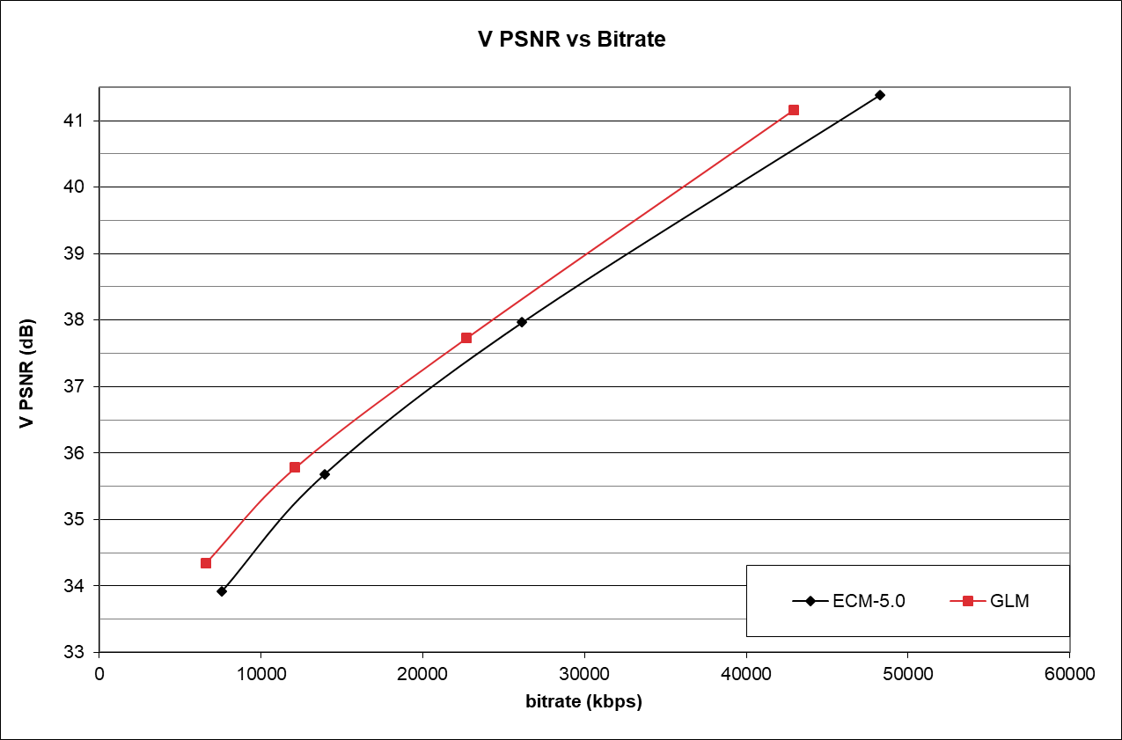
R-D Curves
ParkRunning3, AI configuration
High BD-rate improvements on luma/chroma components
Though GLM aims at chroma intra prediction accuracy, the bit savings in coding chroma residues are reflected on luma as well

Slide 13
Conclusion
Gradient Linear Model (GLM) is proposed
Improve the chroma prediction quality by additionally utilizing the correlation between luma gradients and corresponding chroma values
Two GLM schemes with different trade-offs between coding gain and complexity
2-parameter scheme replaces downsampling filter in CCLM with high-pass gradient filters
3-parameter scheme combines luma gradients with the low-pass downsampled luma value in CCLM
Experimental results show meaningful additional coding gain beyond VVC
{Y, U, V} BD-rate savings for AI and RA: {1.28%, 3.23%, 3.28%} and {0.92%, 2.19%, 2.26%}
2 and 3-parameter GLM have been adopted to the ECM-6.0 and ECM-7.0 respectively for compression efficiency exploration beyond VVC

Slide 14
References
[1] Y.-J. Chang et al, “Compression efficiency methods beyond VVC,” JVET-U0100, Teleconference, Jan. 2021.
[2] V. Seregin, J. Chen, F. Leannec, K. Zhang, “JVET AHG report: ECM software development (AHG6),” JVET-AA0006, Teleconference, Jul. 2022.
[3] J. Chen, V. Seregin, “Chroma intra prediction by scaled luma samples using integer operations,” JCTVC-C206, Guangzhou, Oct. 2010.
[4] J. Huo et al, “CE3-1.5: CCLM derived from four neighbouring samples, JVET-N0271, Geneva, Apr. 2019.
[5] C.-W. Kuo, X. Xiu, N. Yan, H.-J. Jhu, W. Chen, H. Gao, X. Wang, “AHG12: Enhanced CCLM”, JVET-Z0140, Apr. 2022, Teleconference.
[6] Y.-W. Huang et al., “Block Partitioning Structure in the VVC Standard,” in IEEE Transactions on Circuits and Systems for Video Technology, vol. 31, no. 10, pp. 3818-3833, Oct. 2021.
[7] X. Li, Y. Ye, R.-L. Liao, J. Chen, “EE2-related: On Gradient Linear Model (GLM)”, JVET-AA0138, Teleconference, Jul. 2022.
[8] P. Astola, J. Lainema, R. G. Youvalari, A. Aminlou, K. Panusopone, “AHG12: Convolutional cross-component model (CCCM) for intra prediction”, JVET-Z0064, Teleconference, Apr. 2022.
[9] M. Karczewicz, Y. Ye, “Common Test Conditions and evaluation procedures for enhanced compression tool testing,” JVET-Y2017, Teleconference, Jan. 2022.
[10] G. Bjøntegaard, “Calculation of average PSNR differences between RD-Curves,” ITU-T SG16 Q.6 Document, VCEG-M33, Austin, US, Apr. 2001.

Slide 15
Thanks

