Slide 1
On The Energy Statistics of Feature Maps in Pruning of Neural Networks with Skip-Connections
Mohammadreza Soltani
March 2022

Slide 2
Motivation and Problem Statement
Deep Neural Networks (DNNs) are intensive computationally and memory requirement
Making DNNs difficult to deploy on embedded systems with limited hardware resources, e.g., Cell-Phones, Box-TVs
AlexNet 200MB memory (Caffe model)
VGG-16 500MB memory (Caffe model)
Resnet-50 95MB memory.
3.8 X 10^9 floating point multiplications for calculating each image

Slide 3
Motivation and Problem Statement
Energy consumption for limited-resource embedded systems
A lot of memory bandwidth to fetch the weights and huge amount of computation for product operation
Under 45nm CMOS technology,
A 32 bit floating point add consumes 0.9pJ
A 32bit SRAM cache access requires 5pJ
A 32bit DRAM memory access takes 640pJ
Running a 1 billion connection neural network, for example, at 20 fps needs almost 13W power just for DRAM

Slide 4
Deep Neural Architectures with Skip-Connection
Resnet Family
DenseNet Family
$f_{l}$ denotes the various operations on the input of the previous unit, $U_{l−1}$.
We define a skip-unit as the map $f_{l}$for unit $l$-th.

Slide 5
Compression by Pruning
Pruning the model by removing the redundant skip-units based on their learned information
How to study the learned features?
What is the best way to capture the information in the learned features?
How to quantify the redundant residual blocks?
Using Mutual Information as the measure of informativeness.
However,
Mutual Information estimation is computationally challenging in high-dimension of feature space.
We need to model the underlying probability distribution.

Slide 6
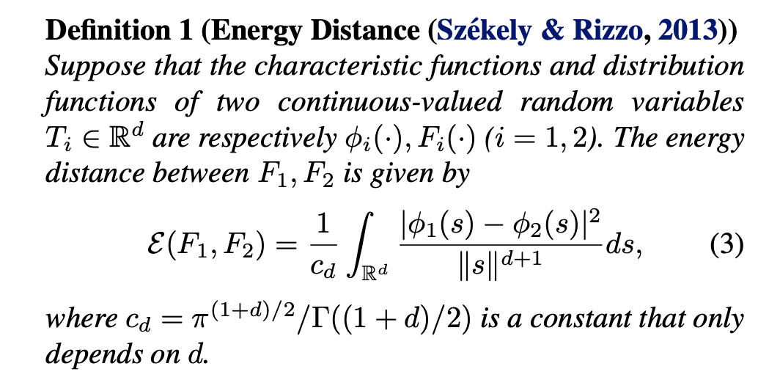
Using a Free Model Statistics
Energy statistics

Slide 7
Using a Free Model Statistics
Estimation of the energy statistics:

Slide 8
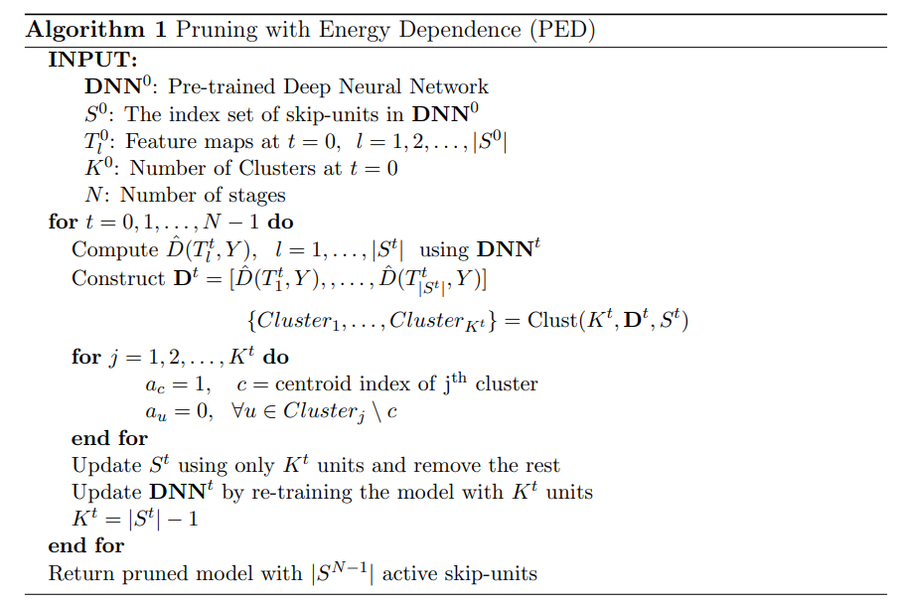
Proposed Algorithm

Slide 9
In a Nutshell:
Train a network
Measure the energy of the skip-units
Cluster the measures (grouping skip-units with similar energy)
Keep one as the cluster head and remove the other units in the cluster
Retrain the network with the weights from the previous stage

Slide 10
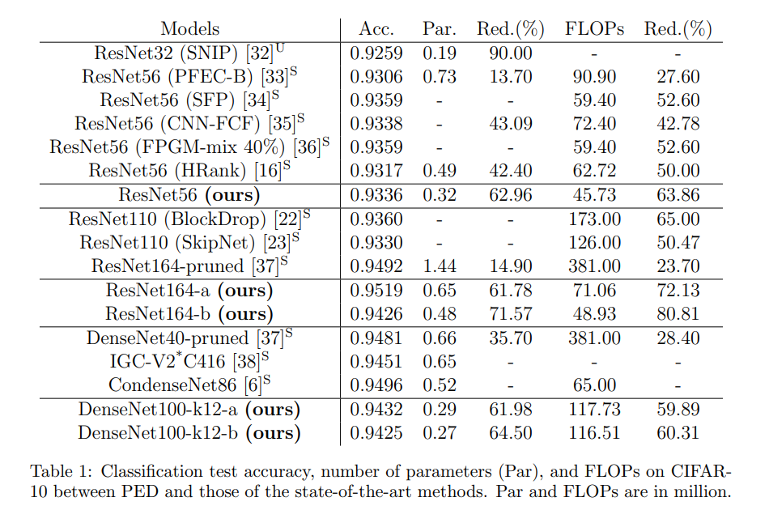
Experimental Results

Slide 11
Experimental Results

