Slide 1
Video-Decoder Power Consumption on Android Devices: Power-Estimation Method, Dataset Creation, and Analysis Results
Roman Kazantsev, Vladimir Yanushkovsky, Dmitriy Vatolin
Video Group
CS MSU Graphics&Media Lab

Slide 2
Introduction
The number of video views on a mobile device has grown constantly in recent years.
Video decoding is a major drain on the battery during playback.
The power efficiency can be maximized as follows:
Video-decoder Power Benchmark that encourages device manufactures to develop green Android ecosystem
Power Consumption Dataset that helps to select a power-efficient compression standard and video-decoder for a given device model

Slide 3
Method for Estimating Video-Decoding Energy
The main idea: the method constantly queries the battery level using the Android API during playback.
The formulas for computing the relative battery consumption to decode a bitstream and the average decoding speed:
Two power metrics used for benchmarking:

Slide 4
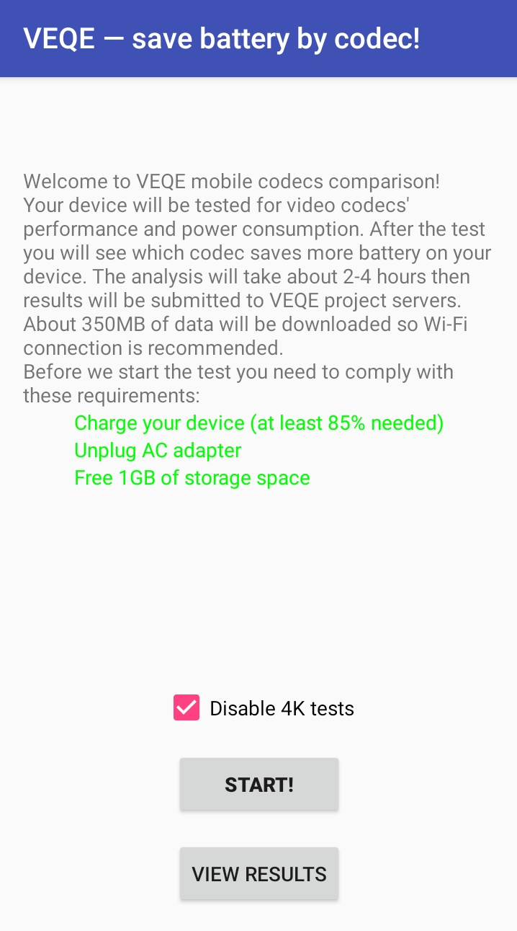
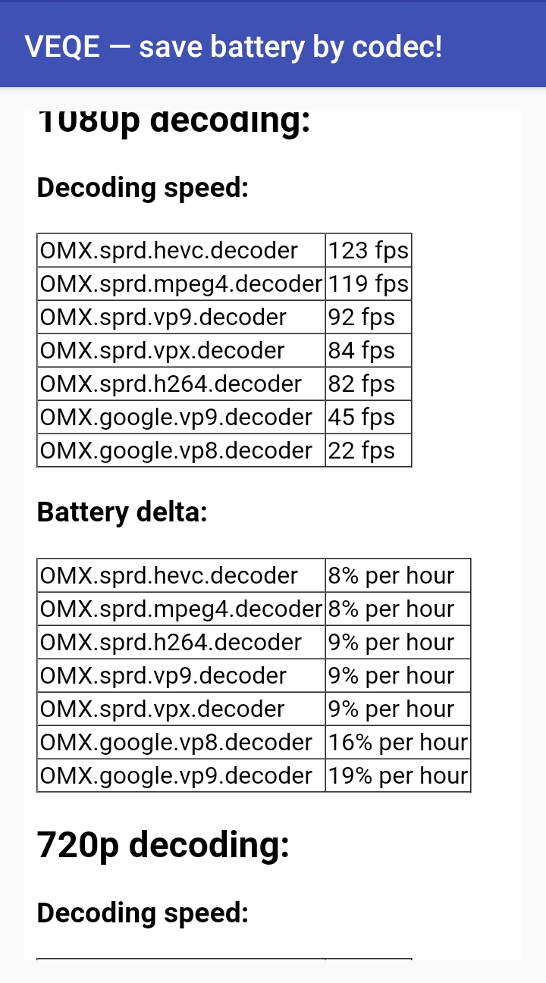
“VEQE — save battery by codec!” Application: Implementation Details
The application tests video-decoders of six standards (AV1, HEVC, VP9, H.264, VP8 and MPEG-4) and three resolutions (SD, HD, and Full HD).
Power estimation must satisfy the requirements:
The device must operate in autonomous mode
The device must have neither too low nor too high a battery level
Power estimation for decoding one bitstream must expend at least 3% of the battery
https://play.google.com/store/apps/details?id=ru.msu.cs.graphics.veqe_mobile

Slide 5
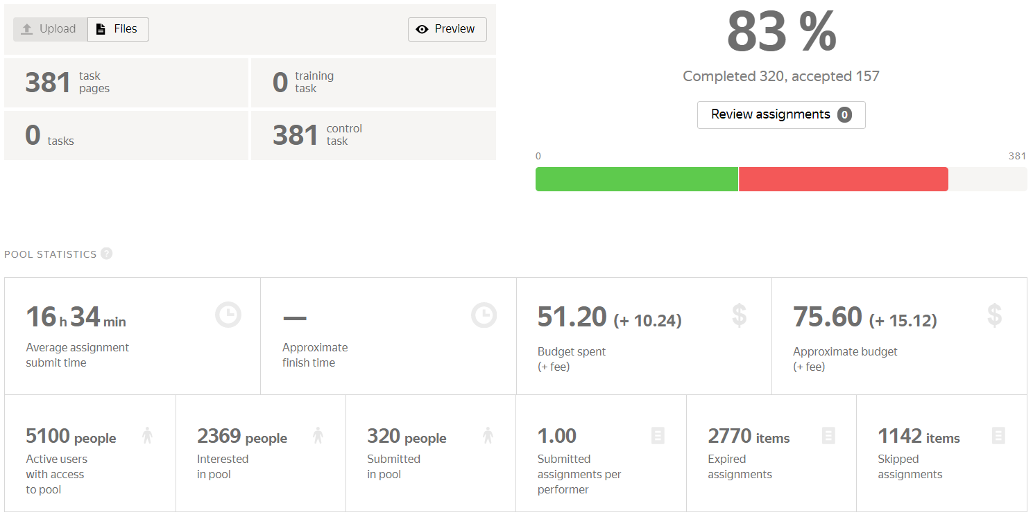
Dataset Creation
We developed an automatic system that consists of:
The VEQE application ⎯ a client for testing
The server for collecting data from all clients once the testing is complete
Yandex.Toloka was used for the dataset creation
The dataset includes 236 devices representing 147 models

Slide 6
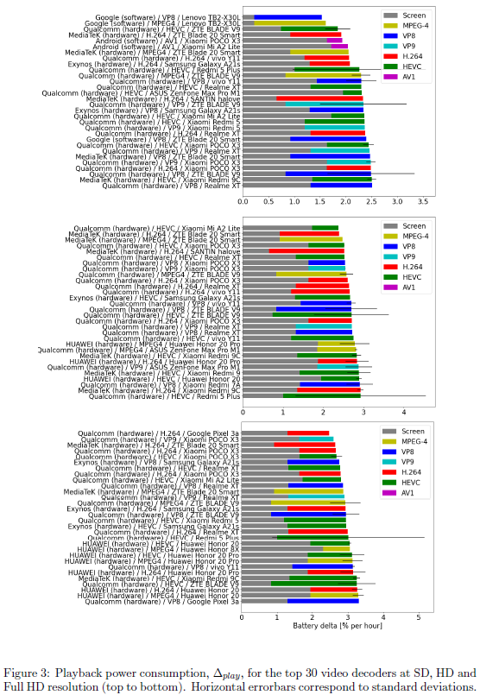
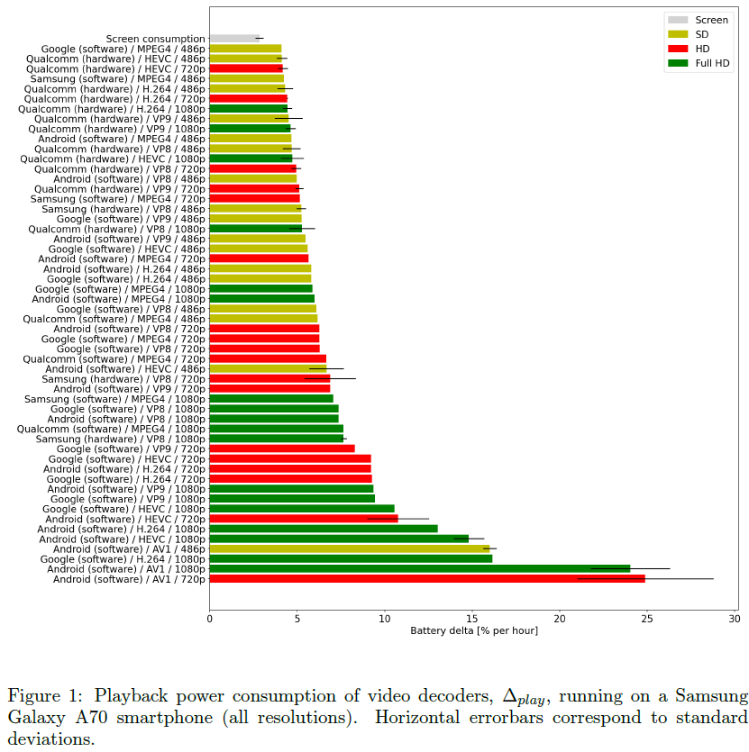
Data Processing and Analysis

Slide 7
Conclusion
The created dataset contains the power metrics from 236 Android devices, representing 147 models and 60 video-decoders
We tested video decoders for six standards (MPEG-4, VP8, H.264, VP9, HEVC, and AV1) and three resolutions (SD, HD, and Full HD)
The dataset covers nine video-decoder manufacturers (Exynos, Google, Huawei, Imagination Technologies, Intel, MediaTek, Qualcomm, Samsung, and Spreadtrum)
Hardware decoders outperform software decoders in power efficiency and decoding speed
Software decoders of MPEG-4, VP8 and AV1 standards can remain efficient for low-resolutions

