Slide 1
Deep Neural Network for Robust Speech Recognition With Auxiliary Features From Laser-Doppler Vibrometer Sensor
Zhipeng Xie^{1,2}，Jun Du¹, Ian McLoughlin³
Yong Xu², Feng Ma², Haikun Wang²
1 National Engineering Laboratory for Speech and Language Processing
2 Research Department, iFLYTEK Co. LTD.
3 School of Computing, University of Kent, Medway, UK
October 18, 2016
Notes:
Hello everyone. I’m Xie Zhipeng from USTC.
Long title, you know, may cause many inconvenience, like filling the registration chart of this conference. But it is important. The title of this talk is …

Slide 2
Outline
Introduction
Proposed Methods
Experimental Results
Conclusion
Notes:
And I’ll show you an interesting ideal and experiment results through 4 steps. First let me give you some brief introduction.

Slide 3
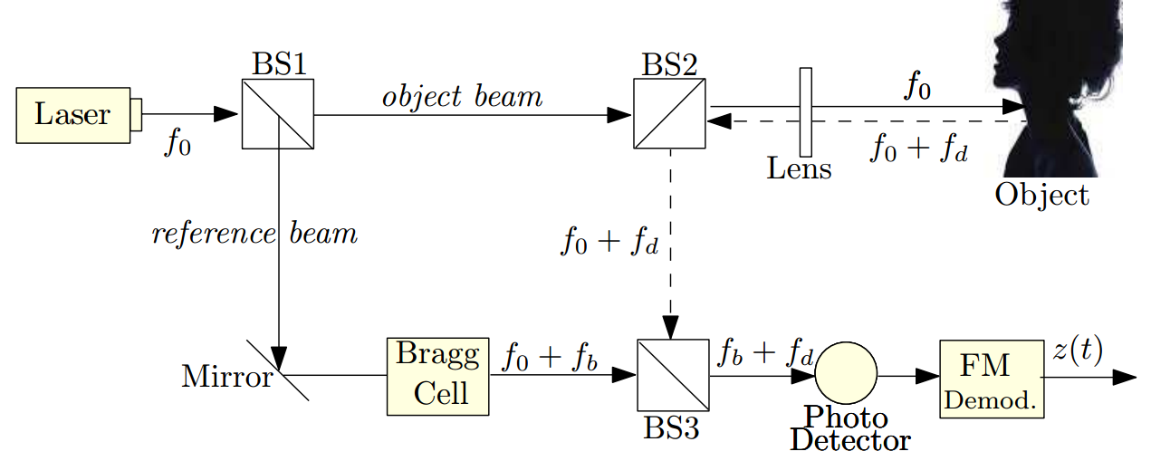
Introduction
Robust ASR using DNN
Laser-Doppler Vibrometer (LDV) Sensor
Directed to speaker’s larynx, non-contact
Measure the vibration velocity
Immune to acoustic interference
Pic from Y. Avargel,“Speech measurements etc.” 2011
Notes:
The title indicates that our…
Target: Robust asr → which is Closely related to our daily life, and of course this conference has many sessions about it.
Model: DNN → Here we just want to try an interesting ideal and DNN is enough. Cause DNNs have demonstrated a great capacity to extract discriminative internal representations that are robust to the many sources of variability in speech signals.
What we have done? We found an interesting signal which captured by laser Doppler vibrometer (LDV) sensor.
Means: try to use LDV feature to assist our normal robust asr.
the LDV sensor is a non-contact measurement device that is capable of measuring the vibration frequencies of moving targets. It is directed at a speaker's larynx, and captures useful speech information at certain frequency bands. Due to this reason, the LDV signal remains almost the same regardless of different background acoustic interference in different SNRs.
That’s quiet good, isn’t it?

Slide 4
Outline
Introduction
Proposed Methods
Experimental Results
Conclusion
Notes:
So LDV signal is interesting and probably good for our tasks, then how can we use it?
First of all, we run a simple test to validate the usage of LDV speech and its features

Slide 5
Proposed
LDV Feature Combination(Limited dataset)
Normal speech
Notes:
The availability of data is limited and it contains parallel recordings of acoustic speech and LDV signals. In other words, LDV speech has its corresponding Normal speech, they were recorded simultaneously with different kinds and levels background noises.
These details will show afterwards.
1. Normal speech asr system using DNN as acoustic model, got feature and training using BP etc.
2. With the same approach like Normal speech, we run the test which combining these two features together.
You guess what, it makes sense! The combining system outperformance the acoustic only system, by getting more robust information.
But the asr accuracy is restricted by the small size of the LDV database such that the DNN-based ASR systems are not trained sufficiently well.

Slide 6
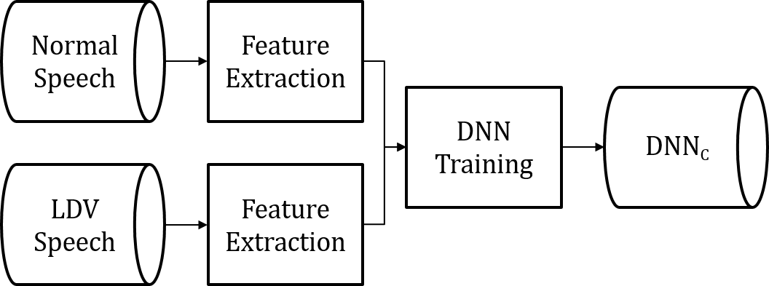
Proposed
LDV Feature Combination(Limited dataset)
Normal speech
Normal + LDV speech
Stereo Data
Notes:
The availability of data is limited and it contains parallel recordings of acoustic speech and LDV signals. In other words, LDV speech has its corresponding Normal speech, they were recorded simultaneously with different kinds and levels background noises.
These details will show afterwards.
1. Normal speech asr system using DNN as acoustic model, got feature and training using BP etc.
2. With the same approach like Normal speech, we run the test which combining these two features together.
You guess what, it makes sense! The combining system outperformance the acoustic only system, by getting more robust information.
But the asr accuracy is restricted by the small size of the LDV database such that the DNN-based ASR systems are not trained sufficiently well.

Slide 7
Proposed
LDV Feature Combination(Limited dataset)
Normal speech
Normal + LDV speech
makes sense!
Stereo Data
Notes:
The availability of data is limited and it contains parallel recordings of acoustic speech and LDV signals. In other words, LDV speech has its corresponding Normal speech, they were recorded simultaneously with different kinds and levels background noises.
These details will show afterwards.
1. Normal speech asr system using DNN as acoustic model, got feature and training using BP etc.
2. With the same approach like Normal speech, we run the test which combining these two features together.
You guess what, it makes sense! The combining system outperformance the acoustic only system, by getting more robust information.
But the asr accuracy is restricted by the small size of the LDV database such that the DNN-based ASR systems are not trained sufficiently well.

Slide 8
Proposed
Limited LDV dataset → validated
Large dataset (Normal real-life speech)
Notes:
We are therefore aiming to make use of much larger datasets, and will test this with acoustic-only ASR at first.
Of cause iflytek has many real-life recordings.
Now we face two questions:
Q a) These two dataset are not matched, so this imbalance might make the acoustic DNN model largely influenced by the larger dataset when simply combing the two datasets. So we first train an acoustic-only DNN-based ASR system from the larger database alone. This provides a good initialization starting point. This DNN is then fine-tuned by using the acoustic-only data from the LDV dataset (LDV-acoustic).
Q b) When training the combining system, we need the corresponding LDV feature. But the larger dataset only contains the acoustic normal speech. So we we obtain corresponding pseudo-LDV features by first training a mapping network to learn the relationships between the features from acoustic speech and the features from the LDV signal. Through this method, we can obtain the parallel recordings of normal speech in large dataset.

Slide 9
Proposed
Limited LDV dataset → validated
Large dataset (Normal real-life speech)
How to use these valuable data?
Well-trained DNN for initialization
Notes:
We are therefore aiming to make use of much larger datasets, and will test this with acoustic-only ASR at first.
Of cause iflytek has many real-life recordings.
Now we face two questions:
Q a) These two dataset are not matched, so this imbalance might make the acoustic DNN model largely influenced by the larger dataset when simply combing the two datasets. So we first train an acoustic-only DNN-based ASR system from the larger database alone. This provides a good initialization starting point. This DNN is then fine-tuned by using the acoustic-only data from the LDV dataset (LDV-acoustic).
Q b) When training the combining system, we need the corresponding LDV feature. But the larger dataset only contains the acoustic normal speech. So we we obtain corresponding pseudo-LDV features by first training a mapping network to learn the relationships between the features from acoustic speech and the features from the LDV signal. Through this method, we can obtain the parallel recordings of normal speech in large dataset.

Slide 10
Proposed
Limited LDV dataset → validated
Large dataset (Normal real-life speech)
How to use these valuable data?
Well-trained DNN for initialization
How to get corresponding LDV feature?
- Mapping network: regression DNN
Notes:
We are therefore aiming to make use of much larger datasets, and will test this with acoustic-only ASR at first.
Of cause iflytek has many real-life recordings.
Now we face two questions:
Q a) These two dataset are not matched, so this imbalance might make the acoustic DNN model largely influenced by the larger dataset when simply combing the two datasets. So we first train an acoustic-only DNN-based ASR system from the larger database alone. This provides a good initialization starting point. This DNN is then fine-tuned by using the acoustic-only data from the LDV dataset (LDV-acoustic).
Q b) When training the combining system, we need the corresponding LDV feature. But the larger dataset only contains the acoustic normal speech. So we we obtain corresponding pseudo-LDV features by first training a mapping network to learn the relationships between the features from acoustic speech and the features from the LDV signal. Through this method, we can obtain the parallel recordings of normal speech in large dataset.

Slide 11
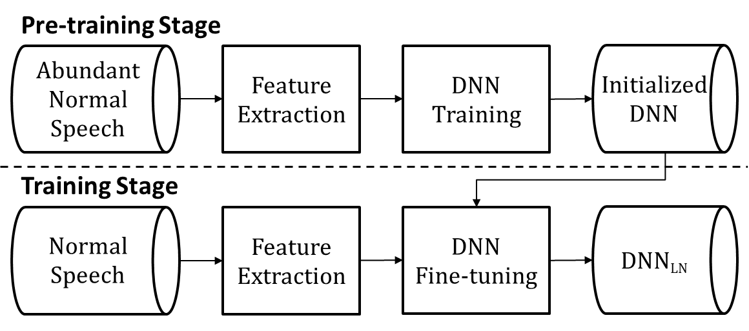
Proposed
Large dataset to train DNN for initialization
Notes:
Following the previous routings, we first test these with acoustic-only ASR system.
The system below the dashed line is the DNN_N system. And we use the larger dataset to train a acoustic DNN system and then use it to initialize the final acoustic asr system. The results shows a obvious improvements. So this validate our suspect, and we want to create a similar network structure to use LDV feature combination method to further improve the performance.
So if we add LDV feature here, The system below the dashed line is the DNN_C system. And Also we should initialize this acoustic asr system using well-trained system with larger dataset and here we supposed to need the corresponding LDV feature to do the combination. And the next step is to train a mapping network to map the normal speech feature into LDV feature, then the whole system can be organized like this.
And then we have large dataset with its pseudo-LDV feature and everything is ready, the system can work and test.

Slide 12
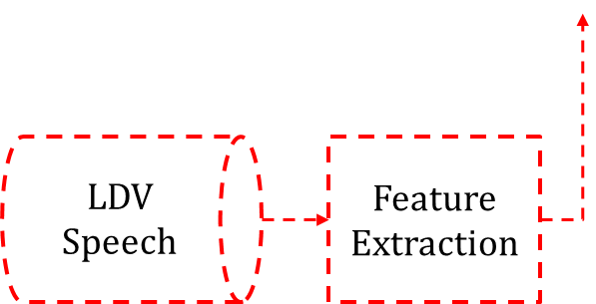
Proposed
Large dataset to train DNN for initialization
Notes:
Following the previous routings, we first test these with acoustic-only ASR system.
The system below the dashed line is the DNN_N system. And we use the larger dataset to train a acoustic DNN system and then use it to initialize the final acoustic asr system. The results shows a obvious improvements. So this validate our suspect, and we want to create a similar network structure to use LDV feature combination method to further improve the performance.
So if we add LDV feature here, The system below the dashed line is the DNN_C system. And Also we should initialize this acoustic asr system using well-trained system with larger dataset and here we supposed to need the corresponding LDV feature to do the combination. And the next step is to train a mapping network to map the normal speech feature into LDV feature, then the whole system can be organized like this.
And then we have large dataset with its pseudo-LDV feature and everything is ready, the system can work and test.

Slide 13
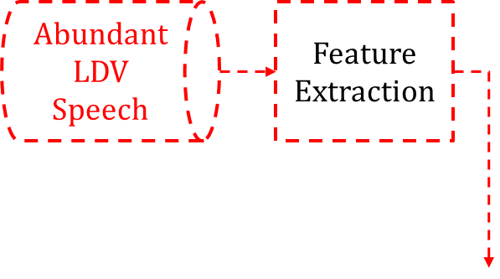
Proposed
Large dataset to train DNN for initialization
Notes:
Following the previous routings, we first test these with acoustic-only ASR system.
The system below the dashed line is the DNN_N system. And we use the larger dataset to train a acoustic DNN system and then use it to initialize the final acoustic asr system. The results shows a obvious improvements. So this validate our suspect, and we want to create a similar network structure to use LDV feature combination method to further improve the performance.
So if we add LDV feature here, The system below the dashed line is the DNN_C system. And Also we should initialize this acoustic asr system using well-trained system with larger dataset and here we supposed to need the corresponding LDV feature to do the combination. And the next step is to train a mapping network to map the normal speech feature into LDV feature, then the whole system can be organized like this.
And then we have large dataset with its pseudo-LDV feature and everything is ready, the system can work and test.

Slide 14
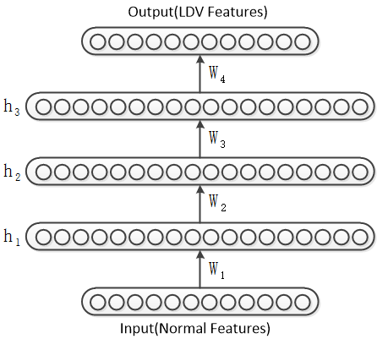
Proposed
Large dataset to train DNN for initialization
Regression DNN
Notes:
Following the previous routings, we first test these with acoustic-only ASR system.
The system below the dashed line is the DNN_N system. And we use the larger dataset to train a acoustic DNN system and then use it to initialize the final acoustic asr system. The results shows a obvious improvements. So this validate our suspect, and we want to create a similar network structure to use LDV feature combination method to further improve the performance.
So if we add LDV feature here, The system below the dashed line is the DNN_C system. And Also we should initialize this acoustic asr system using well-trained system with larger dataset and here we supposed to need the corresponding LDV feature to do the combination. And the next step is to train a mapping network to map the normal speech feature into LDV feature, then the whole system can be organized like this.
And then we have large dataset with its pseudo-LDV feature and everything is ready, the system can work and test.

Slide 15
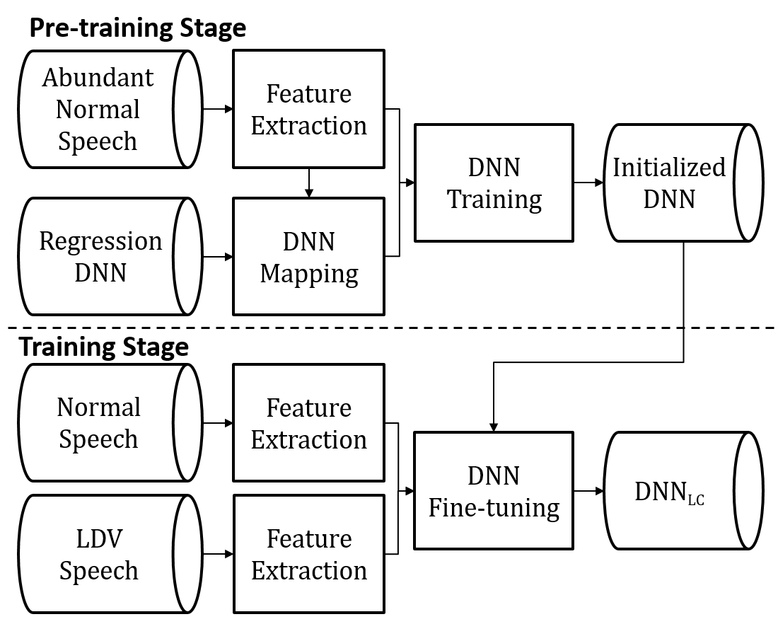
Proposed
Large dataset to train DNN for initialization
Regression DNN
Notes:
Following the previous routings, we first test these with acoustic-only ASR system.
The system below the dashed line is the DNN_N system. And we use the larger dataset to train a acoustic DNN system and then use it to initialize the final acoustic asr system. The results shows a obvious improvements. So this validate our suspect, and we want to create a similar network structure to use LDV feature combination method to further improve the performance.
So if we add LDV feature here, The system below the dashed line is the DNN_C system. And Also we should initialize this acoustic asr system using well-trained system with larger dataset and here we supposed to need the corresponding LDV feature to do the combination. And the next step is to train a mapping network to map the normal speech feature into LDV feature, then the whole system can be organized like this.
And then we have large dataset with its pseudo-LDV feature and everything is ready, the system can work and test.

Slide 16
Outline
Introduction
Proposed Methods
Experimental & Results
Conclusion
Notes:
Next I will show you the experiments’ settings and results

Slide 17
Experiments
No. | Car Speed | Window | Outside | AC
1 | stationary | closed | downtown | middle
2 | stationary | open | car park | off
3 | ≤40km/h | closed | downtown | off
4 | 41-60 km/h | closed | countryside | middle
5 | 80-120 km/h | closed | highway | middle
Corpus
LDV dataset
Total: 13k recordings in 16 kHz, 16 bits
Speakers from: U.S. , Hebrew
Training: 54 speakers → 9.9h
Development set: 4 speakers → 0.62h
Test set: 4 speakers → 0.75h
CZ dataset
Total: 66k recordings in 16 kHz, 16 bits → 620h
Speakers from: U.S. , England, Canada
Replayed in Toyota, Volkswagen and BMW
Notes:
First of all, the corpus we use contains two independent parts.
The LDV limited dataset is from the VocalZoom company, which includes speech recordings captured by LDV sensors along with corresponding acoustic recordings. During recording, besides capturing in a clean environment, recordings were made where interfering acoustic noise was present. In those recordings an undesired speaker and background noises (from a moving vehicle) are present in addition to the desired speaker. Measurements by the LDV and acoustic sensors were recorded simultaneous. The SNR contains 0, -3,-6,-9,-12db. Detailed information can be found in the paper.
The second database we use comes from the iFlytek company research group, which provides a large resource normal speech recordings of native English speakers.
Larger dataset can better coverage of pronunciations and speakers as a supplement to the LDV dataset.
These were recorded first into high-quality audio files, then replayed in three different vehicles, namely Toyota, Volkswagen and BMW cars, in 5 different scenarios, shown in Table above. The `Outside' column details the environment that the car is parked in or moving through, while the `AC' column indicates whether the air conditioner is operating, either on a medium setting or turned off.

Slide 18
Experiments
Experimental settings
Features
72-dim LMFB (24 + Δ + ΔΔ)
10 neighboring frames (± 5 frames)
Acoustic-only Feature: 72*11 = 792-dim
Combining Feature: 72*2*11 = 1584-dim
Acoustic DNN
6 hidden layers with 2048 nodes
State numbers: 9004 (senones of HMM)
Regression DNN
2 hidden layers with 2048 nodes
From normal speech feature to LDV feature
Structure: 792-2048-2048-792
Notes:
The features we use for both DNN regression and acoustic modeling are 72

Slide 19
Results
System | Feature_dim | SER | WER
DNN_{N} | 72 | 89.71% | 58.88%
DNN_{C} | 144 | 84.27% | 52.42%
Table 2: Results of LDV feature combination
Fig 3: Results of LDV feature combination in different environment conditions
Notes:
The recognition performance is evaluated by word error rate (WER) and the sentence error rate(SER), however the WER is more concerned when talking about the performance of acoustic models.
Table 2 lists a performance comparison of the two systems with or without using the combined auxiliary features from the LDV sensors. The only difference between this two system is the input feature dimension. Both the WER and SER of feature combination DNN_C system can be reduced by about 6% over the DNN_N system, which verifies the effectiveness of the auxiliary LDV features.
To further explore the effectiveness of using LDV information in different environments, we test those two systems on two subsets of utterances recorded in clean and noisy environments, the results are shown in table 3. we can make an observation that the auxiliary LDV features can improve the recognition performances for both clean and noisy environments, with relative word error rate (WER) reductions of 11.5\% and 12.5\%, respectively.
The results of the systems initialized by a larger dataset are shown in Table 4. Comparing the first line of Table 2 and Table 4, we can see that with more training data, the system using acoustic-only features significantly outperforms the other. Same results also can be concluded by comparing the second line of table 2 and table 4, which normal speech feature is combined with LDV features. Moreover, if we use both the larger dataset and limited dataset to train the initialized system, we can get a remarkable performance gain.

Slide 20
Results
LDV data helps
System | Feature_dim | SER | WER
DNN_{N} | 72 | 89.71% | 58.88%
DNN_{C} | 144 | 84.27% | 52.42%
Table 2: Results of LDV feature combination
Fig 3: Results of LDV feature combination in different environment conditions
Notes:
The recognition performance is evaluated by word error rate (WER) and the sentence error rate(SER), however the WER is more concerned when talking about the performance of acoustic models.
Table 2 lists a performance comparison of the two systems with or without using the combined auxiliary features from the LDV sensors. The only difference between this two system is the input feature dimension. Both the WER and SER of feature combination DNN_C system can be reduced by about 6% over the DNN_N system, which verifies the effectiveness of the auxiliary LDV features.
To further explore the effectiveness of using LDV information in different environments, we test those two systems on two subsets of utterances recorded in clean and noisy environments, the results are shown in table 3. we can make an observation that the auxiliary LDV features can improve the recognition performances for both clean and noisy environments, with relative word error rate (WER) reductions of 11.5\% and 12.5\%, respectively.
The results of the systems initialized by a larger dataset are shown in Table 4. Comparing the first line of Table 2 and Table 4, we can see that with more training data, the system using acoustic-only features significantly outperforms the other. Same results also can be concluded by comparing the second line of table 2 and table 4, which normal speech feature is combined with LDV features. Moreover, if we use both the larger dataset and limited dataset to train the initialized system, we can get a remarkable performance gain.

Slide 21
Results
LDV data helps
System | Feature_dim | SER | WER
DNN_{N} | 72 | 89.71% | 58.88%
DNN_{C} | 144 | 84.27% | 52.42%
Table 2: Results of LDV feature combination
Fig 3: Results of LDV feature combination in different environment conditions
System | Feature_dim | WER
DNN_{LN} | 72 | 32.93%
DNN_{LC} | 144 | 26.13%
joint-DNN_{LC} | 144 | 25.22%
Table 3: Results of the systems with larger dataset for DNN initialization
Notes:
The recognition performance is evaluated by word error rate (WER) and the sentence error rate(SER), however the WER is more concerned when talking about the performance of acoustic models.
Table 2 lists a performance comparison of the two systems with or without using the combined auxiliary features from the LDV sensors. The only difference between this two system is the input feature dimension. Both the WER and SER of feature combination DNN_C system can be reduced by about 6% over the DNN_N system, which verifies the effectiveness of the auxiliary LDV features.
To further explore the effectiveness of using LDV information in different environments, we test those two systems on two subsets of utterances recorded in clean and noisy environments, the results are shown in table 3. we can make an observation that the auxiliary LDV features can improve the recognition performances for both clean and noisy environments, with relative word error rate (WER) reductions of 11.5\% and 12.5\%, respectively.
The results of the systems initialized by a larger dataset are shown in Table 4. Comparing the first line of Table 2 and Table 4, we can see that with more training data, the system using acoustic-only features significantly outperforms the other. Same results also can be concluded by comparing the second line of table 2 and table 4, which normal speech feature is combined with LDV features. Moreover, if we use both the larger dataset and limited dataset to train the initialized system, we can get a remarkable performance gain.

Slide 22
Results
LDV data helps
System | Feature_dim | SER | WER
DNN_{N} | 72 | 89.71% | 58.88%
DNN_{C} | 144 | 84.27% | 52.42%
Table 2: Results of LDV feature combination
Fig 3: Results of LDV feature combination in different environment conditions
More data for initialization, better performance
System | Feature_dim | WER
DNN_{LN} | 72 | 32.93%
DNN_{LC} | 144 | 26.13%
joint-DNN_{LC} | 144 | 25.22%
Table 3: Results of the systems with larger dataset for DNN initialization
Notes:
The recognition performance is evaluated by word error rate (WER) and the sentence error rate(SER), however the WER is more concerned when talking about the performance of acoustic models.
Table 2 lists a performance comparison of the two systems with or without using the combined auxiliary features from the LDV sensors. The only difference between this two system is the input feature dimension. Both the WER and SER of feature combination DNN_C system can be reduced by about 6% over the DNN_N system, which verifies the effectiveness of the auxiliary LDV features.
To further explore the effectiveness of using LDV information in different environments, we test those two systems on two subsets of utterances recorded in clean and noisy environments, the results are shown in table 3. we can make an observation that the auxiliary LDV features can improve the recognition performances for both clean and noisy environments, with relative word error rate (WER) reductions of 11.5\% and 12.5\%, respectively.
The results of the systems initialized by a larger dataset are shown in Table 4. Comparing the first line of Table 2 and Table 4, we can see that with more training data, the system using acoustic-only features significantly outperforms the other. Same results also can be concluded by comparing the second line of table 2 and table 4, which normal speech feature is combined with LDV features. Moreover, if we use both the larger dataset and limited dataset to train the initialized system, we can get a remarkable performance gain.

Slide 23
Outline
Introduction
Proposed Methods
Experimental Results
Conclusion
Notes:
Last but not least, let us have a conclusion

Slide 24
Conclusion
New & Interesting Idea:
LDV + normal speech combination
Well-trained DNN for initialization
Regression network to get corresponding pseudo-LDV feature
Notes:
In this talk, We have demonstrated an new and interesting ideal that using auxiliary information derived from an LDV sensor for improving ASR performance.
Due to the properties of LDV data which make it immune to acoustic interference, we combine LDV features with normal acoustic speech features to train a DNN acoustic model. Experimental results show significant improvements of recognition accuracy under both clean and noisy conditions. Furthermore, after pre-training the DNN model with pseudo-LDV features combined with acoustic features extracted from a large data set, ASR system achieves much better performance than that trained with smaller LDV datasets alone.
In the future, we are aiming to use it in our daily life and collect more training data, maybe other recognition methods can also improve the performance.

Slide 25
Conclusion
New & Interesting Idea:
LDV + normal speech combination
Well-trained DNN for initialization
Regression network to get corresponding pseudo-LDV feature
Future work:
Practical use in daily life
More LDV data
Other recognition methods
Notes:
In this talk, We have demonstrated an new and interesting ideal that using auxiliary information derived from an LDV sensor for improving ASR performance.
Due to the properties of LDV data which make it immune to acoustic interference, we combine LDV features with normal acoustic speech features to train a DNN acoustic model. Experimental results show significant improvements of recognition accuracy under both clean and noisy conditions. Furthermore, after pre-training the DNN model with pseudo-LDV features combined with acoustic features extracted from a large data set, ASR system achieves much better performance than that trained with smaller LDV datasets alone.
In the future, we are aiming to use it in our daily life and collect more training data, maybe other recognition methods can also improve the performance.

Slide 26
Thanks & Questions

