Slide 1
SAIR
Self-Supervised Face Image Restoration with a One-Shot Reference
- Yanhui Guo, Fangzhou Luo, and Shaoyuan Xu

Slide 2
SAIR
For Image Super-Resolution
Training Domain
Test Domain
Synthetic Degradations
Real-world Degradations
(Camera-specific)
Unseen Degradations
(eg. Different cameras)
Mixed Degradations
Neural Degradations¹
[1] F Luo, X Wu, Y Guo, “AND: Adversarial Neural Degradation for Learning Blind Image Super-Resolution”, NeurIPS 2023

Slide 3
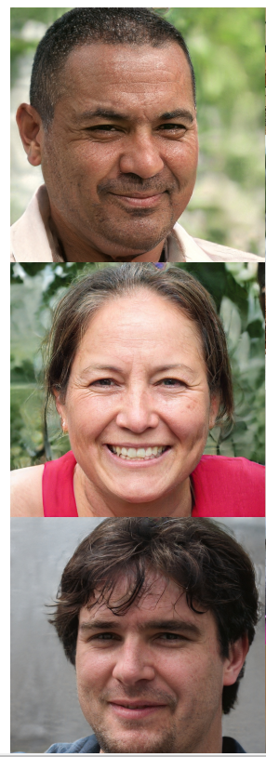
SAIR
Generative Prior
VAE
GAN
HQ Images
sampling
Latent Space
Diffusion

Slide 4
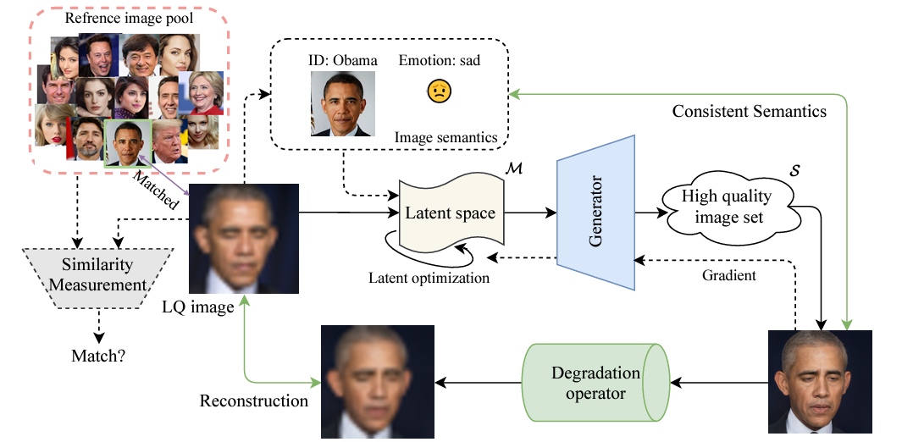
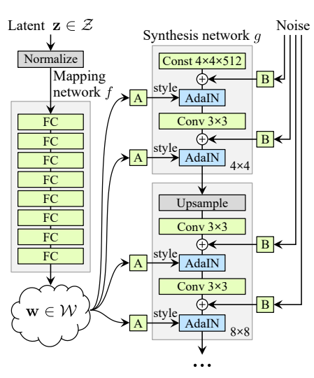
SAIR
Optimizing a latent feature in GAN’s latent space
Adding the identity prior
Guided by reference image & emotion
Robustly restoring extremely low-quality face image (x32 dowsampling)

Slide 5
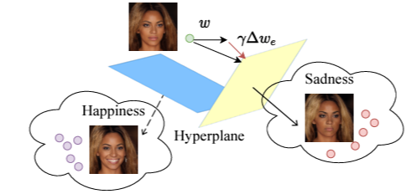
SAIR
Optimization objective
Degradation Model:
Generator (GAN):
: latent vector
Loss:
Finding hyperplanes to distinguish emotions in the latent space
(We can find clustering centers for different emotions in advance)
Image fidelity:
Face ID:
Emotion:
Skin color:
Notes:
CDF: Cumulative distribution function

Slide 6
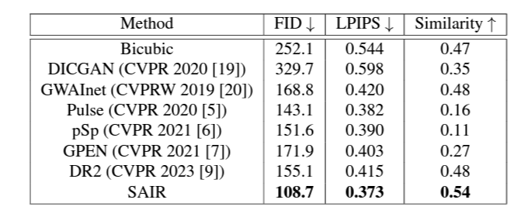
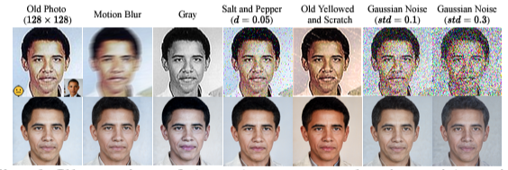
SAIR
Results
Metrics:
Quality evaluation: FID/ LPIPS
Face similarity: a face recognition network
Robust to Various degradations:

Slide 7
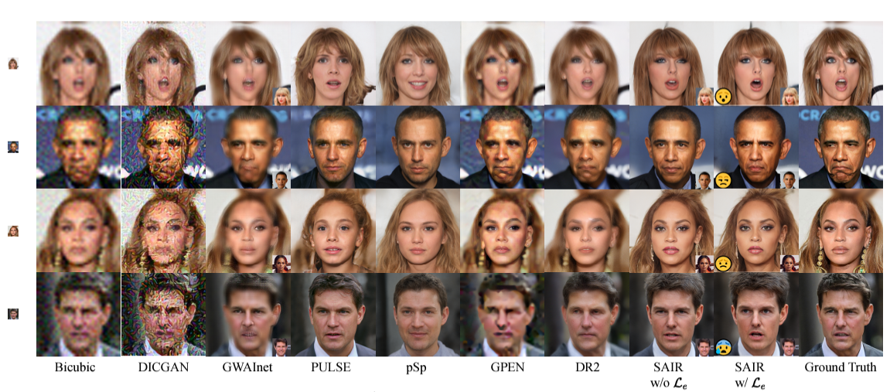
SAIR
Results
Input: 32x32
Output: 1024x1024

Slide 8
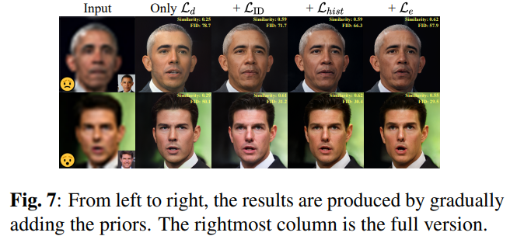
SAIR
Ablation Results

Slide 9
Thanks!

