Slide 1
Research on Knowledge Distillation of Generative Adversarial Networks
Baohua Zhang

Slide 2
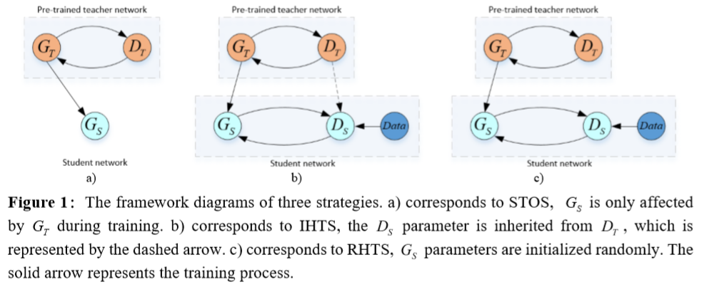

Slide 3
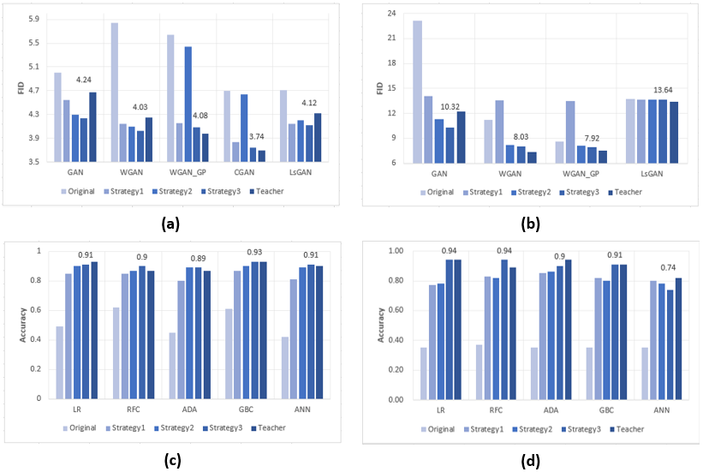

Slide 4
