Slide 1
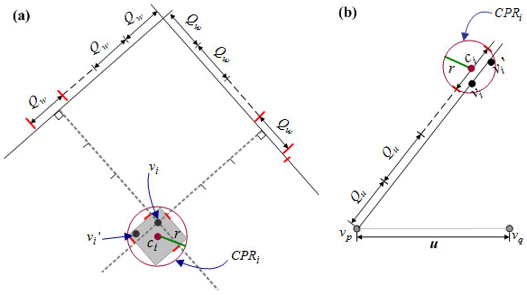
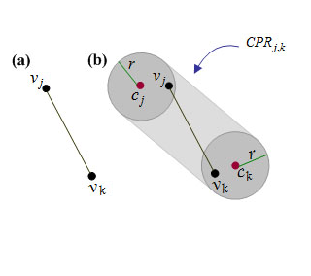
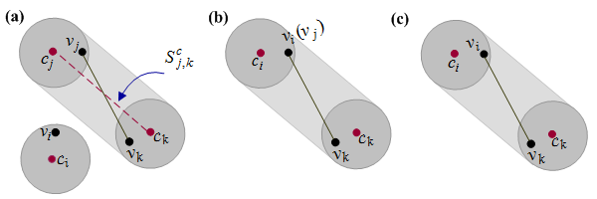
2D Vector Map Reversible Data Hiding with Topological Relation Preservation Nana Wang, Xiangjun Zhao School of Computer Science and Technology, Jiangsu Normal University, China wangnana_5@yahoo.com; idmv68@nus.edu.sg
Motivation
Workflow
Results
Reversible data hiding is a good way for transmitting secrets about the 2D vector map itself.
Data hiding will distort topological relations, which may lead to the acquisition of the hidden data.
Design the controllable perturbation region (CPR) for each vertex and
segment of specific methods (e.g. [3, 4]).
T_{c} : the number of map object pairs
whose directional relations changed
after embedding.
N: the number of map objects of the
vector map.
: the total number of combinations of 2 map
objects selected from N map objects.
Maps | [1] | [2] | [3] | [4] | Proposed
M1 | 0.0131 | 0.0065 | 0.0654 | 0.0523 | 0.0000
M2 | 0.0006 | 0.0001 | 0.0017 | 0.0017 | 0.0000
M3 | 0.0244 | 0.0197 | 0.0197 | 0.0197 | 0.0000
M4 | 0.0031 | 0.0031 | 0.0123 | 0.0031 | 0.0000
Average of 50 maps | 0.0034 | 0.0022 | 0.0102 | 0.0118 | 0.0000
Design Strategy
CPR of a line segment S_{j,k}:
The tubular region in which S_{j,k} may lie after data embedding.
Preserve topology relations by preserving relations between any vertex and any line segment.
.
CPR of a vertex v_{i}: A region that not only contains both v_{i} and its embedded version v_{i}', but also can be correctly calculated during data extraction.
Conclusions
We presented a 2D vector map reversible data hiding method with topological relation preservation.
By calculating the CPR for each vertex and each line
segment, and selecting eligible vertices for data hiding,
topological relations can be preserved.
The method can be integrated with other data hiding methods (e.g., [2-4, 5]) that can calculate a CPR for each
vertex.
eligible vertex:
Embedding data into the vertex will not change its CPR’s relationship with the CPRs of its neighboring segments
Acknowledgements
Embedding vertices into the eligible vertices.
We thank Prof. Mohan S Kankanhalli, National University of Singapore, for his thoughtful advice and comments. This work is supported by the National Natural Science Foundation of China (Grant No. 61602218)
Four relationship between a vertex and a segment
[1]L. Cao, C. Men, and R. Ji, "High-capacity reversible watermarking scheme of 2D-vector data," Signal, Image and Video Processing, vol. 9, no. 6, pp. 1387-1394, 2015.
[2] N. Wang, H. Zhang, and C. Men, "A high capacity reversible data hiding method for 2D vector maps based on virtual coordinates," Computer-Aided Design, vol. 47, pp. 108-117, 2014.
[3] N. Wang, "Reversible watermarking for 2D vector maps based on normalized vertices," Multimedia Tools and Applications, vol. 76, no. 20, pp. 20935-20953, 2017.
[4] D. Xiao, S. Hu, and H. Zheng, "A high capacity combined reversible watermarking scheme for 2-D CAD engineering graphics," Multimedia Tools and Applications, vol. 74 , no. 6, pp. 2109-2126, 2015.
[5] H. Yan, L. Zhang, and W. Yang, "A normalization-based watermarking scheme for 2D vector map data," Earth Science Informatics, pp. 1-11, 2017.1

