Slide 1
Joint Asymmetric Convolution Block and Local/Global Context Optimization for Learned Image Compression
zongmiao Ye, Ziwei Li, Xiaofeng Huang, Haibing Yin
HangzhouDianzi University China

Slide 2
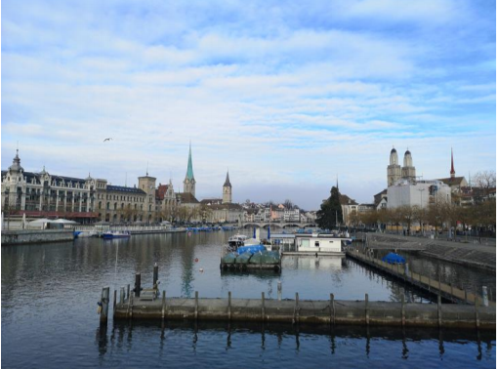
Background:
Massive images
conflict
Limited bandwidth
Size:
source image: 1080x980x3(byte)≈3.028MB
compressed image: 150KB
source image
Image Compression brings little distortion but greatly reduces the image size .
compressed image

Slide 3
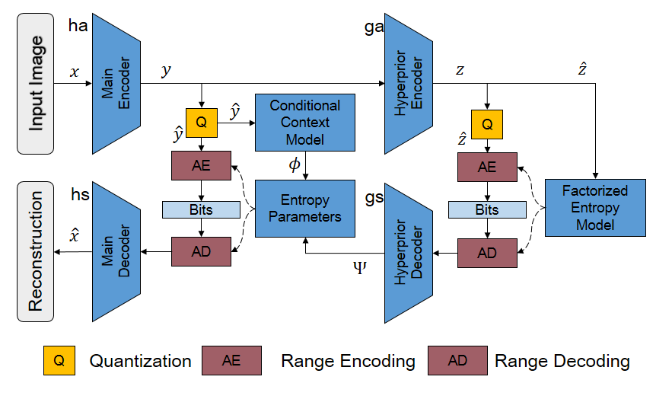
Baseline--Minnen 's methods [1]:
time | Main Decoder | Hyperprior Encoder | Hyperprior Decoder | Context Model | Entropy Parameters
ACB:192×5×5 s2 GDN ACB: 192×5×5 s2 GDN ACB: 192×5×5 s2 GDN ACB: 192×5×5 s2 | IACB:192×5×5 s2 IGDN IACB:192×5×5 s2 IGDN IACB:192×5×5 s2 IGDN IACB:3×5×5 s2 | ACB:192×3×3 s1 Leaky ReLU ACB:192×5×5 s2 Leaky ReLU ACB:192×5×5 s2 | IACB:192×3×3 s2 Leaky ReLU IACB:288×5×5 s2 Leaky ReLU IACB:384×5×5 s1 | Mask Conv384×5×5 s1 LSTM Conv 640×1×1 s1 Leaky ReLU Conv 512×1×1 s1 Leaky ReLU Conv 384×1×1 s1 Leaky ReLU | Conv 640×1×1 s1 Leaky ReLU Conv 512×1×1 s1 Leaky ReLU Conv 384×1×1 s1 Leaky ReLU
Optimize:
1. Enhance the ability of the network to extract features.
2. More accurate bit rate estimation.
[1] Minnen D, Ballé J, Toderici G. Joint autoregressive and hierarchical priors for learned image compression[C]//Proceedings of the 32nd International Conference on Neural Information Processing Systems. 2018: 10794-10803.

Slide 4
Asymmetric convolution block:
compatibility [2]:
ACB training with three parallel layers with d×d, 1×d and d×1 kernels , which can be merged into a standard square convolution kernel in inference.
[2] Ding X, Guo Y, Ding G, et al. Acnet: Strengthening the kernel skeletons for powerful cnn via asymmetric convolution blocks[C]//Proceedings of the IEEE International Conference on Computer Vision. 2019: 1911-1920.

Slide 5
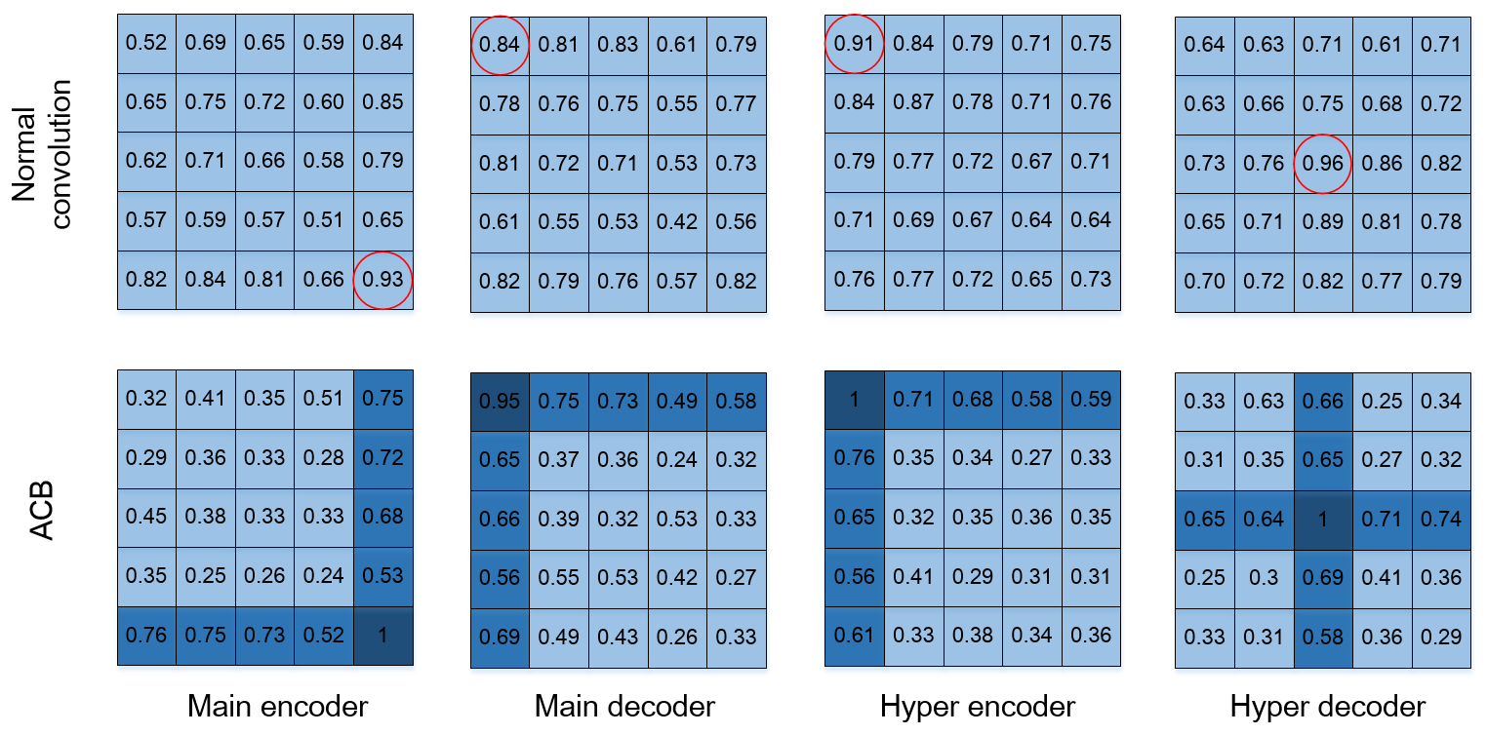
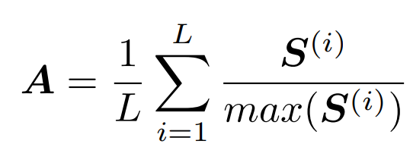
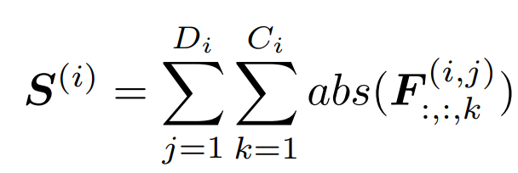
Asymmetric convolution block:

Slide 6
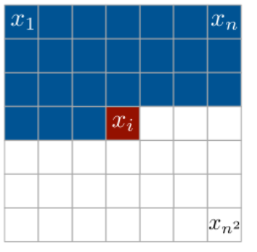
Context Model:
local context
local context

Slide 7
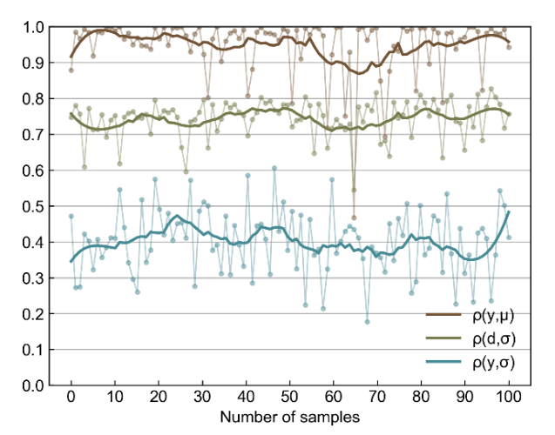
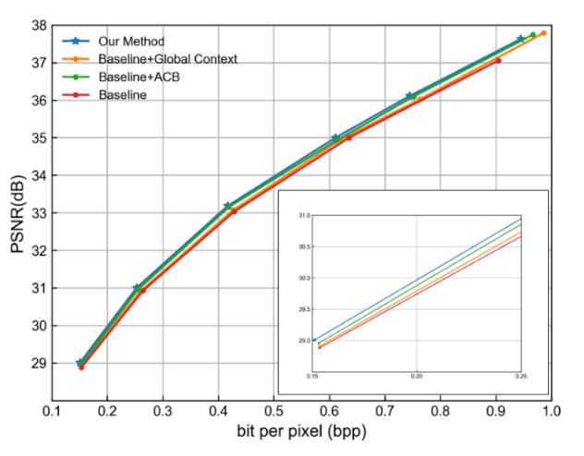
Result:
Methods | Decoding time | BDBR
Balle's [3] | 0.015s | 29.87%
Minnen's [1] | 2.423s | 53.14%
Ours method | 2.431s | 56.46%
RTX 2080Ti and Kodak dataset are used for testing decoding time, and BDBR,which is compared with jpge2000.
[3] Ballé J, Minnen D, Singh S, et al. Variational image compression with a scale hyperprior[C]//International Conference on Learning Representations. 2018.

Slide 8
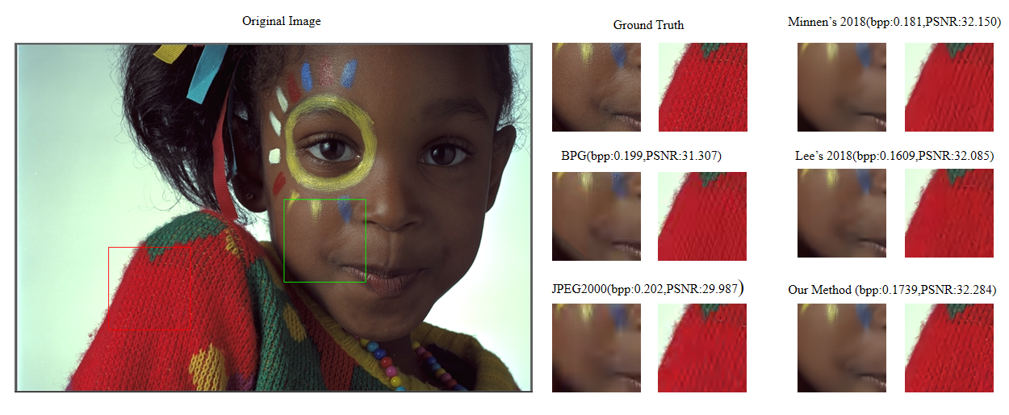
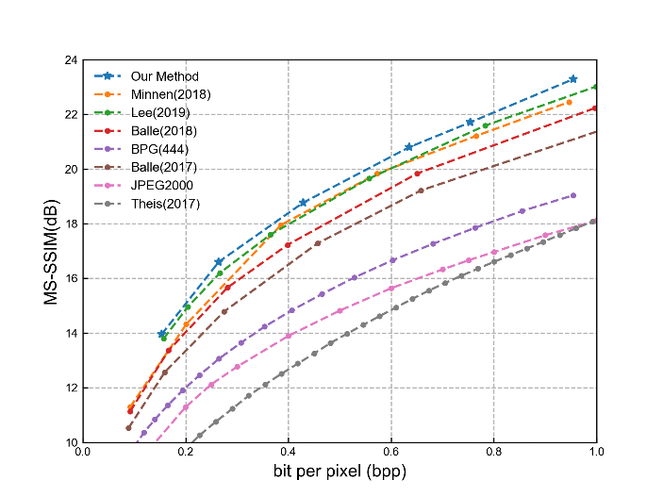
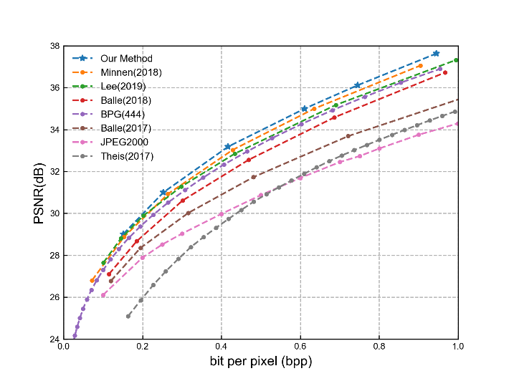
Result:

Slide 9
Thanks for watching
Q ＆A

