Slide 1
Improving BCI-based Color Vision Assessment using Gaussian Process Regression
Hadi Habibzadeh^{1,2}, Kevin J. Long², Ally E. Atkins^{3,2}, Daphney-Stavroula Zois^{1,2}, James J. S. Norton^{2,1}
¹Department of Electrical and Computer Engineering, University at Albany, State University of New York, Albany, NY
²National Center for Adaptive Neurotechnologies, Stratton VA Medical Center, US Department of Veterans Affairs
³Department of Biological Sciences, Union College, Schenectady, NY
IEEE International Conference on Acoustics, Speech, and Signal Processing (ICASSP) 2022
Notes:
Hello
My name is Hadi Habibzadeh.
I am a PhD student in the electrical and computer engineering department at University at Albany.
I am also a researcher at the national center for adaptive neurotechnologies or NCAN.
In this presentation, I discuss our latest work improving BCI-based color vision assessment using Gaussian process regression

Slide 2
Outline
Color vision deficiencies
BCI-based color vision assessment
Improving performance using Gaussian process regression
Results
Notes:
Let’s start by a quick review color vision deficiencies.

Slide 3
Color Vision Deficiency (CVD)
Acquired or Congenital
Normal
Green Deficiency
Affecting approximately 10% of the population
Red Deficiency
Blue Deficiency
Figures taken and modified from https://commons.wikimedia.org/wiki/File:Red_to_Green_Color_Blindness.png
Notes:
Color vision deficiencies (CVDs) change our perception of colors.
Most cases CVDs cause red or green deficiencies. Blue deficiencies are possible by they are relatively uncommon.
CVDs can be acquired or congenital.
They affect about 10 percent of the population and are especially common among men.
CVDs can interfere with school performance, driving abilities, or limit career options, making their diagnosis extremely important, especially early on in life.

Slide 4
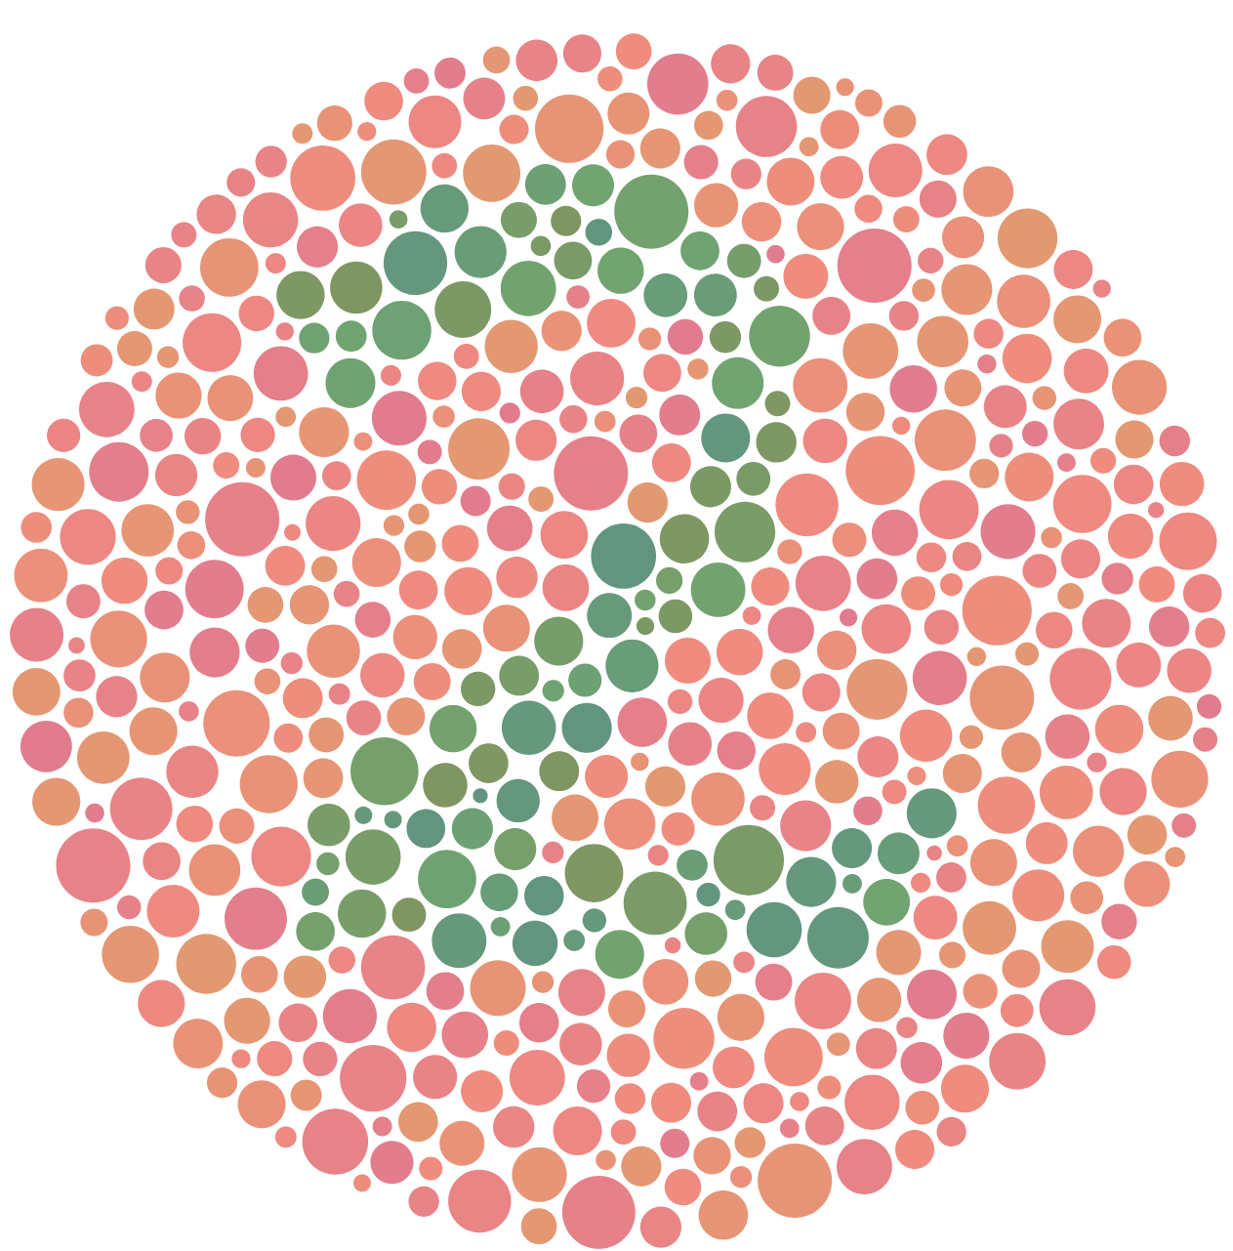
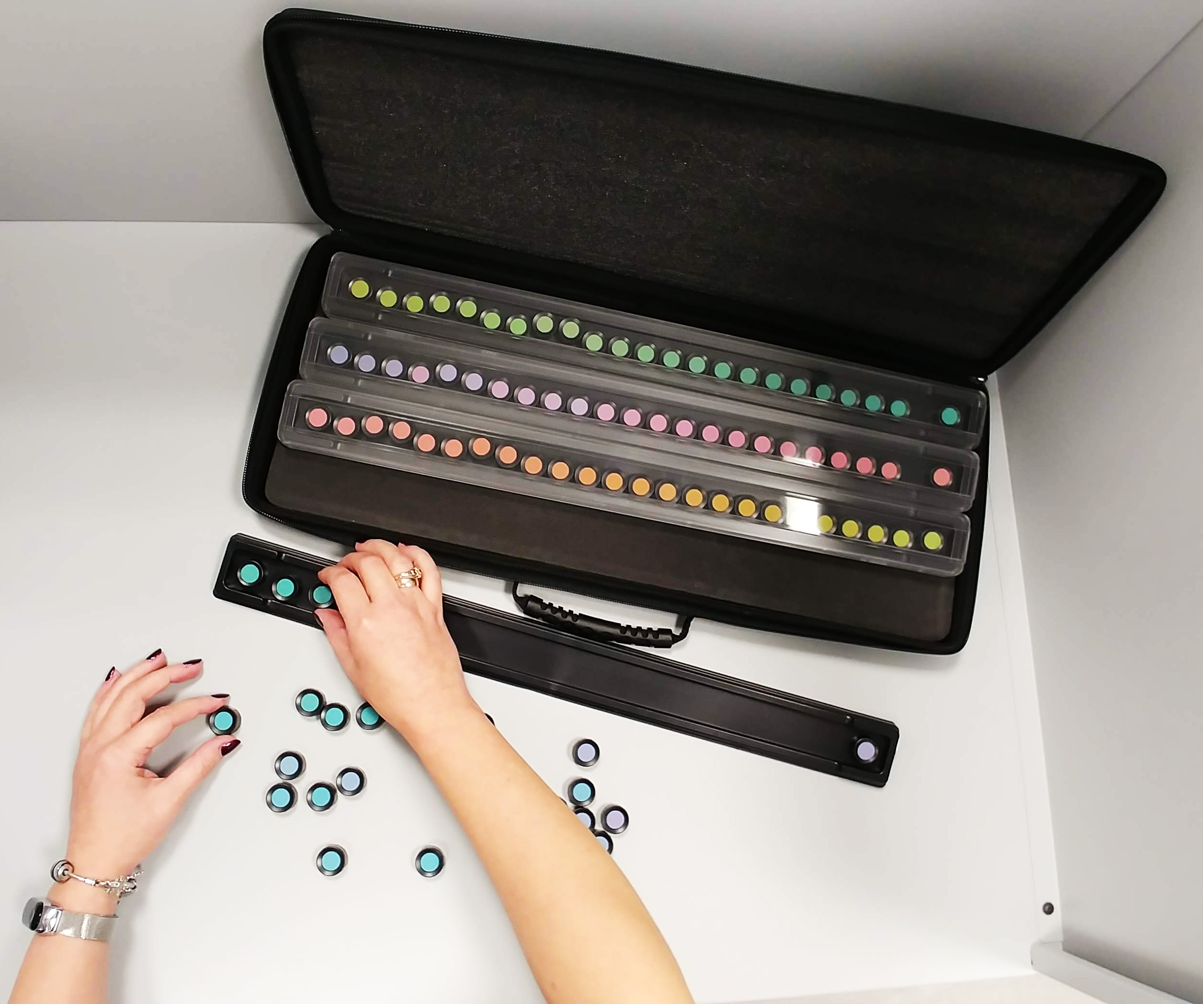
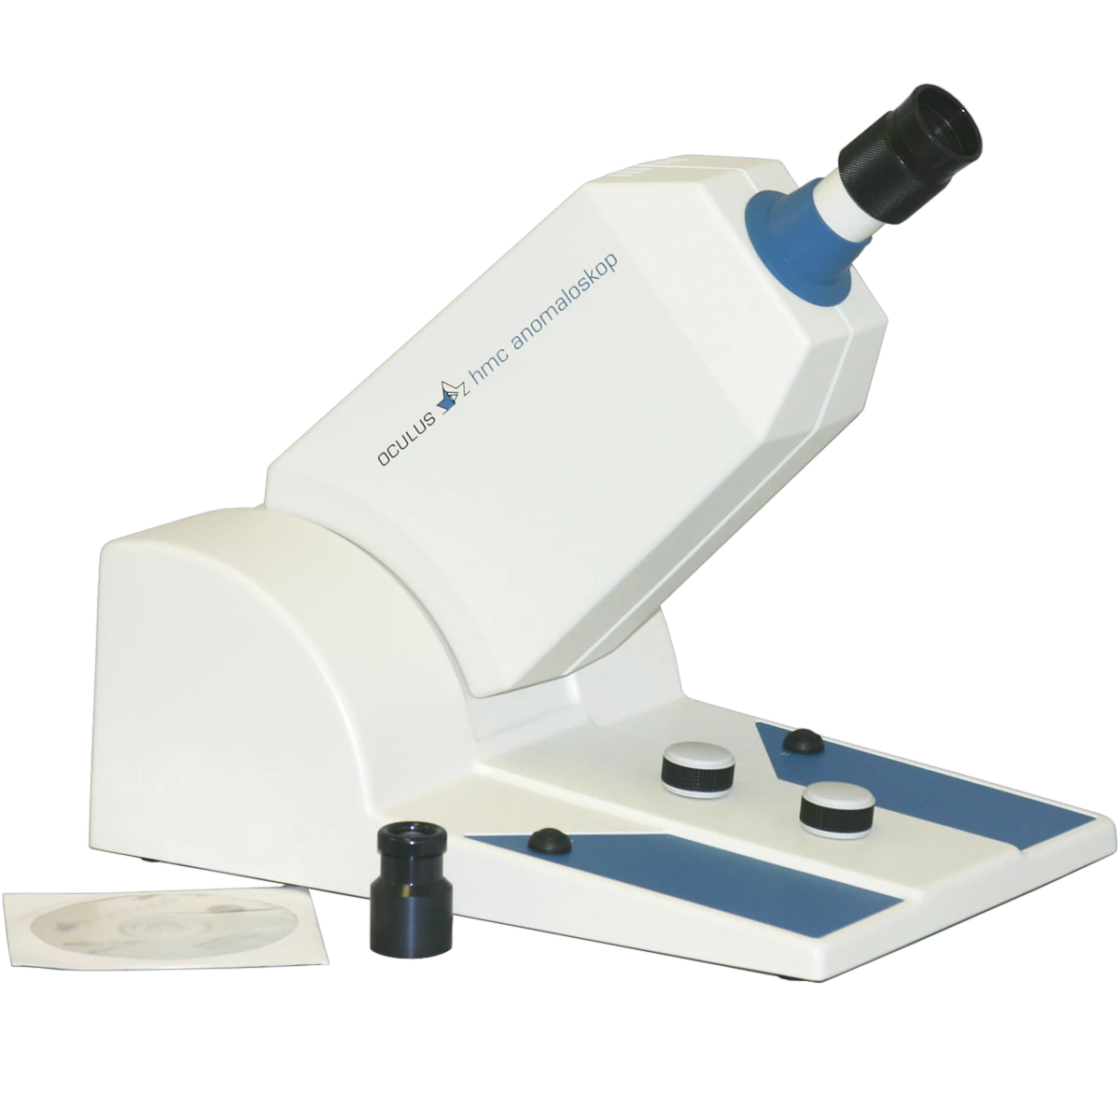
Color Vision Assessment
Farnsworth-Munsell 100 Test
Ishihara Test
Anomaloscope
Complexity and Accuracy
Figures taken and modified from https://commons.wikimedia.org/wiki/File:Ishihara_2.svg
https://commons.wikimedia.org/wiki/File:Farnsworth%E2%80%93Munsell_Hue_Color_Vision_Test,_Material_and_Finishing_Laboratory.jpg
https://www.good-lite.com/products/466600
Notes:
There are three common tests for assessing color vision.
Perhaps the most well-known one is the Ishihara test, where the objective is to identify color patterns.
Another common method is the Farnsworth test, where the user is asked to sort colors based on their similarity.
Finally, the current gold standard method for color vision assessment is to use a device called anomaloscope. When the user looks through the tube, they see a circular field that is divided into two halves. One half is created by a monochromatic amber light and the second half is a mixture of red and green. The user is asked to change the luminance of the red and green to match the color of the monochromatic light and make the color of the circle uniform. Compared to people with normal color vision, people with CVD might use more red or more green in the color match setting.
The complexity of the tests and the amount of information they provide about color vision increases from left to right, with the Ishihara test being the simplest test and the Anomaloscope being the most complicated and accurate test.

Slide 5
Color Vision Assessment
Existing Color Vision Assessment Methods
Behavioral Response
Notes:
The main problem with the existing methods is that they rely on users’ behavioral response, limiting their usefulness for people with limited communication capabilities, such as children, people with neurological impairment and so on.

Slide 6
Color Vision Assessment
Existing Color Vision Assessment Methods
Behavioral Response
Subjective
Notes:
They are also subjective. They cannon measure how well the user can see the difference between the colors

Slide 7
Color Vision Assessment
Existing Color Vision Assessment Methods
Behavioral Response
Subjective
Extensive Training
Notes:
They also need extensive training, this is especially true about anomaloscpe

Slide 8
Color Vision Assessment
Existing Color Vision Assessment Methods
Behavioral Response
Subjective
Extensive Training
Manipulatable
Notes:
And finally, the are manipulable. CVDs can affect job prospects, which might motivate some individuals to manipulate the results, for example by memorizing the patterns in Ishihara test

Slide 9
Outline
Color vision deficiencies
BCI-based color vision assessment
Improving performance using Gaussian process regression
Results
Notes:
To address the limitations of existing color vision assessment methods, we recently introduced the Brain-computer interface (BCI)-based color vision assessment.

Slide 10
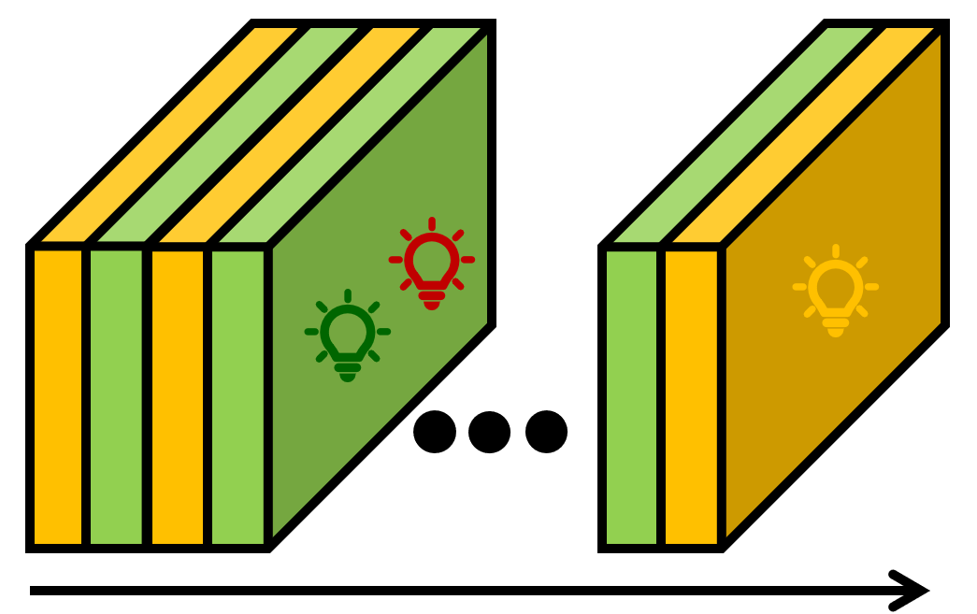
Color Vision Assessment Using Brain-Computer Interfaces (BCIs)
Every 50ms
Time
Every 50ms
Steady-State Visual Evoked Potential (SSVEP)
Measurable Using Electroencephalography (EEG)
Notes:
Similar to the anomaloscope, we have a visual stimulator that includes two light sources. A monochromatic amber light source and a dichromatic red/green light source.
The visual stimulator alternates between the two light sources at fixed intervals (say 50 ms). So instead of spatial division (which is the case for the anomaloscope), we use temporal division.
In this example, the red/green mixture of the dichromatic light source is mostly green. So, what the user seems is a light source that flickers at 10HZ.
Looking at a flickering light source elicits a responds in the brain known as steady-state visual evoked potential or SSVEP that we can measure using non-invasive Electroencephalography or EEG.

Slide 11
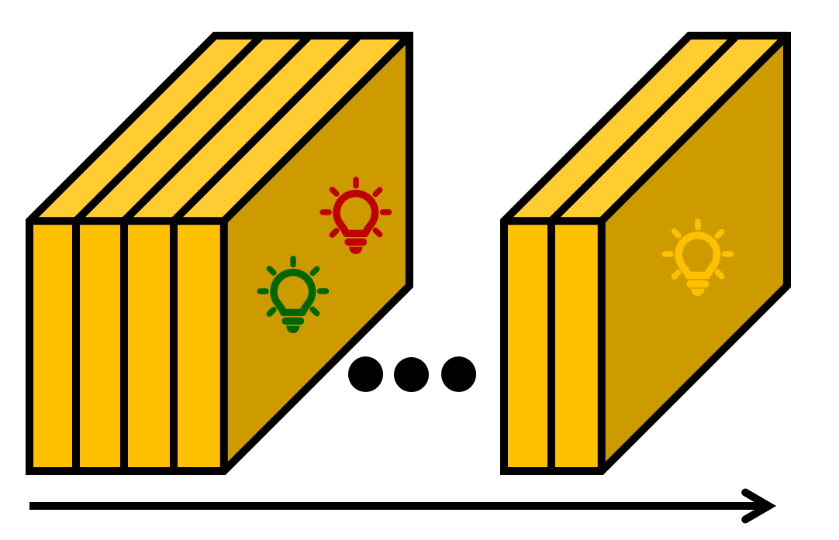
Color Vision Assessment Using BCIs
Every 50ms
Every 50ms
No SSVEP
Notes:
If the red/green mixture of the dichromatic light source matches the monochromatic amber light source (as shown in this example), the user sees a steady and non-flickering visual stimulus.
Because there is no flickers, no SSVEP is elicited in this case.
Thus, by analyzing the SSVEPs, we can quantitatively assess color vision.

Slide 12
Color Vision Assessment Using BCIs
1. Fixed reference amber
Notes:
So, here is procedure of assessing color vision using BCIs.
First, we pick a fixed reference monochromatic amber light source

Slide 13
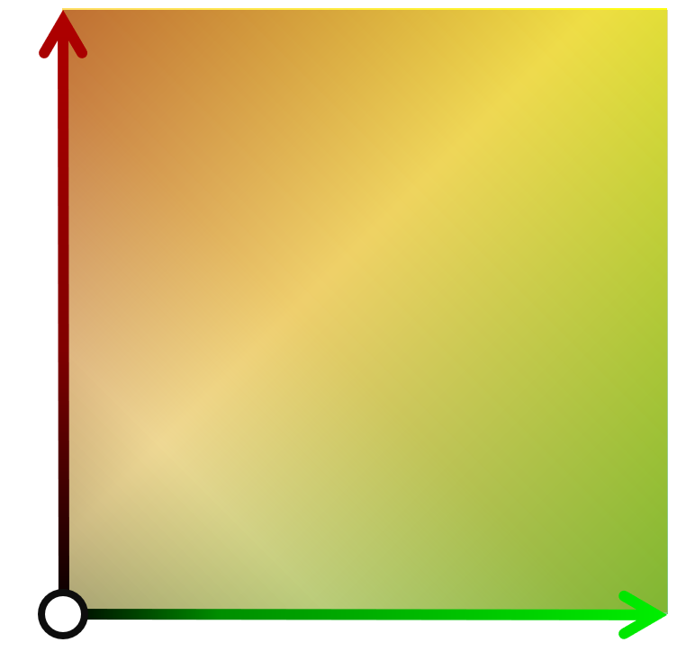
Color Vision Assessment Using BCIs
1. Fixed reference amber
2. Set of candidate red/green colors (color space)
$$×$$ | $$×$$ | $$×$$ | $$×$$ | $$×$$ | $$×$$ | $$×$$ | $$×$$ | $$×$$ | $$×$$ | $$×$$ | $$×$$
$$×$$ | $$×$$ | $$×$$ | $$×$$ | $$×$$ | $$×$$ | $$×$$ | $$×$$ | $$×$$ | $$×$$ | $$×$$ | $$×$$
$$×$$ | $$×$$ | $$×$$ | $$×$$ | $$×$$ | $$×$$ | $$×$$ | $$×$$ | $$×$$ | $$×$$ | $$×$$ | $$×$$
$$×$$ | $$×$$ | $$×$$ | $$×$$ | $$×$$ | $$×$$ | $$×$$ | $$×$$ | $$×$$ | $$×$$ | $$×$$ | $$×$$
$$×$$ | $$×$$ | $$×$$ | $$×$$ | $$×$$ | $$×$$ | $$×$$ | $$×$$ | $$×$$ | $$×$$ | $$×$$ | $$×$$
$$×$$ | $$×$$ | $$×$$ | $$×$$ | $$×$$ | $$×$$ | $$×$$ | $$×$$ | $$×$$ | $$×$$ | $$×$$ | $$×$$
$$×$$ | $$×$$ | $$×$$ | $$×$$ | $$×$$ | $$×$$ | $$×$$ | $$×$$ | $$×$$ | $$×$$ | $$×$$ | $$×$$
$$×$$ | $$×$$ | $$×$$ | $$×$$ | $$×$$ | $$×$$ | $$×$$ | $$×$$ | $$×$$ | $$×$$ | $$×$$ | $$×$$
$$×$$ | $$×$$ | $$×$$ | $$×$$ | $$×$$ | $$×$$ | $$×$$ | $$×$$ | $$×$$ | $$×$$ | $$×$$ | $$×$$
$$×$$ | $$×$$ | $$×$$ | $$×$$ | $$×$$ | $$×$$ | $$×$$ | $$×$$ | $$×$$ | $$×$$ | $$×$$ | $$×$$
$$×$$ | $$×$$ | $$×$$ | $$×$$ | $$×$$ | $$×$$ | $$×$$ | $$×$$ | $$×$$ | $$×$$ | $$×$$ | $$×$$
$$×$$ | $$×$$ | $$×$$ | $$×$$ | $$×$$ | $$×$$ | $$×$$ | $$×$$ | $$×$$ | $$×$$ | $$×$$ | $$×$$
$$×$$ | $$×$$ | $$×$$ | $$×$$ | $$×$$ | $$×$$ | $$×$$ | $$×$$ | $$×$$ | $$×$$ | $$×$$ | $$×$$
$$×$$ | $$×$$ | $$×$$ | $$×$$ | $$×$$ | $$×$$ | $$×$$ | $$×$$ | $$×$$ | $$×$$ | $$×$$ | $$×$$
Notes:
Then, we pick about multiple different red/green mixtures to test. These mixtures are shown by the X’s in this picture.

Slide 14
Color Vision Assessment Using BCIs
1. Fixed reference amber
2. Set of candidate red/green colors (color space)
3. For each color in color space
4. Alternate between two light sources for $λ$ seconds
5. Record EEG and measure SSVEPs
$$×$$ | $$×$$ | $$×$$ | $$×$$ | $$×$$ | $$×$$ | $$×$$ | $$×$$ | $$×$$ | $$×$$ | $$×$$ | $$×$$
$$×$$ | $$×$$ | $$×$$ | $$×$$ | $$×$$ | $$×$$ | $$×$$ | $$×$$ | $$×$$ | $$×$$ | $$×$$ | $$×$$
$$×$$ | $$×$$ | $$×$$ | $$×$$ | $$×$$ | $$×$$ | $$×$$ | $$×$$ | $$×$$ | $$×$$ | $$×$$ | $$×$$
$$×$$ | $$×$$ | $$×$$ | $$×$$ | $$×$$ | $$×$$ | $$×$$ | $$×$$ | $$×$$ | $$×$$ | $$×$$ | $$×$$
$$×$$ | $$×$$ | $$×$$ | $$×$$ | $$×$$ | $$×$$ | $$×$$ | $$×$$ | $$×$$ | $$×$$ | $$×$$ | $$×$$
$$×$$ | $$×$$ | $$×$$ | $$×$$ | $$×$$ | $$×$$ | $$×$$ | $$×$$ | $$×$$ | $$×$$ | $$×$$ | $$×$$
$$×$$ | $$×$$ | $$×$$ | $$×$$ | $$×$$ | $$×$$ | $$×$$ | $$×$$ | $$×$$ | $$×$$ | $$×$$ | $$×$$
$$×$$ | $$×$$ | $$×$$ | $$×$$ | $$×$$ | $$×$$ | $$×$$ | $$×$$ | $$×$$ | $$×$$ | $$×$$ | $$×$$
$$×$$ | $$×$$ | $$×$$ | $$×$$ | $$×$$ | $$×$$ | $$×$$ | $$×$$ | $$×$$ | $$×$$ | $$×$$ | $$×$$
$$×$$ | $$×$$ | $$×$$ | $$×$$ | $$×$$ | $$×$$ | $$×$$ | $$×$$ | $$×$$ | $$×$$ | $$×$$ | $$×$$
$$×$$ | $$×$$ | $$×$$ | $$×$$ | $$×$$ | $$×$$ | $$×$$ | $$×$$ | $$×$$ | $$×$$ | $$×$$ | $$×$$
$$×$$ | $$×$$ | $$×$$ | $$×$$ | $$×$$ | $$×$$ | $$×$$ | $$×$$ | $$×$$ | $$×$$ | $$×$$ | $$×$$
$$×$$ | $$×$$ | $$×$$ | $$×$$ | $$×$$ | $$×$$ | $$×$$ | $$×$$ | $$×$$ | $$×$$ | $$×$$ | $$×$$
$$×$$ | $$×$$ | $$×$$ | $$×$$ | $$×$$ | $$×$$ | $$×$$ | $$×$$ | $$×$$ | $$×$$ | $$×$$ | $$×$$
Notes:
Then, for each test color in the color space of the dichromatic light source, we program the visual stimulator to alternate between the two light sources for a fixed duration of time, determined by a parameter that we sensing budget and refer to with lambda.
At the same time, we collect EEG signals and measure SSVEPs

Slide 15
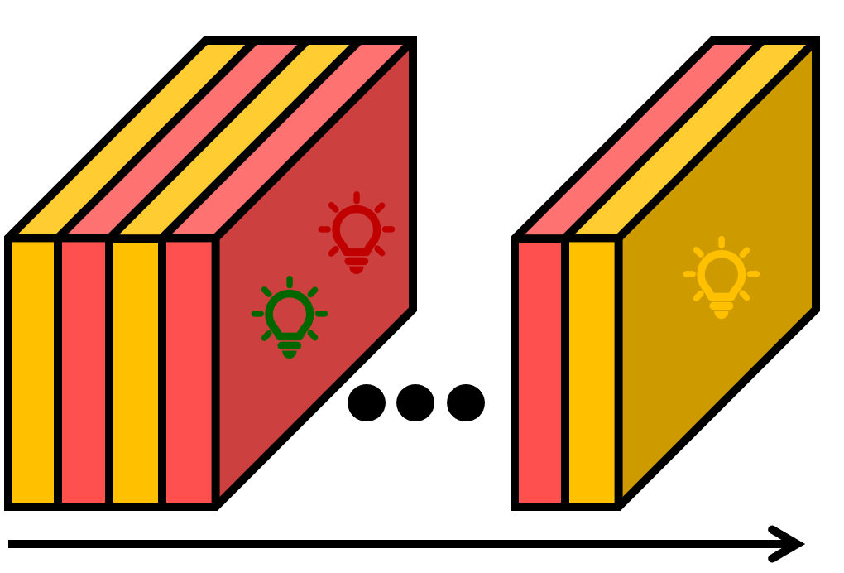
Color Vision Assessment Using BCIs
1. Fixed reference amber
2. Set of candidate red/green colors (color space)
3. For each color in color space
4. Alternate between two light sources for $λ$ seconds
5. Record EEG and measure SSVEPs
$$×$$ | $$×$$ | $$×$$ | $$×$$ | $$×$$ | $$×$$ | $$×$$ | $$×$$ | $$×$$ | $$×$$ | $$×$$ | $$×$$
$$×$$ | $$×$$ | $$×$$ | $$×$$ | $$×$$ | $$×$$ | $$×$$ | $$×$$ | $$×$$ | $$×$$ | $$×$$ | $$×$$
$$×$$ | $$×$$ | $$×$$ | $$×$$ | $$×$$ | $$×$$ | $$×$$ | $$×$$ | $$×$$ | $$×$$ | $$×$$ | $$×$$
$$×$$ | $$×$$ | $$×$$ | $$×$$ | $$×$$ | $$×$$ | $$×$$ | $$×$$ | $$×$$ | $$×$$ | $$×$$ | $$×$$
$$×$$ | $$×$$ | $$×$$ | $$×$$ | $$×$$ | $$×$$ | $$×$$ | $$×$$ | $$×$$ | $$×$$ | $$×$$ | $$×$$
$$×$$ | $$×$$ | $$×$$ | $$×$$ | $$×$$ | $$×$$ | $$×$$ | $$×$$ | $$×$$ | $$×$$ | $$×$$ | $$×$$
$$×$$ | $$×$$ | $$×$$ | $$×$$ | $$×$$ | $$×$$ | $$×$$ | $$×$$ | $$×$$ | $$×$$ | $$×$$ | $$×$$
$$×$$ | $$×$$ | $$×$$ | $$×$$ | $$×$$ | $$×$$ | $$×$$ | $$×$$ | $$×$$ | $$×$$ | $$×$$ | $$×$$
$$×$$ | $$×$$ | $$×$$ | $$×$$ | $$×$$ | $$×$$ | $$×$$ | $$×$$ | $$×$$ | $$×$$ | $$×$$ | $$×$$
$$×$$ | $$×$$ | $$×$$ | $$×$$ | $$×$$ | $$×$$ | $$×$$ | $$×$$ | $$×$$ | $$×$$ | $$×$$ | $$×$$
$$×$$ | $$×$$ | $$×$$ | $$×$$ | $$×$$ | $$×$$ | $$×$$ | $$×$$ | $$×$$ | $$×$$ | $$×$$ | $$×$$
$$×$$ | $$×$$ | $$×$$ | $$×$$ | $$×$$ | $$×$$ | $$×$$ | $$×$$ | $$×$$ | $$×$$ | $$×$$ | $$×$$
$$×$$ | $$×$$ | $$×$$ | $$×$$ | $$×$$ | $$×$$ | $$×$$ | $$×$$ | $$×$$ | $$×$$ | $$×$$ | $$×$$
$$×$$ | $$×$$ | $$×$$ | $$×$$ | $$×$$ | $$×$$ | $$×$$ | $$×$$ | $$×$$ | $$×$$ | $$×$$ | $$×$$
Notes:
So, let’s say we pick a color here. It is mostly green. Thus, the visual stimulus would look like something like this. Because the color difference is noticeable, we expect a large SSVEP for this color.
Then, let’s say we try this color. Again, a noticeable color difference should elicit a large SSVEP.
Finally, let’s say we test a color here. The colors of the two light sources are quite similar at this point. So, no SSVEP should be elicited.

Slide 16
Color Vision Assessment Using BCIs
1. Fixed reference amber
2. Set of candidate red/green colors (color space)
3. For each color in color space
4. Alternate between two light sources for $λ$ seconds
5. Record EEG and measure SSVEPs
6. Output a metaID measurement for that color
$$×$$ | $$×$$ | $$×$$ | $$×$$ | $$×$$ | $$×$$ | $$×$$ | $$×$$ | $$×$$ | $$×$$ | $$×$$ | $$×$$
$$×$$ | $$×$$ | $$×$$ | $$×$$ | $$×$$ | $$×$$ | $$×$$ | $$×$$ | $$×$$ | $$×$$ | $$×$$ | $$×$$
$$×$$ | $$×$$ | $$×$$ | $$×$$ | $$×$$ | $$×$$ | $$×$$ | $$×$$ | $$×$$ | $$×$$ | $$×$$ | $$×$$
$$×$$ | $$×$$ | $$×$$ | $$×$$ | $$×$$ | $$×$$ | $$×$$ | $$×$$ | $$×$$ | $$×$$ | $$×$$ | $$×$$
$$×$$ | $$×$$ | $$×$$ | $$×$$ | $$×$$ | $$×$$ | $$×$$ | $$×$$ | $$×$$ | $$×$$ | $$×$$ | $$×$$
$$×$$ | $$×$$ | $$×$$ | $$×$$ | $$×$$ | $$×$$ | $$×$$ | $$×$$ | $$×$$ | $$×$$ | $$×$$ | $$×$$
$$×$$ | $$×$$ | $$×$$ | $$×$$ | $$×$$ | $$×$$ | $$×$$ | $$×$$ | $$×$$ | $$×$$ | $$×$$ | $$×$$
$$×$$ | $$×$$ | $$×$$ | $$×$$ | $$×$$ | $$×$$ | $$×$$ | $$×$$ | $$×$$ | $$×$$ | $$×$$ | $$×$$
$$×$$ | $$×$$ | $$×$$ | $$×$$ | $$×$$ | $$×$$ | $$×$$ | $$×$$ | $$×$$ | $$×$$ | $$×$$ | $$×$$
$$×$$ | $$×$$ | $$×$$ | $$×$$ | $$×$$ | $$×$$ | $$×$$ | $$×$$ | $$×$$ | $$×$$ | $$×$$ | $$×$$
$$×$$ | $$×$$ | $$×$$ | $$×$$ | $$×$$ | $$×$$ | $$×$$ | $$×$$ | $$×$$ | $$×$$ | $$×$$ | $$×$$
$$×$$ | $$×$$ | $$×$$ | $$×$$ | $$×$$ | $$×$$ | $$×$$ | $$×$$ | $$×$$ | $$×$$ | $$×$$ | $$×$$
$$×$$ | $$×$$ | $$×$$ | $$×$$ | $$×$$ | $$×$$ | $$×$$ | $$×$$ | $$×$$ | $$×$$ | $$×$$ | $$×$$
$$×$$ | $$×$$ | $$×$$ | $$×$$ | $$×$$ | $$×$$ | $$×$$ | $$×$$ | $$×$$ | $$×$$ | $$×$$ | $$×$$
Notes:
We repeat this process of all colors in the color space of the dichromatic light source and use an algorithm called metaID (which I will explain shortly) to obtain one measurement for each color that quantifies how well the user can see the difference between the colors of the monochromatic light source and the dichromatic light source.

Slide 17
Color Vision Assessment Using BCIs
Existing Color Vision Assessment Methods | BCI-based Color Vision Assessment
Behavioral Response | Brain Response
Subjective
Extensive Training
Manipulatable
Notes:
The main advantage of BCI-based color vision is that it relies on the brain response as opposed to behavior response, making it useful even for people with limited communication capabilities.

Slide 18
Color Vision Assessment Using BCIs
Existing Color Vision Assessment Methods | BCI-based Color Vision Assessment
Behavioral Response | Brain Response
Subjective | Objective
Extensive Training
Manipulatable
Notes:
BCI-based color vision is also objective and quantitative, meaning that we can measure how well the user can distinguish the reference monochromatic light source from the test dichromatic light source. We obtain this measure by analyzing SSVEPs

Slide 19
Color Vision Assessment Using BCIs
Existing Color Vision Assessment Methods | BCI-based Color Vision Assessment
Behavioral Response | Brain Response
Subjective | Objective
Extensive Training | Easy to Use
Manipulatable
Notes:
BCI-based color vision assessment is easy-to-use, especially compared to the anomaloscope

Slide 20
Color Vision Assessment Using BCIs
Existing Color Vision Assessment Methods | BCI-based Color Vision Assessment
Behavioral Response | Brain Response
Subjective | Objective
Extensive Training | Easy to Use
Manipulatable | Cannot be Manipulated
Notes:
Finally, the results cannot be manipulated. For example, unlike the Ishihara test, one cannot memorize the patterns.

Slide 21
Color Vision Assessment Using BCIs
Existing Color Vision Assessment Methods | BCI-based Color Vision Assessment
Behavioral Response | Brain Response
Subjective | Objective
Extensive Training | Easy to Use
Manipulatable | Cannot be Manipulated
Accurate | Noisy and Slow
Notes:
Current BCI-based color vision assessment method, however, has one disadvantage. EEGs are noisy and SSVEPs have low SNR. This presence of noise reduces the performance of the system. We can improve the SNR by collecting more data (e.g., asking the participant to look at the stimulus for 5 seconds instead of one second), but that makes the system slow.
In this presentation, our goal is to reduce noise and improve the speed of BCI-based color vision assessment.

Slide 22
Outline
Color vision deficiencies
BCI-based color vision assessment
Improving performance using Gaussian process regression
Results
Notes:
Let see how we can use Gaussian process regression to reduce the effect of noise and improve the speed of BCI-based color vision assessment

Slide 23
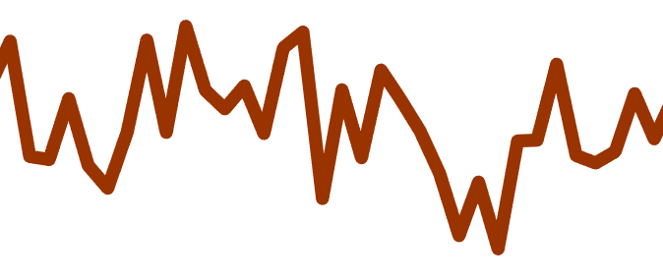
metaID
Brain Response (EEG)
metaID measurement
metaID
color mismatch
Feature extraction
&
$$log\frac{p_{1}(x|𝓜_{1})}{p_{0}(x|𝓜_{0})}$$
color match
Notes:
Our algorithm is based on our previous work metaID. So, first let’s have a quick overview of this algorithm. As shown in this diagram, metaID receives the EEG data, extracts SSVEP features, uses a continuous hypothesis testing method to determine how close the colors of the two light sources are. The output of metaID is a scaler value, which we call metaID measurement. Large measurements mean visible color mismatch, whereas small measurements mean close to a color match.

Slide 24
Noisy Measurements
metaID measurement for color $x$
IID Gaussian noise with zero mean
$$y\left(x\right)=f\left(x\right)+ε$$
Unknown noise-free measurement
Notes:
To derive our algorithm, we model each measurement at color x, y(x) as the sum of some unknown noise-free measurement and an IID gaussian noise with zero mean.
Our goal is to estimate the noise-free measurements f. Very little is known about f, but we expect it to be spatially correlated.

Slide 25
Spatial Correlation
$$r+δr$$
$$f=w^{t}y$$
Red
$$r$$
$$g$$
$$g+δg$$
Green
Notes:
Here is an example that shows the spatial correlation in F. Let’s zoom in on color space and pick a color space, where colors are basically similar (i.e., delta r and delta g are small numbers).
Let’s say we collect nine measurements, and they look like this, where bright cells represent measurements with large amplitudes and darker cells represents measurement with small amplitudes.
We see that one measurement in the middle looks out of place. We cannot change the colors slightly and expect to see a huge change in the brain response. Thus, the odd measurement is probably due to noise (maybe the participant was distracted, or there was noise the data collection set up).
So, using the right filter, can denoise the signal.
This is a simplified abstract example. In practice the spatial correlations are way more complicated.

Slide 26
Modeling Spatial Correlations
Unknown noise-free measurement
Covariance function
$$f\left(x\right)∼𝓖𝓟\left(m\left(x\right), k(x, x′)\right)$$
mean function (zero)
Notes:
But we can use a Gaussian process to model the noise-free measurement. Here, M(x) is the mean function. In color vision assessment, we care more about the relative values of measurement. Thus, we assume m(x) is zero. K covariance function of the Gaussian process and holds the information of the spatial correlations of the noise free-measurements

Slide 27
Modeling Spatial Correlations
Covariance matrix of $y$
Noise
$$Σ_{y}=K\left(X, X\right)+σ_{n}^{2}I$$
Covariance function
$$\left[\begin{matrix}y \\ \hat{f}\end{matrix}\right]∼𝓝\left(0, \begin{matrix}K+σ_{n}^{2}I & K \\ K & K\end{matrix}\right)$$
Estimates of noise-free measurements
$$K(X, X)$$
Notes:
Given that measurement noise is IID, we can compute the covariance matrix of noisy measurement as shown here.
We can use this to botain the join prior distribution of y (noisy measurements) and f hat (our estimate of noise-free measurements)

Slide 28
metaID+
$$\hat{f}|X, y∼𝓝\left(𝔼\left[\hat{f}|X, y\right], Σ_{\hat{f}}\right)$$
$$𝔼\left[\hat{f}|X, y\right]=K{\left[K+σ_{n}^{2}I\right]}^{−1}y$$
$$Σ_{\hat{f}}=K −K{\left[K+σ_{n}^{2}I\right]}^{−1}K$$
Notes:
Finally, to get the posterior on our estimates of noise free measurements, we condition the prior of noisy measurements to obtain this estimator.

Slide 29
Outline
Color vision deficiencies
BCI-based color vision assessment
Improving performance using Gaussian process regression
Results

Slide 30
Methods
Ten participants with no neurological impairments
Ten-fold cross validation for training and testing
Refer to the paper details of the training and experiment setup
Notes:
We collected data from 10 participants with no neurological impairments. We used ten-fold cross validation for training and testing. In each round, data from one participant was reserved for testing and data from other 9 participants was used for training the covariance function K and the noise variance sigma^2.
The details for our training procedure and experimental setup can be found in our paper.

Slide 31
Results
SSE 198.3
SSE 100.6
Ground Truth
Existing method
Our Algorithm
84 Minutes
2.8 Minutes
2.8 Minutes
SSE = ${\left\|ground truth −measurements\right\|}^{2}$
Notes:
Here, we are comparing the output of our algorithm with the ground truth and the existing method.
Each cell in these grid represent the amplitude of the measurements, where dark cells represent measurements with small amplitudes and bright cells represents measurement with large amplitudes.
The ground truth was obtained based on 84 minutes of data collection. Using this much data, the measurements have high SNRs and the effect of noise is minimal, thus we can use it as the ground truth.
The grid for the existing method (metaID) was based on only 2.8 minutes of data collection. We can see when the duration of data collection reduces, the measurements become more contaminated with noise.
Our algorithm was also based on 2.8 minutes of data collection, but we can see that the effect of noise is significantly reduced.
Given the ground truth, we can quantitatively measure the performance of each algorithm using SSE defined as shown below.
For the existing method, the SSE was 198.3 whereas for our algorithm the SSE was 100.6.

Slide 32
Results
Our Algorithm
Reduced SSE over all sensing budgets
Lower error while using 61% more data
16 minutes vs 7 minutes
metaID
$$δ=3.4s$$
Notes:
Here, we see the SSE average across all then participants vs different sensing budgets.
We can see that our algorithm reduced the SSE for all sensing budgets.
For small sensing budgets, the measurements are more contaminated with Nosie, thus denoising is more important. This is why we see a large gap between the two algorithms for small sensing budgets.
As the sensing budget increases, the SNR increases, and denoising becomes less important. Thus, the performance of the two methods converges.
We can also see in this figure that our algorithm had a lower error using a sensing budget that was 3.4 seconds shorter resulting in a 61% reduction in amount data that is required.

Slide 33
Conclusion
Using spatial correlations to reduce error for BCI-based color vision assessment
Lower SSE while using 61.3% less data
Future direction
Online testing
Testing on individuals with CVDs
Expanding the algorithm to use adaptive sensing

Slide 34
Thank You
Please direct your questions to hhabibzadeh@albany.edy or Habibzadeh@neurotechcenter.org
IEEE International Conference on Acoustics, Speech, and Signal Processing (ICASSP) 2022
^{Poster Number: 3270}
Session: BIO-8 Brain-Computer Interfaces
Poster Presentation Date: 11 May 2022; 23:00 – 23:45 Singapore Time or 11:00 – 11:45 Eastern Time

