Slide 1
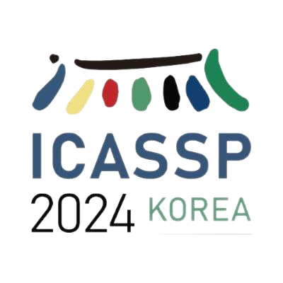
MOTION TRANSFER-DRIVEN INTRA-CLASS DATA
AUGMENTATION FOR FINGER VEIN RECOGNITION
Xiu-Feng Huang^{1,*}, Lai-Man Po¹, Wei-Feng Ou²
1. City University of Hong Kong 2. Dongguan University of Technology
19/04/2024
*Xiufeng Huang is now affiliated with Hong Kong Baptist University

Slide 2
Outline
01
Introduction
02
Related work
03
Contributions
04
Proposed framework
05
06
Experiments
Conclusions

Slide 3
01
Introduction

Slide 4
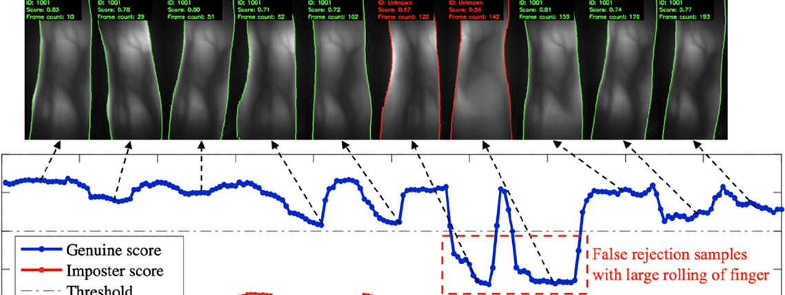
Introduction
Finger Vein Recognition
Finger vein recognition (FVR) is secure identity verification based on finger vascular patterns.
However, The limited size of public vein datasets has a big challenge on:
Overfitting issues which greatly limit the recognition performance.
The current data augmentation method can not capture the real finger posture variation.
[1] Fusion Loss and Inter-class Data Augmentation for Deep Finger Vein Feature Learning
WF Ou, LM Po, C Zhou, YAU Rehman, PF Xian, YJ Zhang (ESWA) 2021

Slide 5
02
Related work

Slide 6
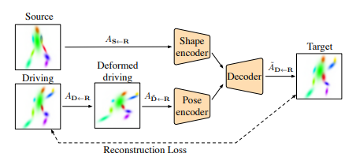
Related work
Motion Transfer Model
Given a source image $S$ and a driving image $D$ from the same subject, the motion transfer model learns the motion between $S$ and $D$ to reconstruct the source image into a new image $D^{′}$ to mimic the driving image’s pose.
[2] Motion Representations for Articulated Animation
Aliaksandr Siarohin, Oliver J. Woodford, Jian Ren, Menglei Chai, Sergey Tulyakov; (CVPR), 2021

Slide 7
03
Contributions

Slide 8
Contributions
We propose a novel motion transfer model as an intra-class data augmentation for enhancing FVR accuracy. To our best knowledge, we are the first to explore using motion transfer as a data augmentation method for biometric.
Our proposed motion transfer model is lightweight and can be effectively applied as an online intra-class augmentation by animating finger vein images to novel poses.
Our approach complements the method of using synthetic samples as inter-class augmentation. The combination of both techniques yields substantial improvements in FVR accuracy.

Slide 9
04
Proposed method

Slide 10
Preliminary
Fusion loss and inter-class data augmentation for finger vein feature learning
Flipping as the inter-class augmentation.
Cropping, rotation, color-jitter as the intra-class augmentation.
Resnet-18 as the feature extraction network.
Cosine-softmax and triplet loss as the fusion loss
Training Set
Original Set
Cropping
Cosine Softmax
Online
Offline
Augmented Set
Rotation
Resnet-18
Triplet Loss
Flipping
ColorJitter
Inter-class
augmentation
Intra-class
augmentation

Slide 11
Proposed method
Motion transfer model for finger vein feature learning
Key point and Pose Detection.
Dense Motion Flow Estimation.
Warping-based Image Generation.

Slide 12
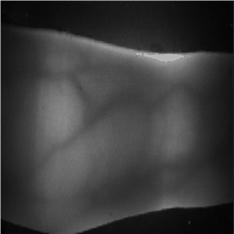
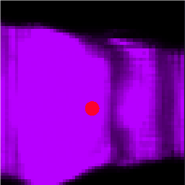
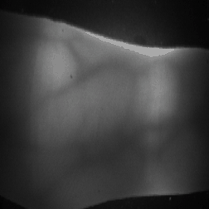
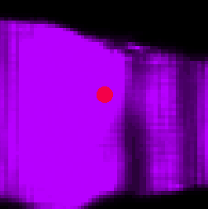
Proposed method
Key point and Pose Detection
The Key-point Detector can estimate the key points and heatmaps for source and driving images.
We compute the key point locations difference $∆p$ the and the heatmap difference $∆H$.
We can construct a coarse motion flow from the key differences $∆p$.
Source
Key-point Detector
Source Heatmap
—
Coarse Motion Flow
Driving
Driving Heatmap
Key-point and Pose Detection

Slide 13
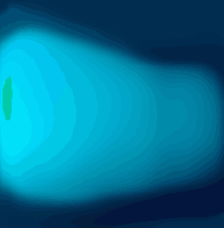
Proposed method
Dense Motion Flow Estimation
The Dense Motion Module use this coarse motion flow and the heatmap difference $∆H$ as input to predict a dense motion flow.
The Dense Motion Module learn a mask $M_{inp}$ to indicate the inpainting area for the image generation.
Coarse Flow
Dense Motion Module
Dense Flow
Source Heatmap
—
—
Inpainting Mask
Driving Heatmap
Dense Motion Flow Estimation

Slide 14
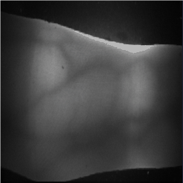
Proposed method
Warping-based Image Generation
The Image Generation Network will warp the source image with the dense flow and inpaint the occluded area to generate novel pose image.
The final loss is the sum of perceptual loss and the equivariance loss : $ℒ= ℒ_{perc} + ℒ_{eq}$.
Image Encoder
Source
ω
Bottle Neck
Dense Flow
Image Decoder
Generated
Inpainting Mask
Image Generation Network

Slide 15
Proposed method
Motion transfer intra-class data augmentation for finger vein recognition
Synthetic samples generated by StyleGANv2 as inter-class augmentation.
Motion transfer model as the intra-class augmentation prior to the traditional augmentation.
Motion transfer augmentation can be performed in a self-supervised way instead of relying on explicit driving images.
Training Set
Original Set
Cropping
Cosine Softmax
Motion Transfer
Rotation
Online
Offline
Augmented Set
Resnet-18
ColorJitter
Triplet Loss
Synthetic
Inter-class
augmentation
Intra-class
augmentation

Slide 16
Proposed method
Algorithm 1. Motion transfer intra-class augmentation.
Input: Training sample $x∈X$ Network: Motion transfer model $θ$
Output: Novel pose sample $x^{′}$
a: | Use motion transfer model $θ$ on the training samples $X$ to extract key point distances into set $∆P$.
b: | Use PCA method to analyze principal motion vectors $V$ based on $∆P$.
During the FVR Training:
1: | Use linear combination to generate a random motion vector $v^{′}$ from $V$.
2: | Use the motion vector $v^{′}$ and motion transfer model $θ$ to reconstruct a training sample $x$ into a novel pose sample $x^{′}$.
3: | Feed the novel pose sample $x^{′}$ to the FVR training pipeline.

Slide 17
05
Experiments

Slide 18
Experiments
FVR training with real finger vein samples
1. Finger vein databases
FV-USM: 5904 finger vein images in total with 492 classes and 12 samples per class.
MMCBNU: 6000 finger vein images in total with 600 classes and 10 samples per class.
SDUMLA: 3816 finger vein images in total with 628 classes and 6 samples per class.
2. Motion transfer model performance
233.7k model parameters and 0.1246 GFLOPs for a standard 64x144 aligned finger vein image.
Inference time, the model achieves a swift 10.68 ms on a i9-13900K Intel CPU.
3. FVR training details
Network and losses: ResNet-18 for feature extraction and cosine-softmax and triplet loss.
Data Augmentation: motion transfer intra-class augmentation and flipping, cropping, rotation.

Slide 19
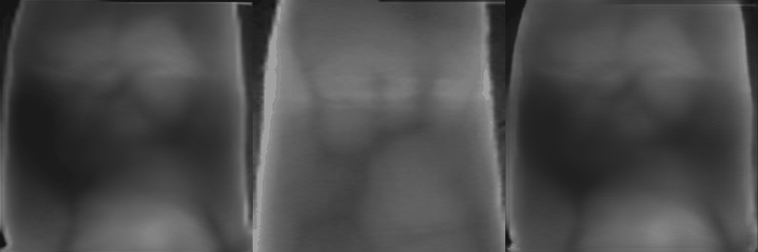
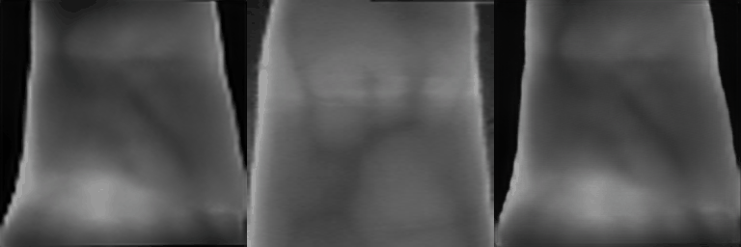
Experiments
Visualization for motion transfer augmentation on real samples
Source is the real FV images from training dataset.
Driving are other FV images in the same dataset with different poses.
Prediction are the generated FV images motion transferred by driving poses.
Source
Driving
Predict
Source
Driving
Predict

Slide 20
Experiments
Table 1. Performance comparison for Finger Vein Recognition with EER.
Method | FVUSM | MMCBNU | SDUMLA
WLD [3] | 5.43% | 3.70% | 3.83%
RLT [4] | 4.67% | 1.68% | 5.88%
MC [5] | 2.63% | 1.12% | 3.67%
FusionAug | 0.45% | 0.30% | 3.31%
Ours (FusionAug+MT-Aug) | 0.35% | 0.19% | 2.91%
[3] Extraction of Finger-Vein Patterns Using Maximum Curvature Points in Image Profiles. N. Miura, A. Nagasaka, and T. (Miyatake, IEICE TRANSACTIONS on Information and Systems), 2007 [4] Finger-vein authentication based on wide line detector and pattern normalization. B. Huang, Y. Dai, R. Li, D. Tang, and W. Li, (ICPR) 2010 [5] Feature extraction of finger-vein patterns based on repeated line tracking and its application to personal identification. N. Miura, A. Nagasaka, and T. Miyatake, (Mach Vis Appl), 2004.

Slide 21
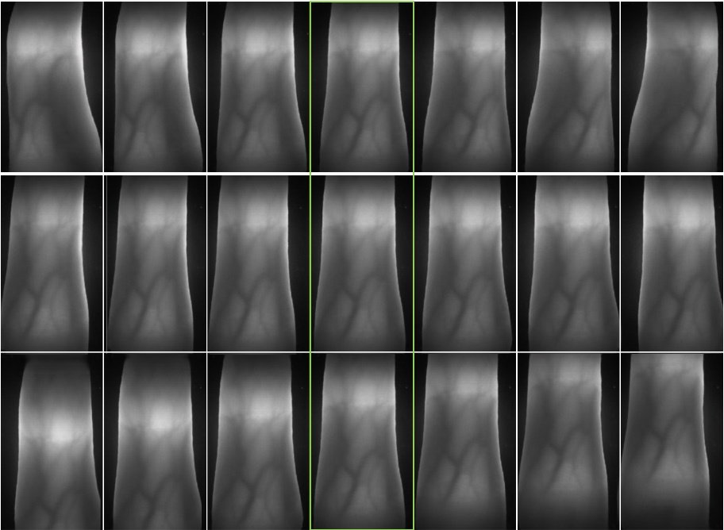
Experiments
FVR training with synthetic finger vein samples
1. Motion transfer learning with in-house dataset
Our in-house dataset contains 252 videos for different fingers and each video contains 120 continuous finger vein images.
Each video contains finger geometric variations such as translation, rotation and rolling.
2. Synthetic finger vein generation
We employ the StyleGAN2 method to train on the finger vein datasets.
Each synthetic sample can be regarded as an inter-class sample since the unique vein pattern and finger geometry.
We apply motion transfer intra-class augmentation on synthetic finger vein sample to generate novel poses.
Figure. Visualization of motion transfer performance about finger rolling, horizontal and vertical translation using in-house dataset.

Slide 22
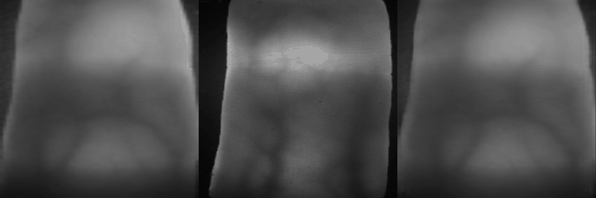
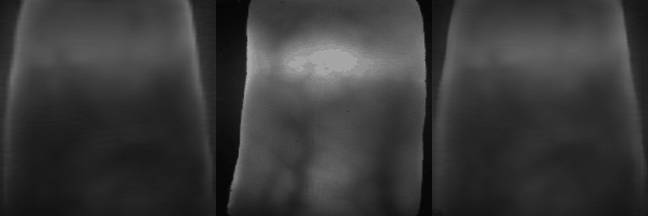
Experiments
Visualization for motion transfer augmentation on synthetic samples
Source is the synthetic FV images generated by StyleGAN2.
Driving are the FV images in our inhouse dataset with different poses.
Prediction are the generated FV images motion transferred by driving poses.
Source
Driving
Predict
Source
Driving
Predict

Slide 23
Experiments
Table 2. Motion transfer intra-class augmentation for synthetic FV samples
Database | Inter-class | Intra-class | EER
FVUSM | 246 synthetic samples | w/o MT-Aug | 0.41%
 |  | with MT-Aug | 0.18%
MMCBNU | 300 synthetic samples | w/o MT-Aug | 0.26%
 |  | with MT-Aug | 0.16%
SDUMLA | 318 synthetic samples | w/o MT-Aug | 3.19%
 |  | with MT-Aug | 2.46%

Slide 24
06
Conclusions

Slide 25
Conclusions
We present a novel motion transfer model for intra-class augmentation to generate realistic finger motion without the need for external pose or image signals.
We can generate synthetic vein images with intra-class samples to closely resemble real finger vein samples, and obtain promising recognition performance.
Our framework facilitates privacy protection by training deep neural networks utilizing completely synthetic finger vein samples instead of real biometric data.

Slide 26
THANK YOU
Q & A
Xiu-Feng Huang^{1,*}, Lai-Man Po¹, Wei-Feng Ou²
1. City University of Hong Kong 2. Dongguan University of Technology
19/04/2024
*Xiufeng Huang is now affiliated with Hong Kong Baptist University

