Slide 1
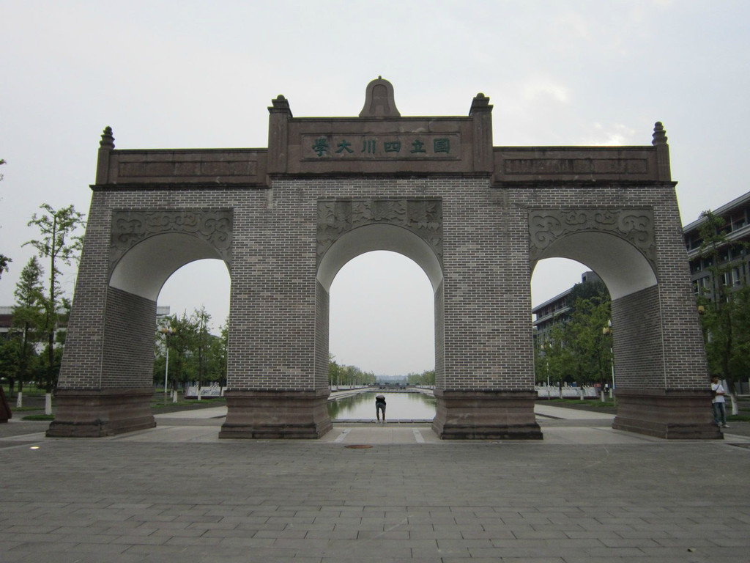
Presenter: Lu Wen
Notes:
Good afternoon, everyone. Today, I am excited to present our latest work titled 'DCL-Net: Dual Contrastive Learning Network for Semi-Supervised Multi-Organ Segmentation.' This research was conducted by Lu Wen and colleagues from Sichuan University and Southwest China Institute of Electronic Technology. Let's dive into the world of medical image segmentation and explore how we can improve the semi-supervised learning approach for multi-organ segmentation

Slide 2
目 录
CONTENTS
1
Introduction
2
Methodology
3
4
Experimental Setup & Results
Conclusion

Slide 3
Introduction

Slide 4
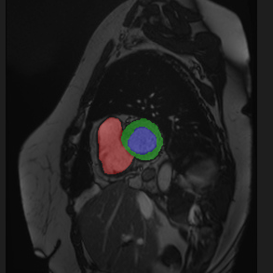
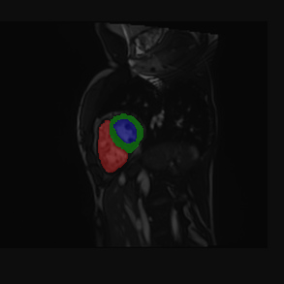
Introduction
Multi-organ segmentation (MoS) aims to simultaneously assign accurate category labels to pixels of multiple organs in the radiology images, playing an essential role in computer-aided treatment, such as disease diagnosis, radiotherapy, and survival prediction.
Right Ventricle
Left Ventricle
Myocardium
(1)
(2)
Samples: Medical image and its corresponding segmentation label.
Notes:
Multi-organ segmentation, or MoS, is a critical task in medical imaging, playing a pivotal role in disease diagnosis, radiotherapy planning, and survival prediction. While deep learning has significantly advanced segmentation performance, it traditionally relies on large-scale, precisely annotated data, which is often expensive and time-consuming to obtain. This is where semi-supervised learning steps in, offering a promising solution to enhance segmentation accuracy without the need for extensive manual annotations.

Slide 5
Introduction
Deep learning (DL)-based Segmentation Methods with Fully Supervised Learning
Recently, deep learning-based methods have gained impressive segmentation performance by fully-supervised training on large-scale labeled data.
However, collecting such a large amount of data with precise pixel-level annotation is unrealistic due to the expensive time and labor costs

Slide 6
Introduction
Semi-supervised Medical Image Segmentation Methods
To reduce the reliance on extensive annotated data, semi-supervised learning (SSL), which simultaneously utilizes the limited labeled data and abundant unlabeled data to enhance the segmentation accuracy, has nowadays gained widespread research attention.
Current SSL methods can be divided into three groups: consistency regularization [8, 9, 10], proxy-label methods [11], and generative models [12].
Yet, these methods make predictions for pixels independently within a single image, ignoring the latent relations among images and classes.
[8] A. Tarvainen, and H. Valpola, “Mean teachers are better role models: Weight-averaged consistency targets improve semi-supervised deep learning results,” Advances in neural information processing systems, vol. 30, 2017.
[9] Y. Chen, Z. Yang, C. Shen, Z. Wang, Y. Qin, and Y. Zhang, “EVIL: Evidential Inference Learning for Trustworthy Semi-Supervised Medical Image Segmentation,” in 2023 IEEE 20th International Symposium on Biomedical Imaging (ISBI), 2023, pp. 1-5.
[10] K. Wang, B. Zhan, C. Zu, X. Wu, J. Zhou, L. Zhou, and Y. Wang, “Semi-supervised medical image segmentation via a tripled-uncertainty guided mean teacher model with contrastive learning,” Medical Image Analysis, vol. 79, pp. 102447, 2022.
[11] Y. Babakhin, A. Sanakoyeu, and H. Kitamura, “Semi-supervised segmentation of salt bodies in seismic images using an ensemble of convolutional neural networks,” in Pattern Recognition: 41st DAGM German Conference, DAGM GCPR 2019, Dortmund, Germany, September 10–13, 2019, Proceedings 41, 2019, pp. 218-231.
[12] J. T. Springenberg, “Unsupervised and semi-supervised learning with categorical generative adversarial networks,” arXiv preprint arXiv:1511.06390, 2015.

Slide 7
Introduction
Contrastive Learning
To exploit the correlations among images or pixels, current works [13, 14, 15, 16] applied contrastive learning to medical image segmentation tasks and gained notable performances. Contrastive learning tries to force the feature representations of similar data to keep close while dissimilar ones to stay apart.
The key step of contrastive learning is to effectively construct positive and negative pairs.
[13] K. Chaitanya, E. Erdil, N. Karani, and E. Konukoglu, “Contrastive learning of global and local features for medical image segmentation with limited annotations,” Advances in neural information processing systems, vol. 33, pp. 12546-12558, 2020.
[14] D. Zeng, Y. Wu, X. Hu, X. Xu, H. Yuan, M. Huang, J. Zhuang, J. Hu, and Y. Shi, “Positional contrastive learning for volumetric medical image segmentation,” in Medical Image Computing and Computer Assisted Intervention–MICCAI 2021: 24th International Conference, Strasbourg, France, September 27–October 1, 2021, Proceedings, Part II 24, 2021, pp. 221-230.
[15] J. Wang, X. Li, Y. Han, J. Qin, L. Wang, and Z. Qichao, “Separated contrastive learning for organ-at-risk and gross-tumor-volume segmentation with limited annotation,” in Proceedings of the AAAI Conference on Artificial Intelligence, 2022, pp. 2459-2467.
[16] C. Tang, X. Zeng, L. Zhou, Q. Zhou, P. Wang, X. Wu, H. Ren, J. Zhou, and Y. Wang, “Semi-supervised medical image segmentation via hard positives oriented contrastive learning,” Pattern Recognition, vol. 146, pp. 110020, 2024.

Slide 8
Introduction
Contrastive Learning
Global contrastive learning (GCL)[13]
Divide the volumes into several partitions and regarded the slices that belong to the same partition as positive pairs.
Positional contrastive learning (GCL)[14]
Use the relative position of slices.
Although these methods in a global fashion can provide the network with a global awareness, the local knowledge is also important for pixel-level dense prediction tasks like MoS.
[13] K. Chaitanya, E. Erdil, N. Karani, and E. Konukoglu, “Contrastive learning of global and local features for medical image segmentation with limited annotations,” Advances in neural information processing systems, vol. 33, pp. 12546-12558, 2020.
[14] D. Zeng, Y. Wu, X. Hu, X. Xu, H. Yuan, M. Huang, J. Zhuang, J. Hu, and Y. Shi, “Positional contrastive learning for volumetric medical image segmentation,” in Medical Image Computing and Computer Assisted Intervention–MICCAI 2021: 24th International Conference, Strasbourg, France, September 27–October 1, 2021, Proceedings, Part II 24, 2021, pp. 221-230.

Slide 9
Introduction
Contributions
We propose a novel dual contrastive learning model incorporating both global and local contrastive learning to excavate more comprehensive knowledge for the challenging semi-supervised MoS task.
To easy the computation burden, we design a mask center computation algorithm to compress the representations of the same category into a unique representation for the local contrastive learning.
Experiments conducted on the public 2017 ACDC dataset and an in-house rectum cancer organs-at-risk (RC-OARs) dataset have shown the superior performance of our method.
[13] K. Chaitanya, E. Erdil, N. Karani, and E. Konukoglu, “Contrastive learning of global and local features for medical image segmentation with limited annotations,” Advances in neural information processing systems, vol. 33, pp. 12546-12558, 2020.
[14] D. Zeng, Y. Wu, X. Hu, X. Xu, H. Yuan, M. Huang, J. Zhuang, J. Hu, and Y. Shi, “Positional contrastive learning for volumetric medical image segmentation,” in Medical Image Computing and Computer Assisted Intervention–MICCAI 2021: 24th International Conference, Strasbourg, France, September 27–October 1, 2021, Proceedings, Part II 24, 2021, pp. 221-230.
Notes:
Our paper makes several key contributions. We propose a novel dual contrastive learning model that incorporates both global and local contrastive learning to extract comprehensive knowledge for semi-supervised multi-organ segmentation. We also introduce a mask center computation algorithm to compress representations and reduce computational burden. Our experiments demonstrate the superior performance of our method on public and in-house datasets

Slide 10
Methodology

Slide 11
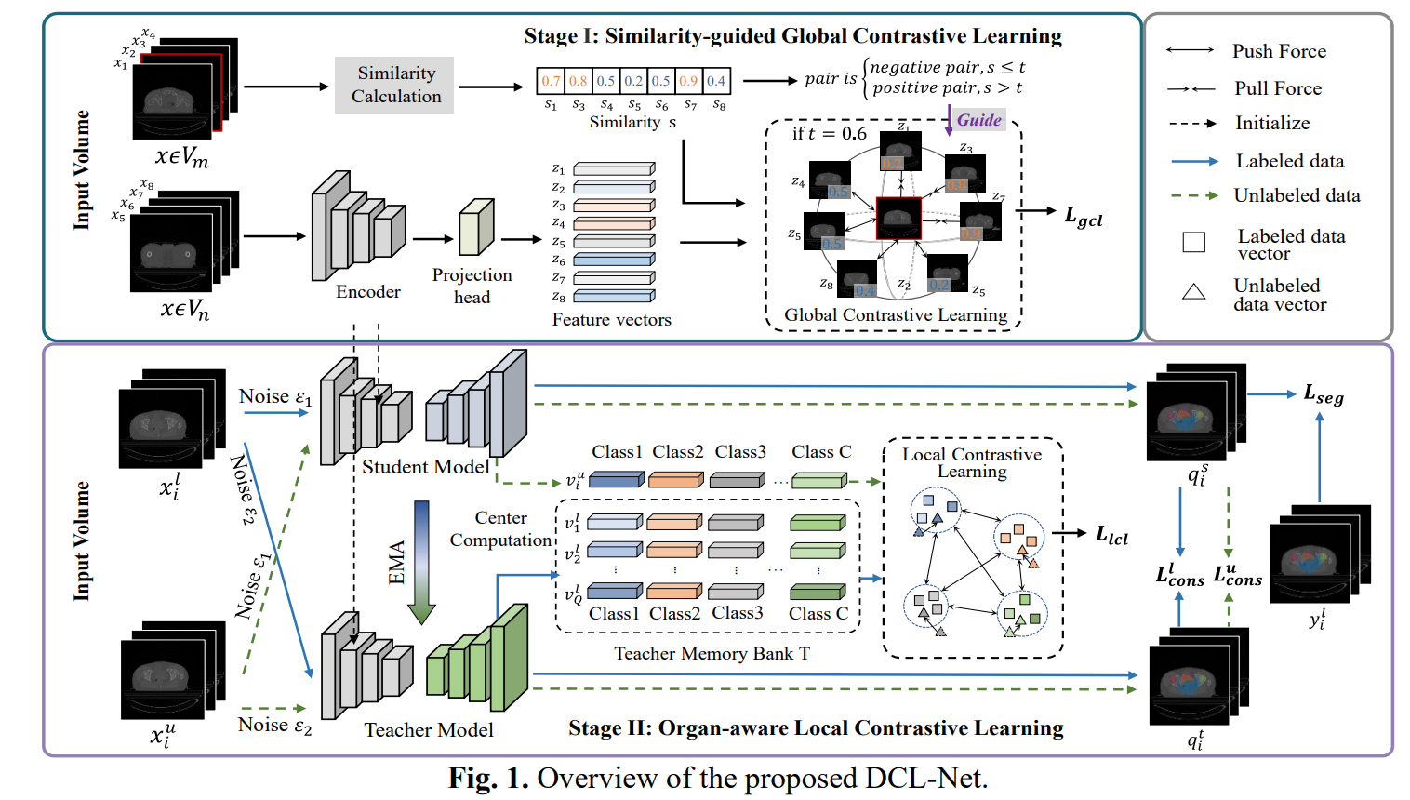
Methodology
Notes:
Our proposed method, DCL-Net, is a novel dual contrastive learning model that incorporates both global and local contrastive learning strategies. This two-stage approach is designed to excavate comprehensive knowledge for the challenging semi-supervised MoS task. In the first stage, we introduce similarity-guided global contrastive learning to explore implicit continuity and similarity among images. The second stage utilizes organ-aware local contrastive learning to further refine class representations, all while easing the computation burden with a mask center computation algorithm.

Slide 12
Methodology
Similarity-guided Global Contrastive Learning
Intrinsic slice continuity and similarity inside the medical volume
Utilize the relative positions ($p_{i}$ and $p_{j}$) of two slices ($x_{i}$ and $x_{j}$) in volumes to calculate the similarity $s_{ij}$
Similarity threshold: $t$
Notes:
Let's delve deeper into the first stage of our methodology. We've developed a similarity-guided global contrastive learning strategy that leverages the intrinsic continuity and similarity within medical volumes. By calculating the relative positions of slices and constructing a global contrastive loss, our model learns to represent similar data points close together in feature space, while pushing dissimilar ones apart. This approach provides the network with a global awareness, which is crucial for understanding the context of the entire medical image.

Slide 13
Methodology
Organ-aware Local Contrastive Learning
Mean teacher architecture
The well-trained encoder in Stage I is utilized for initializing the encoders of both student and teacher.
The segmentation decoders are trained from scratch. The teacher model updates its parameters through exponential moving average (EMA)
Notes:
The second stage involves organ-aware local contrastive learning. Here, we employ a mean teacher architecture and use the well-trained encoder from the first stage to initialize the encoders of both student and teacher models. This stage is designed to perform local contrastive learning between the feature vectors of unlabeled data and the stored vectors in the memory bank, enhancing the model's ability to learn organ-specific features.

Slide 14
Methodology
Organ-aware Local Contrastive Learning
Mask Center Computation
Compress all pixels in the same category into a center representation by masking and maintain it in the memory bank $T$.
Allocate the memory bank to the teacher model.
Update$T$ with the latest $Q$ labeled images

Slide 15
Methodology
Organ-aware Local Contrastive Learning
Perform the local contrastive learning between the feature vector of unlabeled data, i.e., $v_{i}^{u}={[M_{c}^{u}]}_{c∈[1,C]}$, and the stored vectors $V^{′}$ in $T$
Pull together the mask center representations of the same category of labeled and unlabeled data while pushing away those of different categories

Slide 16
Methodology
Training Objective
Total Loss
Global
contrastive loss
Local
contrastive loss
Supervised
loss
Consistency
loss
Supervised Loss
Consistency Loss
Notes:
The training objective of our model combines global contrastive loss, local contrastive loss, supervised loss, and consistency loss. These components work together to ensure that the model learns from both labeled and unlabeled data effectively, while maintaining consistency in the segmentation predictions across different iterations.

Slide 17
Experimental Setup & Results

Slide 18
Experimental Setup & Results
Dataset and Evaluations
ACDC dataset
150 patients with segmentation labels of three organs: left ventricle, right ventricle, and myocardium
80/20/50 samples as training/validation/testing sets
resize the resolution of slices as 352×352 for ACDC
RC-OARs dataset
an in-house CT dataset RC-OARs containing 130 rectum cancer patients with segmentation labels of four organs: bladder, small intestine, right femoral head, and left femoral head.
100/8/22 samples as training/validation/testing sets for RC-OARs dataset
resize the resolution of slices as 256×256 for RC-OARs
Divide the labeled set and the unlabeled set as $n/m$ to simulate the semi-supervised setting, where $n$ and $m$ are the numbers of labeled and unlabeled samples.

Slide 19
Experimental Setup & Results
Experimental Setup
Hardware: A single NVIDIA GeForce 3090 GPU with 24GB memory
Iterations: Stage Ⅰ - SGD - 200 epochs - batchsize of 64 - learning rate of 0.1; Stage Ⅱ - Adam optimizer -100 epochs - batchsize of 16 - learning rate of 5e-4
Size of Memory Bank: 256
Hyper-parameters: Similarity threshold $t$ is set as 0.65 and 0.85 for the ACDC and RC-OARs dataset; $λ_{1}$ and $λ_{2}$ in Eq. (8) are empirically set as 0.01 and 1. As for $λ_{3}$, following [7], we use a warming-up function $λ_{3}(δ)=0.1×e^{\left(−5{\left(1−δ/δ_{max}\right)}^{2}\right)}$.
Note: Local contrastive learning begins at the 30th epoch for stable convergence.
Notes:
Stage Ⅰ, we use SGD optimizer to train the encoder for 200 epochs with batchsize of 64 and learning rate of 0.1. In Stage Ⅱ, we use Adam optimizer to train the model for 100 epochs with batchsize of 16 and learning rate of 5e-4.

Slide 20
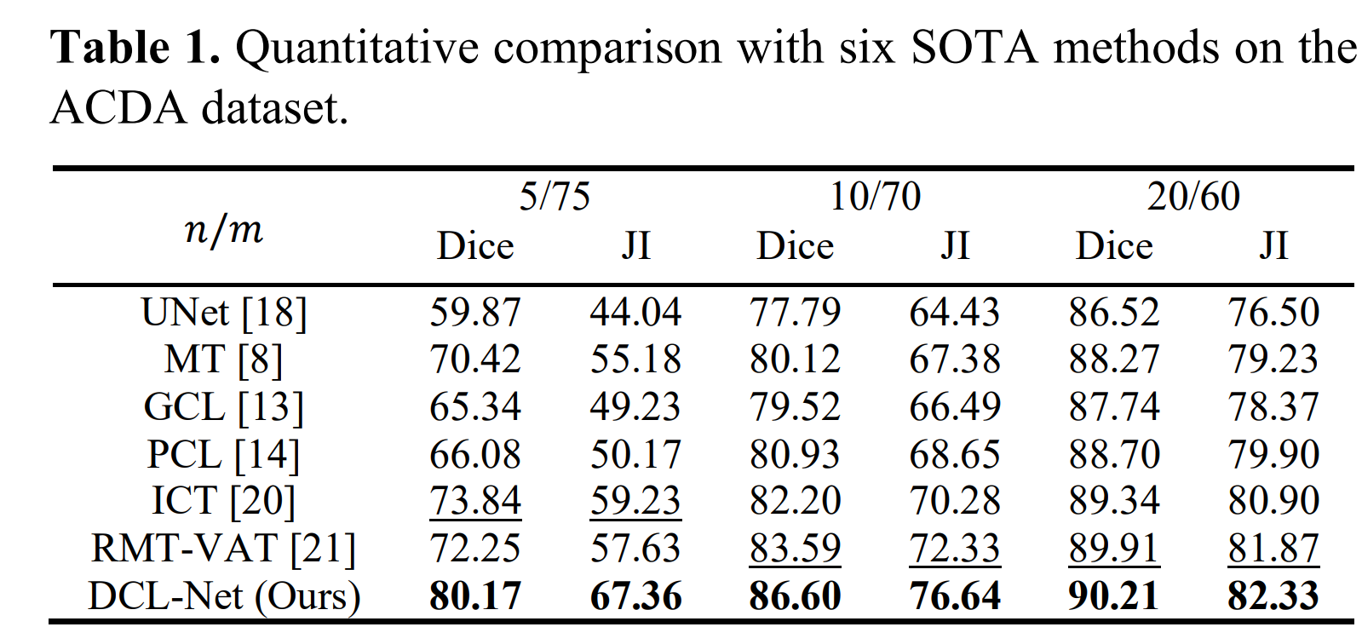
Experimental Setup & Results
Quantitative Comparisons on ACDC
Notes:
Here, we present the quantitative results on the ACDC dataset. Our method outperforms several state-of-the-art models in terms of Dice coefficients, demonstrating its effectiveness in semi-supervised multi-organ segmentation tasks, even with a limited number of labeled samples.

Slide 21
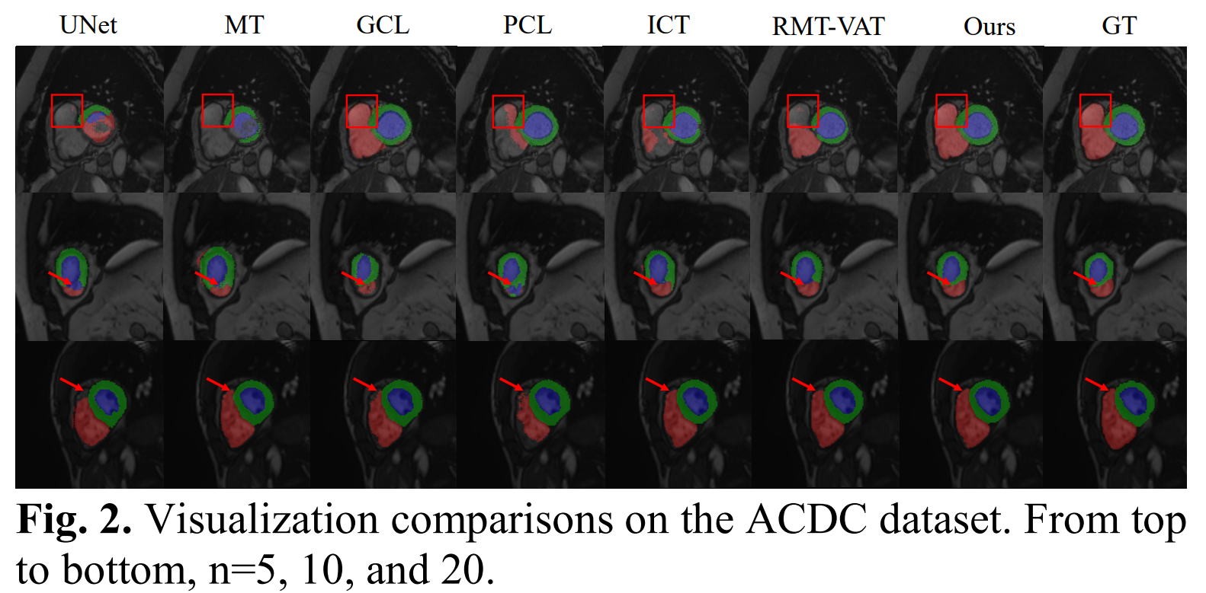
Experimental Setup & Results
Visual Comparisons on ACDC
Notes:
Visual comparisons further illustrate the strengths of our method. As shown here, our DCL-Net produces segmentation results that are closer to the ground truth, with fewer errors compared to other models. This visual evidence supports the quantitative findings and highlights the potential of our approach in practical applications

Slide 22
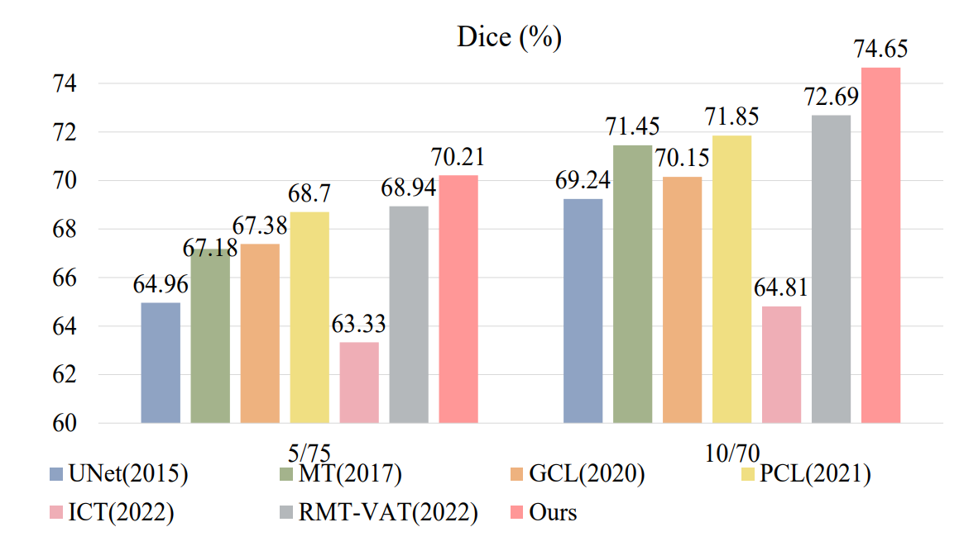
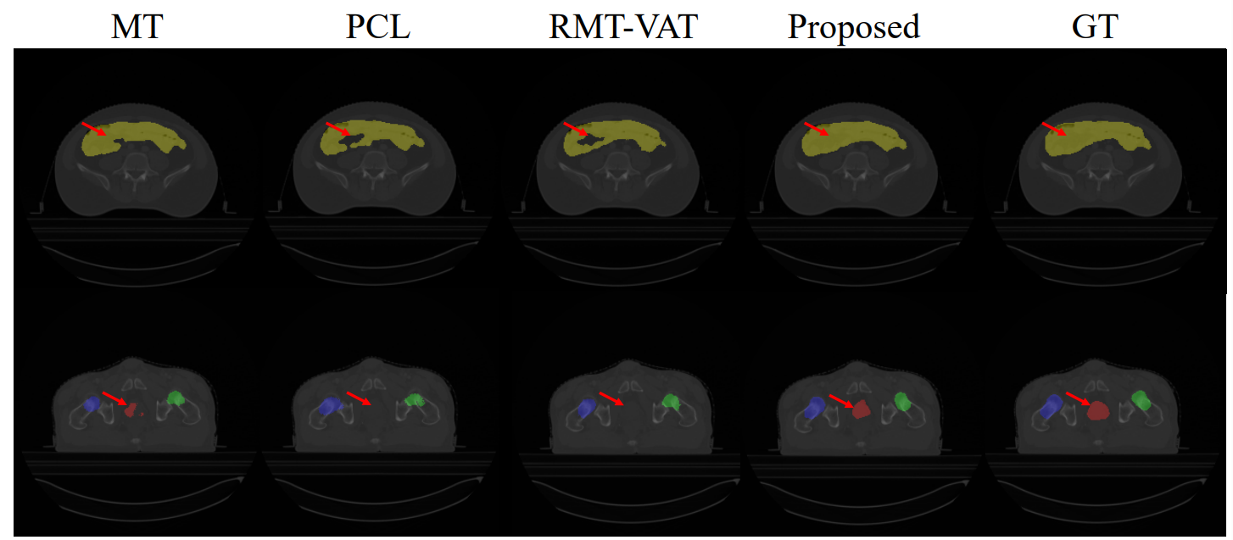
Experimental Setup & Results
Comparisons on RC-OARs
Fig. 3. The quantitative results on the RC-OARs dataset in terms of Dice are listed on the top. Corresponding visualization comparisons are shown on the left when n=5.
Notes:
On the RC-OARs dataset, our method continues to show superior performance. The quantitative results in terms of Dice coefficients are listed here, and as you can see, our model achieves the highest scores, especially when the number of labeled samples is limited

Slide 23
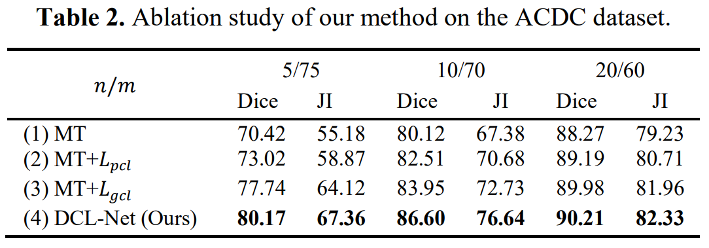
Experimental Setup & Results
Ablation studies on ACDC
mean teacher as the backbone (MT),
MT + positional contrastive learning [14] (MT + $L_{pcl}$),
MT + similarity-guided global contrastive learning (MT + $L_{gcl}$)
MT + $L_{gcl}$ + local contrastive learning (MT + $L_{gcl}$ + $L_{lcl}$) (DCL-Net, Ours).
Notes:
o further understand the contributions of our dual contrastive learning approach, we conducted ablation studies. These experiments demonstrate the effectiveness of each component, showing that both global and local contrastive learning are essential for achieving the best segmentation results

Slide 24
Conclusion

Slide 25
Conclusions
In this paper, we propose a dual contrastive learning network DCL-Net to segment multiple organs in medical images under the semi-supervised scenario.
The proposed method involves a similarity-guided global contrastive learning and an organ-aware local contrastive learning to extract rich feature expressions related to the MoS task.
Experiments on the public ACDC dataset and the in-house RC-OARs dataset have shown the superior performance of our method.
Notes:
Thank you for your attention. I am now open to any questions or discussions about our work. Your feedback is greatly appreciated.

Slide 26
Thank you for listening
Date：2024.04.17
Presenter：Lu Wen

