Slide 1
Selective Weighted Adaptive Coding
Yoav Gross
Ariel University
Shmuel T. Klein
Bar Ilan University
Elina Opalinsky
Ariel University
Dana Shapira
Ariel University
DCC 2022

Slide 2
Static compression
Adaptive
Weighted
Selective

Slide 3
Complete selective
Subset selective
Tuned selective

Slide 4
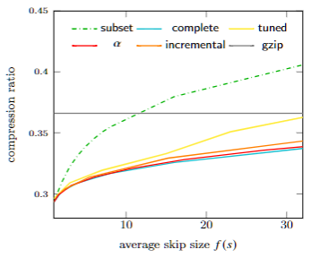
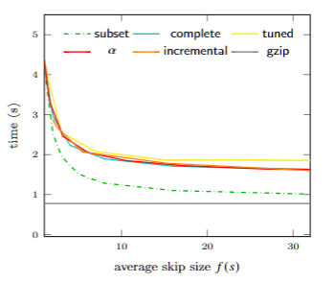
Results
Compression ratio Encoding time

Slide 5
Thank you !

