Slide 1
FOCUS PRIOR ESTIMATION FOR SALIENT OBJECT DETECTION
Xiaoli Sun Associate Professor
Xiujun Zhang, PHD student
Shenzhen University, Shenzhen Guangdong China
xlsun@szu.edu.cn
Sept.20, 2017

Slide 2
Content
1
1. Motivation
2
2. Related Work
3
3. Our Model
4
4. Evaluation

Slide 3
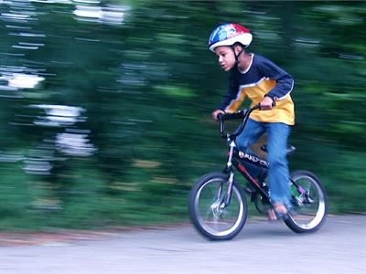
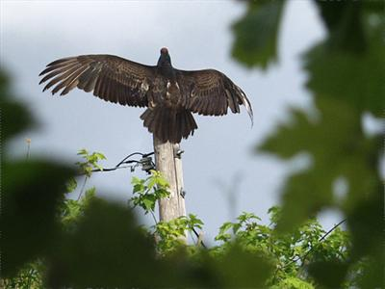
Motivation
Depth of field is often used in photography.
Focus is a naturally strong indicator for the salient object detection task.
Notes:
For the salient object detection task, the focus prior is very important, because the salient objects are always photographed in focus. This is determined by the physiological mechanism of the human eye, so the focus prior is a strong indicator for the salient object. But in the state-of-the-art methods, the focus priors are not well considered.

Slide 4
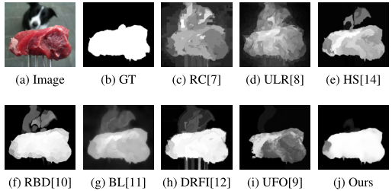
Motivation
An inspired example:
An challenging example for seven state-of-the-art methods. All results of these seven methods are not satisfied, since the focus prior is not well considered.
Focus is a strong indicator for the salient object detection, but is easily igored and not well studied.
Notes:
As shown in Fig.\ref{fig:focusexample}, the input image has clear contrast between the object and the background. The photographer made the meat in focus and the dog in blur through setting the depth of field. It indicates that the meat is the really attractive object. But seven state-of-the-art methods have failed in this case, for not considering the focus prior.

Slide 5
Motivation
Our motivation:
1. Study how to estimation the focus prior for the salient object detection.
2. The focus prior should be indepent from the speicial model and easily be intergrated by the other models.
3. The model should be lightweight and run fastly.

Slide 6
Related Work
Defocus Map Estimation:
Elder and Zucker, TPAMI, 1998
S.J. Zhuo et al., PR, 2011
Y. Zhang et al., CVPR, 2013
Brown and Tai, ICIP, 2009
Ali Karaali et al., ICIP, 2014
......
All are gradient based methods.

Slide 7
Related Work
Focusness Estimation:
P. Jiang et al., CVPR, 2013
The first to propose the focus prior for salient object detection.
Closely integrated with their model and hard to be used for the other methods.

Slide 8
Our Model
Dataset Construction for Evaluating:
New dataset consists of 231 images. All images have the salient objects in focus and the background in blur.

Slide 9
Our Model
Sparse Dictionary Learning for Defocus:
(1)
Given an input matrix , each vector
can be represented by a set of dictionary atoms as above.
Notes:
where $D \in {R^{d \times n}}$ is an over-complete dictionary learned from $Y$. $x_i$ is the coefficient to reconstruct $y_i$. The $l_2$ norm forces the representation error small enough to accurately recover the original signal. The $l_0$ norm of $x_i$ forces a few number of dictionary atoms in $D$ which has be used to reconstruct $y_i$, namely indicating sparsity.

Slide 10
Our Model
1. A slight blurred procedure by Gaussian kernel with Sigma = 2 is imposed on images of the proposed dataset.
2. Extract overlapped image patches from them. Size of each patch is 8*8, forming an input vector of d=64.
3. Our sparse dictionary D with 64 atoms is trained according to Eq.1.
4. Based on our sparse dictionary D, each image patch can be reconstructed by a few atoms together with their non-zero coefficients.
Our learned Sparse Dictionary

Slide 11
Our Model
Focus prior estimation map:
(2)
Here, denotes the i-th patch. The focus strength for the i-th patch, denoted as , is defined as the number of non-zero elements in .

Slide 12
Our Model
Enhancement by Objectness Analysis:
It is observed that when glancing at a scene, objects are much
easier to abstract the attention of human than the flat regions.
Use the objectness proposal method in [21] to enhance the focus prior map.

Slide 13
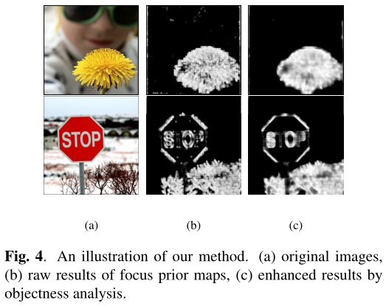
Our Model

Slide 14
Evaluation
Dataset
ASD
The proposed dataset
Evaluation Category
Comparisons with the Other Focus Map for Salient
Object Detection
Improvement to State-of-the-art Methods for Salient
Object Detection

Slide 15
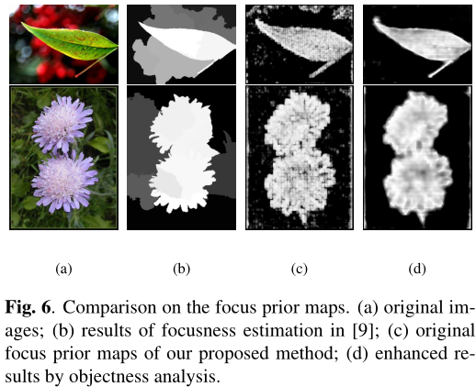
Evaluation
Comparisons with the Other Focus Map for Salient Object Detection:
Notes:
To the best of our knowledge, the work in \cite{UFO2013CVPR} is the first method of estimating the focusness for salient object detection. In our experiments, we have shown the comparison results with \cite{UFO2013CVPR} in Fig.\ref{fig:focuscompare}. As can be seen, our method has more accurate focus prior map than \cite{UFO2013CVPR}. Especially, benefiting from the object-level analysis, the final results in Fig.\ref{fig:focuscompare} (d) is much cleaner. In some cases, the final results are much closer to the ground truths, even without introducing the contrast features in color, shape, etc. This comparison experiment has confirmed the effectiveness and importance of our focus prior map.

Slide 16
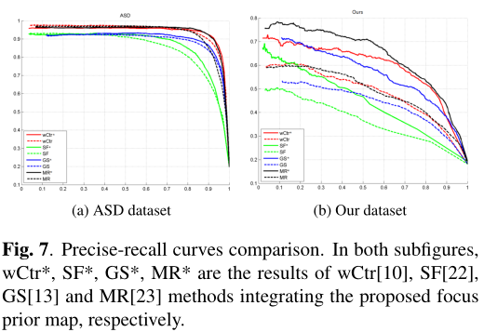
Evaluation
Improvement to State-of-the-art Methods for Salient Object Detection:
Notes:
Our focus prior map is an estimation of the object in focus to the given image. It can be easily integrated into the other methods and help to improve their performances. We have integrated our focus prior map in four state-of-the-art methods: wCtr\cite{wei2014rbd}, SF\cite{sf2012cvpr}, GS\cite{wei2012geodesic}, MR\cite{yang2013saliency}. The experiment results on the ASD dataset\footnote{\url{http://ivrgwww.epfl.ch/supplementary_material/RK_CVPR09/}.} have been shown in Fig.\ref{fig:pr} (a). The performances of all methods have been improved. In order to better show the effect of our method, in Fig.\ref{fig:pr} (b), we have also shown the comparison results on the proposed datasets. It is more obvious on the proposed dataset, the performances of all methods have been improved by a large margin due to integrating our focus prior map.

Slide 17
Conclusions
1. We have proposed a novel method of estimating the focus prior map for any given images.
2.The sparse representation has been used to learn the defocus dictionary and the non-zero number of the coefficients is used to describe the focus strength of
each patch.
3.Object level analysis is introduced to boost the performance, since the focus prior is meaningful to the objects in focus.

Slide 18
Thank You!

