Slide 1
PROMPTING LARGE LANGUAGE MODELS WITH FINE-GRAINED VISUAL RELATIONS FROM SCENE GRAPH FOR VISUAL QUESTION ANSWERING
Jiapeng Liu^{1,2}, Chengyang Fang^{1,2}, Liang Li^{1,*}, Bing Li^{1,*}, Dayong Hu³, Can Ma¹
¹ Institute of Information Engineering, Chinese Academy of Sciences
² School of Cyber Security, University of Chinese Academy of Sciences
³ Heilongjiang Network Space Research Center
Notes:
Good afternoon, everyone. My name is Liu Jiapeng, and I am very glad to stand here and share the paper. The topic of my presentation is “PROMPTING LARGE LANGUAGE MODELS WITH FINE-GRAINED VISUAL RELATIONS FROM SCENE GRAPH FOR VISUAL QUESTION ANSWERING”.

Slide 2
OUTLINE
Introduction
Method
Experiments
Notes:
I will present my introduction in three sections. I will first introduce the background and motivation of this paper in the introduction section.

Slide 3
1. Introduction
Visual Question Answering (VQA) is a vital vision-language task, it requires the model to simultaneously comprehend textual and visual data for precise answer inference.
In recent years, many methods have achieved advanced performance in solving the VQA task by:
training expert models on specialized datasets
leveraging the vast implicit knowledge base and language understanding capabilities of LLMs, combined with image captioning
Notes:
in the first place, the Visual Question Answering (VQA) is a vital vision-language task, it requires the model to comprehend textual and visual data for precise answer inference at the same time.
In recent years, many methods have achieved advanced performance in solving the VQA task by training expert models on specialized datasets. On the other hand, large Language Models like chatGPT have showcased remarkable knowledge transfer and logical reasoning abilities in zero-shot scenarios. To extend these capabilities into VQA task, some studies make efforts to narrow the gap between the
visual information and the input to the LLMs (usually text) by feeding the generated image captions, rather than images, into the LLMs.

Slide 4
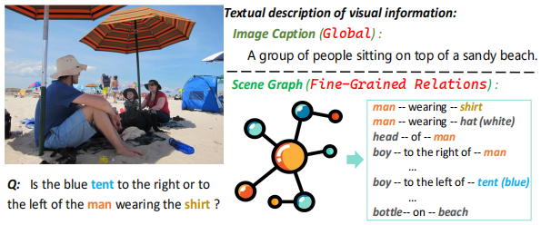
1. Introduction
training expert models may have limitations when dealing with complex questions that involve common sense knowledge.
LLM combined with image captioning typically encompass only the main regions of the image, disregarding fine-grained details.
To deal with such situation, this paper proposes a modular framework that Prompts LLMs with Fine-grained Visual Relations (PFVR) provided by the scene graph.
Notes:
However, there are still some challenges for its practical deployment: Like training expert models may have limitations when dealing with complex questions that involve common sense knowledge. And large language models combined with image caption typically encompass only the main regions of the image but disregard fine-grained details. This results in a limited receptive field for the large language models and restrict its reasoning ability. Even if it understands the semantics of the input question well, it cannot answer it accurately. Like the above image, the image caption generally encompass the main area. We notice that the scene graph extracted from an image is a structured representation of visual objects and the relations between them. As illustrated in this figure, when the visual objects are related, they are connected by edges in the graph, even if their positions in the picture are far apart. To deal with such situation, this paper proposes a modular framework that Prompts large language models with Fine-grained Visual Relations (PFVR) provided by the scene graph.

Slide 5
OUTLINE
Introduction
Method
Experiments

Slide 6
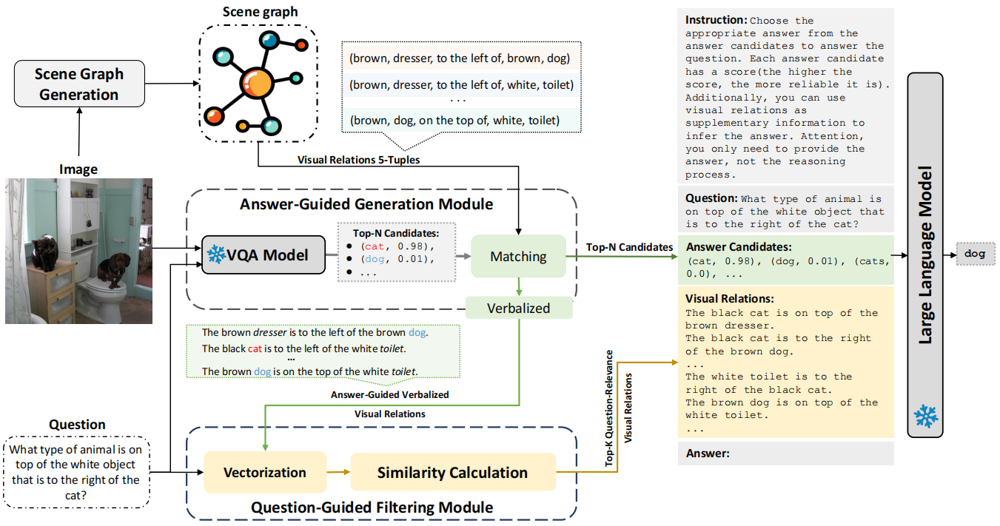
2. Method
Overall Framework
Notes:
The PFVR framework we propose, as depicted in the figure above. In general, the framework consists of two main modules, namely Answer-Guided Generation Module(AGG) and Question-Guided Filtering Module(QGF). Answer-Guided Generation Module in the middle is used to obtain sub-visual relations associated with answer candidates generated by ready-made VQA models. In general, this module first uses a ready-made vqa model to generate answer candidates for questions and retains and outputs them, and then uses answer candidates to screen out possible relevant visual relationships for output. Question-Guided Filtering Module further filters out the information related to the question from the output of Answer-Guided Generation Module. Then output visual relations that are both completely relevant to the answer candidate and potentially relevant to the question. Ultimately, the fine-grained visual relations, in combination with the question and answer candidates, are encoded to create the prompt input for LLMs. In this step, just like the idea of a retrieve-augmented Generation, additional relevant information greatly helps a large language model to select answers from candidates with scores.

Slide 7
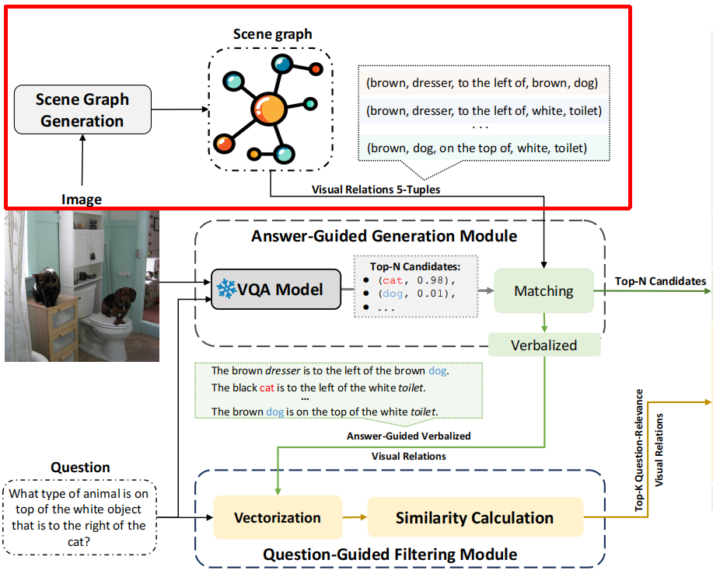
2. Method
2.1 Scene Graph Generation
Scene graph is a structured way of organizing data to describe the objects in an image and the relations between them.
the information-rich scene graph $𝒢_{0}$ consists of a collection of visual relations:
$$𝒢_{0}=\left\{v_{1},...,v_{n}\right\}$$
each visual relation $v_{i}$ is represented as a 5-tuple:
$$\left({attributes}_{i}^{b},{object}_{i}^{b},{relation}_{i},{attributes}_{i}^{c},{object}_{i}^{c}\right)$$
Notes:
First, the model needs to obtain the fine-grained visual relationship of the image from the scene graph. Scene graph is a structured way of organizing data to describe the objects in an image and the relations between them. The information-rich scene graph G subscript 0 consists of a collection of visual relations, this is shown in the following formula, where each visual relation v subscript i is represented as a 5-tuple. Over here, object_i^b and object_i^c denote the visual objects, attributes_i^b and attributes_i^c (such as “white”, “blue”) represent the predicates of the corresponding visual objects, and relation_i is the relation between object_i^b and object_i^c.

Slide 8
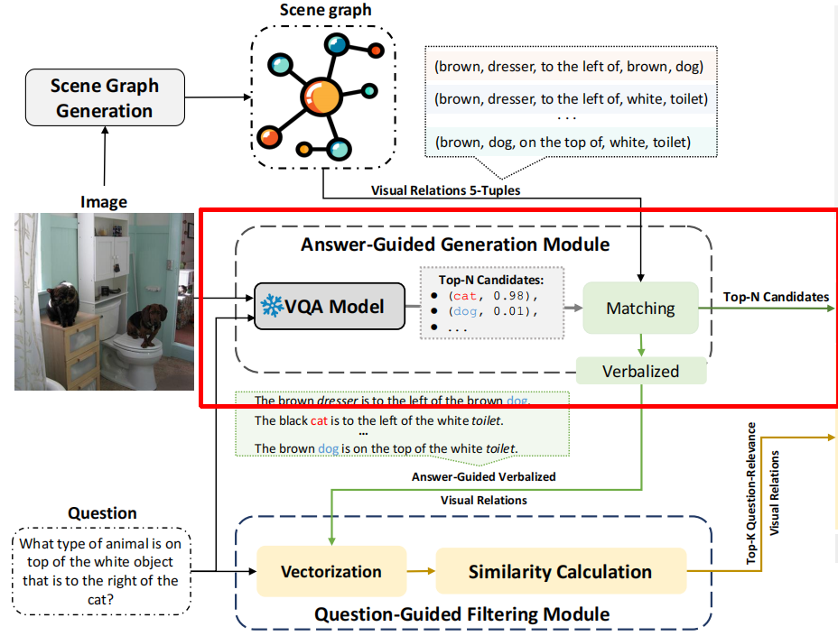
2. Method
2.2 Answer-Guided Generation Module
Given an image I and its corresponding scene graph $𝒢_{0}=\left\{v_{1},...,v_{n}\right\}$, we notice that the scene graph $𝒢_{0}$ contains some visual relations unrelated to the visual information needed to answer the input question.
Using AGG module extract sub scene graph $𝒢$ from the $𝒢_{0}$ :
1. input the image I and question Q into ready-made VQA model M to obtain a list of answer candidates $W={\left\{\left(w_{i},s_{i}\right)\right\}}_{i=1}^{L}$.
2. keyword matching
3. verbalized the structured match result
Notes:
Given an image I and its corresponding scene graph G subscript 0={v subscript 1,...,v subscript n}, we notice that the scene graph G subscript 0 contains some visual relations unrelated to the visual information needed to answer the input question. These noisy visual relations may distract the LLM and disturb its judgment. Therefore, Answer-Guided Gneration Model for short, AGG aims to purify the visual relations from the scene graph that are relevant to answering the question. Intuitively, answer candidates with higher scores correlate more with the image region focused on by the current question. Whereas the lower-scoring candidates have low confidence. Particularly, it retains relations involving visual information found in answer candidates from an ready-made VQA model and converts structured visual relations into natural language that the large language model easily understands. To be specific, the ready-made VQA model in agg firstly accepts the input of image and question, then it will output the answer candidates. Each answer candidate w subscript i has a score S, which indicates the probability that it is correct. This will allow the agg to match potentially relevant information from visual relationships based on candidates with higher scores. Finally, the agg will verbalize the structured information using the template into descriptive information

Slide 9
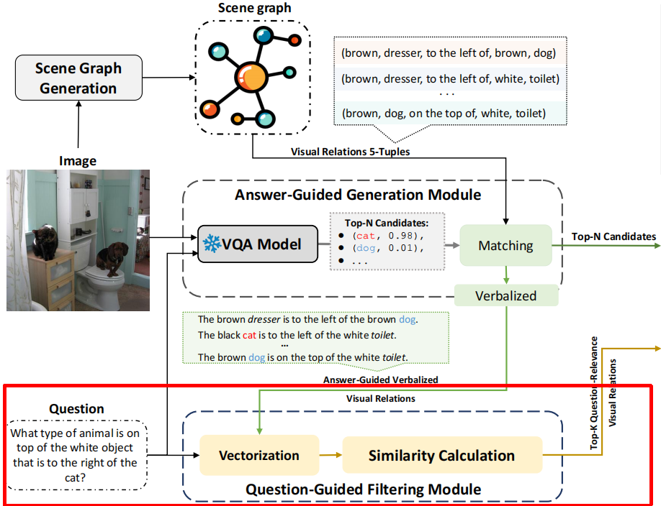
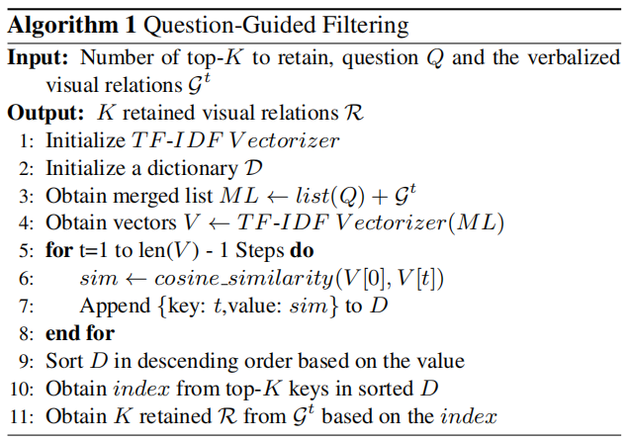
2. Method
2.3 Question-Guided Filtering Module
With the question Q and relations $𝒢^{t}$, QGF initially vectorizes Q and $𝒢^{t}$.
Calculate the cosine similarity scores between the vectorized Q and each visual relation.
Keep the top-K visual relations with the highest similarity as question-relevance visual relations R based on similarity scores.
Notes:
Although relying on the top K answer candidates with high recall can introduce more relevant visual relations, there may be a phenomenon of “off-topic” within these visual relations. Therefore, Question-Guided Filtering Module for short, QGF aims to filter and retain the verbalized visual relations that are highly relevant to the given question. It utilizes the question as a constraint to compute the similarity between all verbalized visual relations and the question, subsequently removing sentences with lower relevance. As the pseudo-code shows, to purify G superscript t by removing out the irrelevant visual relations to the input question, qgf firstly vectorizes question Q and the visual ralations G from the output of the agg, It then computes the cosine similarity scores between the vectorized Q and each visual relation. Finally, based on these similarity scores, it retains the top-K visual relations with the highest similarity as question-relevance visual relations R.

Slide 10
2. Method
2.4 Prompting
Notes:
Finally, PFVR combines the question Q, the generated answer candidates, and the visual relations filtered by multiple complement to a prompt. In order to enhance the understanding of the task by the Large Language Model, we add more detailed description information as the prompt header. The complete example is illustrated on the right side of the figure.

Slide 11
OUTLINE
Introduction
Method
Experiments

Slide 12
3. Experiments
3.1 Experimental setup
Dataset:
GQA is divided into train, validation, test, and test-dev sets. Each image in the train and validation sets is associated with an accessible human-annotated scene graph.
validate the effectiveness of PFVR on the GQA validation set and test on the GQA test-dev set, reporting standard accuracy.
Notes:
To evaluate the effectiveness of our proposed PFVR, we conduct experiments on the GQA dataset. GQA is divided into train, validation, test, and test-dev sets. Each image in the train and validation sets is associated with an accessible human-annotated scene graph. Following previous works, we validate the effectiveness of PFVR on the GQA validation set and test on the GQA test-dev set, reporting standard accuracy.

Slide 13
3. Experiments
3.1 Experimental setup
Implementation Details:
Scene graph generation and the visual relations generation: SHA + CFR.
Answer candidates generation and Baseline model: use CFR model to generate answer candidates, with CFR serving as the baseline model.
Other settings: the default parameter settings entail 5 answer candidates for AGG and retaining 7 question-relevance visual relations for QGF. The LLM we prompt is text-davinci-003 in GPT-3.5.
Notes:
for the scene graph generation and the visual relations generation, we follow the method proposed by the SHA model to generate the initial scene graph and utilize the predicates provided by CFR to enhance the scene graph.
for the generation of the answer candidates, we use in the QGF module, we chose the previous sota module CFR, and use CFR as the baseline. The default parameter settings are 5 answer candidates for AGG and retaining 7 question-relevance visual relations for QGF. The Large Language Model we prompt is text-davinci-003 in GPT-3.5.

Slide 14
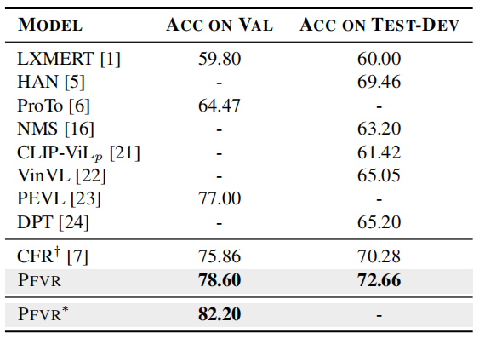
3. Experiments
3.2 Results
Comparison of PFVR with previous models on the validation set and the test-dev set of GQA. “*” denotes that the scene graph used is manually annotated.
Notes:
First, we compared pfvr with baseline and the previous approach on gqa. Based on CFR model and combined with our method, better performance is achieved. The pfvr also showed a further improvement over baseline model CFR, this is because the visual relations provides additional information to help the LLM further select the final answer from the answer candidates predicted by the CFR. On the other hands, the start mark denotes that the scene graph used is manually annotated , which is conducive to testing the highest performance of pfvr. It can be observed that higher-quality scene graphs can further enhance the performance of PFVR.

Slide 15
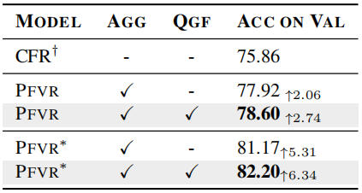
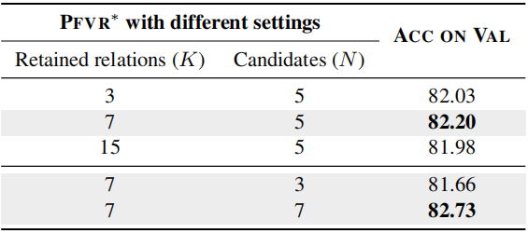
3. Experiments
3.2 Results
Ablation study of PFVR and PFVR* on the GQA validation set.
The accuracy results of PFVR* under different settings on the GQA validation set.
Notes:
At the same time, we also conducted ablation experiments on val set of gqa. The effects of different components on pfvr are shown on the left side, and it can be seen that the combined performance of components is the best. We also investigate how the PFVR performance is affected by the number of answer candidates N and the number of retained relations K. On the right side is the experiment for them. According to the first part of the right table, when N is kept at 5, the model’s performance first increases and then decreases with the number of retained relations K. It indicates the scene graph contains some noisy visual relations that distract the LLM and disturb its judgment. Then, we fix the number of retained relations K as 7 and tune the number of candidate answers N. The results are shown in the gray part of the table. As we can see, the model performance increases as N increases. This means improving the recall of candidate answers used to filter visual relations from the scene graph increases the probability of selecting the correct relation. Look at the whole table, it can be seen that more answer candidates and appropriate fine-grained visual relationships are conducive to improving the prediction accuracy of the model.

Slide 16
Thank you for listening!

