Slide 1
Adaptive Variational Nonlinear Chirp Mode Decomposition
Hao Liang^{1,3}, Xinghao Ding^{1,3}, Andreas Jakobsson², Xiaotong Tu^{1,3,*}, Yue Huang^{1,3}
¹School of Informatics, Xiamen University, China
²Div. of Mathematical Statistics, Lund University, Sweden
³Institute of Artificial Intelligent, Xiamen University, China
ICASSP 2022

Slide 2
Background:
Nonlinear chirp signals: non-stationary structures, multi-components
Periodogram
Time-frequency methods: short-time Fourier transform, synchrosqueezed transform, second-order synchrosqueezed transform…
Decomposition methods: empirical mode decomposition, variation mode decomposition, variational nonlinear chirp mode decomposition, ...

Slide 3
Motivation:
Most methods are unsuitable for wide-band signals.
The performance of many methods relies heavily on the setting of the user-selected parameters.

Slide 4
Contributions:
We propose an adaptive implementation from a Bayesian perspective.
The proposed method can adaptively estimate the instantaneous amplitudes and frequencies, and form the dictionary in a data-driven manner.
A full posterior density function is inferred, which may then be used to give a sense of confidence.

Slide 5
Nonlinear Chirp Signal Model:
A nonlinear chirp signal consisting of modes^{[1,2]}:
Demodulated form:
[1] Shiqian Chen, Xingjian Dong, Zhike Peng, Wenming Zhang, and Guang Meng, “Nonlinear chirp mode decomposition: A variational method,” IEEE Transactions on Signal Processing, vol. 65, no. 22, pp. 6024–6037, 2017.
[2] Xiaotong Tu, Johan Sward, Andreas Jakobsson, and Fucai Li, “Estimating nonlinear chirp modes exploiting sparsity,” Signal Processing, vol. 183, pp. 107952, 2021.

Slide 6
The Proposed Method —— Estimating the Nonlinear Chirp Signal:
The signal components may be estimated as:
The trade-off between the data fitting term and the level of smoothness
Restrict the residual noise energy after extracting the overall signal components
Restrict the smoothness of instantaneous amplitude

Slide 7
The Proposed Method —— Estimating the Nonlinear Chirp Signal:
The signal components may be estimated as:

Slide 8
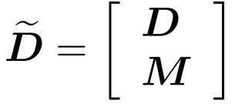
The Proposed Method —— Estimating the Nonlinear Chirp Signal:
Construct an equivalent minimization problem:

Slide 9
The Proposed Method —— Bayesian Strategy:
Formulation:
Marginal likelihood:

Slide 10
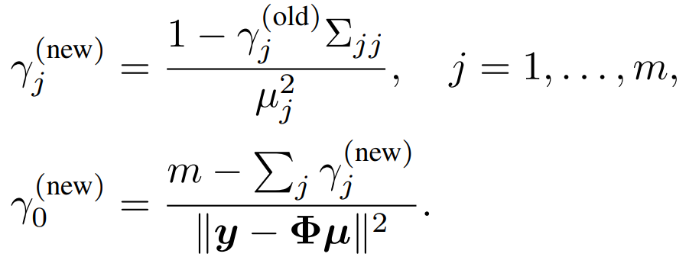
The Proposed Method —— Bayesian Strategy:
Update steps:

Slide 11
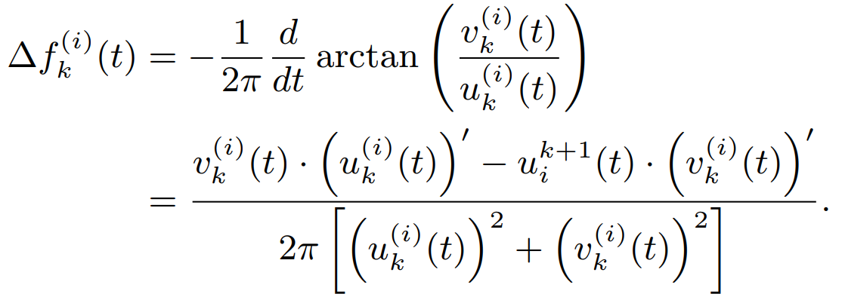
The Proposed Method —— Data-driven Implementation:
Arctangent demodulation technique^{[1,2]}:
Avoid the errors caused by discrete time sampling:
[1] Thomas Y Hou and Zuoqiang Shi, “Data-driven time–frequency analysis,” Applied and Computational Harmonic Analysis, vol. 35, no. 2, pp. 284–308, 2013. [2] Byung-Kwon Park, Olga Boric-Lubecke, and Victor M Lubecke, “Arctangent demodulation with DC offset compensation in quadrature Doppler radar receiver systems,” IEEE transactions on Microwave theory and techniques, vol. 55, no. 5, pp. 1073–1079, 2007.

Slide 12
Numerical Results —— Simulated Signal:
A two-component simulated nonlinear chirp signal:
The codes are available at https://github.com/HauLiang/AVNCMD.

Slide 13
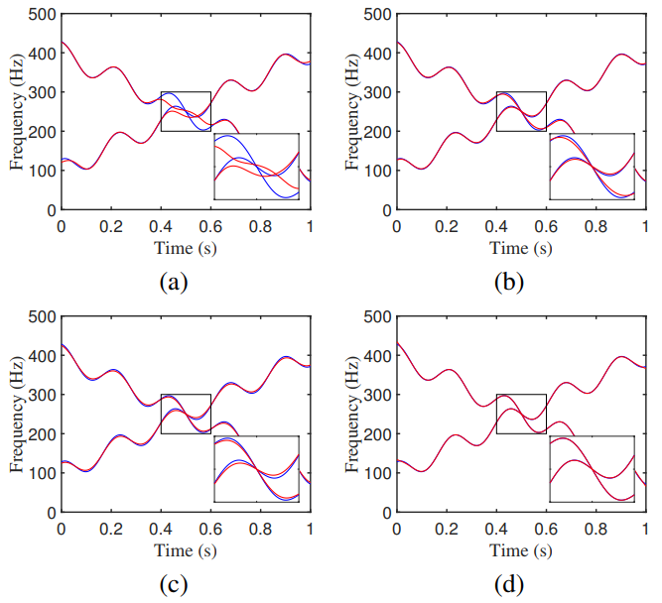
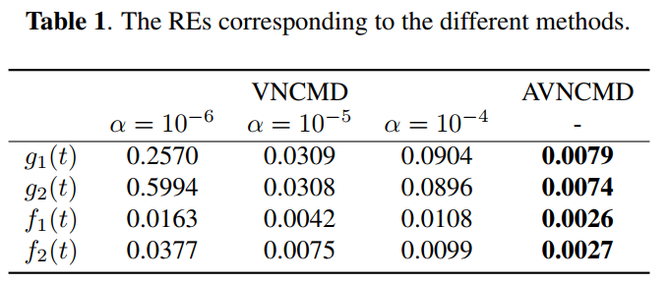
Numerical Results —— Simulated Signal:
The codes are available at https://github.com/HauLiang/AVNCMD.

Slide 14
Numerical Results —— Real-life Signal:
The whistle of a baiji, a Yangtze river dolphin (available in [1])
[1] Kathleen J Vigness-Raposa, Gail Scowcroft, James H Miller, and Darlene Ketten, “Discovery of sound in the Sea: an online resource,” in The Effects of Noise on Aquatic Life, pp. 135–138. Springer, 2012.
The codes are available at https://github.com/HauLiang/AVNCMD.

Slide 15
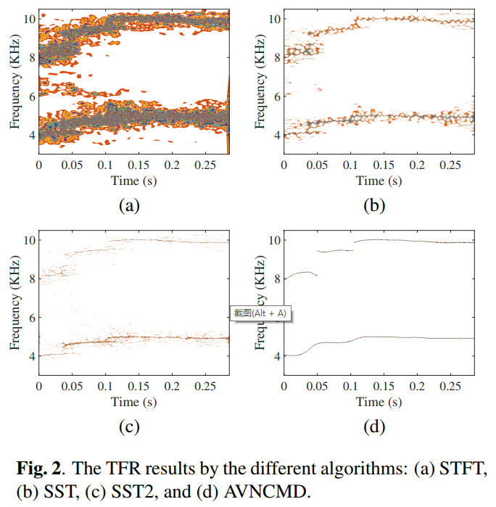
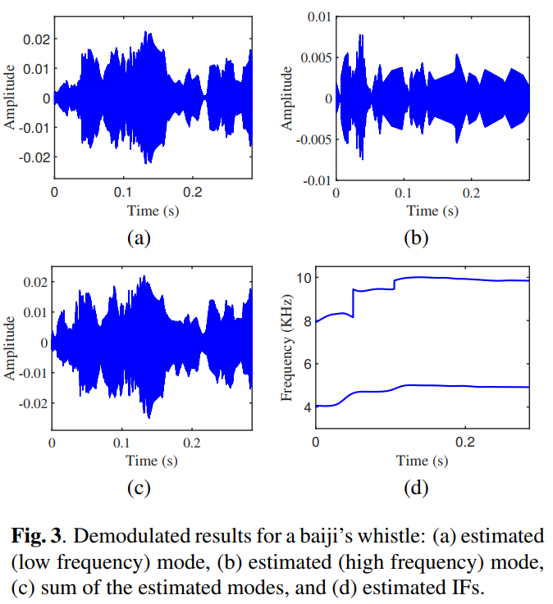
Numerical Results —— Real-life Signal:
The codes are available at https://github.com/HauLiang/AVNCMD.

Slide 16
Thank you!
2022/04/18 Hao Liang (haoliang@stu.xmu.edu.cn)

