Slide 1
Lossy Compression for Integrating Event Sensors
Andrew c. Freeman & Ketan Mayer-Patel
University of north Carolina at Chapel hill

Slide 2
Overview
Sensor Architecture Overview
Camera Emulator Introduction
Event Compression Model
Experimental Evaluation
Conclusion and Future Work

Slide 3
Sensor Architecture Overview
© Zach Dischner

Slide 4
Comparison to Traditional Image Sensors
CMOS (Smartphones, DSLRs, etc.)
ASINT (our sensor)
Each pixel gathers light for same amount of time
Synchronous, outputs still image frames
Low dynamic range (8-14 bits)
Susceptible to blown-out highlight details
Each pixel gathers light for different amounts of time
Asynchronous, outputs a continuous “event” train
Extremely high dynamic range (20+ bits)
Maintains recoverable detail even in the upper range of intensities

Slide 5
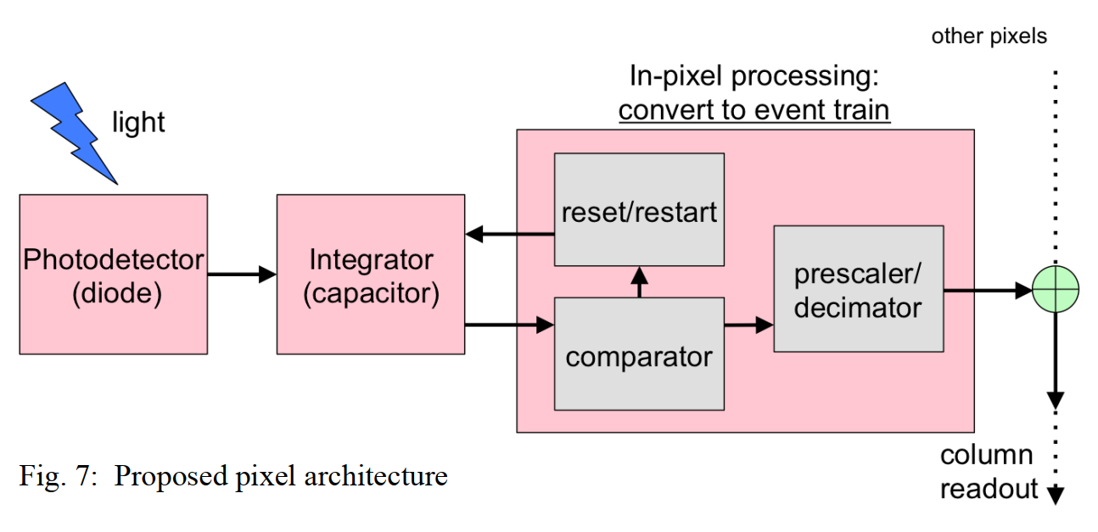
Singh et al.

Slide 6
Pixel Values
Rather than outputting an absolute light intensity value, ASINT pixels effectively output a tuple (D, Δt)
D is the decimation factor determining the pixel’s sensitivity to light
Δt is the amount of time the pixel integrated light before accumulating $2^{D}$ photons
Incident intensity, I, over the time interval is proportional to $\frac{2^{D}}{\text{Δt}}$
Values limited by the global camera ${∆t}_{max}$ interval, which determines the maximum amount of time for which any pixel can integrate light

Slide 7
Camera Emulator
© Zach Dischner

Slide 8
Emulated sensor
Pixel-wise integration
Read input image
(x,y,D,Δt)
(x,y,D,Δt)
Write out 64-bit events to file stream
Some pixels saturate, update D-values

Slide 11
Raw Event Data Format
Pixel X-index
Pixel Y-index
D
Δt
16 bits
16 bits
4 bits
28 bits

Slide 12
Preliminary Decimation Methods
Constant
Self-adjustment
Self-adjustment + Neighbor adjustment
12 | 12 | 12 | 12 | 12
12 | 12 | 12 | 12 | 12
12 | 12 | 12 | 12 | 12
12 | 12 | 12 | 12 | 12
12 | 12 | 12 | 12 | 12
12 | 11 | 12 | 10 | 9
13 | 12 | 12 | 11 | 10
12 | 10 | 9 | 10 | 11
11 | 11 | 9 | 9 | 10
10 | 10 | 9 | 8 | 10
12 | 11 | 2 | 10 | 9
13 | 2 | 2 | 2 | 10
2 | 2 | 2 | 2 | 2
11 | 2 | 2 | 2 | 2
10 | 10 | 2 | 8 | 10
Example: Center pixel’s drastic transition from D-value 9 → 2 causes throttling of neighboring pixels

Slide 13
Event Compression Model
© Zach Dischner

Slide 14
Why a new compression scheme?
Framed video compression techniques do not account for the asynchronous nature of event data
Over a given period, some pixels may fire many events while other pixels not fire at all
Want to design scheme from the ground up that accounts for temporal and spatial coherence in an asynchronous paradigm
Want to build applications that can operate directly on event data, so we must have an efficient compressed event representation

Slide 15
Compression Pipeline Overview

Slide 16
Events are reordered spatially into 4x4 blocks in memory
Read in as many events as necessary for each pixel to saturate the ${∆t}_{max}$ interval,
Pixel coordinates are removed
Cube (0,1)
Cube (0,2)
Cube (0,0)
Cube (1,0)
~${∆t}_{max}$

Slide 17
For all events in memory, shift Δt values right by
$max(\left\{0, ceil\left(\log_{2}\left({∆t}_{max}\right)\right)+λ −24\right\})$ bits, where $λ$ is a user-specified loss level in the range 1-19.
Also shift ${∆t}_{max}$ and the timestamp clock rate, C, by the same amount. These are written at the beginning of the file to instruct the decoder how to read the events.

Slide 18
Analyze the events in each block to determine which cube representation to use
If all the pixels have stable D-values over the ${∆t}_{max}$ interval (1 or fewer D changes) → Combo cube
Else → Prediction cube
Generally, combo cubes will represent static parts of the scene, while prediction cubes represent dynamic parts of the scene

Slide 19
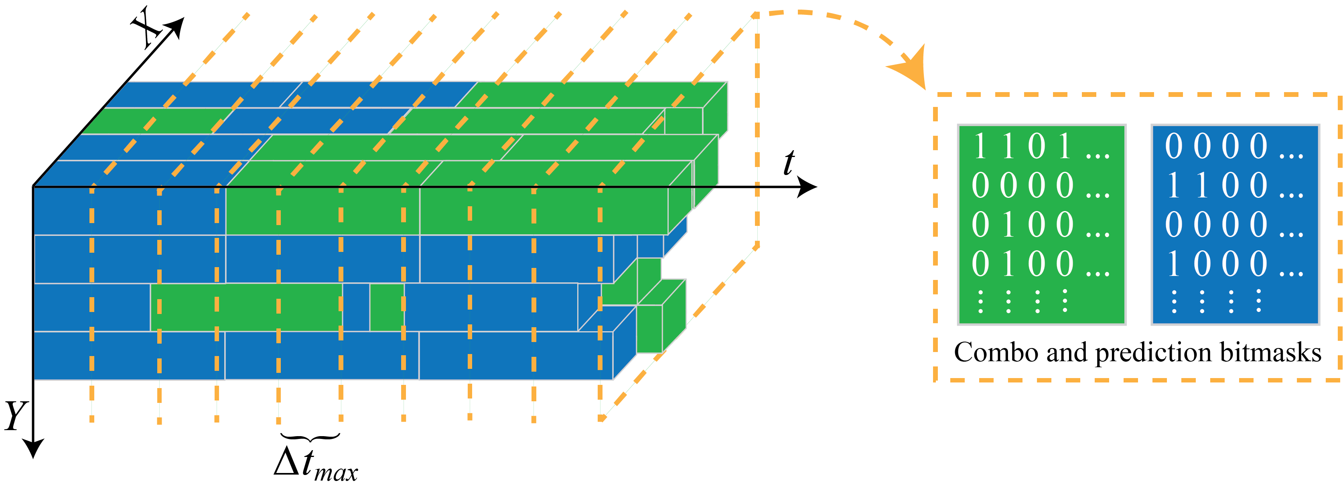
Cubes may extend across multiple ${∆t}_{max}$ intervals of time

Slide 20
When writing out a combo cube, we perform the following
For each pixel, combine all events for that pixel to get a cumulative intensity, $I_{total}$, and a cumulative time, ${∆t}_{total}$
Calculate the D-value corresponding to the cumulative intensity by taking $\log_{2}\left(I_{total}{∆t}_{total}\right)$
This will be a floating-point value to maintain accuracy

Slide 21
Perform DCT on the combo events’ D-values
For each pixel, write out one 64-bit event in row-major order
Floating-point DCT coefficient
Cumulative ${∆t}_{total}$
32 bits
32 bits

Slide 22
As we add events to a prediction cube we reorder them temporally, relative to the first event fired by any pixel in the cube
For each pixel, maintain a prediction model based on $∆D$ from the last event
For each event, encode D and the residual, R, from the predicted $∆t$
X-index in cube
Y-index in cube
D
R
2 bits
2 bits
4 bits
24 bits

Slide 23
Cubes may extend across multiple ${∆t}_{max}$ intervals of time
Notes:
Bitmasks are written at the beginning of each reference interval indicating if there is a combo or prediction cube written there. We only write out a cube when it is full (reaching a pre-defined max count of ref intervals) or if they cube type changes at that point (pixels stabilized or destabilized)

Slide 24
Finally, we run the resulting file through gzip to perform entropy encoding
For testing, the maximal gzip level was used

Slide 25
Experimental Evaluation
© Zach Dischner

Slide 26
Scene 1
360x240, static camera, 100fps with 1/100s shutter

Slide 27
Scene 2
720x480, static camera, 50fps with 1/50s shutter

Slide 28
Scene 3
720x480, fast-moving camera, 50fps with 1/50s shutter

Slide 29
Results
Raw mode 1: 293.7 Mb/s.
Raw mode 2: 322.0 Mb/s
Raw mode 1: 2176.2 Mb/s
Raw mode 2: 2447.3 Mb/s
Raw mode 1: 2354.6 Mb/s
Raw mode 2: 3704.8 Mb/s
Notes:
For PSNR, the “signal” is the uncompressed video made directly from the raw events. The “noise” is the error introduced by our lossy compression.

Slide 30
Conclusion and Future Work
© Zach Dischner

Slide 31
Conclusion
We see space savings upwards of 95% while maintaining high visual fidelity
The self-adjustment decimation method (without neighborhood adjustment) is more generalizable to scenes with global camera motion
Realistic bitrates for streaming are achievable with our lossy compression
Bits of temporal precision necessary for high reconstruction quality determined by bit depth of input images

Slide 32
Future Work
Develop a source model for entropy encoding
Variable-sized cubes, spatially
Improve performance
Shift ingest and processing to the GPU
Investigate useful applications that operate directly on events
Employ real-world ASINT data
Need a camera prototype; working on securing funding

Slide 33
Thank you!
© Zach Dischner

