Slide 1
MULTI-TASK LEARNING WITH COMPRESSIBLE FEATURES FOR COLLABORATIVE INTELLIGENCE
Saeed Ranjbar Alvar and Ivan. V. Bajić

Slide 2
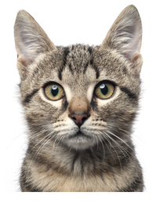
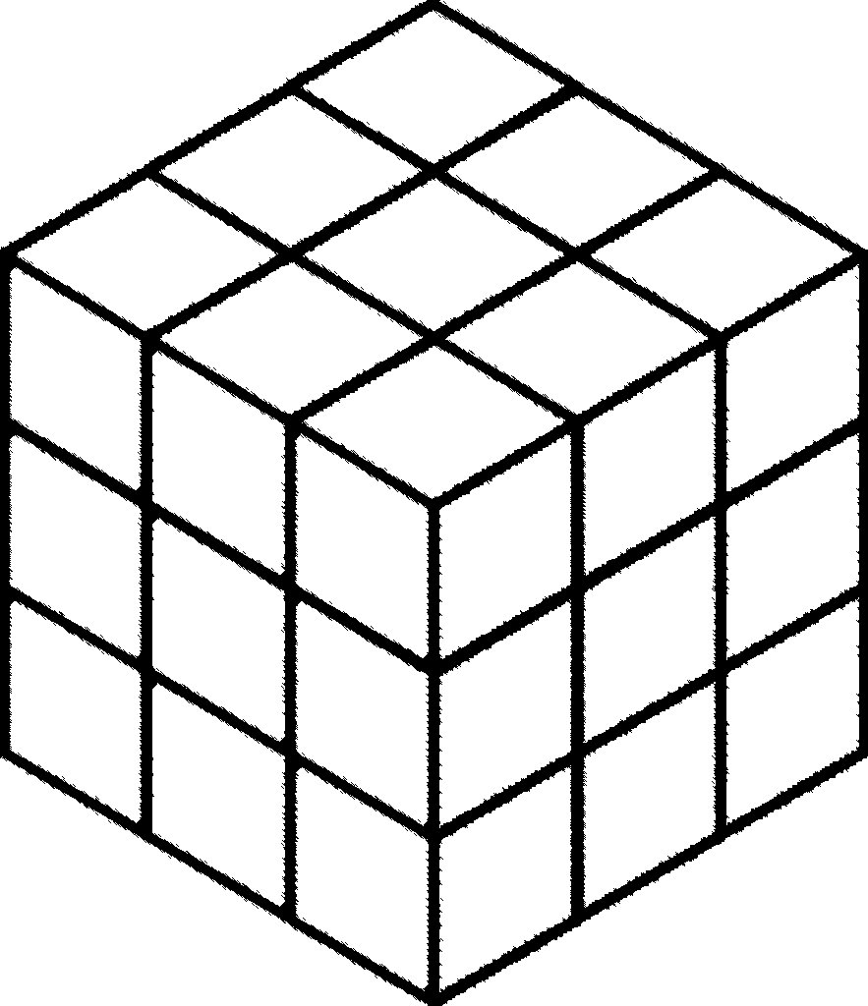
COLLABORATIVE INTELLIGENCE
Mobile Only
Cloud Only
Collaborative
Intelligence
Y. Kang, J. Hauswaldand C. Gao, A. Rovinski, T. Mudge, J. Mars, and L. Tang, “Neurosurgeon: Collaborative intelligence between the cloud and mobile edge,” SIGARCH Comput. Archit. News, vol. 45, no.1, pp. 615–629, Apr. 2017

Slide 3
MULTI-TASK MODEL FOR COLLABORATIVE INTELLIGENCE
Encoder part on the mobile
ResNet34
Inference tasks in the cloud
semantic segmentation
disparity map estimation
input reconstruction
Model 1, Model 2 and Model 3:
convolutional and transpose convolutional
Multi-task model for collaborative intelligence

Slide 4
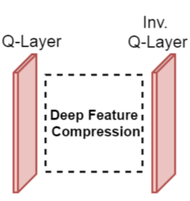
DEEP FEATURE COMPRESSION
Q-Layer:
During the testing: uniform n-bit min-max quantization
During the training: uniform noise
Quantized feature tensor → tiled image
Tiled image is coded:
Lossless codec (PNG)
Lossy codec (JPG)
An example of the tiled quantized deep feature tensor (enhanced for better visualization)
Deep feature compression module

Slide 5
DEEP FEATURE COMPRESSIBILITY LOSS (1)
Loss functions for the three tasks:
semantic segmentation: cross-entropy loss
disparity map estimation: Mean Squared Error (MSE) loss
input reconstruction: Mean Absolute Error (MAE) loss
Feature compressibility loss
input image $X$
encoder model $E$
deep feature tensor: $F∈ℝ^{H ×W ×C}$ (height, width, channels)
$F = f\left(X ;E \right)$
loss function $L_{r}= g\left(F\right)$related to the bitrate required for $F$
$L_{r}$ is used as one of the loss functions
differentiable with respect to $F$ almost everywhere.

Slide 6
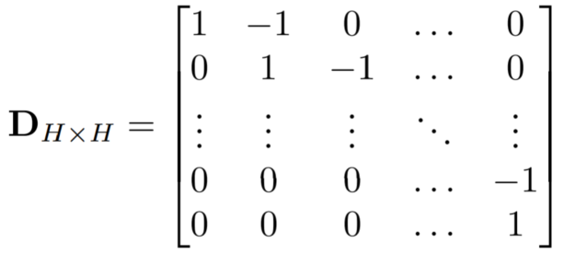
DEEP FEATURE COMPRESSIBILITY LOSS (2)
Entropy is not differentiable → cannot be used in training
$ρ$-domain analysis: a bit rate-related quantity
fraction of non-zero DCT coefficients ($ρ$)
① spatial prediction + ②$l_{1}$-norm of the DCT coefficients of the residual
Differential Pulse Code Modulation (DPCM) along the rows and columns
Let$F_{i}$ be the $i$-th channel of tensor $F$
Then horizontal and vertical differencing of $F_{i}$
①

Slide 7
DEEP FEATURE COMPRESSIBILITY LOSS (3)
Spatial prediction residuals
DCT of the prediction residual signal:
$M_{r}$and $M_{c}$: the DCT matrices for row and column transforms
feature compressibility loss: $l_{1}$-norm of the transformed prediction residual, averaged over the whole feature tensor
the derivative of the absolute value at 0 is set to 1
②

Slide 8
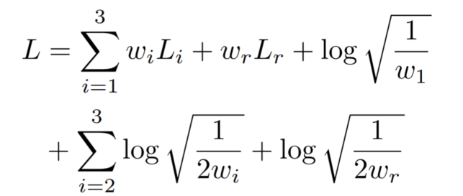
MULTI-TASK LEARNING LOSS
End-to-end training for the multi-task model
A single loss function capturing all task-specific losses
three actual tasks
one loss term related to the compressibility of deep features
Overall multi-task loss: a linear combination of task-specific losses
Following [10]:
classification-type tasks
regression-type tasks
a trainable weight and a correction term for each loss
[10] A. Kendall, Y. Gal, and R. Cipolla, “Multi-task learning using uncertainty to weigh losses for scene geometry and semantics,” in Proc. IEEE CVPR’18, 2018, pp.
7482–7491

Slide 9
EXPERIMENTAL RESULTS (1)
Cityscapes dataset
2,975 training images
semantic segmentation and disparity map labels available for each image
testing on 500 validation images
resizing images to 512 × 256
Pytorch
250 epochs
Adam optimizer
polynomial decay applied to the initial learning rate of ${10}^{−3}$

Slide 10
EXPERIMENTAL RESULTS (2)
Two encoder networks:
Encoder1: entire ResNet-34 (excluding the top classification layer),
8 × 16 × 512 feature tensors
Encoder2: ResNet-34 with the last convolutional block excluded (also excluding the top classification layer)
16 × 32 × 256
Metrics for evaluation:
Mean Intersection over Union (IoU) for segmentation
Inverse Root Mean Square Error (IRMSE) for disparity estimation
Peak Signal to Noise Ratio (PSNR) for input reconstruction
Bits Per Feature Element (BPFE)
Training without the proposed loss vs Training loss including the proposed loss

Slide 11
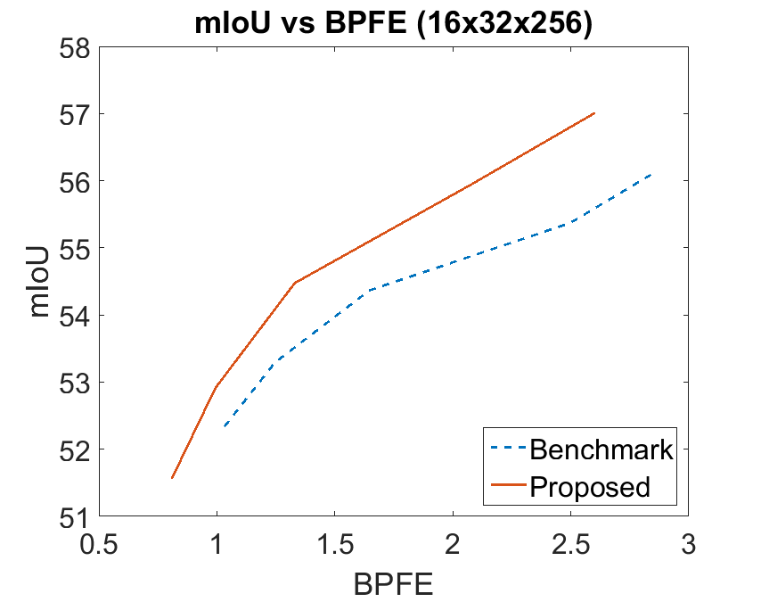
EXPERIMENTAL RESULTS (3)
Encoder1
Encoder2

Slide 12
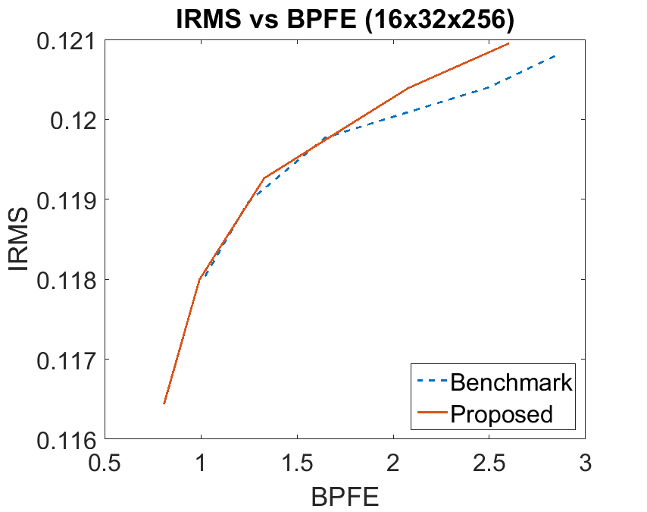
EXPERIMENTAL RESULTS (4)
Encoder1
Encoder2

Slide 13
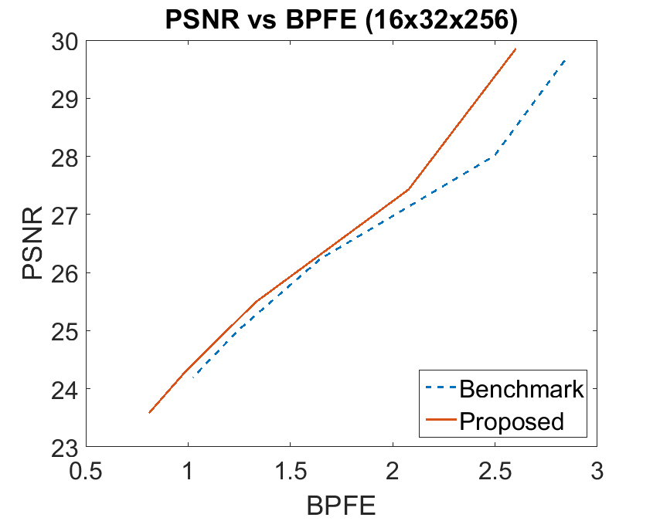
EXPERIMENTAL RESULTS (5)
Encoder1
Encoder2

Slide 14
EXPERIMENTAL RESULTS (6)
to summarize the differences between performance curves:
Bjontegaard delta (BD) approach
average bit rate saving for the same performance metric value
negative numbers = bitrate reduction
The average bitrate reduction over test images of the proposed method compared to the benchmark

Slide 15
Code
Code, weights and the results are available at:
https://github.com/saeedranjbar12/mtlcfci

Slide 16
Any Questions?

