Slide 1
Cluster-Based Senone Selection for the Efficient Calculation of Deep Neural Network Acoustic Models
Jun-Hua Liu^{1,2}, Zheng-Hua Ling¹, Si Wei², Guo-Ping Hu³, and Li-Rong Dai¹
1 National Engineering Laboratory for Speech and Language Processing, USTC
2 Research Department, iFLYTEK Co. LTD.
3 Key Laboratory of Ministry of Public Security for Intelligent Speech Technology
2016-10-17
Notes:
Good morning everyone. My name is Junhua liu, and in this report, I will present our works on efficient calculation of Deep neural networks.

Slide 2
Outline
Introduction
Proposed Methods
Experiments
Conclusion
Notes:
The report will be organized in 4 sections, namely, introduction, proposed methods, experimental results, and conclusion,

Slide 3
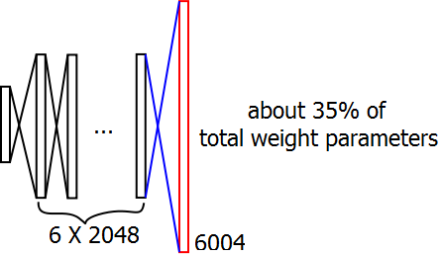
Introduction
Problem
State-of-the-art ASR systems utilize various neural networks, e.g. DNN, RNN, etc.
Decoding process is time consuming, since neural network calculation is very slow.
One of the burden is the large size of output layer
Notes:
First of all, let me show you the problem we try to deal with.
We know that current state of art automatic speech recognition systems usually based various neural networks, such as DNN, RNN, etc.
However the decoding process is very time consuming, since neural network calculation is very slow.
One of the computation burden is due to large output layer size, for example, in a typical 6X2048 DNN with 6004 output senones(tied HMM state), parameters involving the last layer ocupy 35% of total weights.
In this work, we focus on how to efficiently calculate the senone posteriors in DNN framework, which would be easily extended to RNN etc..

Slide 4
Introduction
Current DNN optimization approaches
Reduce hidden layers computation
Low rank weight factorization / SVD [1, 2]
Reshaping DNN structure by node pruning [3]
Reduce output layer computation
Lazy evaluation during decoding, i.e. only calculating senone posteriors when needed [4]
Notes:
There are two approaches to optimize DNN computation, the first try to reduce hidden layers computation, such as low rank weight decomposition or SVD, and reshaping DNN structure by node pruning.
The second approach is to reduce output layer computation, and lazy evaluation is often employed. Senones posterior is caculated when it is needed in Viterbi decoding. But performance degraded, since softmax posteriors estimated based on an unstable sub-set of senones, influenced by decoding network and decoding parameters.

Slide 5
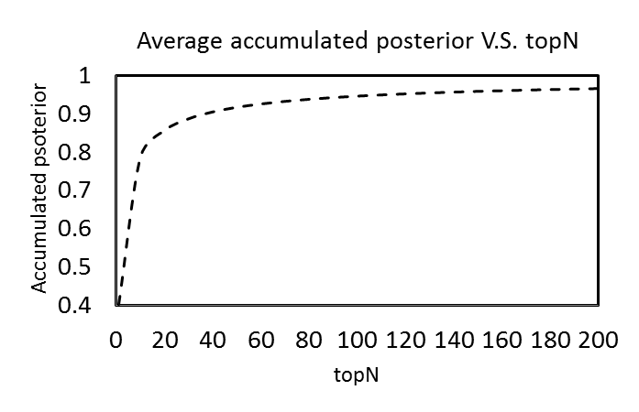
Introduction
Motivation
DNN output posteriors are dominated by a few large senones
Only compute the senones with large posteriors, and set remaining outputs to a floor value
Notes:
In our experimental analysis, DNN output posteriors are dominated by a few very large senones, others are close to 0.
This is a demonstration that, we sorted every frame posteriors and average them together.
As we see, top 60 senone accumulated posteriors have exceed 0.9, and top120 exceeded 0.95.
So we wonder is it possible only compute these large senone posteriors, and set remaining outputs to a floor value.

Slide 6
Outline
Introduction
Proposed Methods
Experiments
Conclusion
Notes:
The report will be organized in 4 sections, namely, introduction, proposed methods, experimental results, and conclusion,

Slide 7
Proposed methods
Question
How to determine the senones with large posterior for each frame ?
Solution
Cluster all frame features
Estimate the senones with large posterior for each cluster
Select senones for each frame according to its cluster

Slide 8
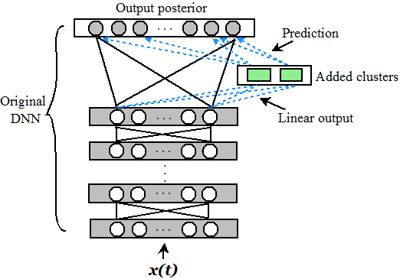
Proposed methods
Cluster-based senone selection DNN structure

Slide 9
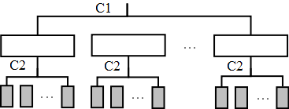
Proposed methods
Cluster
Two-level K-means clustering for all frames
Input feature: last hidden layer linear output
Two-level clustering for efficiency
Notes:
C1=C2=32 in our experiment

Slide 10
Proposed methods
Estimate senones with large posterior
Suppose $K_{c}$frames for the c-th cluster
Compute the average output
$${\overline{y}}^{L}=\frac{1}{K_{c}}\sum_{t=1}^{K_{c}}{y^{L}(t)}$$
Sort ${\overline{y}}^{L}$, the largest $N_{c}$ senones are selected, of which accumulated posteriors exceeds a predefined confidence threshold ɑ
Notes:
Alpha is a control parameter.

Slide 11
Outline
Introduction
Proposed Methods
Experiments
Conclusion
Notes:
The report will be organized in 4 sections, namely, introduction, proposed methods, experimental results, and conclusion,

Slide 12
Experiments
Experiment setup
Evaluate the method on both ASR and KWS tasks
Dataset
spontaneous Mandrin continuous telephone speech
325 hours for clustering and senone selection
1.5 hours speech for development
2.3 hours speech for LVCSR evaluation
14 hours speech for KWS evaluation(274 keywords)
Baseline DNN structure:
(72+3)x11 input features, 6x2048 hidden layer, and 6004 output senones.

Slide 13
Experiments
Evaluation criteria
ACC/CRR for LVCSR performance
Recall rate and F1 for KWS performance
Real-Time(RT) factor to indicate speed performance

Slide 14
Experiments
Parameter tuning on dev. Data
Influence of selection confidence
M: average of selected output senones for all frames
Influence of floor value
ɑ | Baseline | 0.95 | 0.96 | 0.97 | 0.98
M | 6004 | 725 | 824 | 973 | 1220
ACC(%) | 75.80 | 75.38 | 75.63 | 75.74 | 75.86
$$V_{f}$$ | Baseline | 1.0E-05 | 1.0E-06 | 1.0E-07 | 0
ACC(%) | 75.80 | 70.40 | 75.90 | 75.86 | 68.82
Notes:
Alpha is a predefined accumulated posterior threshold.
We found it is feasible to only compute large posterior senones, and set others to a floor value.
So we test it on real applications next.

Slide 15
Experiments
ASR and KWS results
Single CPU of Intel Xeon Dual Core E5-2620
LVCSR performance kept, while KWS performance slightly degraded
Last layer 6004 -> 2222, parameters 35M->27.2M
Whole speech process speed was accelerated by about 13% relatively
Methods | LVCSR Task |  | KWS Task
 | CRR(%) | RT | Recall(%) | F1(%) | RT
Baseline | 75.98 | 0.3084 | 83.22 | 74.74 | 0.3095
Proposed | 75.99 | 0.268 | 83.1 | 74.59 | 0.2669
Notes:
Hardware is single CPU of E5-2620
LVCSR performance kept, while KWS performance slightly degraded.
The reason may be that small posterior senenes are set to the same value, and their distinctions are eliminated, so other candidates rather the best path are influenced. However the degradation is very small, and could be accepted in practice.
More importantly, we could get 13% speech acceleration.

Slide 16
Outline
Introduction
Proposed Methods
Experiments
Conclusion
Notes:
The report will be organized in 4 sections, namely, introduction, proposed methods, experimental results, and conclusion,

Slide 17
Conclusion
In this work, we present an efficient method to calculate DNN output senone posteriors
It could be combined with low rank weight factorization, and extended to RNNs
Future work will focus on other clustering strategies and DNN retraining with senone selection

Slide 18
References
T. N. Sainath, etc.“Low-rank matrix factorization for deep neural network training with high-dimensional output targets,” in Proc. ICASSP, 2013, pp. 6655–6659.
J. Xue, J. Li, and Y. Gong, “Restructuring of deep neural network acoustic models with singular value decomposition,” in Proc. Interspeech, 2013.
T. He, Y. Fan, Y. Qian, T. Tan, and K. Yu, “Reshaping deep neural network for fast decoding by node-pruning,” in Proc. ICASSP, 2014, pp. 245–249.
X. Lei, A. Senior, A. Gruenstein, and J. Sorensen, “Accurate and compact large vocabulary speech recognition on mobile devices,”in Proc. Interspeech, 2013, pp. 662–665.

Slide 19
Thanks & Questions

