Slide 1
POWER LINE DETECTION VIA BACKGROUND NOISE REMOVAL
Chaofeng Pan, Xianbin Cao, DapengWu
Chaofeng Pan
chaofengskye@163.com
Notes:
Good morning, everyone! My name is Chaofeng Pan. It’s my great honor to be here for this presentation. The title of my presentation is “power line detection via background noise removal”.
Before introducing in detail, I would like to show you an overview of our proposed approach.

Slide 2
Overview
Tiny target detections, especially power line detection, is very important to ensure the low altitude flight safety
This work takes advantage of background noise removal by an embedded convolution neural network (CNN) classifier before conducting the final power line extractions.
edge feature map is firstly generated in the beginning
01
a coarse-to-fine strategy to exclude the impact of background noise before providing reliable detection outputs
02
2
Notes:
Today, UAV is used more and more frequently in smart grid construction, so it’s very important to ensure the low altitude flight safety for this unmanned aerial vehicles. From our work, we carry out the background noise removal by an embedded convolution neural network (CNN) classifier before conducting the final power line extractions.
There are two key points in the proposed approach:
Firstly, we designed an edge feature detector to extract the edge feature for power lines.
Secondly, the background noise is removed by a coarse-to-fine strategy before providing reliable detection outputs.
This is the overview of our method, let me give you a more detailed introduction.

Slide 3
Outline
1 Introduction
2 Edge feature map generating strategy
3 The coarse-to-fine strategy
4 Experimental Results
5 Conclusion
Notes:
The rest of the presentation is organized as follows:
First, I will introduce the background of the work.
Then, I will show the method of this work, including the “Edge feature map generating strategy”, and the “coarse-to-fine strategy”.
Finally, the experimental results are given, after with the conclusions.

Slide 4
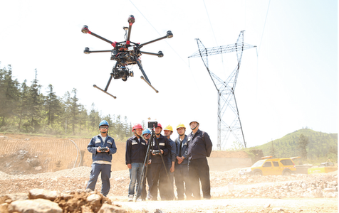
1. Introduction
With the development of modern aircraft design technology and the opening of low airspace, unmanned aerial vehicles (UAVs) have been more frequently applied in a variety of low altitude operations, like Wire inspection.
Comprehensive real data suggests that plenty of the low altitude aerial collision accidents are caused by power lines.
Notes:
In the construction of smart grid or the inspection of high voltage lines, the UAVs have been more frequently applied in a variety of low altitude operations.
It’s very convenient for using a UAV for low-altitude surveillance. However, comprehensive real data show that plenty of the low altitude aerial collision accidents are caused by power lines. Once an accident happens, it will cause a great loss, whether from financial or personnel.

Slide 5
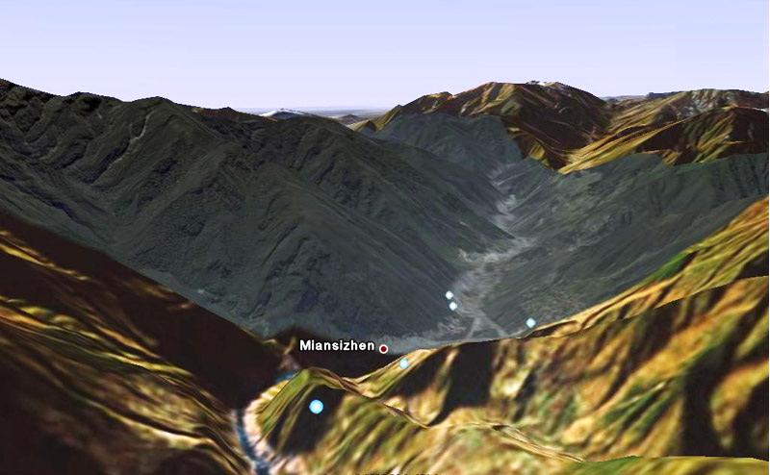
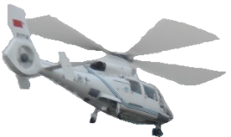
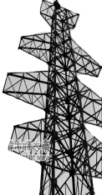
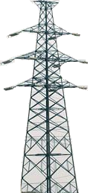
1. Introduction
With the objective of minimizing the damages from the collision between UAVs and power lines, it is vital to develop reliable power line detection techniques thus enable the UAVs to detect power lines during flight by itself.
power lines
Doc 9750
Notes:
So in order to minimize the damages from the collision, we should develop several reliable power line detection methods. So that the UAV can have the ability of autonomous obstacle avoidance by equipped with an optical camera. By doing this, we can reduce the occurrence of accidents and avoid the financial or personnel loss.

Slide 6
1. Introduction
The power line detection (PLD) problem is a recognized challenge in vision based aerial surveillance field
common difficulties such as camera jitters, image blur, color intensity and weather variations could as usual affect the accuracy of detection.
compared with other targets such as buildings and tall trees, power lines are uniquely challenging because the lack of significant features, complete structure, and adequate pixel ratio in the image.
Cluttered background containing other linear objects would further complicate the detection by introducing troublesome noises.
Doc 9750
Notes:
Power line detection is not an easy task, there are several challenges we must clear. There are a lot of problems we need to facing, and I count them into 3 categories:
First, Common difficulties, like camera jitters, image blur, color intensity and weather variations.
Second, significant features absent, compared with other targets such as buildings and tall trees, power lines are acting as a thin line and have no complete structure.
Third, background noise! There are many other linear objects existing in the background other than the power lines. The noise caused by these object is the most difficult challenge part for power line detection.

Slide 7
1. Introduction
In recent years, many optical power line detection (PLD) works have been developed
line-based methods, relying on the linear features of the power line
correlation-based methods, on basis of the spatial correlation, like the parallel relationship, the connection relationship between power lines and the pylon etc.
When detecting power lines in complex circumstance, background noise may mislead the detection
Background noise should be removed before detect !
Notes:
In recent years, many optical power line detection methods have been proposed. They can be classified into the Line-based methods and the correlation-based methods. In previous methods, the background noise may mislead the detection in the complicated scenes. So, we proposed a new power line detection method by moving the troublesome background noise before extracting power lines.

Slide 8
Outline
1 Introduction
2 Edge feature map generating strategy
3 The coarse-to-fine strategy
4 Experimental Results
5 Conclusion
Notes:
Now let me introduce the edge feature map generating strategy in our proposed method.

Slide 9
2. Edge feature map generating strategy
Detecting by background noise removal
Edge Feature Detect
Coarse Select
Fine Select
Output
Notes:
First, we should see the framework of the proposed method. The whole system consists of three components:
The first component is an edge feature detector. It is used to extract edge features from the image to generate the candidate target set. This target set is also referred as the edge feature map, which contains both power lines edge features and background noise.
The second component is a coarse selector based on CNN, which serves the purpose of eliminating the small noise patch in the edge feature map. Most of the background noise can be filtered out after this coarse selection, yet there is still a small amount left over.
In order to obtain more accurate information on the power lines, the third component- a fine selection module is employed. The fine selection module is essentially a line segment detection system based on Hough transform.
Finally, the power line segments are combined with the original image to display the position of the power lines.
So, let’s see how we design the edge feature detector!

Slide 10
2. Edge feature map generating strategy
Edge feature detect algorithm
Input Image I
The filter Gi in the direction of θ i
Sub edge feature map Ii
Next
round
The iterative calculations Ei
EM
Notes:
The detailed process of edge detection is described on this flow chart. At the beginning, the original image I is processed by the first base filter G1 in the direction of theta1 to yield the sub edge feature map I1. Subsequently, the second base filter G2 processes the original image I in the direction of theta2 and result in the sub edge feature map I2. Here E1 and E2 is calculated according to this iterative formula. Such an iteration continues until all the M directions are considered. The result of the last round of iteration is the edge feature map of the power line. Here it represented by E_{M}.

Slide 11
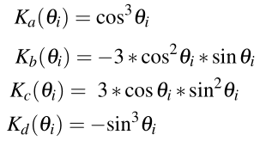
2. Edge feature map generating strategy
Base filter Gi : steerable filter
Notes:
In this edge detector, the base filter in each direction is calculated according to the steerable filter. Filter function Gi for each direction theta i is calculated by this formula.
G0, Gpi/4, Gpi/2, G3pi/4 is the three order derivatives of Gauss in direction 0, pi/4, pi/2 and 3pi/4. They serve as the basis functions for constructing the filter Gi. And the coefficients Ka(theta i), Kb(theta i), Kc(theta i), Kd(theta i) in the direction of theta i are defined as this.
If this is not so clear for you to understand, then I recommend you to find the details in our paper.

Slide 12
Outline
1 Introduction
2 Edge feature map generating strategy
3 The coarse-to-fine strategy
4 Experimental Results
5 Conclusion
Notes:
Then let me introduce the coarse-to-fine strategy, it containing two components in our framework. A coarse selector and a fine selection module.

Slide 13
3. The coarse-to-fine strategy
Coarse detection : CNN Classifier
The network structure of CNN adopted in our method
Notes:
In the field of deep learning, CNN is one of the most frequently used algorithms for classification. It has been applied to various classification scenarios and achieved appealing results. In our method, a CNN with five hidden layers has been employed to classify the patches. these patches contain the edge features of the power lines and the background noises. The network structure of CNN adopted in our method is shown in this figure. And the configuration parameters of CNN are determined according to the constant trial and error in the training phase.
For CNN, insufficient training data is likely to cause the overfitting problem. To overcome such a situation, in our experiments, a large number of power line images are collected. (including 300 raw videos and 10,000 raw color images.) Totally 45,000 positive patches and 60,000 negative patches are extracted from these raw data and used to build a sufficient training data set.

Slide 14
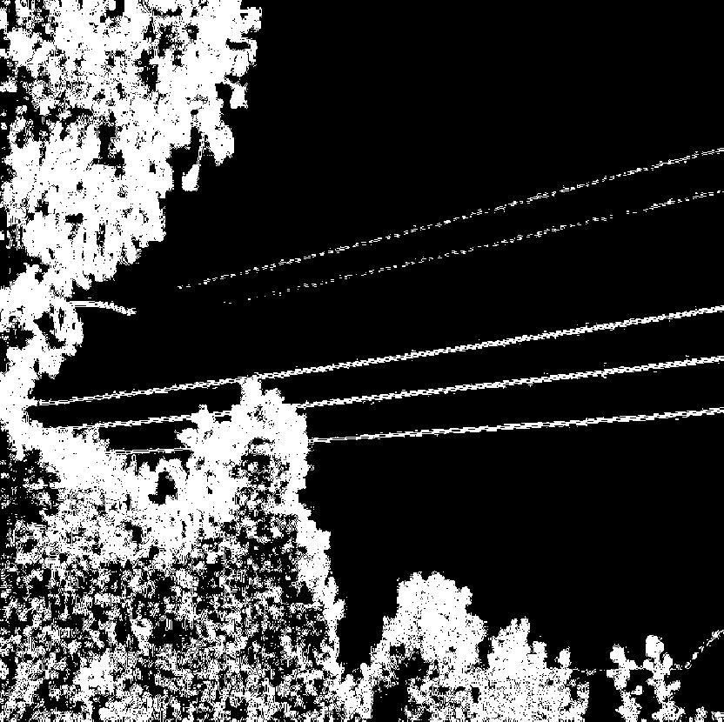
3. The coarse-to-fine strategy
Coarse detection : Background Removal
Picture 1：BEFORE
Picture 2 ：AFTER
Most of the noise be removed
Notes:
OK! Here is the result of the CNN classifier. Before applying the classifier, there is a lot of noise in the background. And this will have a great impact on the detection of power lines.
Then, after we use the classifier to remove the background noise, the edge feature of power lines become clear.
It’s obvious that detect power lines in picture 2 will be much easier than in picture 1. Therefore, our background noise removal strategy has played a role. Next thing needs to do is just to extract the power lines.

Slide 15
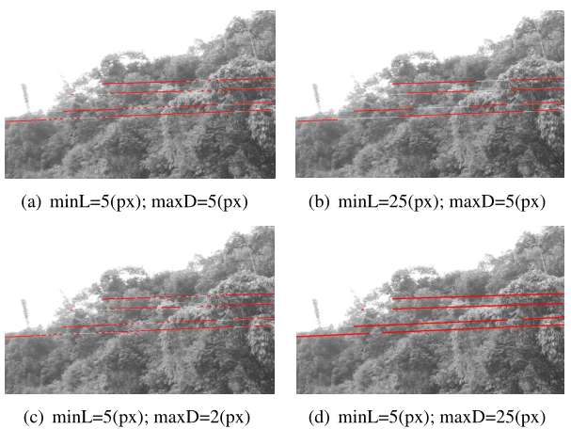
3. The coarse-to-fine strategy
Fine detection : Hough Transform
Notes:
So, it's time to find a suitable and effective line detection method.
Hough transform is importance for detecting the shape of the object. So, an improved Hough transform is used as our fine selection module to extract power line segments. It calls Gradient-based Progressive Probabilistic Hough Transform, shorted as GPPHT.
The algorithm first extracts the longest, most significant line segment, then the second longest and significant one, and continues looking down until all the points in the edge feature map are traversed.
There are two parameters which play important roles in controlling the computational results in the process.
The first parameter is the threshold Minimum Length, which controls the length of the line segment. Only the line segment length larger than Minimum Length can be extracted.
The second parameter is called Maximum D, which limits the maximum distance between two points that can be connected.
By adjusting these two parameters, we can get different detection results as shown in this four pictures.

Slide 16
Outline
1 Introduction
2 Edge feature map generating strategy
3 The coarse-to-fine strategy
4 Experimental Results
5 Conclusion
Notes:
Since the theoretical method has been introduced. Now let me show some experiment results.

Slide 17
4. Experimental Results
The table presents quantitative results for detecting three video sequences in different scene
Quantitative Evaluation of Our Method
Scene | PR (%) | MR (%) | FAR (%)
S301 | 91.41 | 10.61 | 14.88
S302 | 90.63 | 12.70 | 14.35
S303 | 89.92 | 12.39 | 15.23
The quantitative results involving three performance indexes, precision rate (PR), missing rate (MR) and false alarm rate (FAR), are demonstrated in Table.
Notes:
We perform experiments on three videos and quantitatively evaluate the detecting results. These videos are shoot by an optical camera during actual flying of UAV in Beijing, China.
Here we use precision rate (PR), missing rate (MR) and false alarm rate (FAR) to measure the effectiveness of the proposed method.
OK, if the data makes you confused, I also prepared some visual images. let’s see the experiment results in some visual pictures.

Slide 18
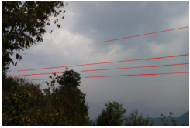
4. Experimental Results
The Figure is the detecting results in different scenes and the results of each step are arranged in a sequence.
Notes:
These images contain the processing results of each step in our method.
The first column is the original images.
The second column is the edge feature maps.
The third are the results from the classifier.
The fourth column is the line extraction result.
And the last column is the outputs of the method, where you can see the exact location of the power lines.

Slide 19
Outline
1 Introduction
2 Edge feature map generating strategy
3 The coarse-to-fine strategy
4 Experimental Results
5 Conclusion
Notes:
OK! It’s time for a conclusion.

Slide 20
5. Conclusion
In this paper, we proposed a coarse-to-fine strategy for power line detection, specially, a CNN is employed to help eliminate the background noise via patch classification.
The coarse-to-fine strategy assisted by CNN is able to extract most of the power line segments from the edge feature map
The precision rate can be greatly improved and the false alarm rate reduced significantly
Future, we will focus on applying patch classification to raw images. And take the spatial relationship into consideration.
We demonstrated that the proposed formulation performs well when detecting power line.
Notes:
This work at first time employed a CNN classifier to help remove the background noise in the field of power line detection.
And the extensive experiments have proven that our method has the state-of-art performance within our specialized real scenes.
The precision rate can be greatly improved and the false alarm rate reduced significantly when applying our proposed work.
Future, we will focus on applying patch classification to raw power line images. And take the spatial relationship into consideration
At last, I want to thank my adviser, professor Wu, for the guidance and the help he gave to me.
(he is right here at the meeting)
And I also want to say thank you to all the staff of the GlobalSIP. thank you for organizing such a great meeting. Thank you~!

Slide 21
Q&A
Notes:
That is all of my presentation.
Thank you very much!
Any questions?
实际应用情况：
I think my work is an interesting researching topic, and it can be used in practical application. Actually, we are preparing the application of my work in one of the projects in our lab.
对于某个问题：
We have taken this into account.
其他线段干扰
In consideration of this situation, the linear object which can’t be picked out by the classifier can mislead the detect. So in the future work, we will add the spatial correlation of the power lines into the algorithm to enhance its robustness.
细节问题：
Because the time is limited, so if you want to know more details, you can communicate with us through the mail.
如何评价性能:
Generally speaking, a perfect detecting algorithm would have higher precision rate and lower missing rate and the false alarm rate. And in our method, I would say the missing rate and the
其他CNN:
Auto-Encoder, Sparse Coding, Restricted Boltzmann Machine(RBM), Deep Belief Networks

