Slide 1
Transformer-based Image Compression
Ming Lu¹, Peiyao Guo¹, Huiqing Shi², Chuntong Cao², and Zhan Ma¹
¹Nanjing University, ²Jiangsu Longyuan Zhenhua Marine Engineering Co.
Email: luming@smail.nju.edu.cn

Slide 2
Network
$$x$$
Conv(5,2)
$$y$$
$$z$$
STB
Conv(3,2)
STB
Conv(3,2)
Conv(3,1)
STB
Conv(3,2)
STB
STB
Conv(3,2)
Conv(3,2)
$$g_{a}$$
Q
$$h_{a}$$
Q
$$\hat{y}$$
$$\hat{z}$$
AE
AE
bits
CAM
bits
AD
AD
$$\hat{y}$$
Tconv(3,2)
$$\hat{z}$$
Tconv(5,2)
STB
STB
Tconv(3,2)
Tconv(3,2)
STB
Conv(3,1)
STB
$$\hat{x}$$
STB
Tconv(3,2)
Tconv(3,2)
params
$$g_{s}$$
$$h_{s}$$
Fig. 1 The Network of Proposed Transformer based Image Compression

Slide 3
STB
LN
SWA
LN
MLP
FE
STL
FU
LN
WA
LN
MLP
Fig. 2 The Swin Transformer Block

Slide 4
CAM
$$B∗B$$
$$\hat{y}$$
-Inf
…
…
…
…
-Inf
FE
MA
MLP
FU
-Inf
…
…
…
…
-Inf
…
…
…
$$B∗B$$
params
-Inf
…
…
-Inf
…
-Inf
Fig. 3 The Causal Attention Module

Slide 5
Performance
Fig. 4 R-D Performance on the
Kodak dataset. 2.6% BD-rate
improvement over VVC intra.

Slide 6
Complexity
Fig. 5 Computational complexity
comparison with CNN-based LICs.
45% model params reduction
compared with CNN-based.

Slide 7
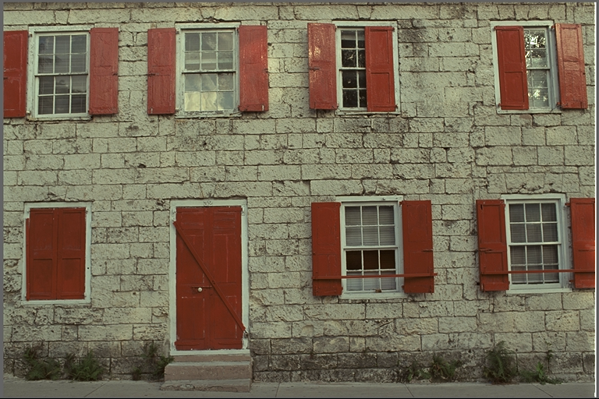
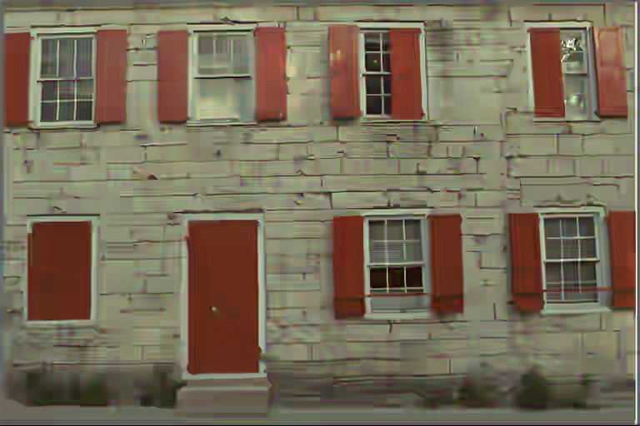
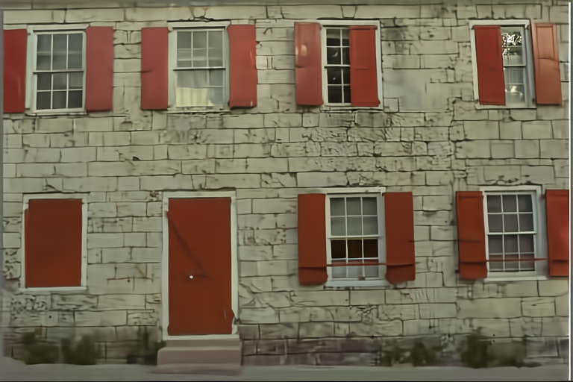
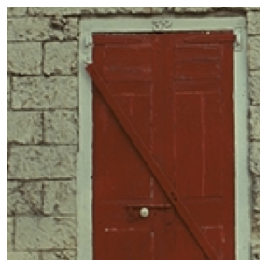
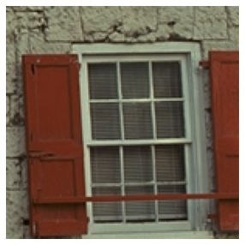
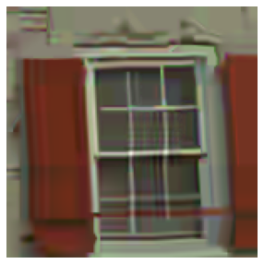
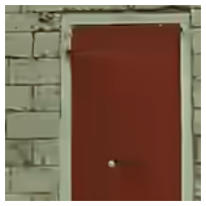
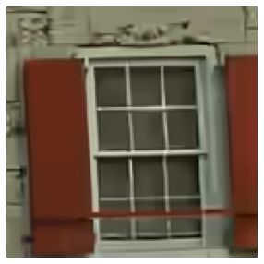
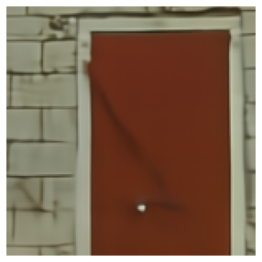
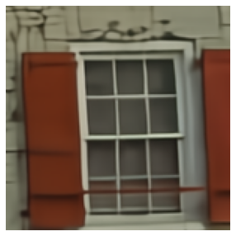
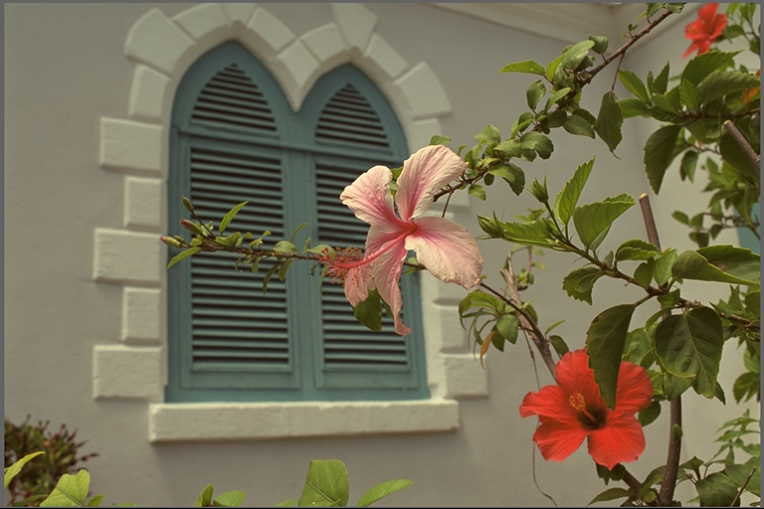
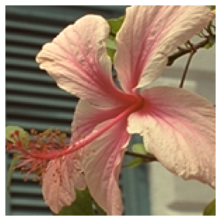
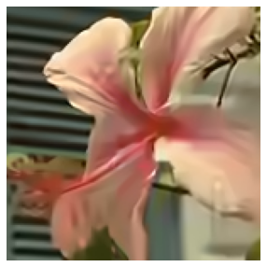
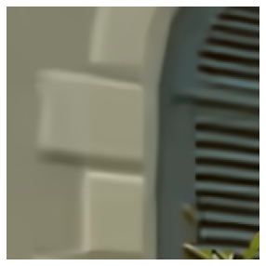
Visualization
Original
BPG
Original
BPG
0.157bpp, 25.00dB
VTM
0.155bpp, 25.74dB
TIC
0.154bpp, 25.76dB
TIC
VTM
Original
BPG
Original
BPG
0.119bpp, 29.41dB
VTM
0.108bpp, 30.19dB
TIC
0.097bpp, 30.41dB
VTM
TIC
Fig. 6 Qualitative Visualization. Reconstructions and close-ups of the
TIC,BPG (HEVC Intra) & VTM (VVC Intra). Corresponding bpp and PSNR are marked.

Slide 8
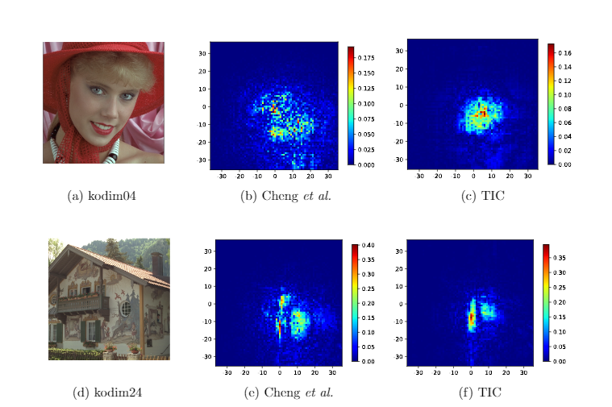
Visualization
Fig. 7 Compactness Visualization of Latent Features. Close-ups of the gradient maps
averaged over all channels for different test images

Slide 9
Thank you!

