Slide 1
Robust Self-Supervised Learning with Contrast Samples for Natural Language Understanding
Jie Liu, Xue Han, Chao Deng, Junlan Feng
China Mobile Research Institute, Beijing, China

Slide 2
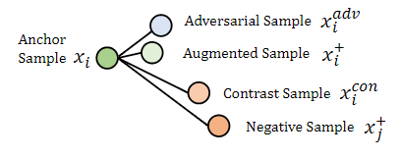
Background
Robustness
Previous studies have focused more on how to efficiently obtain adversarial samples with similar semantics,but less attention has been paid to the perturbed samples that change the gold label.
To improve the robustness of PLMs in the field of NLP, it’s crucial to perceive these different types of small perturbations, especially those that change the label of the sample.
the difference of
adversarial sample
contrast sample

Slide 3
Background
Existing Solutions
Two types of existing methods
data augmentation techniques to enrich the diversity of training samples
adversarial training mechanism
The shortage of previous studies
foucs more on the adversarial samples: the definition of robustness in NLP
the way of sample generation: gradient-based, token-level
the difference of
adversarial sample
contrast sample

Slide 4
Motivation
How to fully perceive the effects of these different types of small perturbations on robustness ？
These two types of samples are complementary to each other for robustness.

Slide 5
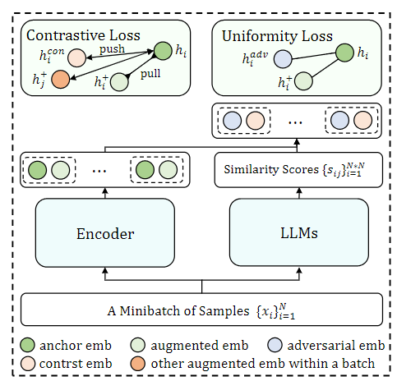
Method
Overall Architecture
two-stage paradigm
the further pretrain stage for improving the representation.
a self-supervised learning method
a samples generation method
a framework to adopt the different types of samples simultaneously
the finetune stage for specific task.

Slide 6
Method
Overall Architecture
we first analyze the importance and necessity of adversarial and contrast samples to the robustness of PLMs, and propose an efficient sample generation strategy, which adaptively controls the generation process based on fine-grained similarity information generated by LLMs.
Subsequently, we incorporate adversarial and contrast samples into a self-contrastive learning framework to address the issue.

Slide 7
Method

Slide 8
Method
Further Work
now：the fixed LLM
future：Parameter-Efficient Fine-Tuning
now：task-agnostic
future：task-specific，e.g., MABEL (individual position)
now：metric classification
future：multi-view
now：fine-grained information from LLMs
future：external knowledge (augmented LLM？ augmented task？)

Slide 9
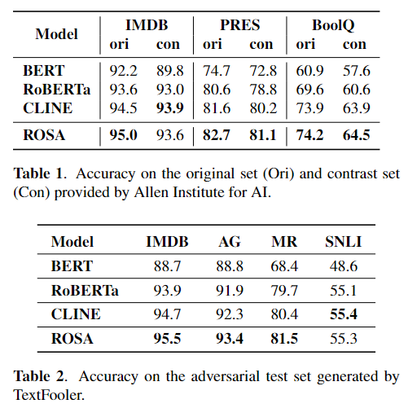
Experiments
Performance
Datasets
sentiment analysis dataset like IMDB,
natural language inference dataset like PERS
reading comprehension instances with boolean answers like BoolQ
Baselines
vanilla BERT
RoBERTa
CLINE

Slide 10
Conclusion
1. A robust self-supervised method that harnesses both adversarial and contrast samples to learn semantically discriminative representations to improve the robustness of PLMs for natural language understanding.
2. Rather than focusing only on the adversarial samples, we consider the effects of both adversarial and contrast samples on robustness during training, where the
perturbed samples are generated based on the mixup-based data augmentation and the fine-grained similarity information from LLMs.

Slide 11
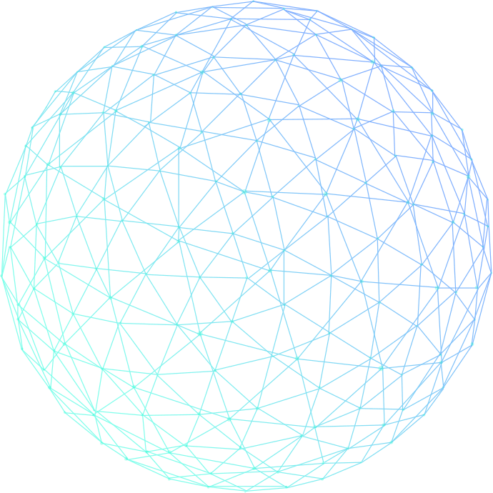
Thanks for your listening!

