Slide 1
Retrieving Information Lost by Image denoising
Mushfiqur Rouf Rabab K Ward
University of British Columbia
Vancouver BC Canada

Slide 2
Retrieving Information Lost by Image denoising
Improves denoising
A “post-processing” step
Denoising methods
Bilateral filtering
Non-local means denoising
Block matching and 3D filtering (BM3D)

Slide 3
Overview
28.12 dB
26.30 dB
28.28 dB
BM3D
Noisy image
+Our method

Slide 4
Overview
BM3D
Our method
28.12 dB
28.28 dB
26.30 dB
output
final result
noisy image
noise
retrieved data

Slide 5
Observation: Chromaticity is low freq
Densely sampled
Luma
Chroma
Sparsely sampled
Lesser impact of high frequency noise
Bayer pattern

Slide 6
Method
B
Latent
Unknown
Latent image
G
R

Slide 7
Method
B
Noise
Unknown
Noise
G
R

Slide 8
Method
Noisy observation
B
Noisy image
G
R

Slide 9
Method
Noisy observation
B
Denoised image
Denoised value
G
R

Slide 10
Method
Noisy observation
B
Noise estimate
Noise estimate
Denoised value
G
R

Slide 11
Method
?
B
Difference
Unknown
G
R

Slide 12
Method
Noisy observation
B
Latent
Unknown
G
Denoised value
R

Slide 13
Method
B
Denoisers can restore chrominance values better than the luminance values
Latent
Unknown
G
Denoised value
R

Slide 14
Method
Noisy observation
B
Latent
Unknown
G
Denoised value
R

Slide 15
Method
Noisy observation
B
Potential intrinsic data
G
Denoised value
R

Slide 16
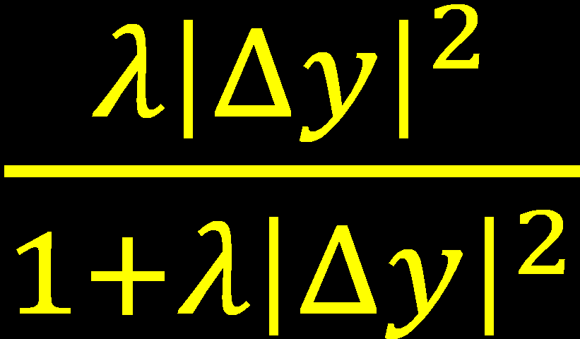
Method
B
Denoisers can restore low curvature areas better
Data to add back
G
Denoised value
R
Curvature

Slide 17
Method
B
MAP estimate
MAP estimate
G
Denoised value
R

Slide 18
=
+
MAP estimate

Slide 19
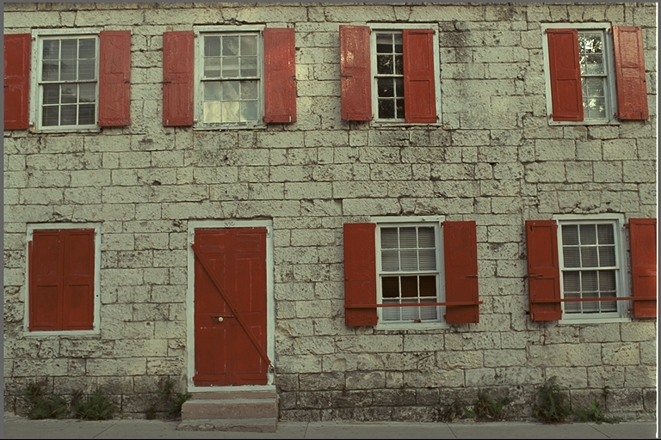
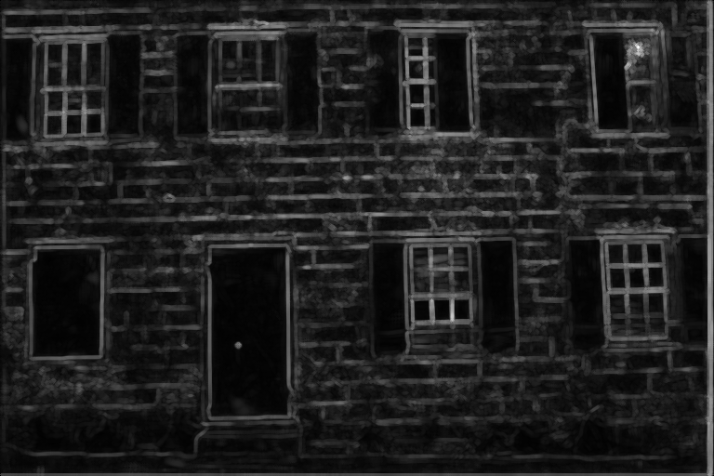
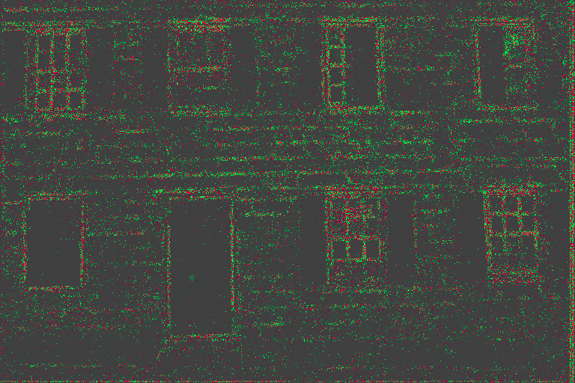
Results
+0.16 dB

Slide 20
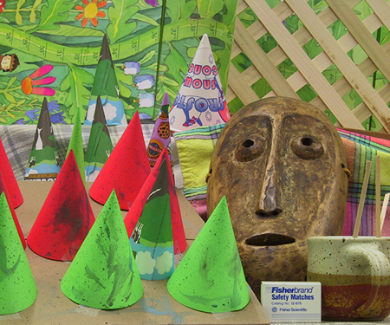
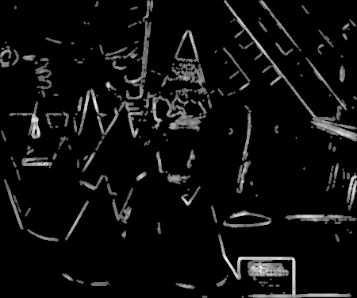
Results
+0.34 dB

Slide 21
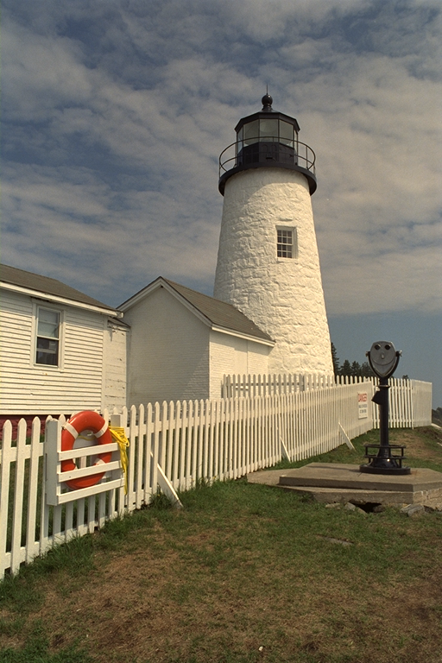
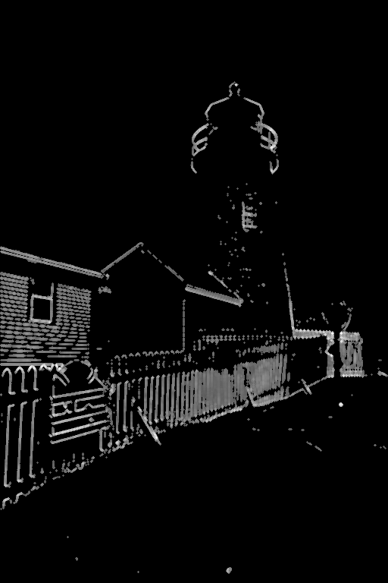
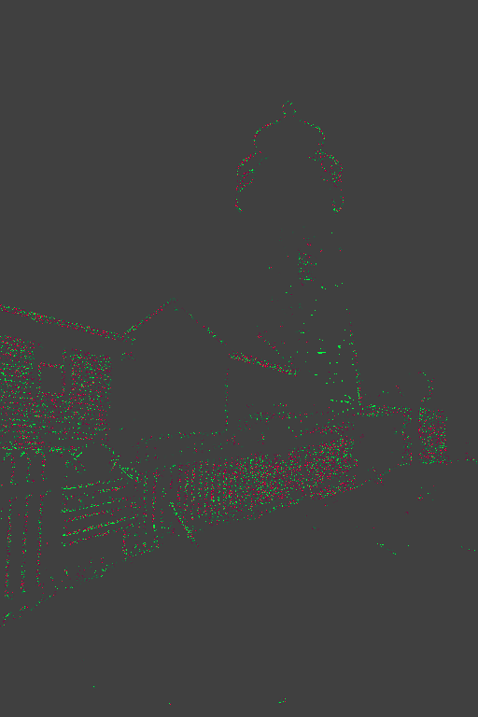
Results
+0.08 dB

Slide 22
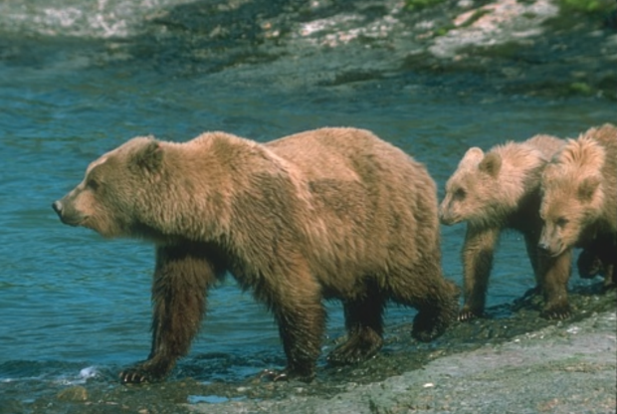
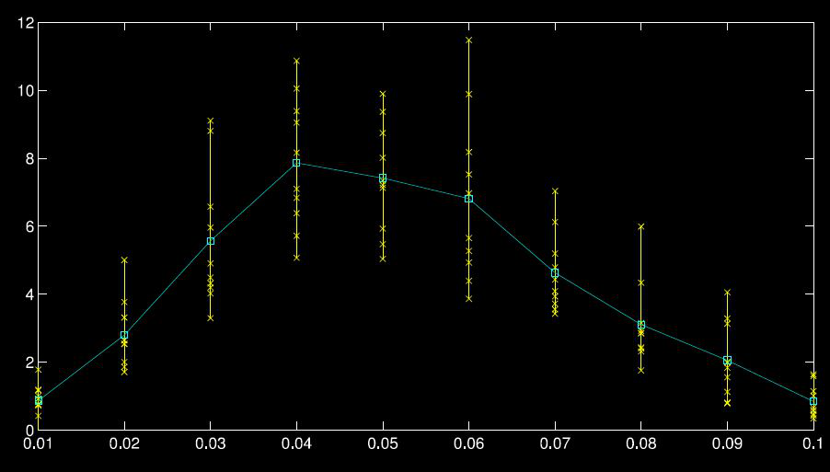
Results - Analysis
% improvement of noise estimate
Increase in noise
Edges disappearing
Noise sigma

Slide 23
Conclusion
Proposed a simple method to enhance denoisers
Tested on BM3D
Performs well on average

Slide 24
Thanks!

