Slide 1
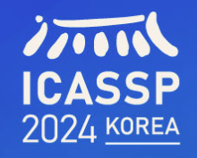
Self-Supervised Multi-Scale Hierarchical Refinement Method for Joint Learning of Optical Flow and Depth
1
1
1
1
Rokia Abdein, Xuezhi Xiang, Yiming Chen, Mingliang Zhai and Abdulmotaleb El Saddik
1. Harbin Engineering University
2. University of Ottawa
2
Notes:
Good morning, gentlemen and ladies. The title of our paper is "SELF-SUPERVISED MULTI-SCALE HIERARCHICAL REFINEMENT METHOD FOR JOINT LEARNING OF OPTICAL FLOW AND DEPTH". Next, we will report on our work from several aspects.

Slide 2
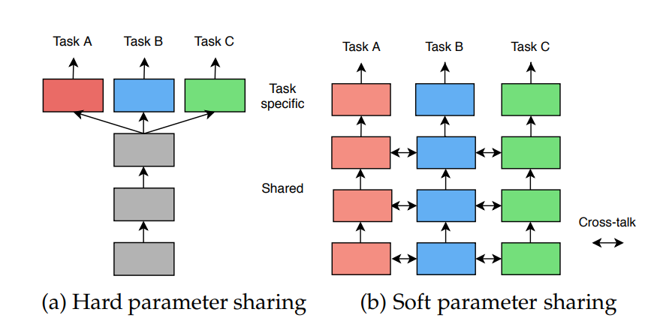
1. Joint Learning of Optical Flow and Depth
The joint learning of optical flow and depth is important to provide more information to reconstruct the scene flow. However, improving them through joint learning is challenging.
Notes:
The joint learning of optical flow and depth is important to provide more information to reconstruct the scene flow, which is useful for different applications such as autonomous vehicles and mobile robots. However, improving them through joint learning is challenging since each task is constrained by the other, which hinders them from getting an optimal solution, as if they were estimated separately. On the other hand, resolving some issues with one task and improving its performance could also provide useful cues to enhance the other task.

Slide 3
1. Joint Learning of Optical Flow and Depth
Self-supervised Learning
Self supervised learning does not require manual annotation of training data. Its model mainly trains to mine supervised information that can be applied to itself from large-scale unsupervised data, so as to learn another part from the input data.
Notes:
Various methods for training optical flow and depth methods rely on the availability of the ground truth to provide direct and accurate supervision for their models. Since providing enough annotated and real-world datasets is expensive in laboratories, training on an unannotated dataset can be considered a good alternative, but it comes at the expense of providing more constraints to bridge the gap with the supervised methods. The training on an unannotated dataset heavily depends on reducing the difference between the reference image and its reconstruction from the estimated optical flow or depth. The occluded parts are naturally excluded, as they cause a significant error.

Slide 4
2. Motivation
The occlusion is considered the critical part that should be carefully handled in the absence of supervision from the ground truth. In the joint learning of optical flow and depth, this problem exacerbates since the wrongly estimated regions have a mutual negative impact on each task.
Notes:
Different network architectures that have been adopted for the supervised learning of optical flow have been adapted to work under the unsupervised situation, such as OAFlow which adopts the FlowNet as the baseline with occlusion handling techniques to avoid their direct influence on the estimated flow. ARFlow utilizes the PWC-Net with more advanced techniques to allow the network to learn the flow in occluded regions and to be more effective and reliable in challenging scenes. SMURF improved the RAFT architecture by proposing a full-image warping operation to reduce the occlusions that result from out-of-frame motion. Therefore, the occlusion is considered the critical part that should be carefully handled in the absence of supervision from the ground truth. In the joint learning of optical flow and depth, this problem exacerbates since the wrongly estimated regions have a mutual negative impact on each task.

Slide 5
3. Recent works
Self-Mono-SF uses PWC-Net as the baseline, infers occlusion cues through a bidirectional estimation process, and incorporates them into the occlusion perception loss of scene flow and disparity estimation.
Notes:
Self-Mono-SF uses the PWC-Net as a baseline, infers the occlusion cues via the bi-directional estimation process, and involves it in an occlusion-aware loss for scene flow and disparity estimation.

Slide 6
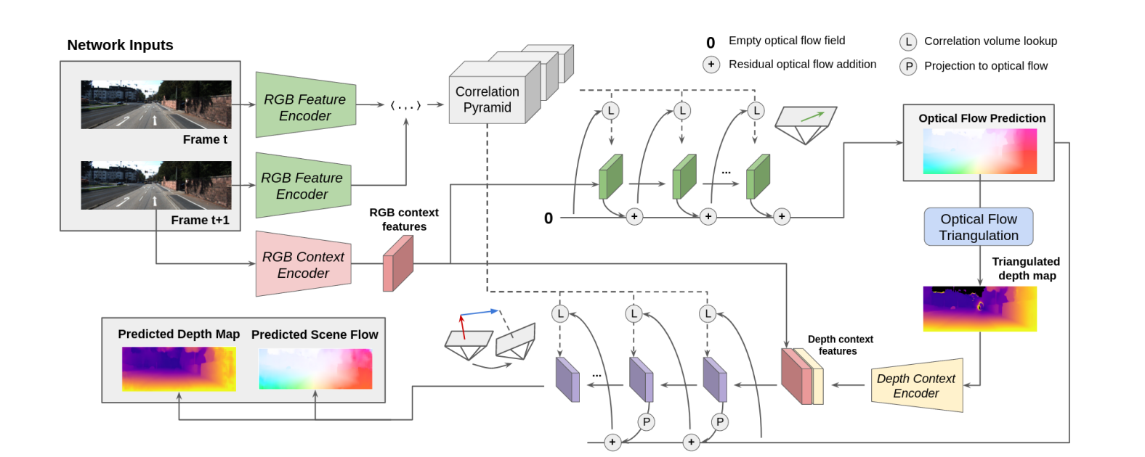
3. Recent works
DRAFT uses RAFT as a baseline to initialize the triangulation depth from optical flow and estimate occlusion masks to remove false information from self supervised and consistency loss.
Notes:
DRAFT utilizes the RAFT as a baseline, initializes the triangulated depth from the optical flow, and estimates an occlusion mask to remove spurious information from the self-supervised and consistency losses.

Slide 7
4. Our main contributions
We propose a novel multi-scale hierarchical refinement architecture with a multi-scale single-iteration strategy for the joint learning of optical flow and depth on an unlabeled dataset that can hierarchically refine the optical flow across multiple scales, allowing the network to learn better optical flow, particularly in occluded regions.
We propose a novel self-supervised patch-based similarity loss to ensure consistency between the matched and unmatched regions, utilizing a kernel-like searching scheme that demonstrates its efficiency in alleviating the occlusion impact on the estimated optical flow.
Our proposed method achieves competitive results compared to the state-of-the-art methods for the joint learning of optical flow and depth tasks on the KITTI 2015 scene flow dataset.
Notes:
We propose a novel architecture for the joint learning of depth and optical flow. Our architecture joins the strength of the RAFT by utilizing the global correlation, refining the optical flow using the gated recurrent unit, and the strength of the pyramid scheme of the PWC-Net by performing this refinement on different scales. The key insight is to avoid the significant error related to refining the optical flow over a single high-resolution feature that resulted from the training on unlabeled datasets using the reconstruction loss that ignores the occluded regions. In addition, our architecture
adopts a single-iteration multi-scale strategy instead of a multi-iteration single-scale strategy for the training on an unlabeled dataset, where increasing the number of iterations will bring more computation overhead without significant improvement. The reason is that the error that resulted from the first iteration due to the occlusion is high, and increasing the number of iterations cannot remedy it. Instead of increasing the iterations, we use the depth to refine the optical flow, which demonstrates a remarkable enhancement in the occluded regions, as shown by our experiments. Besides this architecture, we propose a self-supervised patch-based similarity loss that is added to the reconstruction loss to reduce the error in the occluded regions. The key idea is to reduce the difference between the estimated optical flow in the occluded regions and their most similar neighbors in a patch-based scheme.

Slide 8
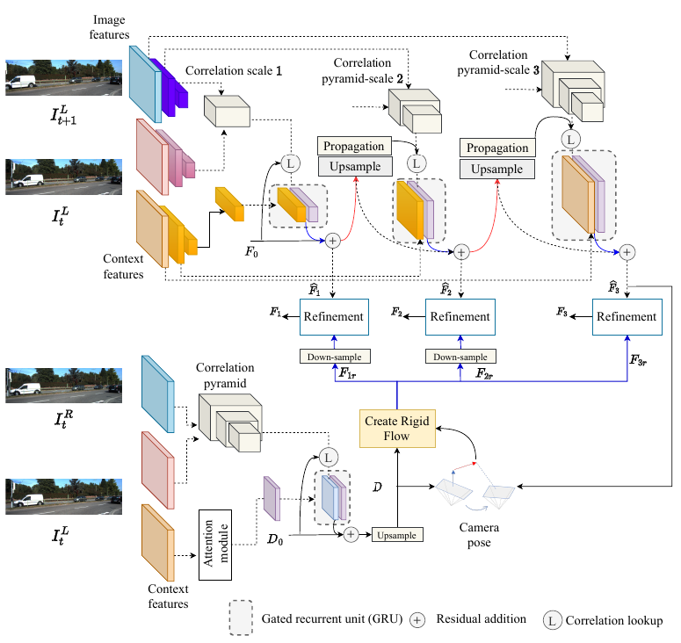
5. Network Architecture
We jointly train two networks, the optical flow and depth networks. For the depth network, the input is a stereo image, and only single-scale single-iteration is adopted to estimate the depth map.
For the optical flow, we propose to add multiple scales with only one iteration in order to allow the network to catch the large movements from the lower resolutions and use them to refine the higher resolution with the GRU.
Rigid flow is used at each scale for optical flow refinement.
Notes:
We jointly train two networks, the optical flow and depth networks. For the depth network, the input is a stereo image, and only single-scale single-iteration is adopted to estimate the depth map. The attention module is used for flow propagation. Working on a single high-resolution scale provides a simple yet fast network. The occluded regions due to the left-right shift between the stereo pairs have no significant effect as in the occluded regions of the optical flow since the displacement is not large. In the optical flow, the occluded regions increase with increasing resolution, thereby increasing the error. Therefore, we propose to add multiple scales with only one iteration in order to allow the network to catch the large movements from the lower resolutions and use them to refine the higher resolution with the GRU. We utilize the all-to-all correlation as proposed in RAFT but with different pyramid scales according to the feature size. The correlation pyramid has scales 4, 3, and 1 for the three scales, from higher to lower, respectively. Each correlation pyramid is passed along with the context features to the GRU to estimate the optical flow. The estimated flow at each scale is added to the upsampled flow of the previous scale after multiplying the upsampled flow with an estimated mask from the reference image to avoid inaccurate propagation. The estimated depth and optical flow at the higher scale are used to estimate the camera pose using the P nP method which is then used along with the depth to find the rigid flow. Finally, we use the rigid flow to refine the optical flow by minimizing the difference between the optical flow and the rigid flow in the static regions where the rigid flow is more accurate.

Slide 9
6. Self-supervised patch-based similarity loss
In the loss stage, we remedy the occluded parts by reducing the difference between the estimated flow of the occluded pixels and the estimated flow of their neighbors from the non-occluded regions that have the largest similarity with them.
However, we found that this per-pixel operation is extremely expensive and slows down the training process. Therefore, we propose patch-based, self-supervised similarity loss. In this loss, we divide the image into patches, and a kernel with a size of $3×3$ is moved over these patches, where each location in this kernel is a patch of pixels. Then, we check the similarity between the center patch and its neighbor patches
Notes:
In the loss stage, we remedy the occluded parts by reducing the difference between the estimated flow of the occluded pixels and the estimated flow of their neighbors from the non-occluded regions that have the largest similarity with them.
However, we found that this per-pixel operation is extremely expensive and slows down the training process. Therefore, we propose patch-based, self-supervised similarity loss. In this loss, we divide the image into patches, and a kernel with a size of $3×3$ is moved over these patches, where each location in this kernel is a patch of pixels. Then, we check the similarity between the center patch and its neighbor patches

Slide 10
7. Settings
Our method is trained on the unlabeled KITTI raw dataset that has a total of 28,968 images out of 42,382 images after excluding the images that are included in the KITTI 2015 training dataset. For optical flow and depth validation, the KITTI 2015 training dataset is used with the corresponding ground truth. The input images for depth and optical flow training and testing are resized to 256 × 832, and we extract the features at the scales of 1/8, 1/16, and 1/32. We initially warm up the optical flow network for 215K iterations with batch size=8, and we warm up the depth network for 81K iterations with batch size=10 on the KITTI raw for both tasks. Then, we start the joint training of the optical flow and depth networks for 200K iterations with batch size=10 on the KITTI 2015 scene flow dataset.
Notes:
Our method is trained on the unlabeled KITTI raw dataset that has a total of 28,968 images out of 42,382 images after excluding the images that are included in the KITTI 2015 training dataset. For optical flow and depth validation, the KITTI 2015 training dataset is used with the corresponding ground truth. The input images for depth and optical flow training and testing are resized to 256 × 832, and we extract the features at the scales of 1/8, 1/16, and 1/32. We initially warm up the optical flow network for 215K iterations with batch size=8, and we warm up the depth network for 81K iterations with batch size=10 on the KITTI raw for both tasks. Then, we start the joint training of the optical flow and depth networks for 200K iterations with batch size=10 on the KITTI 2015 scene flow dataset.

Slide 11
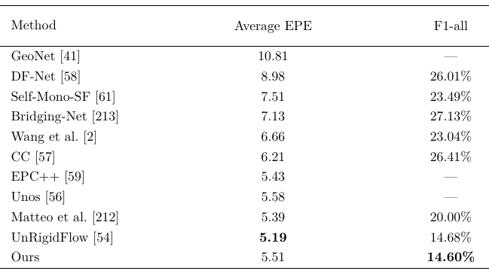
8. Quantitative Results
Results on KITTI dataset for optical flow
Notes:
For a fair comparison, we compared our method with the methods that use joint training, as they are considered more challenging than the methods that estimate the optical flow separately. All the stated methods are trained on the unlabeled KITTI datasets. Our method achieves the best F1 and a competitive end point error compared to the previous methods.

Slide 12
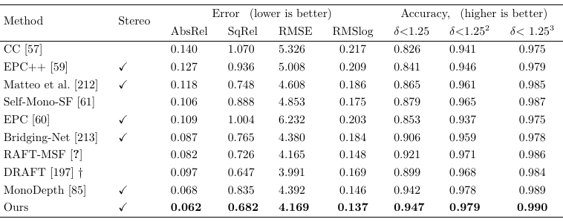
8. Quantitative Results
Results on KITTI dataset for depth
Notes:
For the depth estimation, our method surpasses the previous methods.

Slide 13
8. Quantitative Results
Visualization from KITTI dataset for optical flow
Notes:
Visualization comparison between the estimated flow from the baseline and from our method on samples from KITTI 2015 dataset.

Slide 14
9. Ablation study
Ablation on the effectiveness of each contribution on the optical flow results.
Ablation on patch size for similarity loss of the optical flow task.
Notes:
The proposed architecture and loss: Table.1 reports the results compared to using the original RAFT architecture that is trained on unlabeled dataset as a baseline. Our proposed loss shows a remarkable enhancement, particularly in the occluded regions. Our architecture significantly improves the overall accuracy compared to the baseline by
a large margin.
Patch size in similarity loss: For each location in our proposed loss with the 3×3 kernel, we tried different patch sizes. Our ablation is carried out using the RAFT architecture without any improvements. Table.2 reports the results. For a moderate solution, we adopted the size of 9 in our method and final results.

Slide 15
10. Conclusion
In this paper, we provide a new method for joint learning of optical flow and depth that addresses occlusion in the case of unlabeled dataset training.
We suggested an innovative design that uses a single-iteration, multi-scale strategy to optimize optical flow at multiple scales. More cues learned from the estimated depth are fed into each refining layer to help improve the optical flow.
Furthermore, we presented a self-supervised patch-based similarity loss that is optimized with the reconstruction loss to help the network improve its estimated optical flow, particularly in occluded regions. On the KITTI 2015 scene flow dataset, our technique considerably enhances the accuracy of the estimated depth and optical flow.
Acknowledgement: This work was supported in part by National Natural Science Foundation of China under Grant 62271160, in part by the Natural Science Foundation of Heilongjiang Province of China under Grant LH2021F011, in part bythe Fundamental Research Funds for the Central Universities of China under Grant 3072022TS0801, in part by the Key Laboratory Open Fund underGrant AMCIT2103-03.
Notes:
In this paper, we provide a new method for joint learning of optical flow and depth that addresses occlusion in the case of unlabeled dataset training. We suggested an innovative design that uses a single-iteration, multi-scale strategy to optimize optical flow at multiple scales. More cues learned from the estimated depth are fed into each refining layer to help improve the optical flow. Furthermore, we presented a self-supervised patch-based similarity loss that is optimized with the reconstruction loss to help the network improve its estimated optical flow, particularly in occluded regions. On the KITTI 2015 scene flow dataset, our technique considerably enhances the accuracy of the estimated depth and optical flow. More experiments and details will be provided in a future work.

Slide 16
Q&A
Please contact us for more details. Thank you.
Rokia Abdein(roqyiahabdeen@ymail.com)
Xuezhi Xiang (xiangxuezhi@hrbeu.edu.cn)

