Slide 1
ADAPTIVE RE-BALANCING NETWORK WITH GATE MECHANISM FOR LONG-TAILED VISUAL QUESTION ANSWERING
Hongyu Chen, Ruifang Liu*, Han Fang, Ximing Zhang
Beijing University of Posts and Telecommunications (BUPT)
{hongyuchen, lrf, fanghan, XimingZhang}@bupt.edu.cn

Slide 2
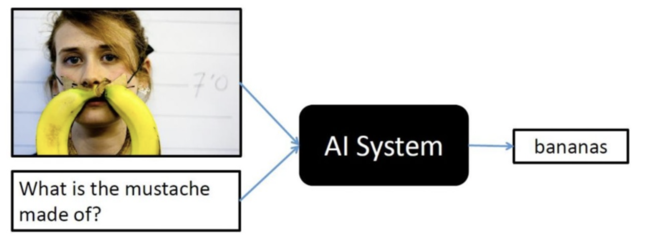
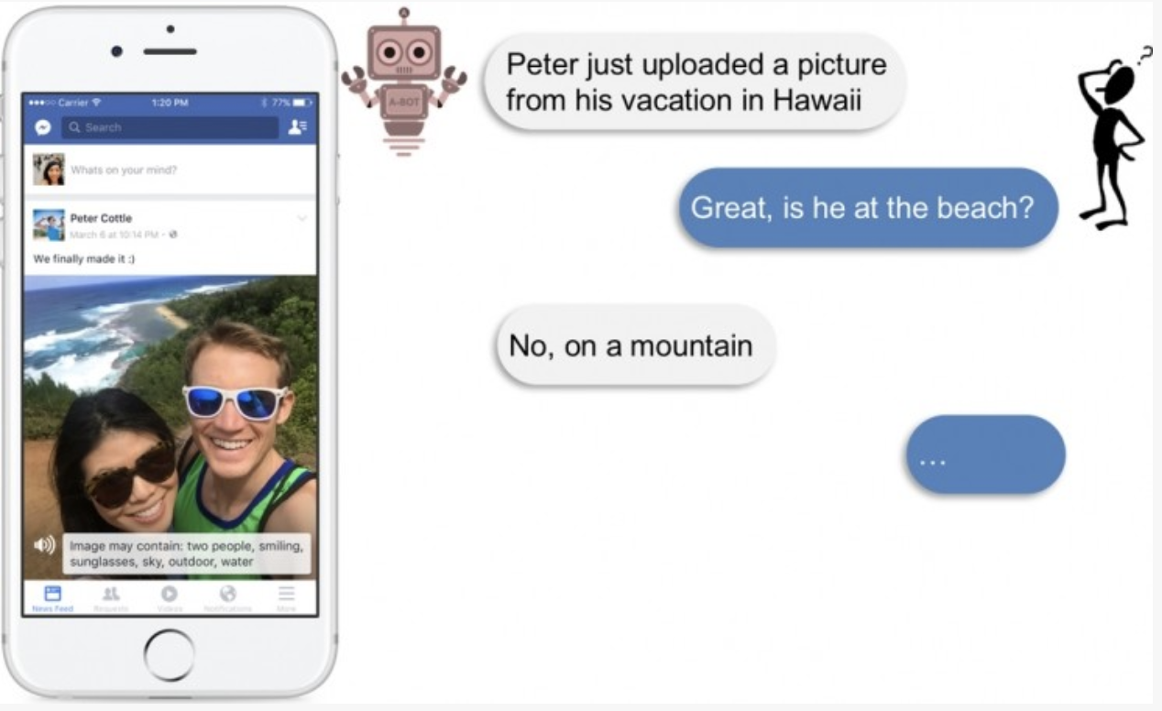
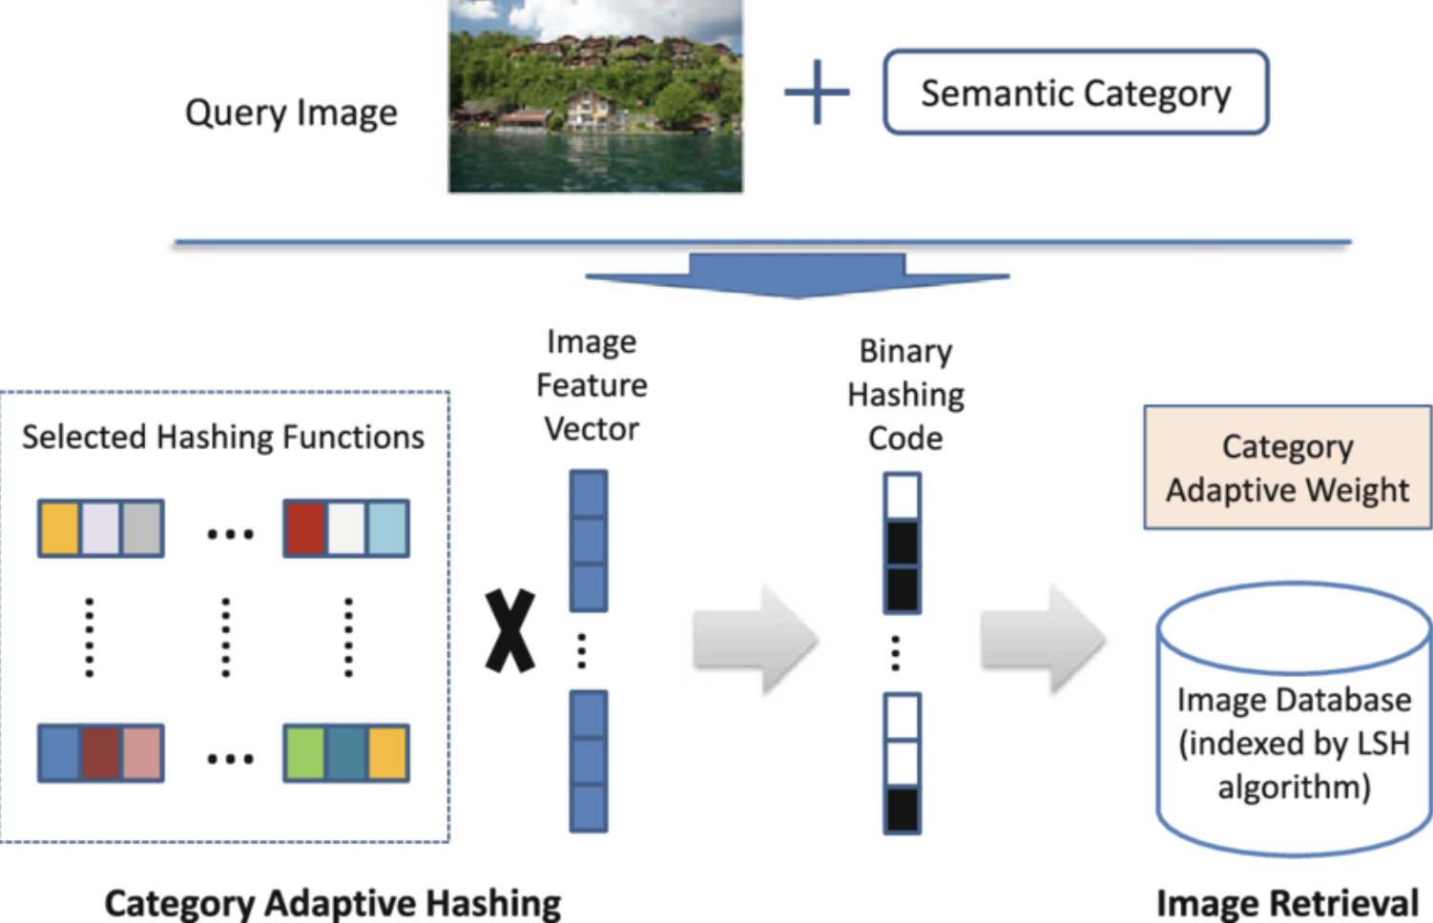
Preliminary and background
For the blind and visually impaired
for education or recreation
For the image retrieval systems

Slide 3
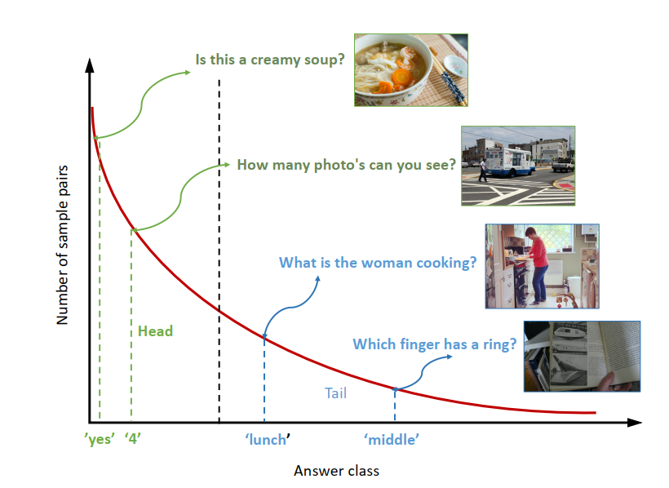
Background and motivation
The popular framework for visual question answering (1)
The ﻿long-tailed data distribution of the datasets (2)
﻿re-sampling
﻿re-weighting
(1)
(2)

Slide 4
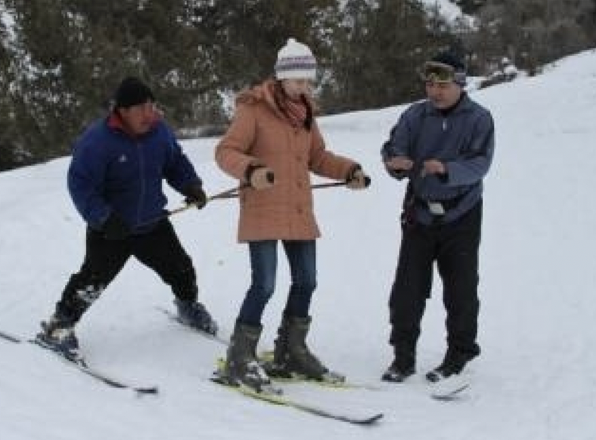
Background and motivation
Inadequate understanding of the question
Question: How many poles is the man on the left holding?
Visual attention:
Answer: 2
2
1
3
4
0.048 | 0.065 | 0.025 | 0.132 | 0.018 | 0.009
1
2
3
4
5
6
5
6

Slide 5
Network architecture (ARN)

Slide 6
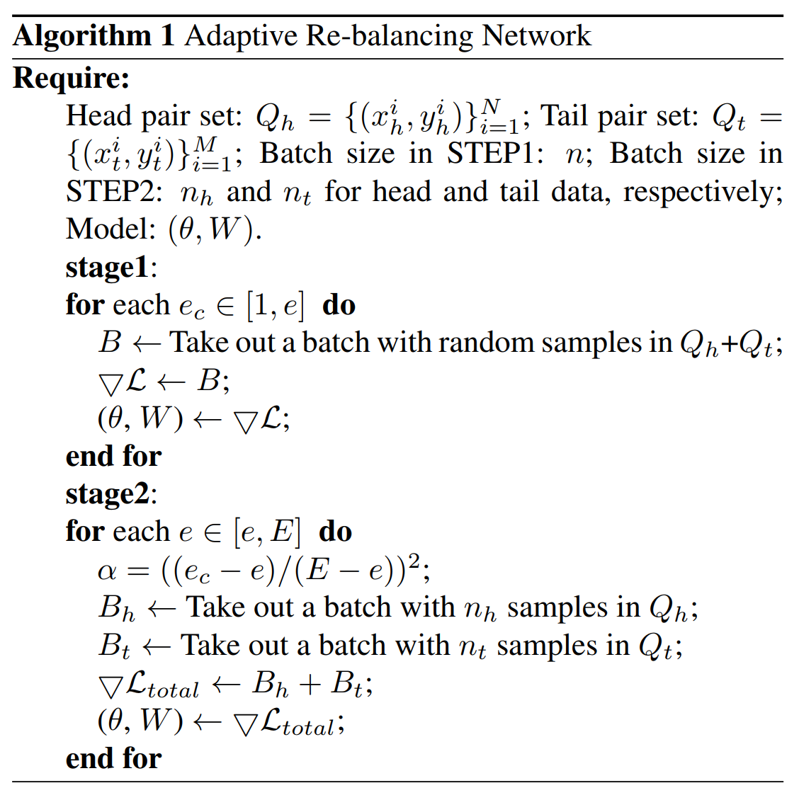
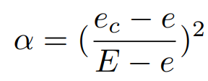
﻿Adaptive Learning Strategy
Score for each candidate answer
﻿Binary cross-entropy based loss
The ﻿final loss function
﻿trade-off parameter α
﻿E : the number of training epochs is denoted
$e_{c} :$the current epoch
e : ﻿the max number of training epochs in the first stage

Slide 7
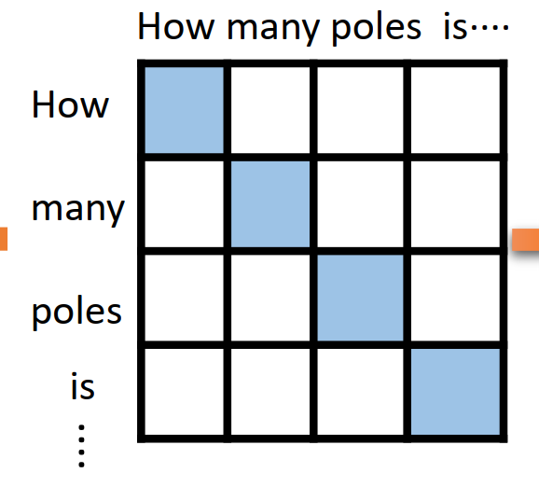
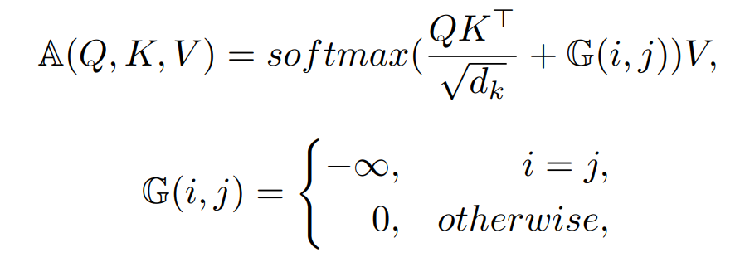
The Gate Mechanism

Slide 8
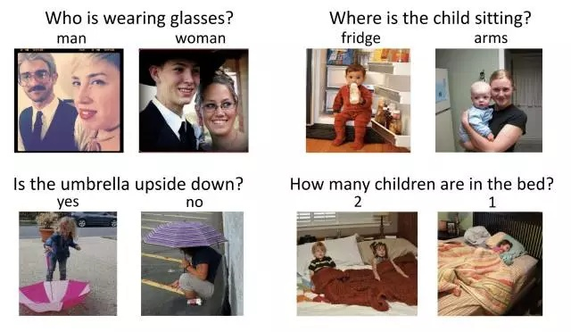
Analysis of results
Pre-process
Dataset : ﻿VQA-v2
number of questions : train/val/test : ﻿443,757/214,354/447,793.
﻿three questions per image and ten answers per question.

Slide 9
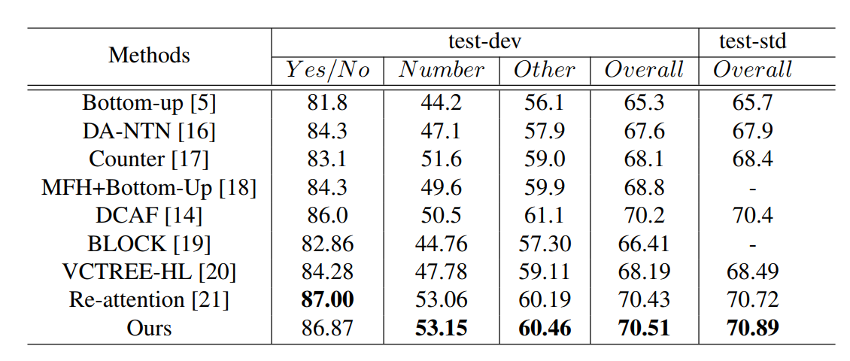
Experiment 1: ﻿Comparisons with State of the Art
Table. Comparison with several state-of-the-art methods on the test-dev and test-std splits of the VQA-v2 dataset

Slide 10
Experiment 2: Validation experiments
Table. ﻿Validation experiments on VQA-v2 val set. HeadAcc and TailAcc denote the overall accuracy on the head and tail split of the val set. “base” indicates the basic attention-based model with the gate mechanism. “base+re” and “base+ARN” indicate the “base” model trained with rebalancing network from scratch and with our proposed ARN.

Slide 11
Experiment 3: ﻿Ablation Study
Table. ﻿Ablation studies of our proposed method on the VQA-v2 val set. The “base” model is a basic attention based VQA model. The “base+GM” method is the “base” model with the proposed gate mechanism. “base+AR+GM” is our proposed ARN with the gate mechanism. Adaptors are utilized to calculate α mentioned in the adaptive learning strategy. ’-’ means with no adaptor.

Slide 12
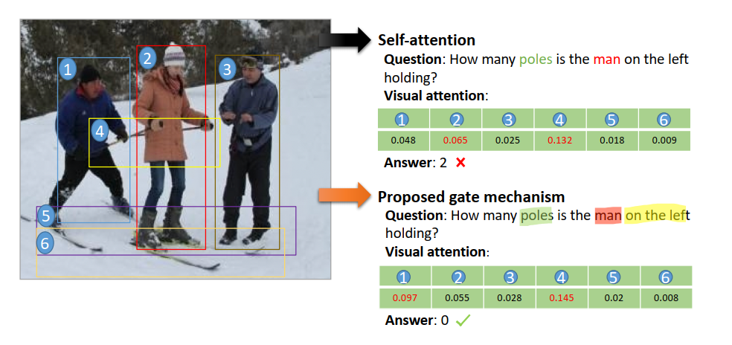
Experiment 4: ﻿Qualitative Analysis
Figure. ﻿We visualize objects and words with the highest attention weights for different mechanisms applied to the question. Corresponding visual attention map is also reported.

Slide 13
Summary (ARN)

Slide 14
Thanks!
Beijing University of Posts and Telecommunications

