Slide 1
Are Soft prompts good zero-shot learners for speech recognition?
2024 International Conference on Acoustics, Speech, and Signal Processing (ICASSP)
Dianwen Ng, Chong Zhang, Ruixi Zhang, Yukun Ma, Fabian Ritter-Gutierrez, Trung Hieu Nguyen, Chongjia Ni, Shengkui Zhao, Eng Siong Chng, Bin Ma
Alibaba Group
ALIBABA-NTU SINGAPORE JOINT RESEARCH INSTITUTE
Notes:
Paper ID: 2735 Paper Title: ARE SOFT PROMPTS GOOD ZERO-SHOT LEARNERS FOR SPEECH RECOGNITION?
Session: SLP-L14: Self-supervised learning for speech processing I
Wednesday, 17 April, 13:30 - 15:30
Good afternoon, everyone. I'm Shengkui Zhao from Alibaba, Since our first didn’t come to the conference, I'll be presenting our paper titled “Are soft prompts good zero-short learners for speech recognition?”.

Slide 2
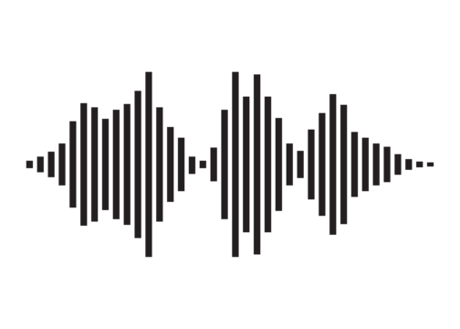
Speech recognition with prompt tuning
INTRODUCTION
Text Prediction
Decoder (Optional)
Involves prepending a set of soft prompt tokens to the latent speech features before sending to transformer
The soft prompts learn task specific instructional signals that guide the model’s attention towards relevant information for target task
Transformer
Off-the-Shelves SSL Speech Encoder
Soft-prompts
Latent Features
CNN Encoder
Pros (Why is this useful and why do we care?)
[1]
Optimize for training resources like energy, and computational power. Useful for building target domain specialized or personalized ASR model [1].
Small tunable parameters (on the external module) largely preserve the knowledge of the backbone model, preventing catastrophic forgetting and overfitting to the low-resource downstream domain [2].
[1] Zih-Ching Chen, Chin-Lun Fu, Chih-Ying Liu, Shang-Wen Daniel Li, and Hungyi Lee. 2023. Exploring Efficient-Tuning Methods in Self-Supervised Speech Models. In 2022 IEEE Spoken Language Technology Workshop (SLT). 1120–1127. https://doi.org/10.1109/SLT54892.2023.10023274
[2] Weijieying Ren and Xinlong Li and Lei Wang and Tianxiang Zhao and Wei Qin. 2024. Analyzing and Reducing Catastrophic Forgetting in Parameter Efficient Tuning. arXiv preprint arXiv:2402.18865
Notes:
First of all, let’s take a look at what soft prompt tuning is for speech recognition.
Soft prompt tuning in speech recognition addresses the need to fine-tune large pre-trained models, which can be computationally expensive.
Soft prompt tuning offers an efficient solution by calibrating a small number of trainable parameters called soft prompts.
These prompts are used to guide the pre-trained models without altering their weights.
Therefore, soft prompt tuning only needs to augment the latent speech features by prepending the soft-prompt tokens.
It not only saves storage space and simplifies model management by avoiding the need to store individual large models for each specific task.
but also helps prevent catastrophic forgetting and overfitting in low-resource downstream domains.

Slide 3
We heard voices…
NLP: Soft-prompts assist in accelerating convergence and enhance attention.
NLP: Soft-tokens (prompts) resemble natural language tokens, offering flexibility and being explainable.
Samet Oymak et al., 2023. “On the role of attention in prompt tuning,” in ICLR 2023 Workshop
Brian Lester, et al., 2021. “The power of scale for parameter-efficient prompt tuning,” in EMNLP 2021
SPEECH: Design for suitable soft-tokens remains a challenge, resulting in performance lagging behind NLP applications. (Not transferable across modality)
NLP: Soft-prompts do not generally correspond to natural language prompts (Hard/Hand engineered prompts)
Zih-Ching Chen et al., 2023. “Exploring Efficient-Tuning Methods in Self-Supervised Speech Models,” in SLT 2023
Luke Bailey, et al., 2023. “Soft prompting might be a bug, not a feature,” in ICML 2023 Workshop
Notes:
While soft prompts have shown promise, the exact mechanisms for improving model performance remain unclear.
Previous studies in NLP have explored their roles, but applying them to speech models poses challenges. This motivates our exploration in this domain.

Slide 4
QUESTIONS WE ASKED (What do soft-prompts mean to ASR model?)
What roles might soft-prompts play? (Based on our empirical experiments)
In the context of tuning and generalizability of fine-tuned models, how do soft prompts influence performance?
Can soft prompts be designed to enable quick adaptation in zero-shot learning?
Notes:
In this work, our study focuses on soft prompts in ASR models. We would like to address three key questions:
What roles might soft prompts play in ASR tasks?
How do soft prompts influence tuning and generalizability?
Can soft prompts enable quick adaptation in zero-shot learning? We conducted step-by-step experimental studies to answer these questions.

Slide 5
Training details
EXPERIMENT DESIGN
Datasets
Backbone SSL Speech Encoder
HuBERT (Base)
Utilizes a 2-layer LSTM network like the one used in SUPERB system as decoder.
Learning rate: 1e-4
Number of steps: 80,000
Size of prompts: {20, 50}
Standard LibriSpeech 100h (EN Corpus)
Mixing FreeSound (0 – 20dB, 80%)
Stationary Noise: Car, Metro, Traffic
Non-stationary Noise: Babble, Airport/Station, Café, and AC/Vacuum
Testing data
Official LibriSpeech: Test-clean, Test-other
Pre-mixed: LS (subset) + FreeSound [1]
[1] Archiki Prasad, Preethi Jyothi, and Rajbabu Velmurugan, “An investigation of end-to-end models for robust speech recognition,” in ICASSP 2021-2021 IEEE International Conference on Acoustics, Speech and Signal Processing (ICASSP). IEEE, 2021, pp. 6893–6897
Notes:
For our experimental configurations, we utilized HuBERT base as the self-supervised pre-trained speech encoder backbone,
we connected the encoder to a 2-layer LSTM network for decoding, using the same setup as Chen's work in SLT 2023.
The learning rate was set to 1e-4 (one times ten to the minus four), and we trained it for a total of 80,000 steps.
We compared results across three scenarios: not using any soft prompts, using 20 soft prompts, and using 50 soft prompts.
Our training data consists of 100 hours of synthesized LibriSpeech data, with added noise levels ranging from 0 dB to 20 dB.
The mixing noise was taken from FreeSound including stationary and non-stationary noise types.
Our evaluation includes the official LibriSpeech test sets and a pre-mixed noisy test set. All of them are publicly available.

Slide 6
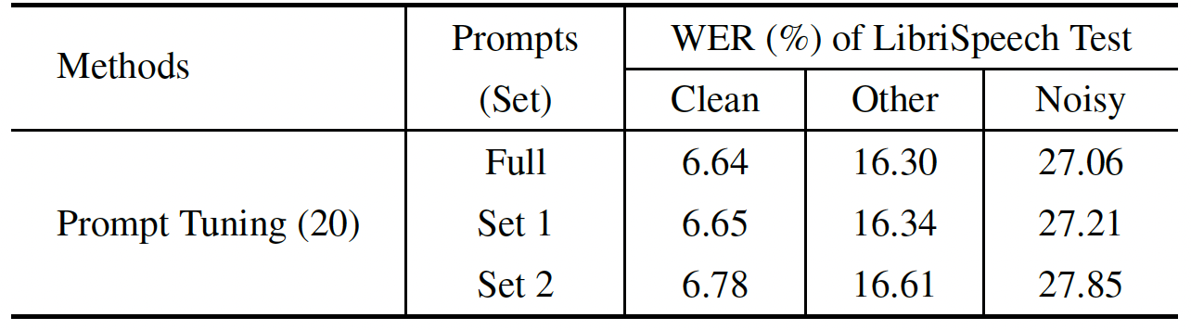
Role of soft-prompts
Cluster identification (Experiment Setup)
Analyze impact of soft-prompts on ASR performance by removing single prompts (Probing)
Visualize soft-prompts and their relationships using t-SNE plot. Highlighted sets in the plot correspond to the identified prompt clusters.
ASR Performance
With prompts from set 1 (omitting set 2) results in similar ASR performance for clean but affects noisy ASR
Using only prompts from set 2 leads to noticeable decrease in general ASR performance
Performance comparison between the prompt tuning (20) model with the utilization of different prompt sets on the LibriSpeech test set.
Visualization of soft-prompts using t-SNE plot
Notes:
In our exploration of soft prompts' role in speech recognition, we conducted a probing experiment.
we systematically removed individual soft prompt tokens to measure their impact on ASR performance.
Our findings revealed two distinct groups: one primarily affecting performance across all utterances, while the other mainly influenced performance in noisier contexts.
This suggests that soft prompts likely serve dual functionalities: content handling and noise reduction.
Visualizing the soft prompts' geometrical relationships further supported our findings. As shown in the t-SNE plot, the visualization showed two prominent clusters that aligned with our experimental observations.
To validate these findings, we tested the impact of prompt Set 1 and Set 2.
As shown in the table, using only Set 1 showed minimal performance changes, indicating its role in content handling,
when excluding prompts from Set 1 and using only Set 2, we observed a more noticeable decrease in overall ASR performance. It indicated that set 2 focuses more on noise reduction.

Slide 7
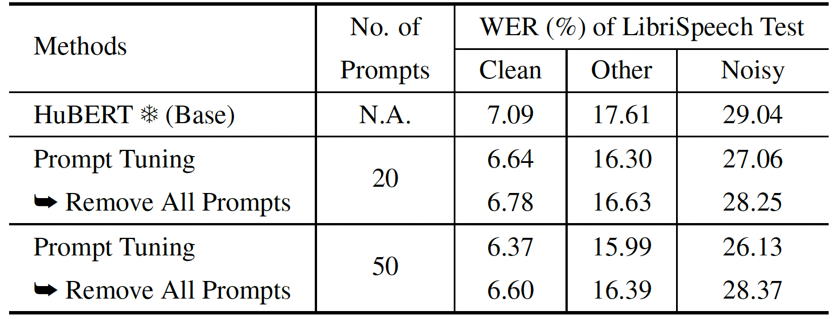
soft-prompts help better fine-tuning & improve generalizability
Experiment Setup:
Remove prompts during inference. (Explore if the model depends on prompt instructional signals or can function adequately without them.)
NOTE: The simplification makes them equivalent to the frozen-based model (Fully frozen encoder)
Results:
Prompt-tuned model outperforms even without soft-prompts (more pronounced with larger prompt size)
WER of different models, exhibiting the generalization power of the downstream decoder and predictor head by removing the use of all soft prompts during feedforward
Notes:
To identify how soft-prompts help better fine-tuning and improving the generalizability of speech models,
we compared ASR performance between baseline HuBERT and soft-prompt tuned HuBERT.
We observed performance gains with soft prompt tuning, even after removing prompts during inference.
This suggests that soft prompts guide latent representations during inference and assist the downstream decoder in converging to a better local minimum solution.
Additionally, it is observed that using more prompts can help boost effectiveness.

Slide 8
Quick adaptation in zero-shot learning setting
Experiment Setup:
Evaluate FreeSound Noise model on new FSD50K dataset (select specifically office noise – Writing, Typing, Typewriter…)
Corrupt official LS with SNR of 0-20dB to make OOD set
Naively: we pool and average representations from the FSD50K using the prompt tuning (PT) model for global representations of the noise.
Broadcast the vector and apply Hadamard product to geometrically shift the set of noise prompts in the embedding space of PT to align the “instructions” with the information of the new noise domain.
Performance comparison of different models on out-of-domain noise augmented testing sets from LibriSpeech, where noisy speech is simulated with SNR of 0-20dB.
Notes:
Based on the roles identified for soft-prompts, we investigated rapid adaptation through zero-shot learning in out-of-domain noise environments.
We constructed an out-of-domain noise augmented test set using samples from the LibriSpeech and FSD50K datasets.
The noise is primarily sourced from office environments, with noise levels ranging from 0 to 20 dB SNR.
To facilitate zero-shot learning, we augmented the learned soft-prompts by capturing the global noise representation through the soft prompt tuning model.
We then applied a Hadamard product between the global noise representation and the clustered set 2 of the soft prompts.
These augmented noise-shifted prompts were then used across all evaluation sets.
Our results, as shown in the table, demonstrate that using the noise-shifted prompts leads to lower WER compared to using the original prompts.
This indicates the feasibility of modifying noise prompts to achieve zero-shot learning adaptation in new noise domains.

Slide 9
Conclusion
We identified two primary roles of soft prompts:
refining content
enhancing noise information
to work on adaptation for down-streaming task and for model robustness against background noise.
We showed that the soft prompts offer the model capacity to avoid suboptimal local minima during training, leading to improved ASR performance.
We demonstrated a modification to the noise prompts to achieve zero-shot learning on adapting to out-of-domain noise environments.
Notes:
In conclusion, we have identified that soft prompts play crucial roles in refining content and enhancing noise information for speech recognition.
We showed that the soft prompts offer the model capacity to avoid suboptimal local minima during training, leading to improved ASR performance.
We demonstrated a modification to the noise prompts to achieve zero-shot learning on adapting to out-of-domain noise environments
We hope that our findings can contribute to understanding prompt tuning's effectiveness and its applications in real-world scenarios.

Slide 10
Thank You for Your attention
dianwen001@e.ntu.edu.sg
Notes:
Thank you for your attention. I would like to take simple questions. If you want to discuss more, please send email to the address. Thank you.

